Slide 1

ONLINE MONITORING OF UNAUTHORIZED CONSTRUCTION ACROSS THE CITY
BATCH – 20
D. ADITHYA – 227Y1A1266
A. RAHUL REDDY – 227Y1A1299
K. SIRISHA – 227Y1A12B3
Under the guidence of:
Mrs. KARIMUNNISA SHAIK

Slide 2
PROBLEM STATEMENT
Urban development is growing fast, but unauthorized constructions are also increasing.
These illegal buildings break zoning rules and put pressure on city infrastructure.
Right now, finding and managing such constructions mostly depends on:
Manual inspections
Complaints from the public
Disconnected reporting systems
There is no single system to monitor these activities in real time.
This causes delays in action, missing records, and difficulty in spotting patterns of violations across the city.

Slide 3
ABSTRACT
In cities, some constructions happen without permission, which causes problems like:
Safety risks
Traffic issues
Unplanned city growth
This project plans to build a smart system to monitor and detect illegal construction activities automatically and in real time.
The system will use AI and machine learning to study real-time data like: Photos, Videos and Reports.

Slide 4
LITERATURE SURVEY
S.No | TITLE | AUTHORS | TECHNOLOGY USED / ALGORITHM | ADVANTAGES | DISADVANTAGE
1. | Smart Monitoring System for Illegal Construction | K. Manjula et al. (2020) | IoT sensors, Cloud computing, Android app | Real-time alerts, easy mobile access | Limited coverage area, expensive sensor setup
2. | Satellite-Based Construction Monitoring | N. Sharma, R. Kumar (2019) | Remote Sensing, GIS, Image Processing | Large area coverage, historical data tracking | Not real-time, high satellite data cost
3. | AI for Smart City Construction Regulation | A. Patil et al. (2021) | Deep Learning, Drone Imagery | Automated detection, high accuracy | Drone deployment and privacy concerns
4. | Digital Building Permission System (DBPS) | MCGM Initiative (2020) | GIS Integration, Online Workflow | Transparent process, faster approvals | Focused on permissions, not violations

Slide 5
EXISTING SYSTEM
City authorities mostly use manual or partly digital methods to track illegal constructions.
Some cities have basic online complaint systems, but they often: Don’t provide real-time updates, Lack location tracking, have no proper reporting tools.
Technologies like GIS and drone surveillance are being tested in big cities. But these are not widely used due to high costs and tech limitations.
So, there is a strong need for a smart, real-time system that:
Focuses on tracking unauthorized constructions
Uses modern tech like AI, ML, and satellite/drones
Fills the current gaps in monitoring effectively.

Slide 6
PROPOSED SYSTEM
The proposed system uses AI and Machine Learning (ML) to automatically monitor and detect illegal construction in cities in real-time.
It combines data from:
Building permit records from city offices, Location (geospatial data)
Using advanced computer vision methods like:
Convolutional Neural Networks (CNNs)
Change detection algorithms
Object detection models (like YOLO or Faster R-CNN)
Overall, this system helps city officials enforce building rules more efficiently and keep cities well-planned.

Slide 7
OBJECTIVES
The main goal of this project is to create an online, real-time system to report and manage illegal construction in cities.
The system will help with:
Reporting unauthorized buildings.
Tracking each case.
Managing actions taken on reported violations.
This will help authorities to:
Focus on problem areas
Act faster
Work more efficiently
Increase transparency and accountability in city management.

Slide 8
METHODOLOGY
System Design & Development
Meetings with municipal authorities, urban planning departments, and end-users to gather functional and non-functional requirements.
Technology Integration
Implement a dynamic user interface with real-time updates for reporting and tracking violations. Develop backend services using Python (Django/Flask) to manage business logic, APIs, and database connectivity.
Testing & Deployment
Test individual modules like form submission, data upload, and case tracking.

Slide 9
WORKING
Requirement Analysis and Planning :
• Identify project goals, data sources (satellite images, drone footage, CCTV), and system requirements.
• Define roles, responsibilities, and timelines.
Frontend Development: Implement a dynamic user interface with real-time updates for reporting and tracking violations.
Backend Development: Develop backend services using Python (Django/Flask) to manage business logic, APIs, and database connectivity.

Slide 10
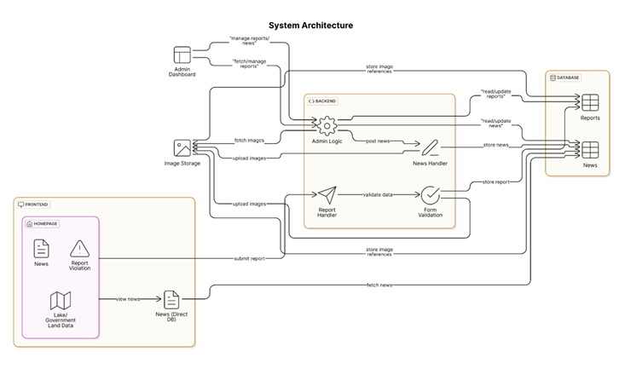
SYSTEM ARCHITECTURE

Slide 11
UML DIAGRAMS
Unified Modelling Language (UML) diagrams are used to visually represent the design and structure of a software system. For the system, UML diagrams help stakeholders, developers, and administrators understand how the system behaves, how users interact with it, and how components are structured and communicate internally.
User:
Attributes: User ID, Name, Email, Phone, Role (Citizen/Officer/Admin).
Document: Represents documents uploaded for a particular application.
Case Action:
Attributes: Action ID, Report ID, Officer ID, Action Taken, Timestamp.
Enumerations: Used to represent the predefined values for user roles, certificate types, and application status.

Slide 12
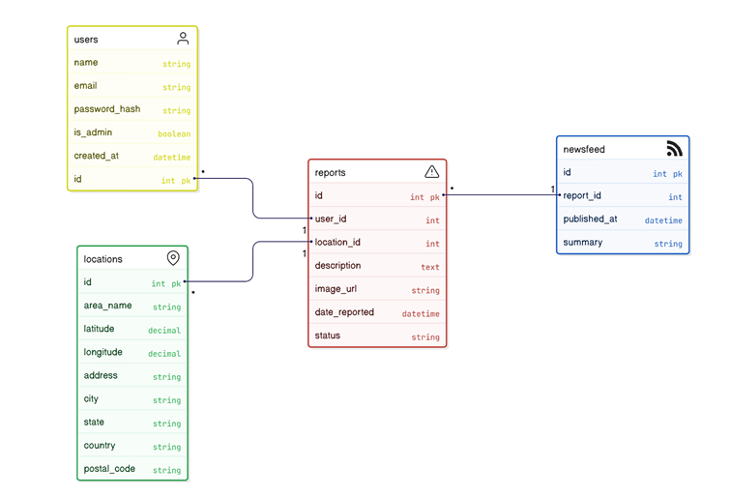
CLASS DIAGRAM:

Slide 13
SEQUENCE DIAGRAM:
The Citizen logs in to the platform.
The Portal sends credentials to the Server for validation.
Upon authentication, the Citizen submits a violation report.
The Server saves the report and associated images in the Database.
The System sends a confirmation back to the Citizen.
Officers are notified and can retrieve the report for field verification.

Slide 14
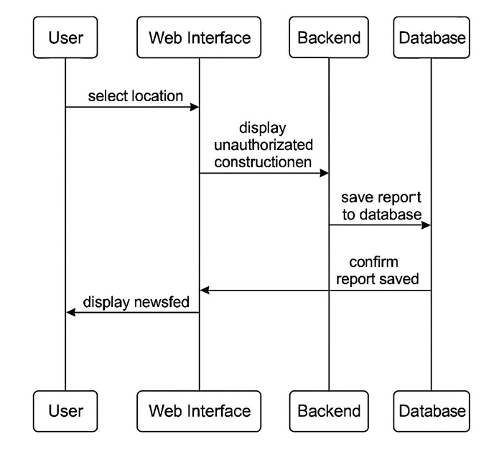

Slide 15
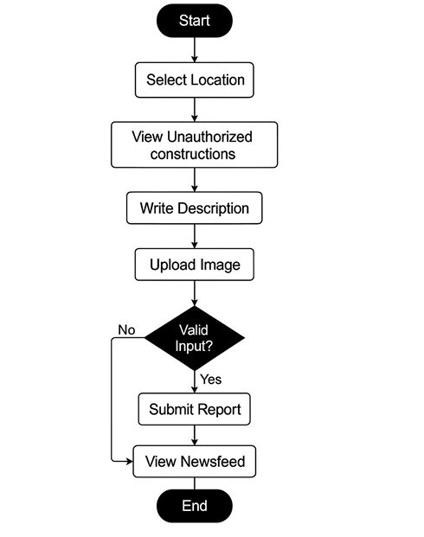
ACTIVITY DIAGRAM:
The process begins when a Citizen logs in or registers on the Gov-Certify portal.
The Citizen fills out the application form, selects the desired certificate type, and uploads supporting documents.
Upon submission, the application is routed to the responsible Officer for review.

Slide 16
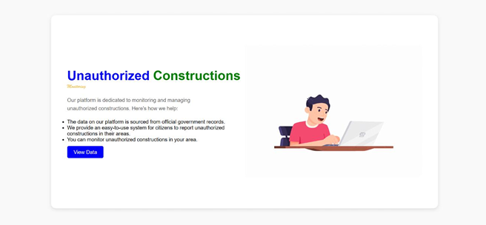
RESULTS
.
Testcase1: User Interface
The main page of the Unauthorized Construction Monitoring System serves as a welcoming and intuitive entry point for users looking to report illegal constructions or explore government land records online. Designed with user friendliness in mind, the platform’s mission is clear: to simplify citizen participation in urban governance by providing a fully digital and streamlined alternative to traditional complaint mechanisms.

Slide 17
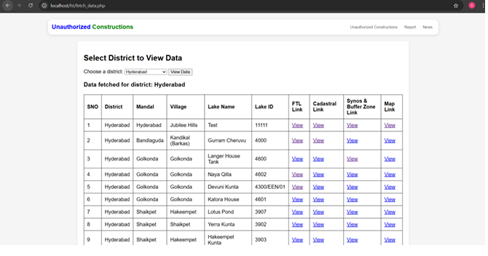
Testcase2: Database of lakes and Govt Data
This page provides access to a centralized database containing official government land records across different districts. Citizens can select a district and retrieve detailed information about public lands, reserved areas, and ownership details.

Slide 18
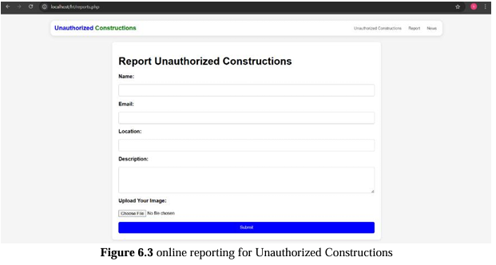
Testcase3: Services
The report submission form empowers citizens to become active participants in urban monitoring by allowing them to report illegal construction activities around them. Users can enter key details such as the type of violation, exact location (with Google Maps integration), a short description, and upload photographic evidence or supporting documents.

Slide 19
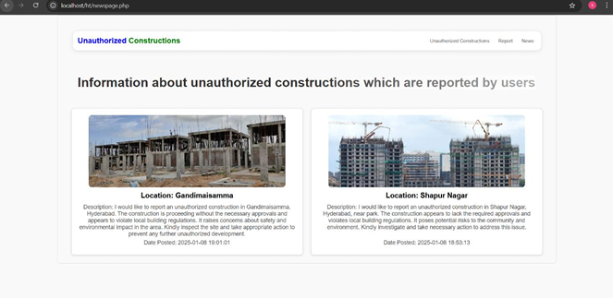
Testcase4 News and Updates Section
The report submission form is a multi-step dynamic form designed to capture complete details necessary for verifying a complaint.

Slide 20
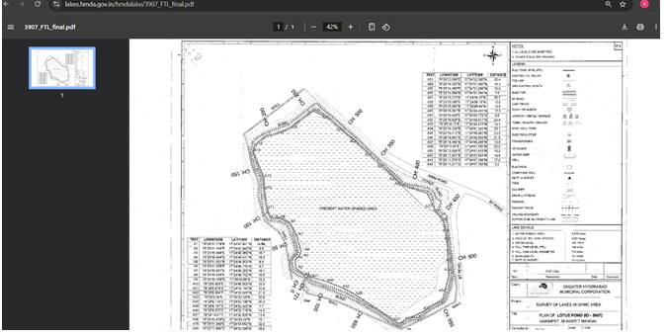
Testcase5 Viewing Original Government Land Maps
This feature provides access to the original, officially issued government land maps. By clicking on specific links, users can view detailed land ownership information, zoning boundaries, and protected areas. It helps citizens verify whether a reported construction falls under unauthorized zones, government properties, or restricted lands.

Slide 21
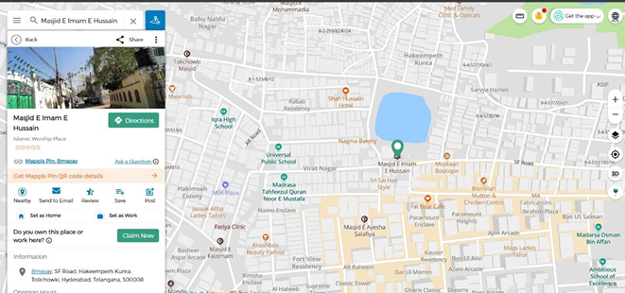
Testcase6: Location Viewing after clicking link
The location viewing feature allows users to pinpoint the exact geographical location where an unauthorized construction was reported. Integrated with Google Maps, it provides a visual reference for better understanding and verification.

Slide 22
CONCLUSION
The new Unauthorized Construction Monitoring System solves these problems by offering a full digital solution with:
Live dashboards for updates
Automated alerts for new violations
Location-based reporting
Notifications to citizens
Centralized land record access
The system makes sure all illegal constructions are:
Detected quickly
Tracked properly
Handled transparently and on time
Overall, this project creates a scalable, modern, and citizen-friendly platform that helps protect public land and ensures legal urban development.
It supports the larger goals of smart city development and digital governance.

Slide 23
REFERENCES
[1] Mulhafz Ahmed Mustofa, Yohannes Alemayehu Dagnew, Prabhakar Gantela ,and M. Javed Idrisi, “SECHA: A Smart Energy-Efficient and Cost-Effective Home Automation System for Developing Countries” in Journal of Computer Networks and Communications, 2023.
[2] Shubham Gupta , Saurav , Vidit Patira , Nishant Jain and Dr. Vijay Kumar, “Home Automation Solution Using Node-Red and MQTT” in International Journal of Advanced Research in Computer and Communication Engineering, 2021.
[3] Md. Sadad Mahamud, Md. Saniat Rahman Zishan, Syed Ishmam Ahmad, Ahmed Rezaur Rahman, Mehedi Hasan and Md.Lutfur Rahman, “Domicile - An IoT Based Smart Home Automation System” inInternational Conference on Robotics, Electrical and Signal Processing Techniques (ICREST), 2019.
[4] V. Pravalika and Ch. Rajendra Prasad “Internet of Things Based Home Monitoring and Device Control Using Esp32” in International Journal of Recent Technology and Engineering (IJRTE), July 2019.
[5] Kodali, Ravi Kishore, and SreeRamya Soratkal. "MQTT based home automation system using ESP8266." 2016 IEEE Region 10 Humanitarian Technology Conference (R10-HTC). IEEE, 2016.

Slide 24
[6] Arun Kumar, A., & Vaigandla, K. K. (2022). Review of Internet of Things (IoT) for Future Generation Wireless Communications. International Journal for Modern Trends in Science and Technology, 8(03), 01 08.
[7] D. K. (2022). Investigation on Internet of Things (IoT):Technologies, Challenges and Applications in Healthcare. International Journal of Research , XI (II), 208-218.
[8] Mr.RadhaKrishna Karne, M. M. (2022). Applications of IoT on Intrusion Detection System with Deep Learning Analysis.
[9] Venu, D. N. (2022). IOT Surveillance Robot Using ESP-32 Wi-Fi CAM & Arduino. IJFANS International Journal of Food and Nutritional Sciences , 11 (5), 198-205.
[10] Venu, D. N. (2022). IOT Based Speech Recognition System to Improve the Performance of Emotion Detection. IJFANS International Journal of Food and Nutritional Sciences, 11 (3), 92- 102.

Slide 25
THANK YOU

