Slide 1

Analyze of different types of functions using symbolic regression
By
Sirisha Narayansa

Slide 2
Objective is to analyze empirically which types of functions are easy to evolve by GP and easy to find underlying functions
And which forms of functions are difficult to find mathematical expression in search space . Comparatively difficult means it is not impossible.

Slide 3
So, what is Symbolic regression ?
the task of finding a function that explains hidden relationships in data, without prior knowledge on the form of such function.

Slide 4
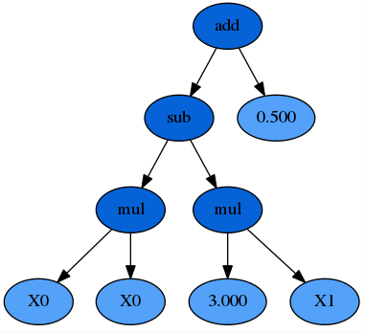
Representation :
𝑦=𝑋0* X0−3×𝑋1+0.5
We could represent formula as syntax tree.
Functions are interior nodes and constants
and variables makeup the leave node.

Slide 5
Input Parameters
Size of population | 500
Max Generations | 100
Generate initial population-init.method | Half-and-half
Init.depth | 2-8
Max_nodes | 500
Max_depth | 15
Crossover | Tournament -7
Reproduction | Tournament -7
Mutation | Tournament-7

Slide 6
Functions I have induced in app.c in symbolic regression
Dimensions | Polynomial /Trigonometry
1 | Trignometry Y= x*x + sin(x+2) -x
1 | Y= x*x + cos(x+2) -x
1 | Y = 0.1 sin(x) + 0.7* cos(x)
1 | Y= 0.3 sin (x) - 0.9 cosx)
1 | Poly of degree 3 Y= 0.x *x + 0.9 * x*x + 0.7 * x* x*x
2 | Y = 0.26(( x1 * x1) + (x2* x2) ) -0.48*x18x2
2 | Y = | (x1* x1*)+((x2 * x2) + x1*x2 | +|sin(x1)| +|cos(x2)|

Slide 7


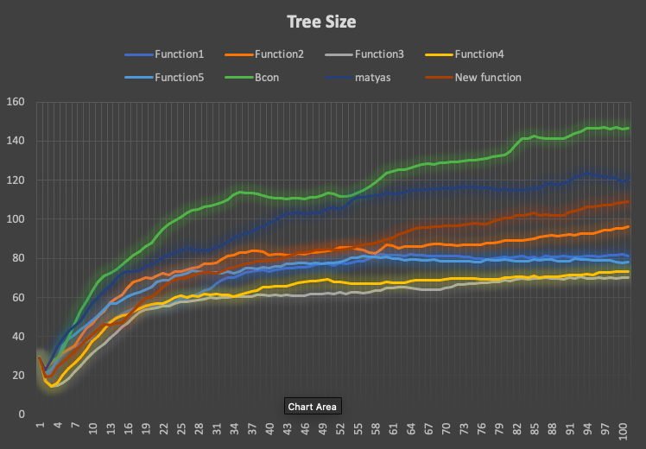


Slide 8
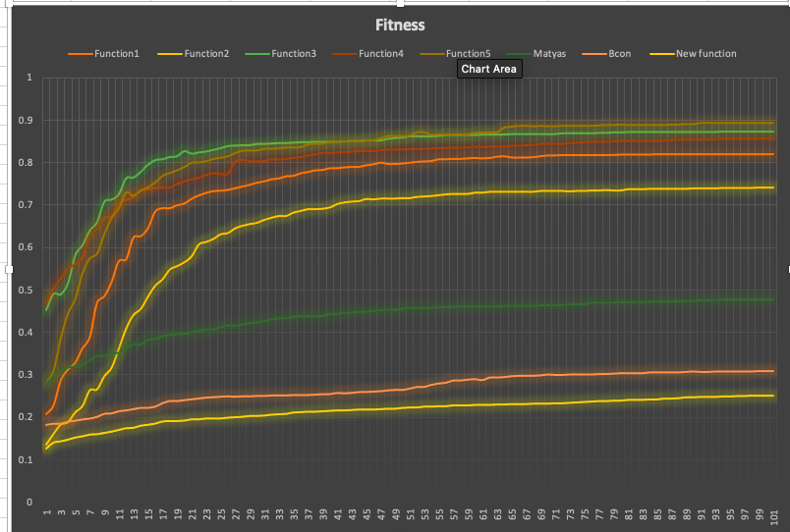

Slide 9
More trees size we found it means it will take more time to analyse and search for best fit of objective function within given terminals .
Best fitness always yield to find best possible trees /functions.

Slide 10
Experiments on polynomial function
I tried with different constraints to see how CGP could search mathematical expression for objective function.

Slide 11
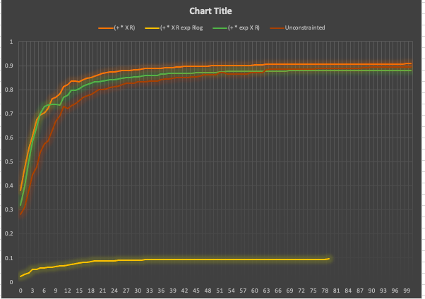

Slide 12
Here when I included all trigonometry functions its just gave around best fitness value of 0.88 but when I tried with different constraints like excluding trigonometry functions and also in other case I tried to remove unnecessary arithmetic because my function is “ ax+bx*x+c*x*x*x in which there is no minus symbol.

Slide 13
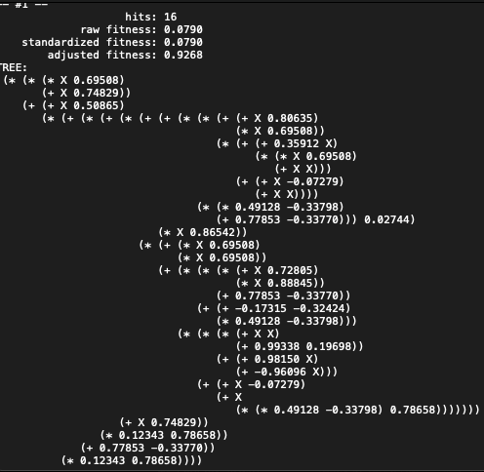

Slide 14
In the above graph we can see lot better improvement in the case one ( * + X R) for objective function
It means symbolic regression will find best suitable expression from given functional and terminal set to get the expected output function.
So we are reducing or by giving right suitable set cgp can find best mathematical expression.

Slide 15
END

