Slide 1
Memory Management

Slide 2
Memory management
We have seen how CPU can be shared by a set of processes
Improve system performance
Process management
Need to keep several process in memory
Share memory
Learn various techniques to manage memory
Hardware dependent

Slide 3
Memory management
What are we going to learn?
Basic Memory Management: logical vs. physical address space, protection, contiguous memory allocation, paging, segmentation, segmentation with paging.
Virtual Memory: background, demand paging, performance, page replacement, page replacement algorithms (FCFS, LRU), allocation of frames, thrashing.

Slide 4

Background
Program must be brought (from disk) into memory
Fetch-decode-execute cycle
Memory unit only sees a stream of addresses + read requests, or address + data and write requests
Sequence of memory addresses generated by running program
CPU

Slide 5

Logical vs. Physical Address Space
Logical address – generated by the CPU; also referred to as virtual address
Physical address – address seen by the memory unit
Logical address space is the set of all logical addresses generated by a program
Physical address space is the set of all physical addresses generated by a program
CPU

Slide 6
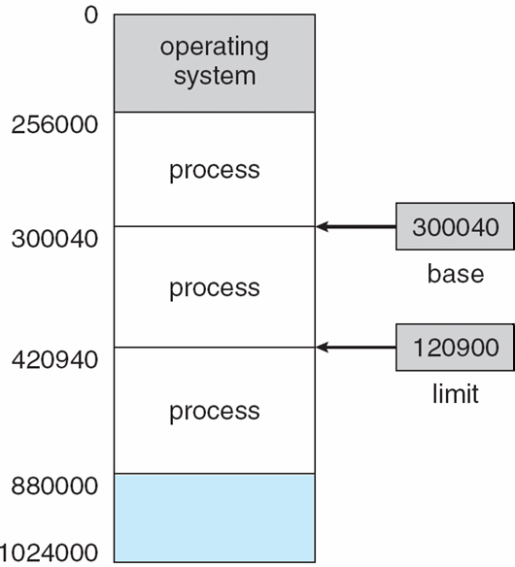
Background
Multiple processes resides in memory
Protection of memory required to ensure correct operation
1. Protect OS
2. Protect user processes

Slide 7
Base and Limit Registers
A pair of base and limit registers define the logical address space

Slide 8
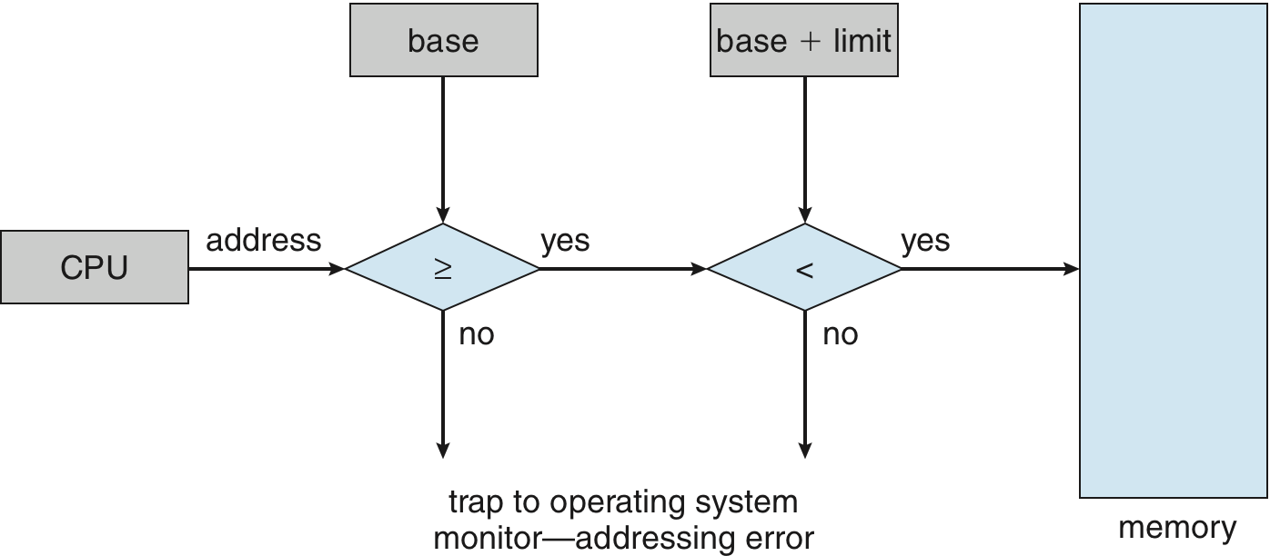
Hardware Address Protection with Base and Limit Registers
OS loads the base & limit reg.
Privileged instruction

Slide 9
Address Binding
Process resides in main memory
Associate each data element with memory address
Further, addresses represented in different ways at different stages of a program’s life
Source code addresses usually symbolic
Compiled code addresses bind to relocatable addresses
i.e. “14 bytes from beginning of this module”
Linker or loader will bind relocatable addresses to absolute addresses
i.e. 74014

Slide 10
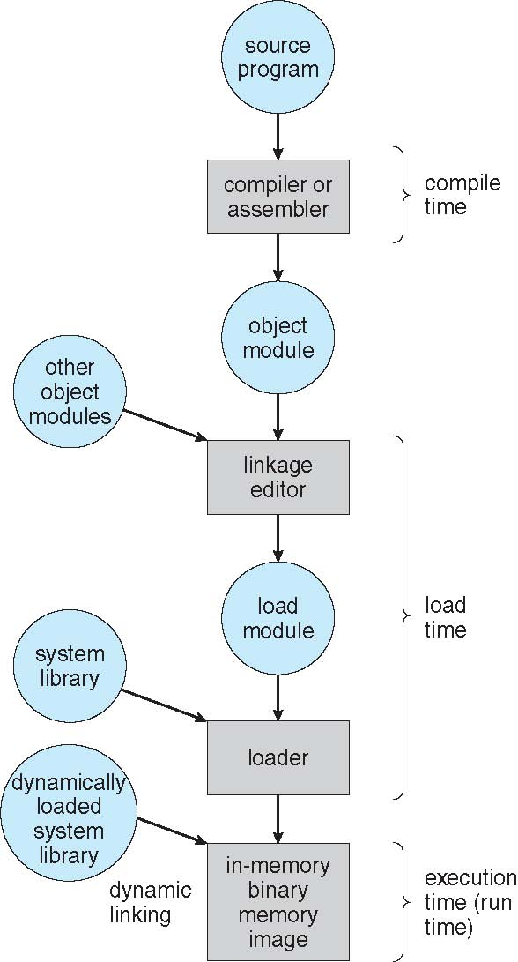
Multistep Processing of a User Program

Slide 11
Binding of Instructions and Data to Memory
Address binding of instructions and data to memory addresses can happen at three different stages
Compile time: If memory location known a priori, absolute code can be generated; must recompile code if starting location changes
Load time: Must generate relocatable code if memory location is not known at compile time
Execution time: If the process can be moved during its execution from one memory segment to another
Binding delayed until run time
Need hardware support for address maps (e.g., base and limit registers)

Slide 12
Logical vs. Physical Address Space
Logical address – generated by the CPU; also referred to as virtual address
Physical address – address seen by the memory unit
Logical and physical addresses are the same in compile-time and load-time address-binding schemes;
logical (virtual) and physical addresses differ in execution-time address-binding scheme
Logical address space is the set of all logical addresses generated by a program
Physical address space is the set of all physical addresses generated by a program
CPU

Slide 13
Memory-Management Unit (MMU)
Hardware device that at run time maps virtual to physical address
Many methods possible
To start, consider simple scheme where the value in the relocation register is added to every address generated by a user process at the time it is sent to memory
relocation register
MS-DOS on Intel 80x86 used 4 relocation registers
The user program deals with logical addresses (0 to max); it never sees the real physical addresses (R to R+max)
Say the logical address 25
Execution-time binding occurs when reference is made to location in memory
Logical address bound to physical addresses

Slide 14
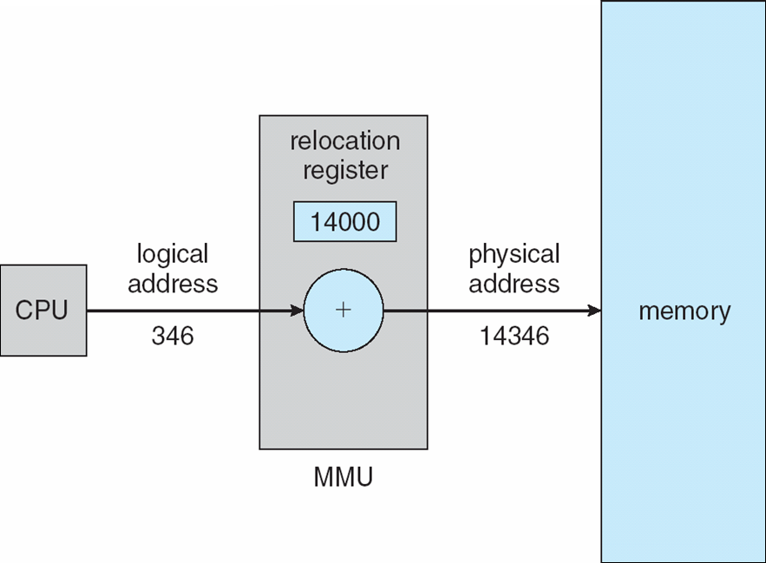
Dynamic relocation using a relocation register
14000
Relocatable code

Slide 15
Contiguous Allocation
Multiple processes resides in memory

Slide 16
Contiguous Allocation
Main memory usually divided into two partitions:
Resident operating system, usually held in low memory
User processes then held in high memory
Each process contained in single contiguous section of memory

Slide 17
Contiguous Allocation (Cont.)
Multiple-partition allocation
Divide memory into several Fixed size partition
Each partition stores one process
Degree of multiprogramming limited by number of partitions
If a partition is free, load process from job queue
MFT (IBM OS/360)

Slide 18
Contiguous Allocation (Cont.)
Multiple-partition allocation
Variable partition scheme
Hole – block of available memory; holes of various size are scattered throughout memory
Keeps a table of free memory
When a process arrives, it is allocated memory from a hole large enough to accommodate it
Process exiting frees its partition, adjacent free partitions combined
Operating system maintains information about: a) allocated partitions b) free partitions (hole)
OS
OS
OS
OS
OS
process 5
process 5
process 5
process 5
process 9
process 9
Hole
process 8
process 10
process 2
process 2
process 2
process 2

Slide 19
Dynamic Storage-Allocation Problem
How to satisfy a request of size n from a list of free holes?
Dynamic storage allocation problem
First-fit: Allocate the first hole that is big enough
Best-fit: Allocate the smallest hole that is big enough; must search entire list, unless ordered by size
Produces the smallest leftover hole
Worst-fit: Allocate the largest hole; must also search entire list
Produces the largest leftover hole

Slide 20
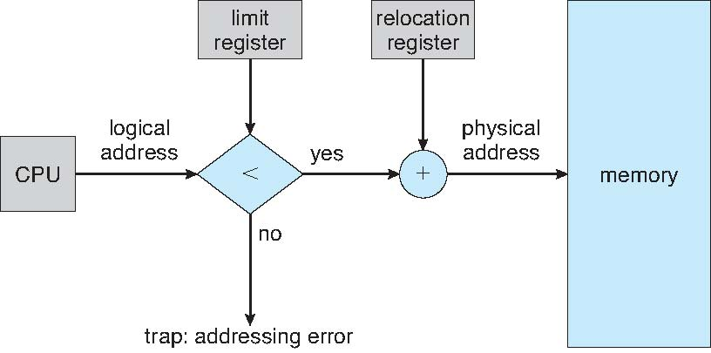
Hardware Support for Relocation and Limit Registers
Relocation registers used to protect user processes from each other, and from changing operating-system code and data
Relocation register contains value of smallest physical address
Limit register contains range of logical addresses – each logical address must be less than the limit register
Context switch
MMU maps logical address dynamically

Slide 21
Fragmentation
Processes loaded and removed from memory
Memory is broken into little pieces
External Fragmentation – total memory space exists to satisfy a request, but it is not contiguous
First fit analysis reveals that given N blocks allocated, 0.5 N blocks lost to fragmentation
1/3 may be unusable -> 50-percent rule

Slide 22
Fragmentation (Cont.)
Reduce external fragmentation by compaction
Shuffle memory contents to place all free memory together in one large block
Compaction is possible only if relocation is dynamic, and is done at execution time
Change relocation reg.
Cost
Internal Fragmentation – allocated memory may be slightly larger than requested memory; this size difference is memory internal to a partition, but not being used

Slide 23
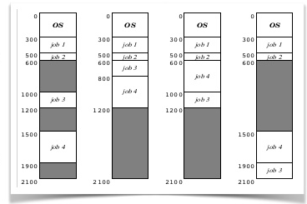

Slide 24
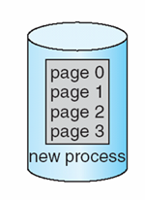
Paging
Physical address space of a process can be noncontiguous;
process allocates physical memory whenever the latter is available
Divide physical memory into fixed-sized blocks called frames
Size is power of 2, between 512 bytes and 16 Mbytes
Divide logical memory into blocks of same size called pages
To run a program of size N pages, need to find N free frames and load program
Backing store likewise split into pages
Set up a page table to translate logical to physical addresses
System keeps track of all free frames

Slide 25
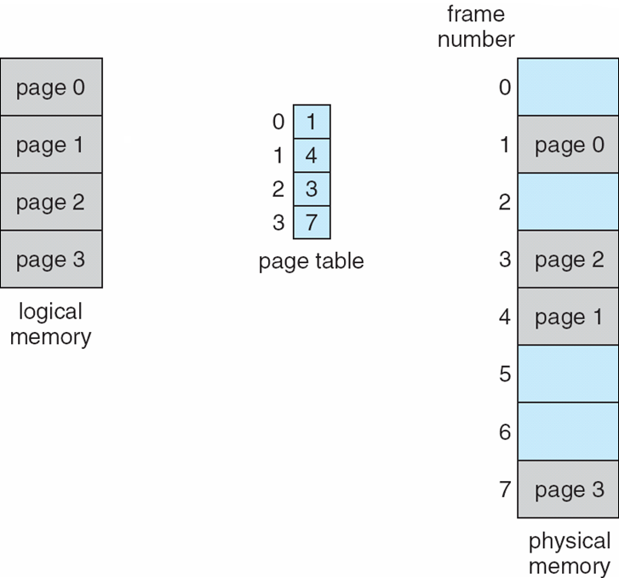
Paging Model of Logical and Physical Memory
page table to translate logical to physical addresses

Slide 26
Address Translation Scheme
Address generated by CPU is divided into:
Page number (p) – used as an index into a page table
which contains base address of each page in physical memory
Page offset (d) – offset within a page
combined with base address to define the physical memory address that is sent to the memory unit
For given logical address space 2^{m} and page size 2^{n}
offset
page
page number
page offset
p
d
m - n
n

Slide 27
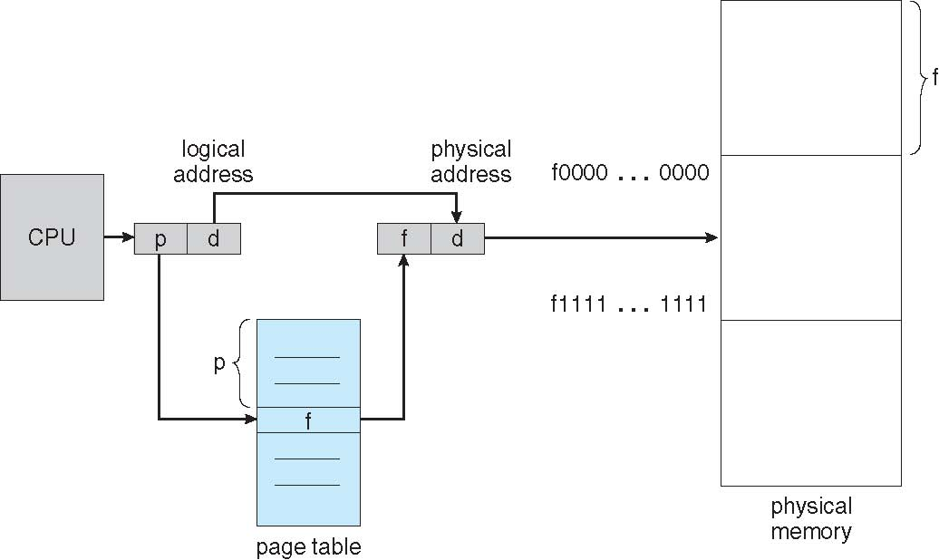
Paging Hardware

Slide 28
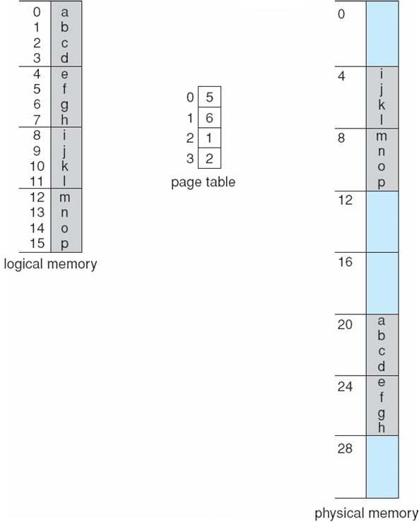
Paging Example
Logical address 0
(0*4+0)
Physical address: (5*4+0)=20
Logical address 3
(0*4+3)
Physical address:
(5*4+0)=23
Logical address 4
(1*4+0)
Physical address:
(6*4+0)=24
Logical address 13
(3*4+1)
Physical address: (2*4+1)
Logical address = 16
Page size=4
Physical memory=32
User’s view
Run time address binding
n=2 and m=4 32-byte memory and 4-byte pages

Slide 29
Paging
External fragmentation??
Calculating internal fragmentation
Page size = 2,048 bytes
Process size = 72,766 bytes
35 pages + 1,086 bytes
Internal fragmentation of 2,048 - 1,086 = 962 bytes
So small frame sizes desirable?
But increases the page table size
Poor disk I/O
Page sizes growing over time
Solaris supports two page sizes – 8 KB and 4 MB
User’s view and physical memory now very different
user view=> process contains in single contiguous memory space
By implementation process can only access its own memory
protection

Slide 30
Each page table entry 4 bytes (32 bits) long
Each entry can point to 2³² page frames
If each frame is 4 KB
The system can address 2⁴⁴ bytes (16TB) of physical memory
Virtual address space 16MB.
Page table size?

Slide 31
Process P1 arrives
Requires n pages => n frames must be available
Allocate n frames to the process P1
Create page table for P1

Slide 32
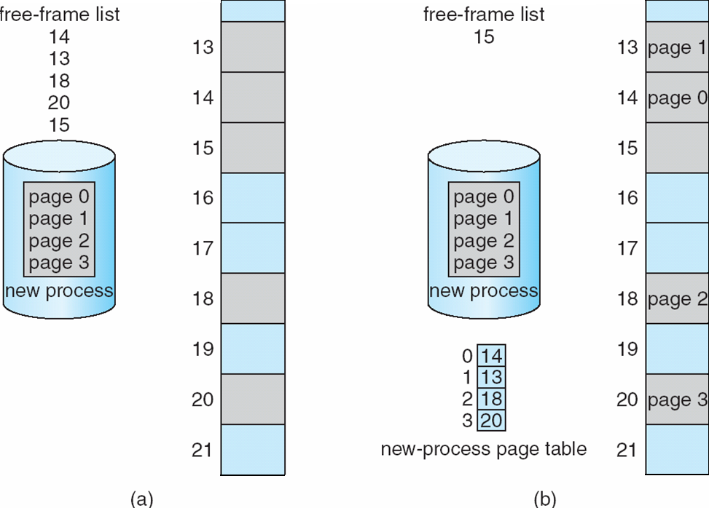
Free Frames
Frame table
Use’s view
System’s view
RAM
RAM
Before allocation
After allocation

Slide 33
Implementation of Page Table
For each process, Page table is kept in main memory
Page-table base register (PTBR) points to the page table
Page-table length register (PTLR) indicates size of the page table
In this scheme every data/instruction access requires two memory accesses
One for the page table and one for the data / instruction
The two memory access problem can be solved by the use of a special fast-lookup hardware cache called associative memory or translation look-aside buffers (TLBs)

Slide 34
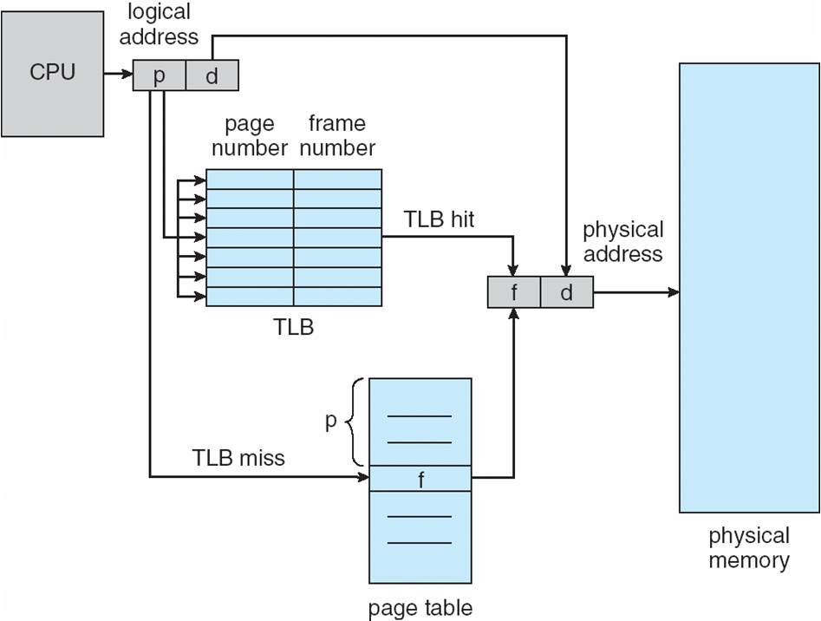
Paging Hardware With TLB

Slide 35
Effective Access Time
Associative Lookup = ε time unit
Can be < 10% of memory access time
Hit ratio = α
Hit ratio – percentage of times that a page number is found in the associative registers; ratio related to size of TLB
Consider α = 80%, ε = 20ns for TLB search, 100ns for memory access
Effective Access Time (EAT)
EAT = (100 + ε) α + (200 + ε)(1 – α)
Consider α = 80%, ε = 20ns for TLB search, 100ns for memory access
EAT = 0.80 x 120 + 0.20 x 220 = 140ns
Consider better hit ratio -> α = 98%, ε = 20ns for TLB search, 100ns for memory access
EAT = 0.98 x 120 + 0.02 x 220 = 122ns

Slide 36
Memory Protection
Memory protection implemented by associating protection bit with each frame to indicate if read-only or read-write access is allowed
Can also add more bits to indicate page execute-only, and so on
Valid-invalid bit attached to each entry in the page table:
“valid” indicates that the associated page is in the process’ logical address space, and is thus a legal page
“invalid” indicates that the page is not in the process’ logical address space
Or use PTLR
Any violations result in a trap to the kernel

Slide 37
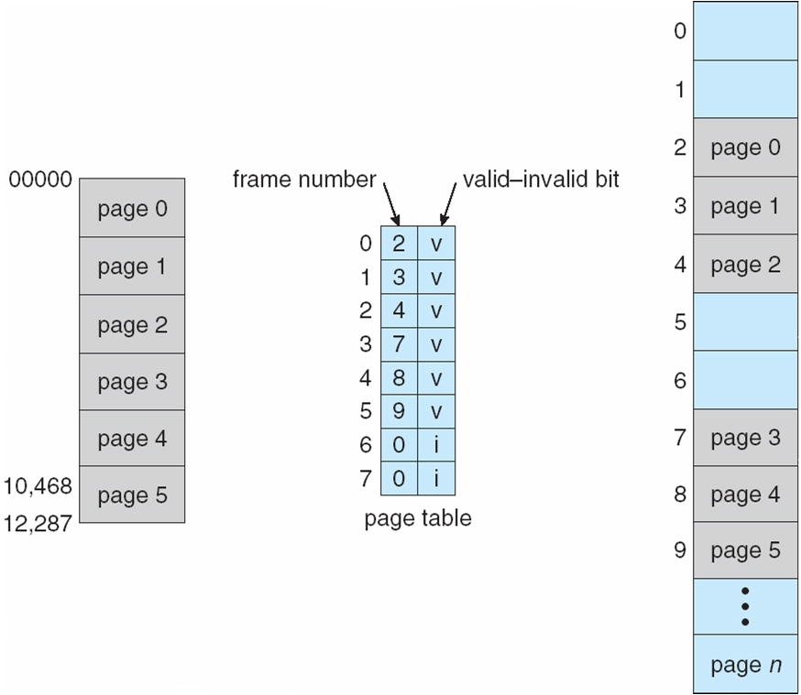
Valid (v) or Invalid (i) Bit In A Page Table
14 bit address space (0 to 16383)
Page size 2KB
Process P1 uses only 0 to 10468
P2
Page 0
Page 1
Page 2
Page 3
P1
Internal fragmentation
Use of PTLR (length)

Slide 38
Shared Pages Example
System with 40 users
Use common text editor
Text editor contains 150KB code 50KB data (page size 50KB)
8000KB!
Shared code
One copy of read-only (reentrant) code shared among processes (i.e., text editors, compilers, window systems)
Code never changes during execution
Only one copy of the editor in the memory
Total memory consumption
40*50+150=2150KB

Slide 39
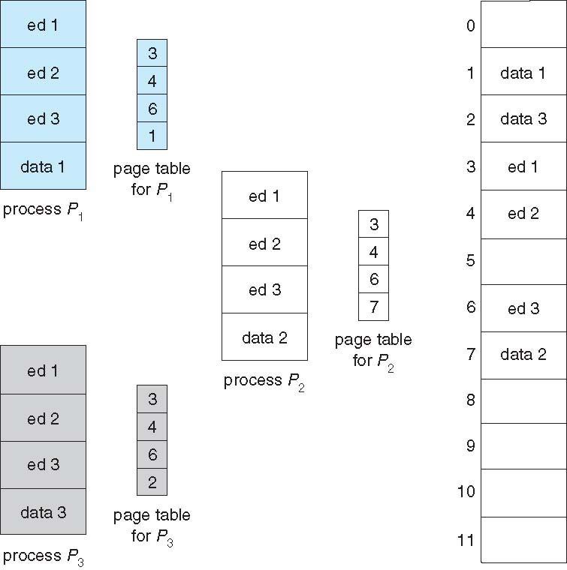
Shared Pages Example

Slide 40
Virtual Memory

Slide 41
Background
Code needs to be in memory to execute, but entire program rarely used
Error code, unusual routines, large data structures
Entire program code not needed at same time
Consider ability to execute partially-loaded program
Program no longer constrained by limits of physical memory
programs could be larger than physical memory
More processes can be accommodated

Slide 42
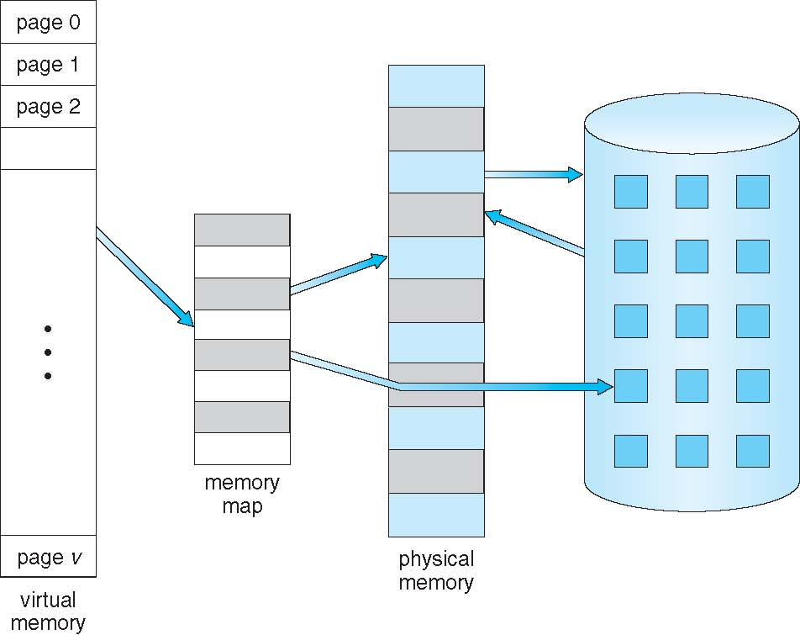
Virtual Memory That is Larger Than Physical Memory
Large virtual space
Small memory

Slide 43
Classical paging
Process P1 arrives
Requires n pages => n frames must be available
Allocate n frames to the process P1
Create page table for P1
Allocate < n frames

Slide 44
Background
Virtual memory – separation of user logical memory from physical memory
Extremely large logical space is available to programmer
Concentrate on the problem
Only part of the program needs to be in memory for execution
Logical address space can therefore be much larger than physical address space
Starts with address 0, allocates contiguous logical memory
Physical memory
Collection of frame
Virtual memory can be implemented via:
Demand paging
Demand segmentation

Slide 45
Demand Paging
Bring a page into memory only when it is needed
Lazy swapper – never swaps a page into memory unless page will be needed
Swapper that deals with pages is a pager
Less I/O needed, no unnecessary I/O
Less memory needed
More users
Page is needed ⇒ reference to it
invalid reference ⇒ abort
not-in-memory ⇒ bring to memory
Valid address information is available in PCB

Slide 46
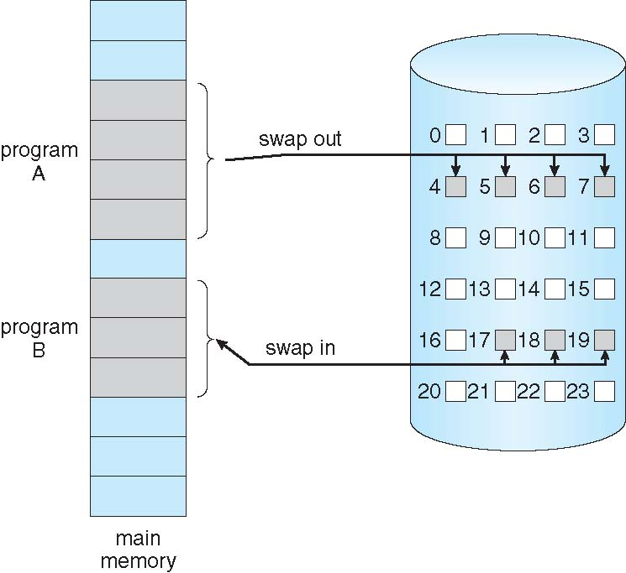
Transfer of a Paged Memory to Contiguous Disk Space
When we want to execute a process, swap in
Instead of swap in entire process, load page
Pager

Slide 47
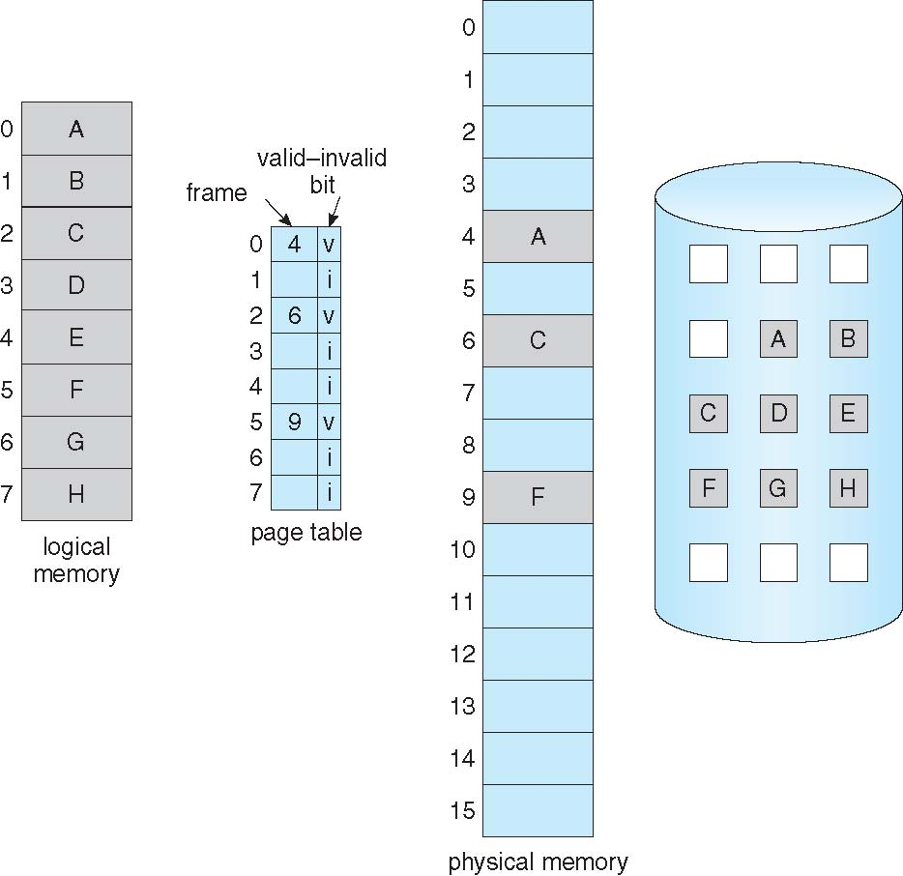
Page Table When Some Pages Are Not in Main Memory
Pager loads few necessary pages in memory

Slide 48
Valid-Invalid Bit
With each page table entry a valid–invalid bit is associated (v ⇒ in-memory – memory resident, i ⇒ not-in-memory)
Initially valid–invalid bit is set to i on all entries
Example of a page table snapshot:
During address translation, if valid–invalid bit in page table entry
is i ⇒ page fault
Frame #
valid-invalid bit
v
v
v
v
i
page table
….
i
Disk address
i

Slide 49
Page Fault
If the page in not in memory, first reference to that page will trap to operating system:
page fault
Operating system looks at PCB to decide:
Invalid reference ⇒ abort
Just not in memory (load the page)
Get empty frame
Swap page into frame via scheduled disk operation
Reset page table to indicate page now in memory Set validation bit = v
Restart the instruction that caused the page fault

Slide 50
What Happens if There is no Free Frame?
Example
40 frames in memory
8 processes each needs 10 pages
5 of them never used
Two options
Run 4 processes (10 pages)
Run 8 processes (5 pages)
Increase the degree of multiprogramming
Over allocating memory
Page fault
No free frame
Terminate? swap out? replace the page?
Page replacement – find some page in memory, not really in use, page it out
Performance – want an algorithm which will result in minimum number of page faults
Same page may be brought into memory several times

Slide 51
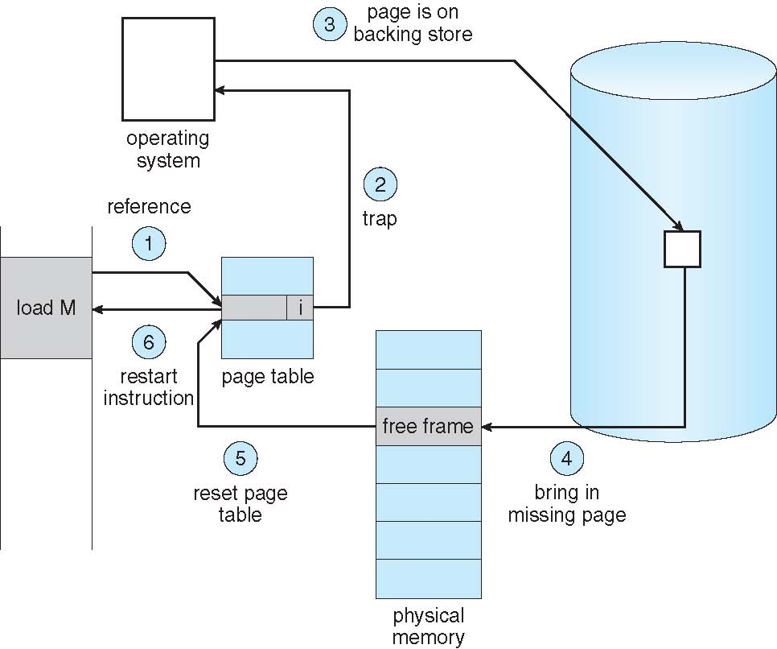
Steps in Handling a Page Fault
Check PCB

Slide 52
Pure Demand Paging
Extreme case – start process with no pages in memory
OS sets instruction pointer to first instruction of process, non-memory-resident -> page fault
Swap in that page
Pure demand paging
Actually, a given instruction could access multiple pages (instruction + data) -> multiple page faults
Pain decreased because of locality of reference
Hardware support needed for demand paging
Page table with valid / invalid bit
Secondary memory (swap device with swap space)
Instruction restart after page fault

Slide 53
Allocation of Frames
How do we allocate the fixed amount of memory among various processes?
Single user system
Trivial

Slide 54
Allocation of Frames
Each process needs minimum number of frames
Minimum number is defined by the instruction set
Page fault forces to restart the instruction
Enough frames to hold all the pages for that instruction
Example:
Single address instruction (2 frames)
Two address instruction (3 frames)
Maximum of course is total frames in the system
Two major allocation schemes
fixed allocation
proportional allocation

Slide 55
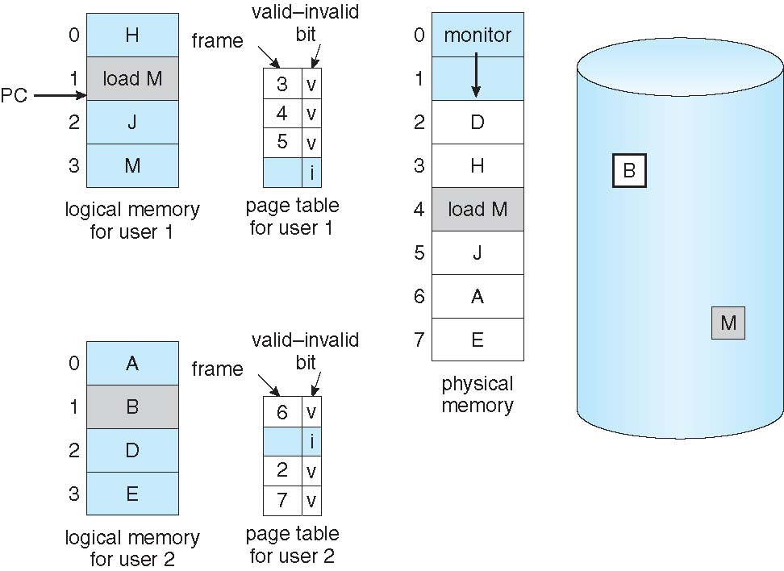
Need For Page Replacement
P1
K
P2

Slide 56
Need For Page Replacement
P1
K
P2
PC

Slide 57
Basic Page Replacement
Find the location of the desired page on disk
Find a free frame: - If there is a free frame, use it - If there is no free frame, use a page replacement algorithm to select a victim frame (of that process) - Write victim frame to disk
Bring the desired page into the (newly) free frame; update the page and frame tables
Continue the process by restarting the instruction that caused the trap
Note now potentially 2 page transfers for page fault – increasing Effective memory access time

Slide 58
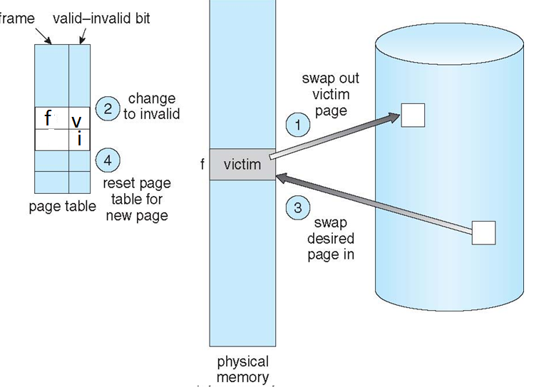
Page Replacement
5
5
6
6

Slide 59
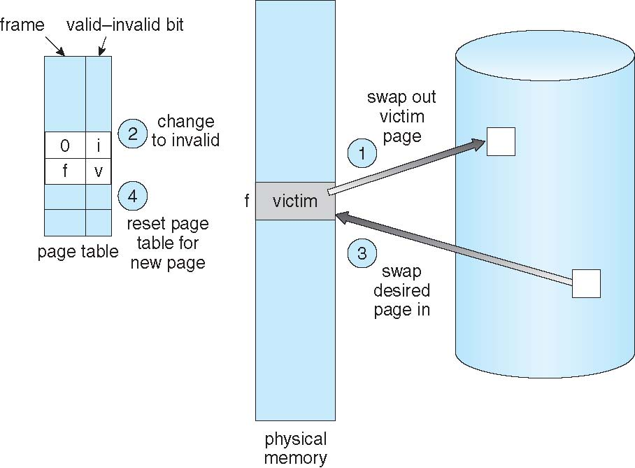
Page Replacement
5
5
6
6

Slide 60
Evaluation
Evaluate algorithm by running it on a particular string of memory references (reference string) and computing the number of page faults on that string
String is just page numbers, not full addresses
Repeated access to the same page does not cause a page fault
Trace the memory reference of a process
0100, 0432, 0101, 0612, 0102, 0104, 0101, 0611, 0102
Page size 100B
Reference string 1, 4, 1, 6, 1, 6
In all our examples, the reference string is
7,0,1,2,0,3,0,4,2,3,0,3,0,3,2,1,2,0,1,7,0,1

Slide 61
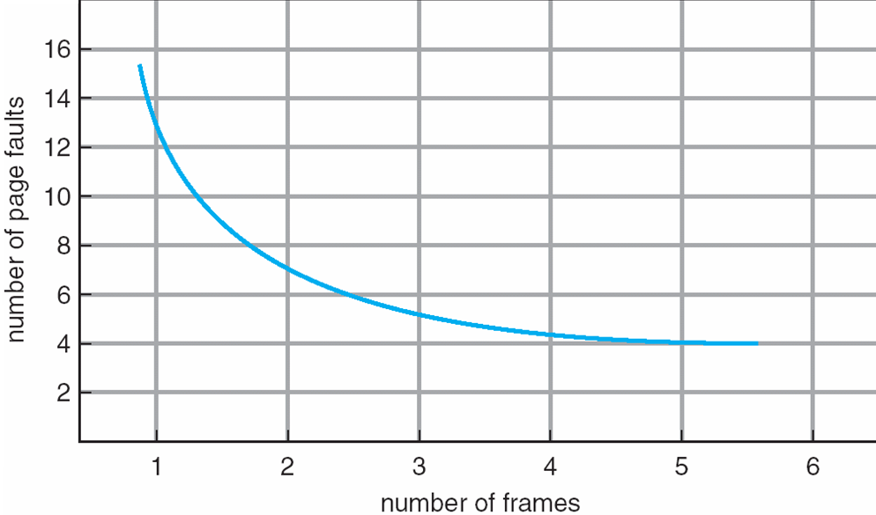
Graph of Page Faults Versus The Number of Frames

Slide 62
First-In-First-Out (FIFO) Algorithm
Associates a time with each frame when the page was brought into memory
When a page must be replaced, the oldest one is chosen
Reference string: 7,0,1,2,0,3,0,4,2,3,0,3,0,3,2,1,2,0,1,7,0,1
Limitation:
A variable is initialized early and constantly used

Slide 63
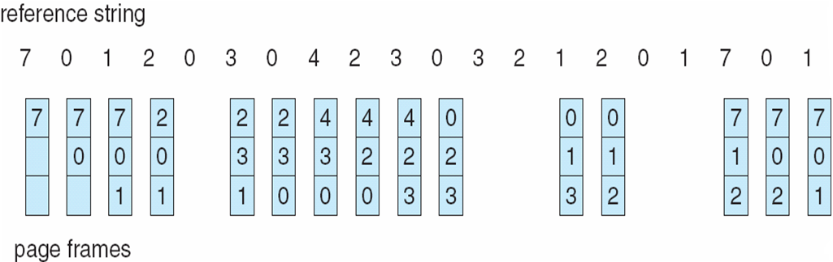
FIFO Page Replacement
3 frames (3 pages can be in memory at a time)
15 page faults
How to track ages of pages?
Just use a FIFO queue to hold all the pages in memory
Replace the page at the head
Insert at tail

Slide 64
Optimal Algorithm
Replace page that will not be used for longest period of time
How do you know this?
Can’t read the future
Used for measuring how well your algorithm performs

Slide 65
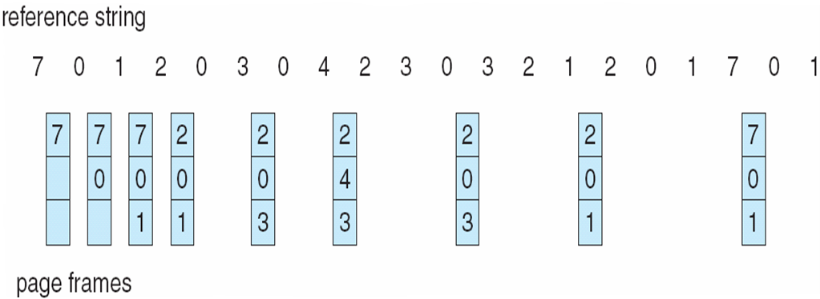
Optimal Page Replacement
9 page faults

Slide 66
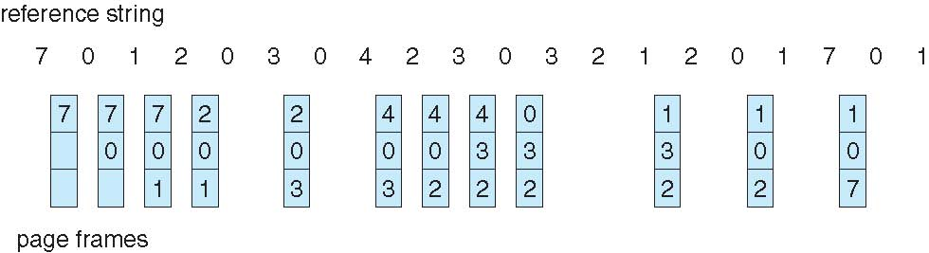
Least Recently Used (LRU) Algorithm
Use past knowledge rather than future
Past is the proxy of future
Replace page that has not been used in the most of the time
Associate time of last use with each page
12 faults – better than FIFO but worse than OPT
Generally good algorithm and frequently used
But how to implement?

Slide 67
LRU Algorithm-Implementation
Counter implementation
CPU maintains a clock
Every page entry has a Time of use;
every time page is referenced, copy the clock into the time of use
When a page needs to be replaced, look at the “Time of use” to find smallest value
Search through table needed
Page table
 |  | Time of Use
Clock
CPU
0
1
address
2
3

Slide 68
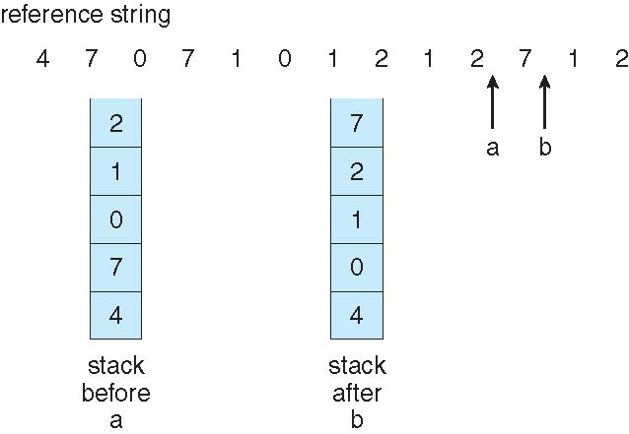
LRU Algorithm-Implementation
Stack implementation
Keep a stack of page numbers in a double linked list form:
Page referenced:
move it to the top
Victim page is the bottom page

Slide 69
LRU Approximation Algorithms
LRU needs special hardware and still slow
Reference bit
With each page associate a bit, initially = 0
When page is referenced bit set to 1
Additional reference bit algorithm
Record the reference bits in regular interval
Keep a 8 bit string for each page in memory
At regular interval, timer copies the reference bit to the high order bit (MSB) of the string.
Shift the other bits right side by one bit

Slide 70
FIFO Example – Program - 5 pages, 3 frames of Memory allocated
Increase in page frame decreases page fault rate?
1 2 3 4 1 2 5 1 2 3 4 5
9
faults
1
1
2
1
2
3
4
2
3
4
1
3
4
1
2
5
1
2
5
1
2
5
1
2
5
3
2
5
3
4
5
3
4










Slide 71
FIFO Example – Program - 5 pages, 4 frames of Memory allocated
1 2 3 4 1 2 5 1 2 3 4 5
1
1
2
1
2
3
4
2
3
4
1
3
4
1
2
5
1
2
5
1
2
5
1
2
5
3
2
5
3
4
5
3
4
10
faults
1
1
2
1
2
3
1
2
3
4
1
2
3
4
1
2
3
4
5
2
3
4
5
1
3
4
5
1
2
4
5
1
2
3
4
1
2
3
4
5
2
3











Slide 72
Belady's Anomaly
# of Page Faults
Number of Frames

Slide 73
Belady’s Anomaly
This most unexpected result is known as Belady’s anomaly – for some page-replacement algorithms, the page fault rate may increase as the number of allocated frames increases
Is there a characterization of algorithms susceptible to Belady’s anomaly?

