Slide 1
Introduction

Slide 2
Reference
Wireless and Mobile Network Architectures，Yi-Bing Lin and Imrich Chlamtac，Wiley Computer Publishing。

Slide 3
Outline
Introduction
PCS Architecture
Cellular Telephony
Cordless Telephony and Low-Tier PCS
Summary

Slide 4
Introduction

Slide 5
Personal Communications Services
Personal Communications Services (PCS) refers to a wide variety of wireless access and personal mobility services.
PCS systems can connected to Public Switched Telephone Network (PSTN).
Goal of PCS：enabling communications with a person at anytime, at any place and in any terminal form.

Slide 6
Examples of Wireless Communications Systems (1/4)
High-tier digital cellular systems
For vehicular and pedestrian services
Global System for Mobile Communication (GSM), Digital Communication System-1800 (DCS1800)
IS-136 TDMA based Digital Advanced Mobile Phone Service (DAMPS)
Personal Digital Cellular (PDC)
IS-95 CDMA-based cdmaOne System

Slide 7
Examples of Wireless Communications Systems (2/4)
Low-tier telecommunication systems
For residential, business, and public cordless access applications
Cordless Telephone 2 (CT2)
Digital European Cordless Telephone (DECT)
Personal Access Communications Systems (PACS)
Personal Handy Phone System (PHS)

Slide 8
Examples of Wireless Communications Systems (3/4)
Wideband wireless systems
To accommodate Internet and multimedia services.
cdma2000 (evolved from cdmaOne)
W-CDMA (proposed by Europe)
TD-SCDMA (proposed by China/Europe)

Slide 9
Examples of Wireless Communications Systems (4/4)
PCS umbrella
Paging systems
Trunking Radio
Mobile-satellite system
Unlicensed industrial, scientific, and medical
（ISM）band technologies, as well as wireless local area networks（WLANs）

Slide 10
PCS Architecture

Slide 11
PSTN
Public Switched Telephone Network
Switch
Taichung
subscriber loop ^{Switch}
trunk
Switch
Taipei

Slide 12
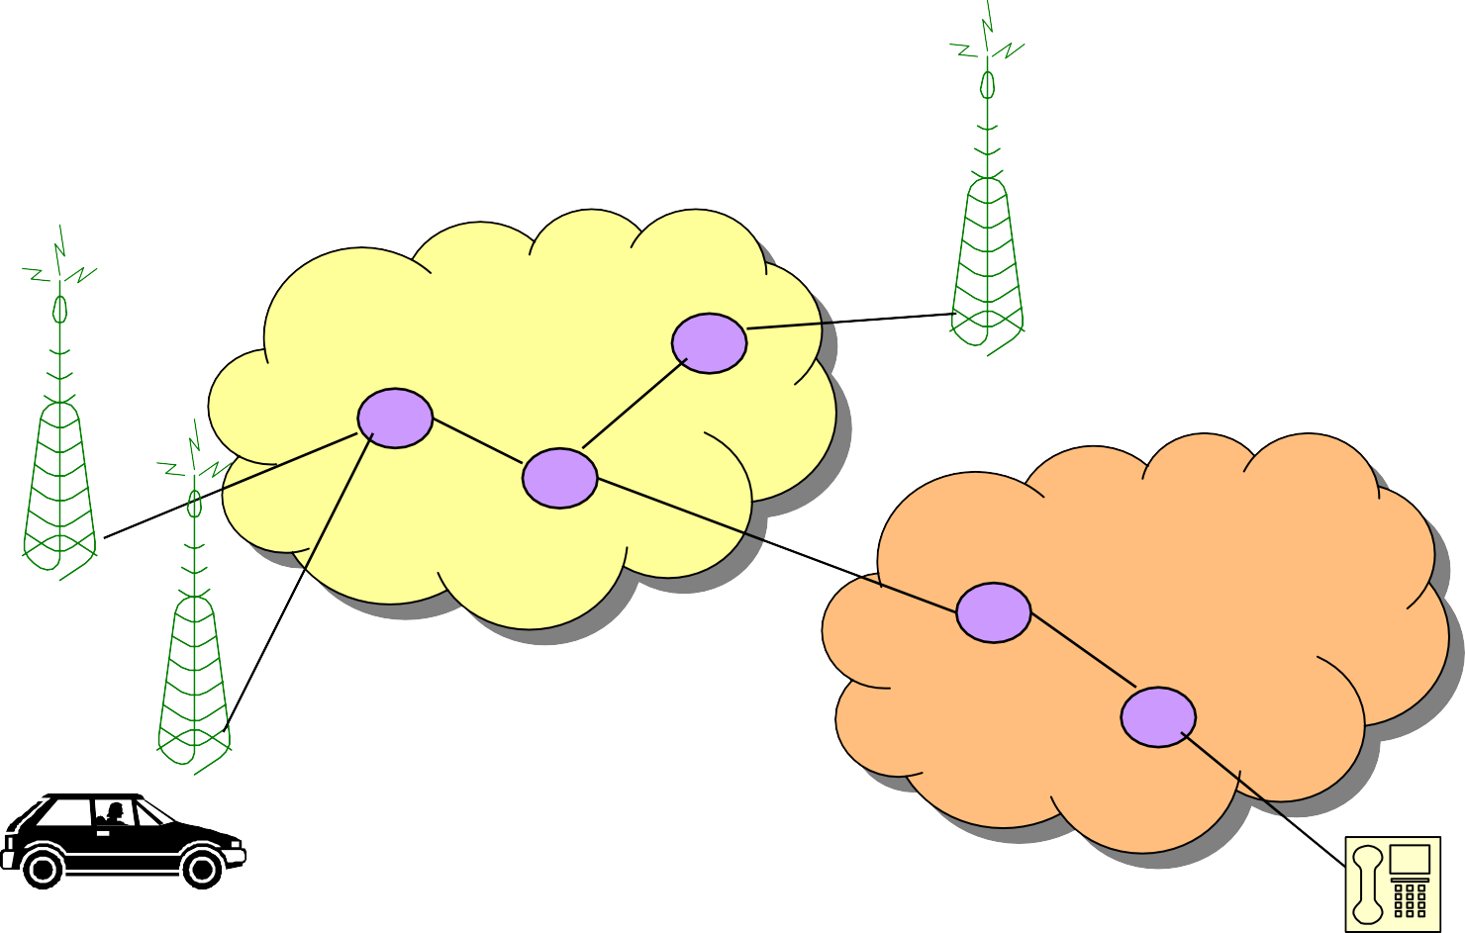
PLMN
Public Land Mobile Network
PLMN
PSTN

Slide 13
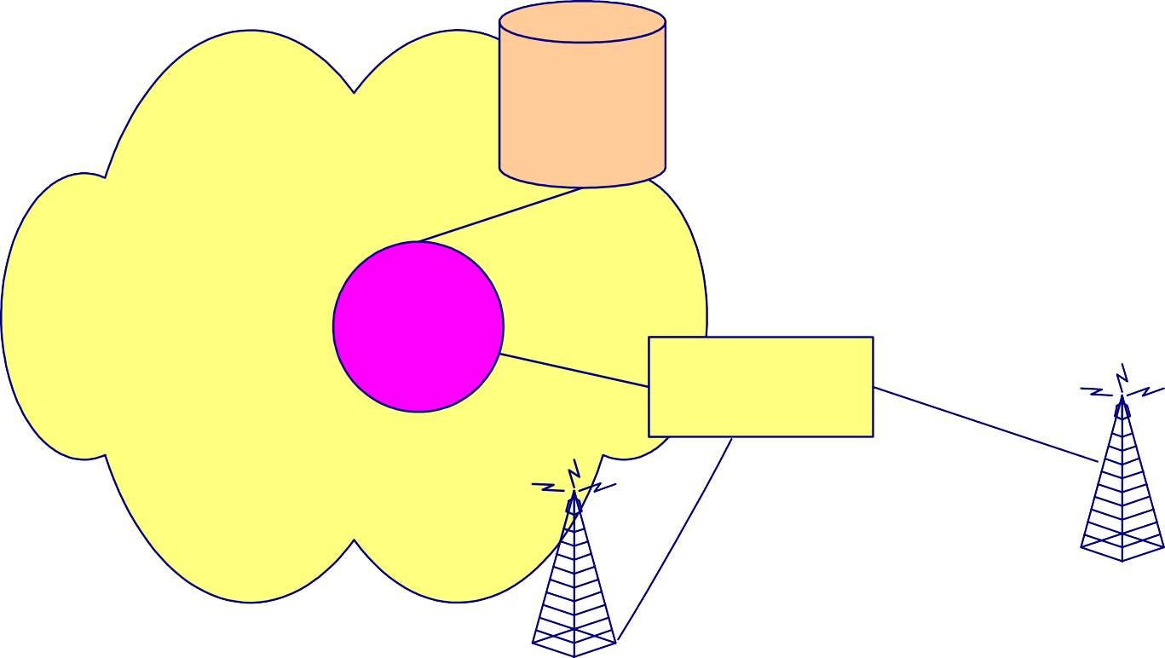
The Basic PCS Architecture
Mobility Database
Wireline Transport Network
Public Land Mobile Network
Switch for Mobile
Applications
Base Station Controller
Base Transceiver Station
BTS
Radio Network
Mobile Station

Slide 14
PCS Architecture
Each PCS technology has similar architectures which consists two parts：
Radio Network
MS (Mobile Station)
BS (Base Station) System
Wireline Transport Network
MSC (Mobile Switching Center)
The Mobility Database connected to MSC is used to track the locations of mobile station.

Slide 15
Mobile Station (MS)
Handset, mobile phone, subscriber unit, portable
Multi-mode handset

Slide 16
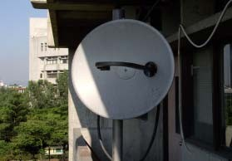
Base Station (BS)
The radio coverage of a BS is called a Cell.
The BS system is partitioned into
a controller
radio transmitters/receivers
The BSs usually reach the wireline core network via land links or dedicated microwave
links.
17

Slide 17
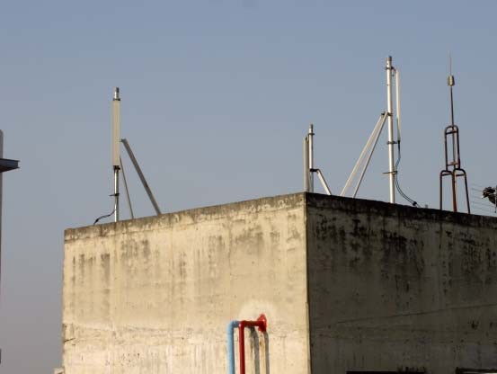
GSM Antenna

Slide 18
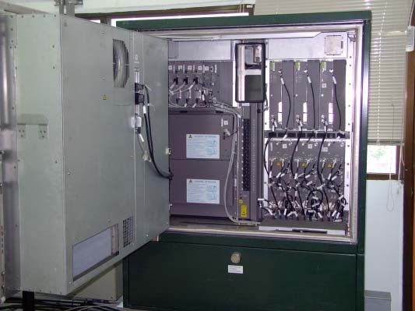
GSM Base Station

Slide 19

Cellular Concept
cluster
√
√
√
cell
sector
√
√
√

Slide 20
Duplex Technologies
Down-link: BS to handset
Up-link: handset to BS
Two duplex Technologies:
FDD（Frequency Division Duplex）
TDD（Time Division Duplex）

Slide 21
FDD
Frequency
A1 talks to A2
B1 talks to B2
C1 talks to C2
Down Link
A2 talks to A1
B2 talks to B1
C2 talks to C1
Up Link
Time

Slide 22
Frequency
TDD
A2 | B2 | C2 |  | A1 | B1 | C1
talks | talks | talks |  | talks | talks | talks
to | to | to |  | to | to | to
A1 | B1 | C1 |  | A2 | B2 | C2
 |  |  | ..... |  |  |  | .....
Time

Slide 23
Multiple Access Technology
FDMA（Frequency Division Multiple Access）
TDMA（Time Division Multiple Access）
CDMA（Code Division Multiple Access）

Slide 24
FDMA
Frequency
30kHz for AMPS
Time

Slide 25
TDMA
Frequency
200kHz for GSM
Time
4.615 ms/frame
8 time slots for GSM
26

Slide 26
Cellular Telephony

Slide 27
1G Cellular Telephony
Advanced Mobile Phone Service (AMPS)
Total Access Communication System (TACS)
NMT (Nordic Mobile Telephone) 450/900
NTT (Nippon Telephone & Telegraph) , JTACS (1988), NTACS (1993)
C450

Slide 28
Advanced Mobile Phone Service (AMPS) (1/2)
Analog FM radio for voice transmission
FSK modulation for signal channels
FDMA
FDD
Total 50 MHz=824-849 MHz(down-link) + 869-894 MHz(up-link)
832 full-duplex channels using 1664 discrete frequencies
30kMHz spacing

Slide 29
Advanced Mobile Phone Service (AMPS) (2/2)
Frequency reuse scheme for radio communication
12-cell cluster using omni-directional antennas
7-cell cluster using three sectors per BS
4-cell cluster, 6-sector design in Motorola AMPS system. There are about 50 channels per cell.
EIA/TIA IS-41 standard for roaming management.

Slide 30
2G Cellular Telephony
Global System for Mobile Communications (GSM)
EIA/TIA IS-136 Digital Cellular System
EIA/TIA IS-95 Digital Cellular System
Japanese Digital Cellular (JDC) in Japan

Slide 31
Global System for Mobile Communications (GSM) (1/2)
“Digital” cellular system
Group Special Mobile of Conference Europeenne des Posts et Telecommunications (CEPT) and European des Postes et Telecommunications (ETSI)
TDMA/FDD
935-960 MHz for Downlink
890-915 MHz for Uplink
200 kHz for RF channel spacing
Speech coding rate 13 Kbps

Slide 32
Global System for Mobile Communication (GSM) (2/2)
Frequency carrier is divided into 8 time slots
Every pair of radio transceiver-receiver supports 8 voice channels.
GSM Mobile Application Part (MAP) for roaming management
Digital switch can provide many applications:
Example: point-to-point short messaging, group addressing, call waiting, multiparty services

Slide 33
Comparison of Cellular Systems
System | AMPS | GSM DCS1800 | IS-136 | IS-95 | JDC
Region | 美 | 歐,台灣 | 美 | 美,韓,中國 | 日
Duplex | FDD | FDD | FDD | FDD | FDD
MAC | FDMA | FDMA TDMA | FDMA TDMA | FDMA CDMA | FDMA TDMA
Downlink (MHz) | 870-890 | 935-960 1805-1880 | 869-894 | 869-894 | 810-826
Uplink (MHz) | 825-845 | 890-915 1710-1785 | 824-849 | 824-849 | 940-956
Carrier | 30kHz | 200kHz | 30kHz | 1.25MHz | 25kHz
Channels | 1 | 8 | 6 | 32 | 3
Speech rate | 10 kps | 13 kps | 7.95kps | 8 kps | 11.2 kps
Channel bit rate |  | 270.833 kps | 48.6 kps | 1228.8 kps | 42 kps
44

Slide 34
Cellular Characteristics
The characteristics of the cellular system:
Support high mobility
Large coverage area
High transmission power of BS and handset
High signal process power (for handset)
Low voice quality
High network complexity
Microcell is developed for:
Low transmission power
Low base station cost
Increase capacity
45

Slide 35
Low-Tier PCS (2nd Generation)

Slide 36
Examples of Low-Tier PCS
Cordless Telephone, Second Generation (CT2)
Digital European Cordless Telephone (DECT)
Personal Handy Phone System (PHS)
Personal Access Communications System (PACS)

Slide 37
Cordless Telephone, Second Generation (CT2) (1/2)
Developed in Europe since 1989.
40 FDMA channels
32-Kbps speech coding rate
TDD
The maximum transmit power of a CT2 handset is 10 mW
CT-1
CT-1+
CT-2
CT-2+
CT-3
48

Slide 38
Cordless Telephone, Second Generation (CT2) (2/2)
No handoff in CT2
No call delivery in CT2
In CT2+, both handoff and call delivery are OK.

Slide 39
Digital European Cordless Telephone (DECT) (1/2)
Published in 1992
TDMA/TDD
12 voice channels per frequency carrier
Sleep mode is employed in DECT to conserve the power of handsets.
32 Kbps speech coding rate

Slide 40
Digital European Cordless Telephone (DECT) (2/2)
DECT is typically implemented as a wireless- PBX connected to the PSTN.
Dynamic channel allocation
Time slot transfer
Seamless handoff
Dual mode: DECT + GSM

Slide 41
Personal Handy Phone System (PHS) (1/2)
Developed by Research and Development Center (RCR), Japan 1993
Telecommunication services for homes, offices, and outdoor environment
TDMA/TDD
4 multiplexed channels/frequency carrier
1895-1906.1 MHz = 300 KHz × 37 channels (home/office)
1906.1-1918.1 MHz = 300 KHz × 40 channels (public system)

Slide 42
Personal Handy Phone System (PHS) (2/2)
BS: 500 mW; handset < 10mW
32 Kbps speech coding rate
Dynamic channel allocation.
Dedicated control channels
Sleep Mode
J100: 7 hours talk time, 700 hours standby time, 64kbps wireless data
Dual mode: PHS + GSM

Slide 43
Personal Access Communications System (PACS)
Developed at Telcordia, U.S.A.
PACS is designed for wireless local loop and PCS.
TDMA
8 voice channels/frequency carrier
Both TDD and FDD are accommodated.
The highly effective and reliable mobile- controlled handoff (MCHO) completes in less than 20 msec.

Slide 44
Comparison of PCS Systems
System | CT-2 | DECT | PHS | PACS
Region | 歐,台灣 | 歐 | 日本 | 美
Duplex | TDD | TDD | TDD | FDD
MAC | FDMA | FDMA TDMA | FDMA TDMA | FDMA TDMA
Frequency (MHz) | 864-868 | 1880-1900 | 1895-1918 | 1930-1990(down) 1850-1910(uplink)
Carrier | 100kHz | 1728kHz | 300kHz | 300MHz
Channels | 1 | 24 | 8 | 8
Speech rate | 32kps | 32kps | 32kps | 32kps
Channel bit rate | 72kps | 1152kps | 384kps | 384kps

Slide 45
Low-tier PCS Characteristics
The characteristics of the low-tier system:
Low transmission power
Long talk time
Small coverage area
Large no. of base station
Low transmission delay
High voice quality
Low mobility
Low network complexity
Low cost

Slide 46
Summary
PCS Architecture
Cellular Telephony
Cordless Telephony and Low-Tier PCS

Slide 47
Outlines
Introduction
Handoff
Roaming Management

Slide 48
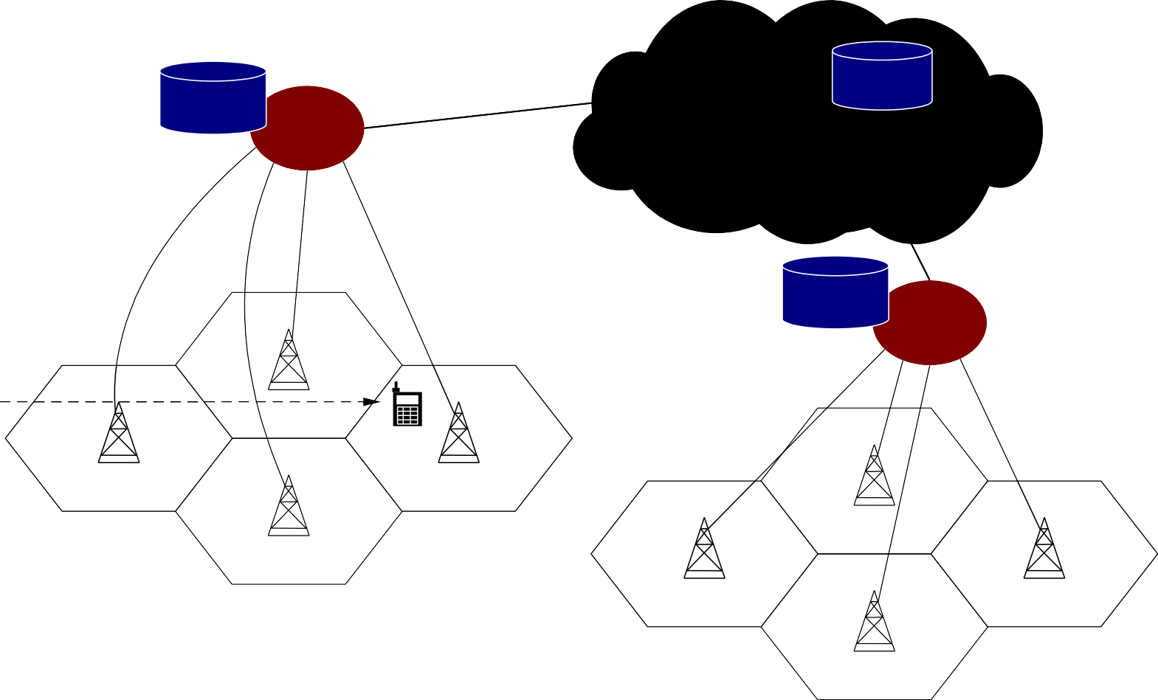
A Common PCS Network Architecture
VLR
MSC
HLR
PSTN
VLR
MSC
BS
HLR: Home Location Register MSC: Mobile Switching Center
PSTN: Public Switched Telephone Network VLR: Visitor Location Register

Slide 49
Introduction
In the PCS system, the mobile service area is covered by a set of BSs which are responsible for relaying the calls to/from the MSs.
The BSs are connected to MSCs by land links.
MSC interfaces the MSs (via BSs) with the PSTN.
Two types of databases are used for roaming management.
Home Location Register (HLR)
Visitor Location Register (VLR)
Examples of the protocols to support mobility management
EIA/TIA Interim Standard 41 (IS-41 or ANSI-41)
GSM Mobile Application Part (MAP)

Slide 50
Two Aspects of Mobility in a PCS network
Handoff (link transfer, or handover).
When a mobile user is engaged in conversation, the MS is connected to a BS via a radio link.
If the mobile user moves to the coverage area of another BS, the radio link to the old BS is disconnected, and a radio link to the new BS should be established to continue the conversation.
Roaming.
When a mobile user moves from one PCS system (e.g., the system in Taipei) to another (e.g., the system in Tainan), the system should be informed of the current location of the user.

Slide 51






Three Strategies for Handoff Detection
Mobile-Controlled Handoff (MCHO).
MCHO is used in DECT and PACS.
Part I. The MS continuously monitors the signals of the surrounding BSs.
Part II. The MS initiates the handoff process when some handoff criteria are met.
Network-Controlled Handoff (NCHO).
NCHO is used in CT-2 plus and AMPS.
Part I. The surrounding BSs measure the signal from the MS.
Part II. The network initiates the handoff process when some handoff criteria are met.
Mobile-Assisted Handoff (MAHO).
MAHO is used in GSM and IS-95.
Part I. The network asks the MS to measure the signal from the surrounding BSs.
Part II. The network the handoff decision based on the reports from the MS.

Slide 52
Inter-BS link transfer
M SC
M SC
Old BS
New BS
Old BS
New BS
(a) Step 1
(b) Step 2
M SC
M SC
Old BS
New BS
Old BS
New BS
(c) Step 3
(d) Step 4

Slide 53


Inter-BS Handoff (1/3)
The new and old BSs are connected to the same MSC. Assume
that MCHO is adopted here.
Step 1. The MS momentarily suspends conversation and initiates the handoff procedure by signaling on an idle channel in the new BS. Then it resumes the conversation on the old BS.
Step 2. Upon receipt of the signal, the MSC transfers the encryption information to the selected idle channel of the new BS and sets up the new conversation path to the MS through that channel. The switch bridges the new path with the old path and informs the MS to transfer from the old channel to the new channel.

Slide 54


Inter-BS Handoff (2/3)
Step 3. After the MS has been transferred to the new BS, it signals the network, and resumes conversation using the new channel.
Step 4. Upon receipt of the handoff completion signal, the network removes the bridge from the path and releases resources associated with the old channel

Slide 55
Inter-BS Handoff
For NCHO, all handoff signaling messages are exchanged between the MS and the old BS through the failing link. Thus, the whole process must be completed as quickly as possible.
If the new BS does not have an idle channel, the handoff call may be dropped (forced to terminate).
Forced termination of an ongoing call is considered less desirable than blocking a new call attempt.

Slide 56



ISSUE 1: Channel Assignment Schemes for Handoff Calls (1/3)
Nonprioritized Scheme.
The networks handle a handoff in the same manner as a new call attempt.
Reserved Channel Scheme.
Similar to the nonprioritized scheme, except that some channels in each BS are reserved for handoff calls.

Slide 57


Channel Assignment Schemes for Handoff Calls (2/3)
Queuing Priority Scheme.
There is a considerable area where a call can be handled by either BS, which is called the handoff area.
If no new channel is available in the new BS during handoff, the new BS buffers the handoff request in a waiting queue.
The MS continues to use the channel with the old BS until either a channel in the new BS becomes available.

Slide 58


Channel Assignment Schemes for Handoff Calls (3/3)
Subrating Scheme.
The new BS creates a new channel for a handoff call by sharing resources with an exiting call if no free channel is available.
Subrating means an occupied full-rate channel is temporarily divided into two channels at half the original rate.
One half-rate channel is to serve the exiting call, and the other half-rate channel is to serve the handoff request.
When occupied channels are released, the subrated channels are immediately switched back to full rate channels.

Slide 59








Intersystem Handoff (1/3)
In intersystem handoff, the new and old BSs are connected to two different
MSCs.
Assume that NCHO is adopted (as in IS-41 procedure).
BS 1
BS 2
BS 1
BS 2
PSTN
MSC A
Trunk
MSC B
PSTN
MSC A
Trunk
MSC B
(a) Before the Handoff
(b) After the Handoff

Slide 60





Intersystem Handoff (2/3)
Step 1.
Part I. MSC A requests MSC B to perform handoff measurements on the call in progress.
Part II. MSC then selects a candidate BS “BS 2”, and interrogates BS 2 for signal quality parameters.
Part III. MSC B returns the signal quality parameters, along with other relevant
information, to MSC A.
Step 2.
Part I. MSC A checks if the MS has made too many handoffs recently (e.g., to avoid that MS is moving within overlapped area) or if intersystem trunks are not available.
Part II. If so, MSC A exits the procedure.
Part III. Otherwise, MSC A asks MSC B to set up a voice channel.

Slide 61






Intersystem Handoff (3/3)
Step 3.
Part I. MSC A sends the MS a handoff order.
Part II. The MS synchronizes to BS 2.
Part III. After the MS is connected to BS 2, MSC B informs MSC A that the handoff is successful.
Part IV. MSC A then connects the call path (trunk) to MSC B.
MSC A is referred to as the anchor MSC, and is always in the call path before and after the handoff.

Slide 62
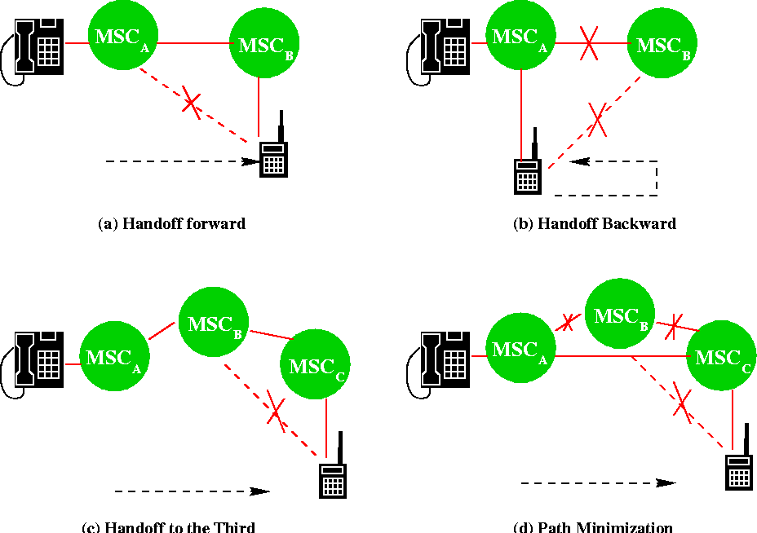
ISSUE 2: Anchor Approach (1/2)
The Anchor Approach is used in all existing mobile phone networks because the re- establishment of a new call path (without involving MSC A) between MS and the new MSC would require extra trunk release/setup operations in PSTN.

Slide 63

Anchor Approach (2/2)
If the MS moves back to MSC A again, the connection between
MSC A and MSC B is removed.
If the MS moves to the third MSC C, then MSC B will be in the call path.
Path Minimization. When the MS moves to the third MSC, the second MSC may be removed from the call path. The link between MSC A and MSC B is disconnected, and MSC C is connected MSC A directly.

Slide 64


Roaming Management
Two basic operations in roaming management are
Registration (or Location Update): the process whereby an MS informs the system of its current location
Location Tracking: the process during which the system locates the MS (this process is required when the network attempts to deliver a call to the mobile user)
The roaming management schemes proposed in IS-41 and GSM
MAP are two-level strategies
They use a two-tier system of home and visited databases that are
Home Location Register (HLR), and
Visited Location Register (VLR).

Slide 65






Home Location Register (HLR)
When a user subscribes to the services of a PCS network, a record is created in the system’s database,
which is referred as to the home system of the mobile user.
HLR is a network database that stores and manages all subscriptions of a specific operator.
The information contained in HLR includes
MS Identity,
directory number,
profile information,
current location,
validation period.

Slide 66
Visitor Location Register (VLR)
When the mobile user visits a PCS network other than the home system, a temporary record for the mobile user is created in the visitor location register (VLR) of the visited system.
The VLR temporarily stores subscription information for the visiting subscribers.
Thus, the MSC (corresponding with the VLR) can provide service to the mobile user.
The VLR is the “other” location register used to retrieve information for handling calls to/from a visiting mobile user.

Slide 67
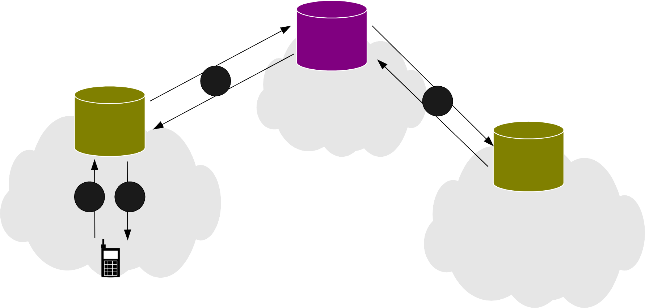
MS Registration Process (1/3)
HLR
2
Cloud
Cloud
4
New VLR
Morristown, New Jersey
Old VLR
Cloud
1
C³loud
Cloud
Los Angles, California
Cloud
New York City, New York

Slide 68





MS Registration Process (2/3)
Step 1.
Suppose that the home system of a mobile user is in Morristown. When the mobile user moves from one visited system (e.g., New York City) to another (e.g., Los Angeles), it must register in the VLR of the new visited system.
Step 2.
Part I. The new VLR informs the mobile user’s HLR of the person’s current location-the address of the new VLR.
Part II. The The HLR sends an acknowledgement, which includes the MS’s profile, to the new VLR.

Slide 69


MS Registration Process (3/3)
Step 3.
The new VLR informs the MS of the successful registration.
Step 4.
After Step 2, the HLR also sends a deregistration message to
cancel the obsolete location record of the MS in the old VLR.
The old VLR acknowledges the deregistration.

Slide 70



Call Origination Procedure
To originate a call, the MS executes the following steps.
Step 1. MS contacts the MSC in the visited PCS network.
Step 2. The call request is forwarded to the VLR for approval.
Step 3. If the call is accepted, the MSC sets up the call to the called party following the standard PSTN call setup procedure.

Slide 71
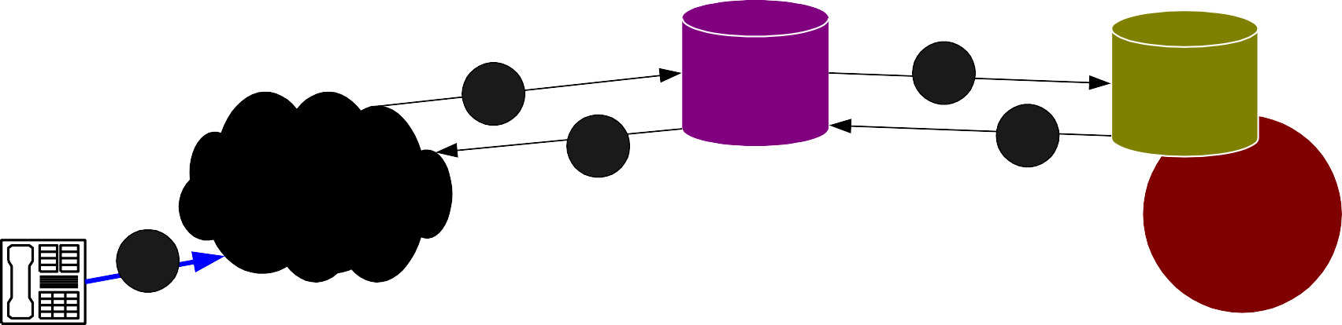
Call Delivery (Call Termination/Location Tracking) (1/3)
1
HLR
1
VLR
2
2
PSTN
MSC
1
3
3

Slide 72





Call Delivery (Call Termination/Location Tracking) (2/3)
Step 1.
Part I. If a wireline phone attempts to call a mobile subscriber, the call is forwarded to a switch, called the originating switch in the PSTN.
Part II. The originating switch queries the HLR to find the current VLR of the
MS.
Part III. The HLR queries the VLR in the which the MS resides to get a routable address.
Note that if the originating switch is not capable of querying the HLR (i.e., it is not equipped to support mobility), the call is routed through the PSTN to the subscriber’s Gateway MSC, which queries the HLR to determine the current VLR serving the MS.

Slide 73
Step 2. The VLR returns the routable address to the originating switch through HLR.
Step 3. Based on the routable address, a trunk (voice circuit) is set up from the originating switch to the MS through the visited MSC.

