Slide 1
OOPs (Object Oriented Programming) Concepts
Fresher Learning Program
January, 2013

Slide 2
Objectives of OOPs Concept
Purpose:
To understand software object, class and OOPs concepts
Product:
To understand Object; Behavior and state of object
To understand Class
Understanding of OOPs concepts like – Polymorphism, Encapsulation, Inheritance.
Process:
Theory Sessions along with a workshop on class and object identification
A review at the end of the session and a Quiz.

Slide 3
Table of Contents
Introduction To Java
All About Java
History
What is Virtual Machine?
About the JVM
Java Class Libraries
Object
Class
OOPs Concepts
Encapsulation
Inheritance
Polymorphism (Overloading, Overriding)
Advantage of OOPs
Recap

Slide 4
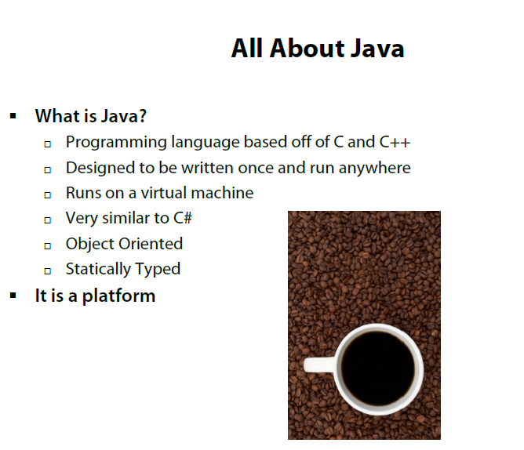
All about Java

Slide 5
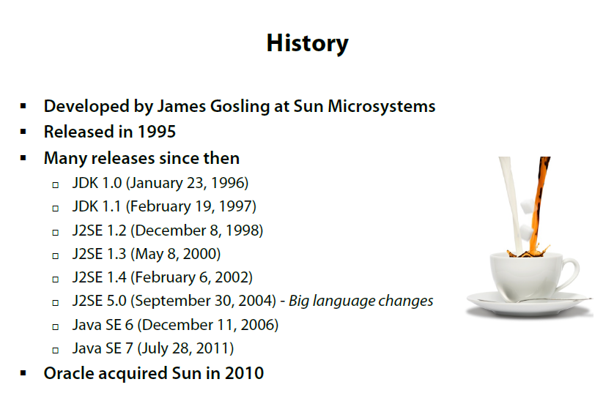
History

Slide 6
What is Virtual Machine?
Java Source
Complied Java
Virtual Machine
Virtual Machine
Virtual Machine
Operating
System
Operating
System
Operating
System

Slide 7
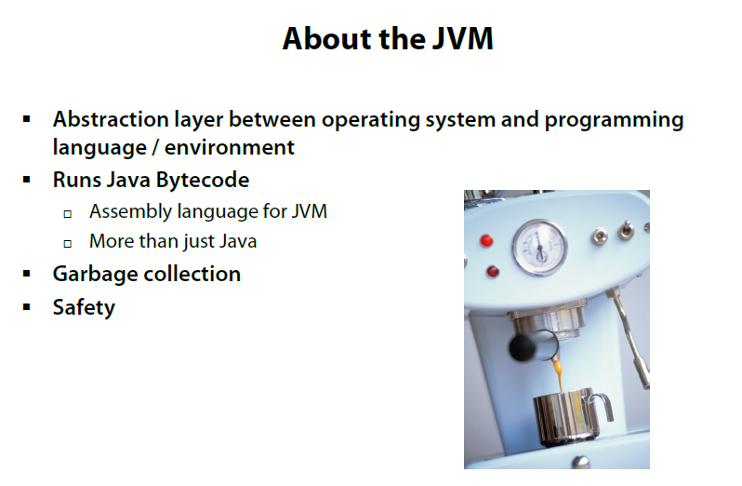
About the JVM

Slide 8
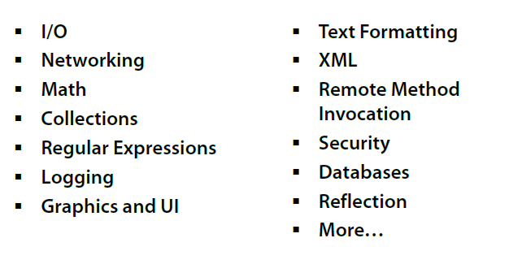
Java Class Libraries

Slide 9
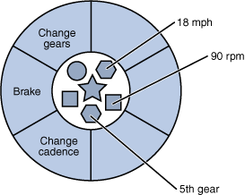
Object
REAL-WORLD OBJECTS
Share two characteristics:
They all have state and behavior.
Example – A vehicle have state (current gear, is moving, current speed) and behavior (changing gear, changing speed / accelerate, applying brakes).
SOFTWARE OBJECTS
Conceptually similar to real-world objects:
They too consist of state and related behavior.
State as fields
(variables in some programming languages) and
Behavior as methods
(functions in some programming languages)

Slide 10
Class
In the real world, you'll often find many individual objects all of the same kind.
(example - There may be thousands of other bicycles in existence, all of the same make and model.)
Each object (bicycle) was built from the same set of blueprints and therefore contains the same components.
In object-oriented terms, we say that your bicycle is an instance of the class of objects known as bicycles.
A class is the blueprint from which individual objects are created.
Name of class
Vehicle
Current Speed
Current gear
Is Moving
Change gear ()
Accelerate ()
Apply Break ()
States
Behavior

Slide 11
Workshops
Workshop 1
Consider few real-world objects (like table, car, bottle, etc)
For each object ask yourself two questions: "What possible states can this object be in?" and "What possible behavior can this object perform?"
List down states and behavior of the objects
Workshop 2
Create class diagram of object of workshop 1
(three part rectangular box - three part for its
name, states, and behavior respectively)
Name of class
Vehicle
Current Speed
Current gear
Is Moving
Change gear ()
Accelerate ()
Apply Break ()
States
Behavior

Slide 12
OOPs Concepts - Encapsulation
Hiding internal state and requiring all interaction to be performed through an object's methods is known as data encapsulation
- a fundamental principle of object-oriented programming.
Example – Change Gear () behavior of vehicle (say car). Driver just know how to change gear, but he/she has no idea of how physically gear is getting changed inside the engine.
User (driver in this example) have access of this behavior but exact changing mechanism is hiding inside engine

Slide 13
OOPs Concepts - Inheritance
Different kinds of objects often have a certain amount in common with each other.
Example – car, bike, train all are vehicle and have common state (current speed, is Moving, etc) and common behavior (accelerate, apply break)
Yet each also defines additional features that make them different
We do not need to rewrite common field and functionality (state and behavior) in every class.
Object-oriented programming allows classes to inherit commonly used state and behavior from other classes
Inheriting class termed as sub class and parent class called super class

Slide 14
OOPs Concepts - Inheritance
In the Java programming language, each class is allowed to have one direct super class,
Each superclass has the potential for an unlimited number of subclasses:
Vehicle
Car
Bike
Train

Slide 15
OOPs Concepts - Polymorphism
Some functions (behavior) of an object can be achieved by different manner
Example - a vehicle can have various types of break – air break, oil break, wire break, disc break, etc.
Now the name of function should not change on how it is achieving, but different functions of achieving it should be there in object
Object-oriented programming allows classes to overload its own function (behavior)
Name of class
Bike
Current Speed
Current gear
Is Moving
Change gear ()
Accelerate ()
Apply Break (air)
Apply Break (oil)
Apply Break (wire)
Apply Break (disc)
States
Behavior
In Bike class; the apply break functionality is overloaded

Slide 16
OOPs Concepts – Polymorphism
Some functions (behavior) of an object, which it inherited from its super class may needs to modify
Example - a specified-car class, which is sub class of car class, has inherited change gear functionality.
Now, specified-car class is an automatic car, so change gear () should be automatic.
Object-oriented programming allows classes to override function (behavior) of its super class
Object of super class will have original method, while sub class will have overridden method
Car
Current Speed
Current gear
Is Moving
Change gear ()
Accelerate ()
Apply Break ()
Specified-car
current Mode
Change gear (auto)
Change mode ()

Slide 17
OOPs Concepts – Polymorphism
Overloading and Overriding together called Polymorphism
Overloading scenario arises for functionality (behavior) within same class
Overriding case comes into picture in case of sub and super classes scenario.

Slide 18
OOPs Concepts –
To remember these OOPs concepts, remember PIE
P Polymorphism
I Inheritance
E Encapsulation

Slide 19
Workshops
Workshop 3
Create tree like structure of vehicle class and its sub classes (generalize to specialize objects).
Vehicle class will be pre-created, with three sub classes – Land, Air and Water vehicle. Divide the class into 3 group, and each group will create structure for each sub class
Vehicle
Is Moving
Current Speed
Accelerate ()
Apply Break ()
Air
Vehicle
Land
Vehicle
Water
Vehicle

Slide 20
Advantage of OOPs
Modularity:
The source code for an object can be written and maintained independently of the source code for other objects. Once created, an object can be easily passed around inside the system.
Information-hiding:
By interacting only with an object's methods, the details of its internal implementation remain hidden from the outside world.
Code re-use:
If an object already exists (perhaps written by another software developer), you can use that object in your program. This allows specialists to implement/test/debug complex, task-specific objects, which you can then trust to run in your own code.
Pluggability and debugging ease:
If a particular object turns out to be problematic, you can simply remove it from your application and plug in a different object as its replacement.

Slide 21
Recap
Behavior
PIE
Overloading
Encapsulation
Instance of a class
State
Overriding
Software Object
Notes:
Recap – tips : To make it further lighter, many facilitator ask participant that they were allow to leave only if they will answer say 12 correct answers out of 15 questions. And then produce all recaps as questions.

Slide 22
Thank You For Your Time

