Slide 1
Product Recommendation System for E-Commerce using Collaborative Filtering and Content Based Filtering
Aadithya pabbisetty -245318733061
Unnathi kunchakuri -245318733095
Sirispandana velagala- 245318733117
Internal Guide : Mr. P.Nageswara Rao
(Assisstant Professor)

Slide 2
Content
Introduction
Problem Statement
Background
Proposed Solution
Work-flow
Future Work
References
Conclusion

Slide 3
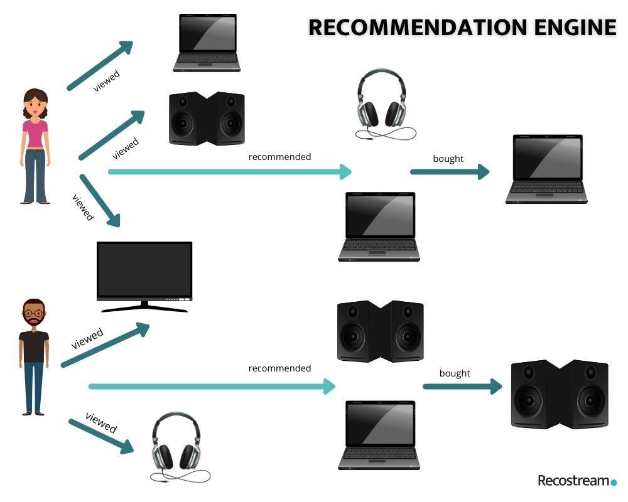
What is a recommendation engine?

Slide 4
Problem Statement
Providing related content out of relevant and irrelevant collection of items to users.
Product Recommendation System aims to recommend products to users based on user-items (item) ratings.
Given a set of users with their previous ratings for a set of items, can we predict the rating they will assign to a item they have not previously rated?

Slide 5
EXISTING SYSTEM
Here we present several different e-commerce recommender system approaches and their advantages or disadvantages. We see recommendation systems utilizing data mining techniques, clustering analysis (in which the system focuses on customer’s comments and reviews), Dynamic Table based approach which takes into account the customer’s life cycle for his recommendations, mining user-contributed photos, and using visual and UGC for user interest mining, Fuzzy logic, portal. One of the main conclusions is that the mentioned systems aim to enhance conversion rate (the buying part of recommendations) by providing more personalized recommendations.

Slide 6
Proposed system
This proposed recommendation system will use model-based collaborative filtering and will recommend products based on the rating and previous purchase history of the users. Also, the new users will get recommendations of new products, popular products, and products on sale. Since we're setting up a new e-commerce website, initially we won't have user ratings on the different products, so in this case, we will be making recommendations based on the textual clustering analysis of product descriptions. The proposed E-Commerce website is having two views- one for the admin and the other for the users or buyers.

Slide 7
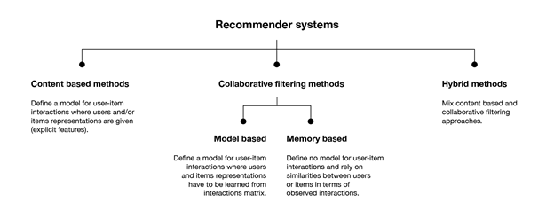
Problem Background

Slide 8
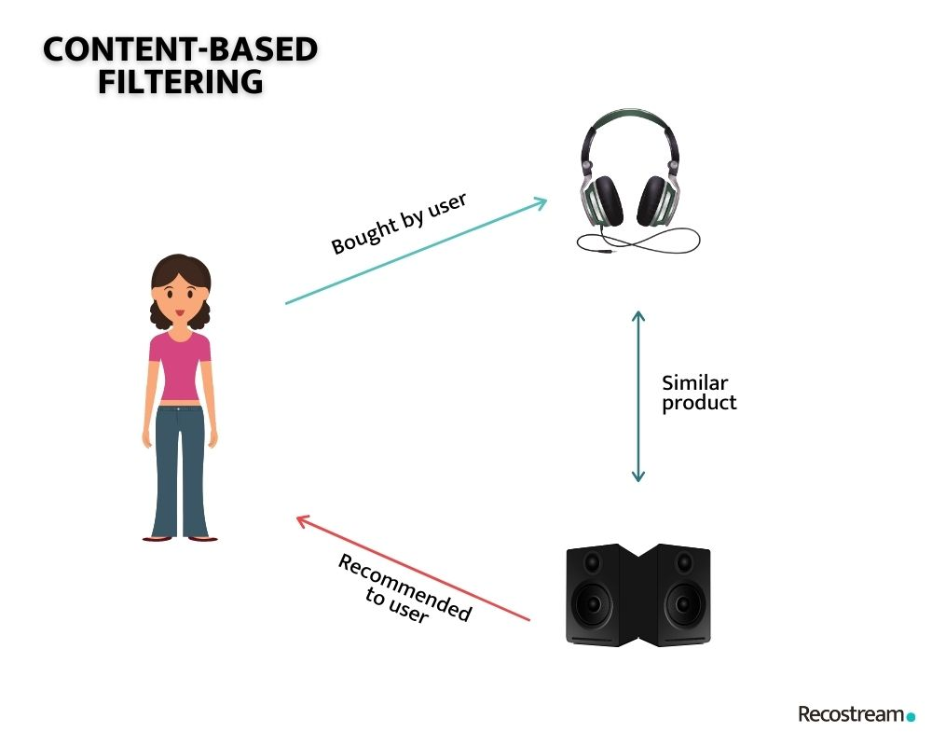
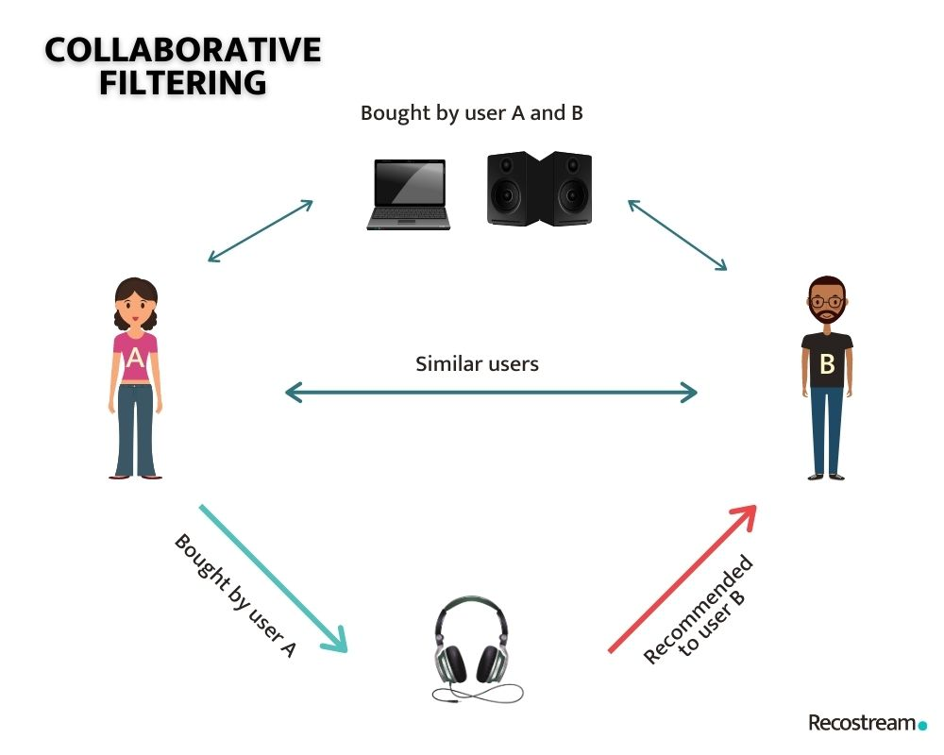
Content based filtering
Collaborative based filtering

Slide 9
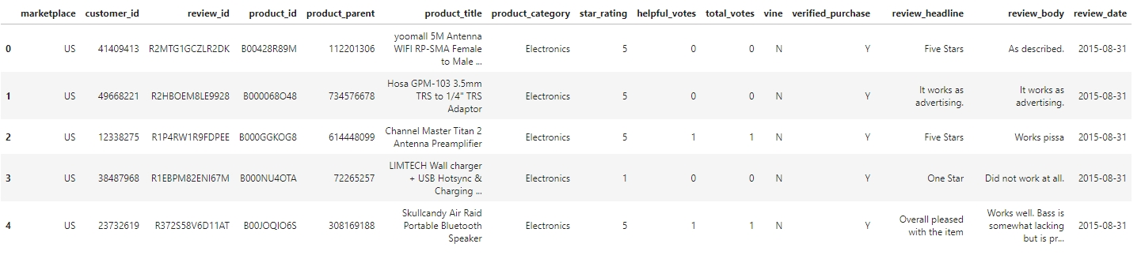
Dataset
Datafiniti_Amazon_Consumer_Reviews_of_Amazon_Products.csv is a data set that provides user ratings on Products.

Slide 10
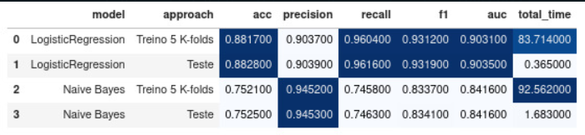
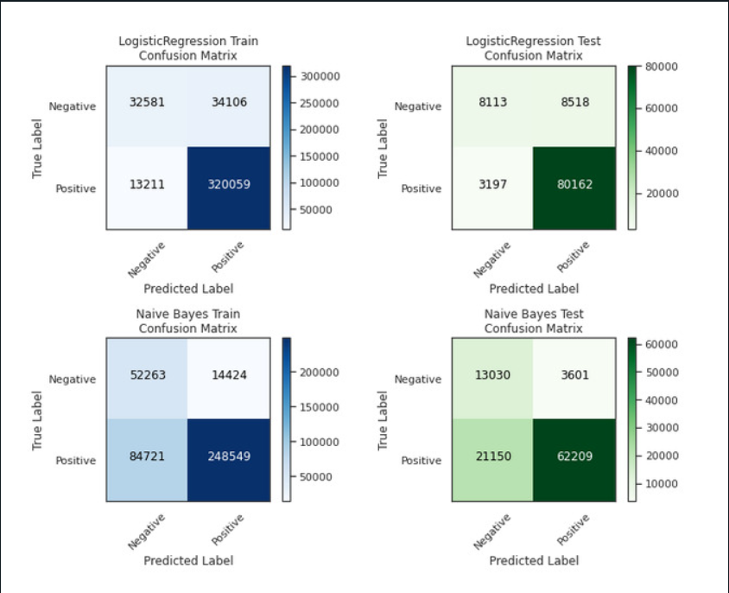

Slide 11
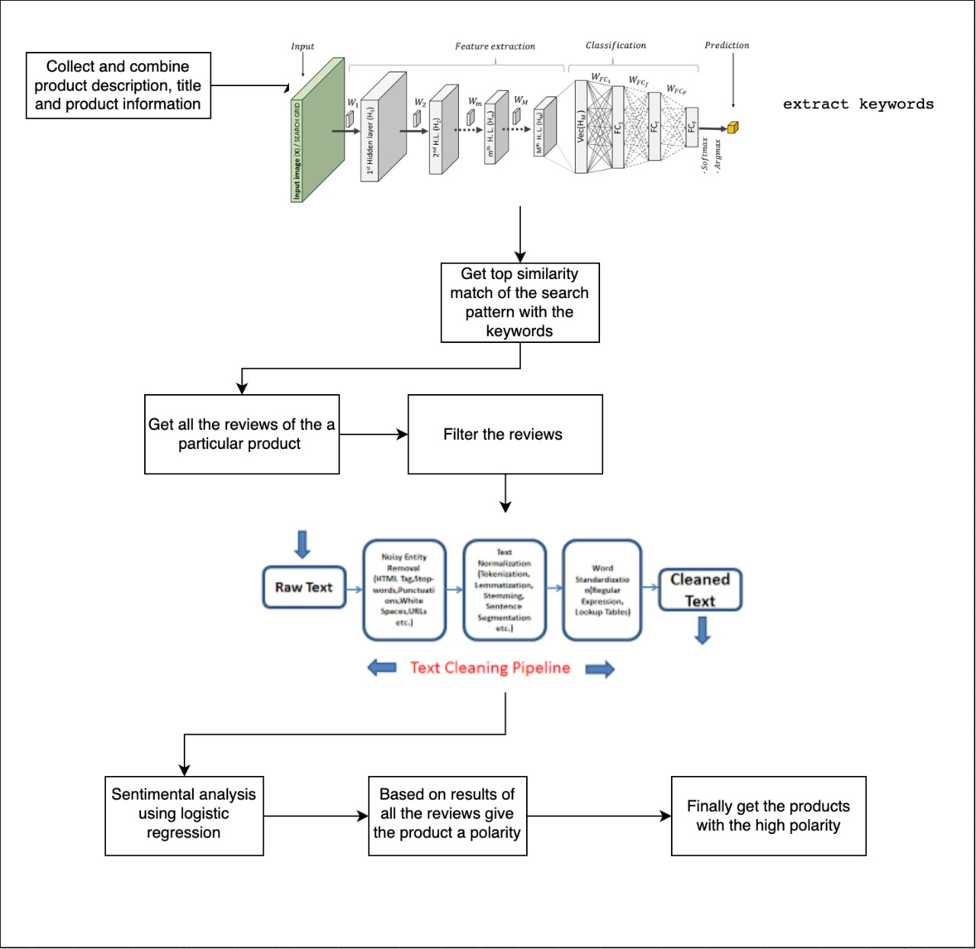

Slide 12
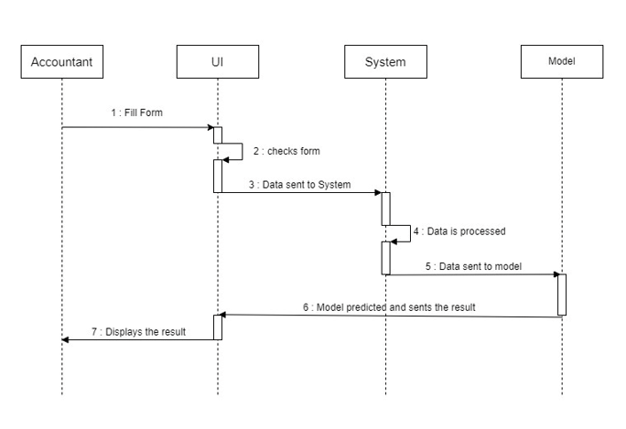
Sequence diagram

Slide 13
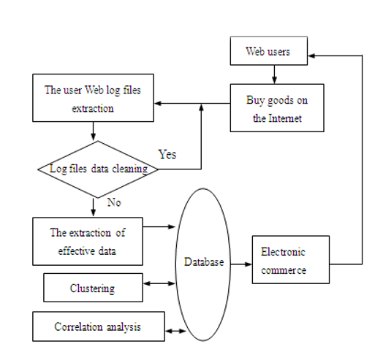
State diagram

Slide 14
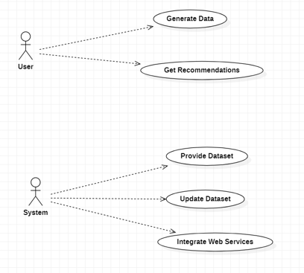
USE case diagram

Slide 15
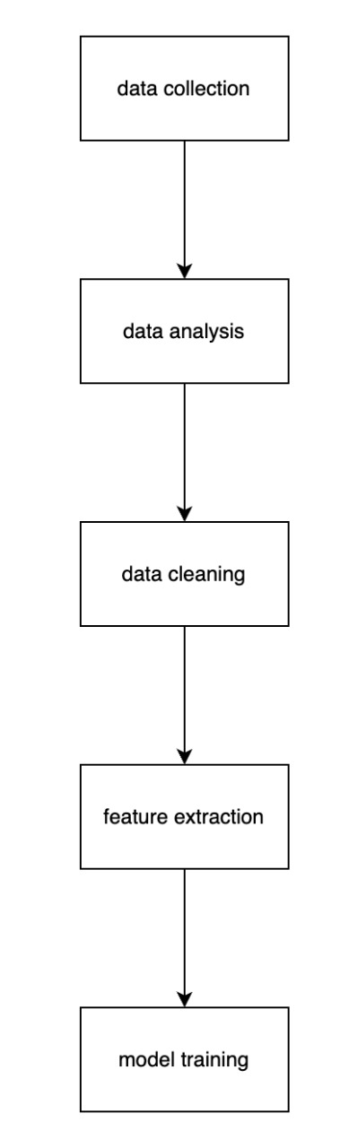
Work-flow

Slide 16
Future work
In future, we would like to collect data about product description, extract keywords from product information for cosine similarity and use it for content based filtering to produce more efficient recommendation system.
Add filtering techniques like whether reviews are Spam or not.
Including products reviews of users in data, only when the product has been bought by them.

Slide 17
References
https://docs.streamlit.io/
https://www.kaggle.com/datasets/sayantanmukh/consumer-reviews-of-amazon-products
https://www.kaggle.com/datasets/promptcloud/amazon-product-dataset-2020
https://developers.google.com/machine-learning/recommendation/content-based/basics
https://developers.google.com/machine-learning/recommendation/collaborative/basics

Slide 18
Conclusion
Recommendation systems provide content for us by taking what other people recommend as well as our selections into account
Collaborative Filtering is a widely used solution for this problem which we make use of in our project

Slide 19
Thank you

