Slide 1

Customer service chatbot
(Xfinity – Bot)
Team – C :
Gayathri P
Nithya Balaji
Padmavathi
Rithvika Alapati
Siri Chandana
Mentor :
Prathamesh Jagdish Kulkarni

Slide 2
Problem Statement
Customer support teams struggles with manual query handling leading to :
Delayed responses
Overburdened agents
Inconsistent responses

Slide 3
Why This Matters
Declining customer satisfaction
Rising operational costs
Scalability challenges slowing growth
Automation is critical to streamline operations and enhance customer engagement

Slide 4
The Solution : AI-Powered Customer Support Chatbot
How it solves the challenges :
Automates query handling
Uses sentiment analysis
Categorizes query (General vs. Complaints)
Retrieves answers from Knowledge base
Stores Customer Interactions and Details

Slide 5
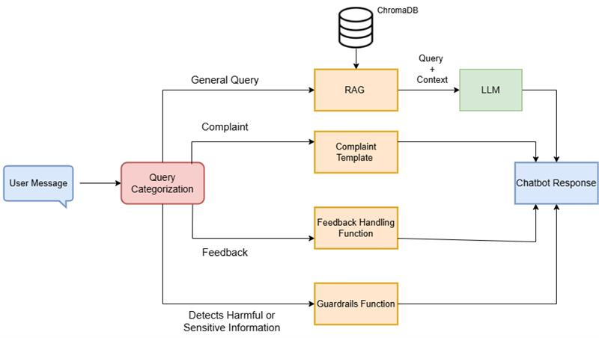
How the Chatbot Works (High-Level Design)

Slide 6
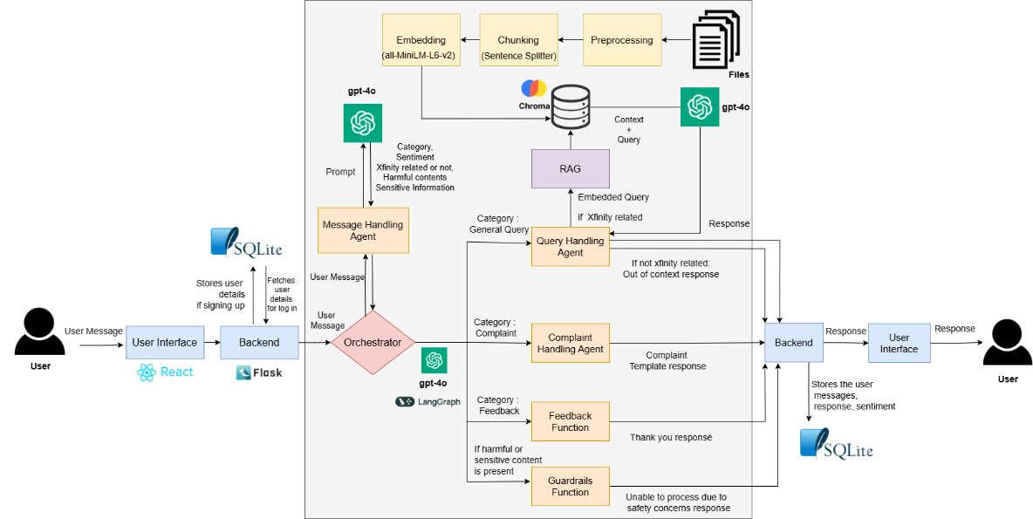
Chatbot’s Backend Processing (Low-Level Design)

Slide 7







Technology Stack
Frontend
Backend
Databases
React
FLASK
Python
Chromadb
SQLITE
LLM Orchestration and Agents
GPT – 4O
Lang Graph

Slide 8
Evaluations

Slide 9
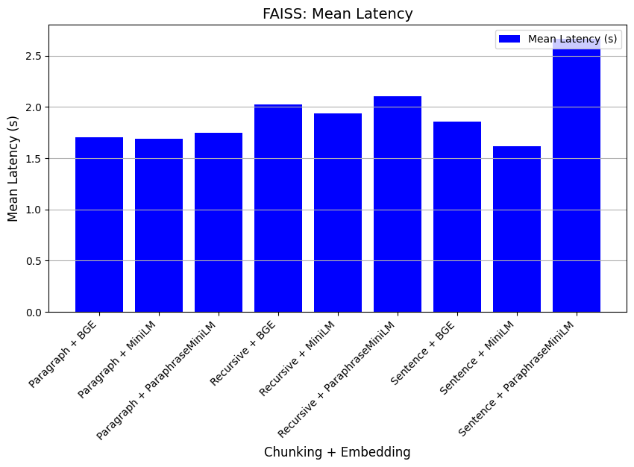
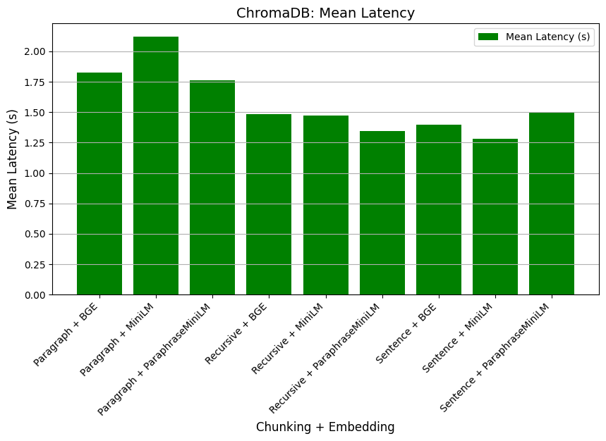
Comparison of Vector Databases, Chunking & Embedding Strategies

Slide 10
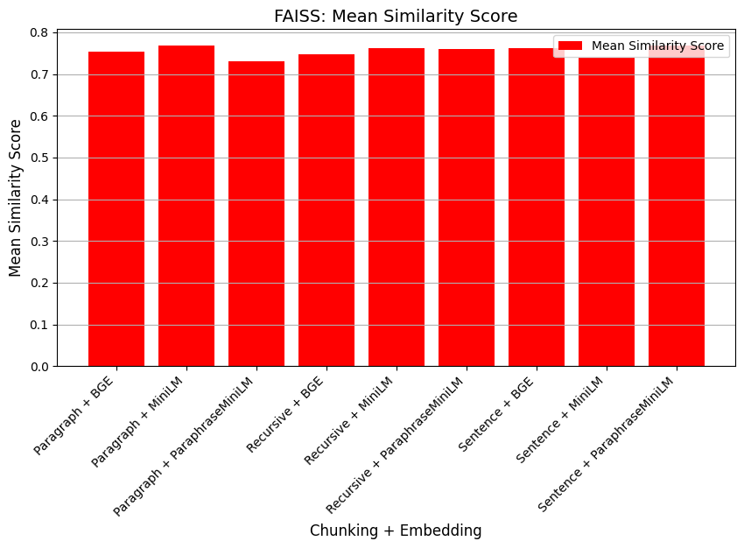
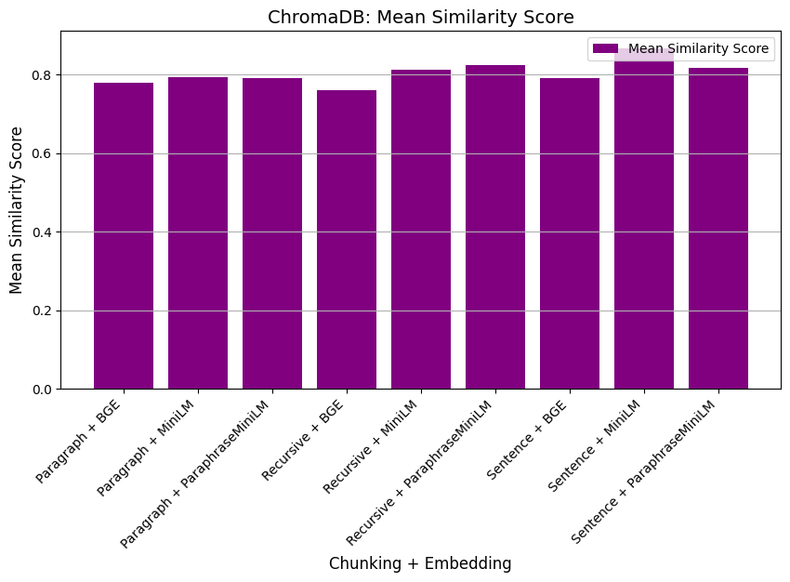
Comparison of Vector Databases, Chunking & Embedding Strategies

Slide 11
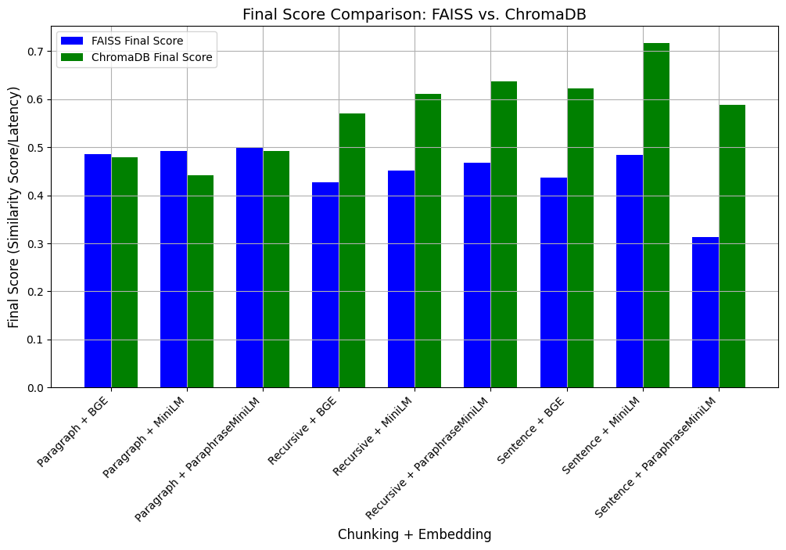
Comparison of Vector Databases, Chunking & Embedding Strategies

Slide 12
DEMO

Slide 13
Future Work
Multimodal Support
Multilingual Support
Agent Dashboard
Guardrails

Slide 14
Thank you !

