Slide 1


Customer service chatbot
(Xfinity – Bot)
Team – C :
Gayathri P
Nithya Balaji
Padmavathi
Rithvika Alapati
Siri Chandhana
Mentor :
Prathamesh Jagdish Kulkarni

Slide 2

Problem Statement
Customer support teams struggles with manual query handling leading to :
Delayed responses
Overburdened agents
Inconsistent responses
PAGE
2

Slide 3
Why This Matters
Declining customer satisfaction
Rising operational costs
Scalability challenges slowing growth
Automation is critical to streamline operations and enhance customer engagement
PAGE
3

Slide 4
The Solution : AI-Powered Customer Support Chatbot
How it solves the challenges :
Automates query handling
Uses sentiment analysis
Categorizes query (General vs. Complaints)
Retrieves answers from Knowledge base
Stores Customer Interactions and Details
PAGE
4

Slide 5
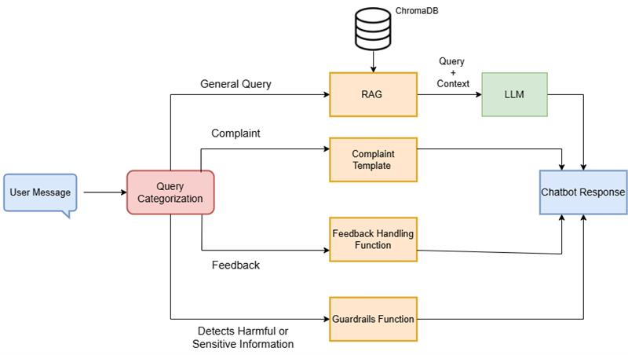
How the Chatbot Works (High-Level Overview)
PAGE
5

Slide 6
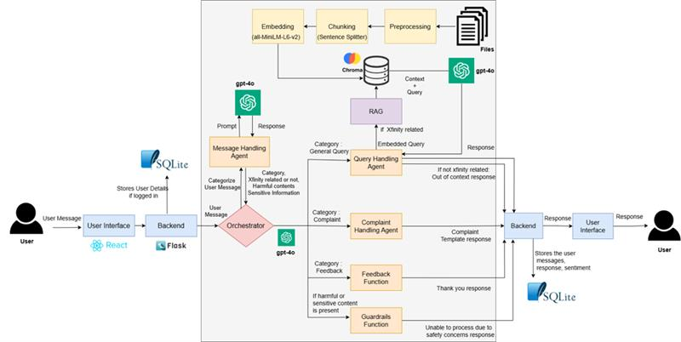
Chatbot’s Backend Processing (Low-Level Overview)
PAGE
6

Slide 7
How Data Powers the Chatbot
Data | Source | Processing | Usage
Xfinity Policy Knowledge Base (Primary data source) | Scraped from https://www.xfinity.com/terms/web | Preprocessed -> chunked -> embedded -> stored in Vector database (Chromadb) | Retrieval-Augmented Generation (RAG) fetches answers for user queries
User Interaction Data (Collected over time ) | Queries from Users , Chatbot responses , Sentiment Analysis Results , Complaint Logs | Logged in SQLite database | For tracking and analytics Stored for agent dashboard Used for trend Insights
Pre-stored knowledge base in vector database enables fast and accurate query resolution
User data is logged over time to refine chatbot accuracy and improve customer service
Complaint tracking ensures users agents can review unresolved issues efficiently
PAGE
7

Slide 8

Technology Stack
Frontend
BACKEND
FLASK , LANGCHAIN, LANGRAPH,CHROMADB, SQL LITE
React
PAGE
8

Slide 9
Evaluations

Slide 10
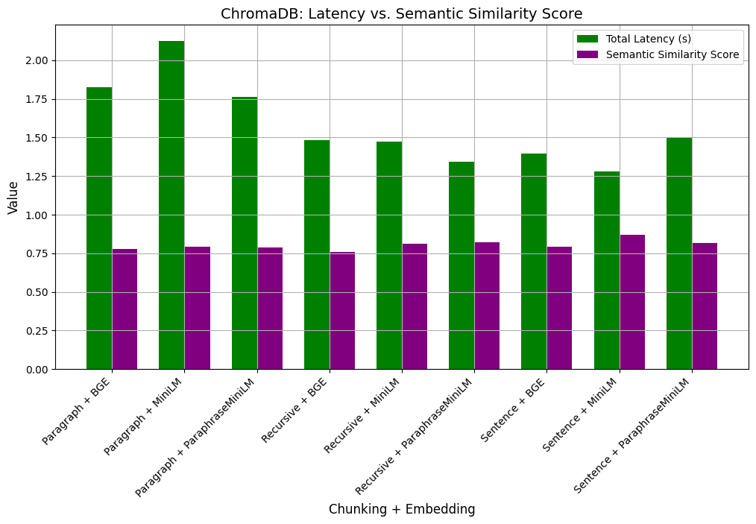
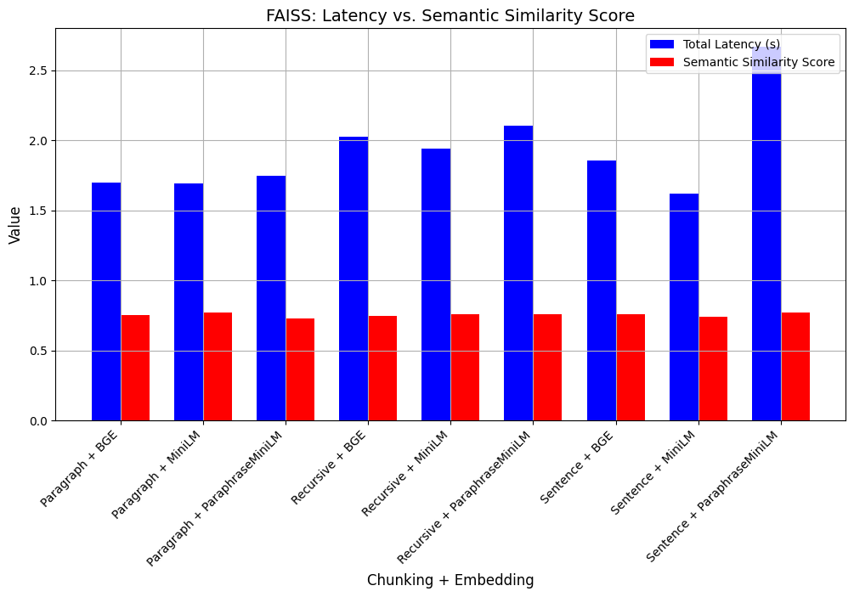
Comparison of Vector Databases, Chunking & Embedding Strategies
PAGE
10

Slide 11
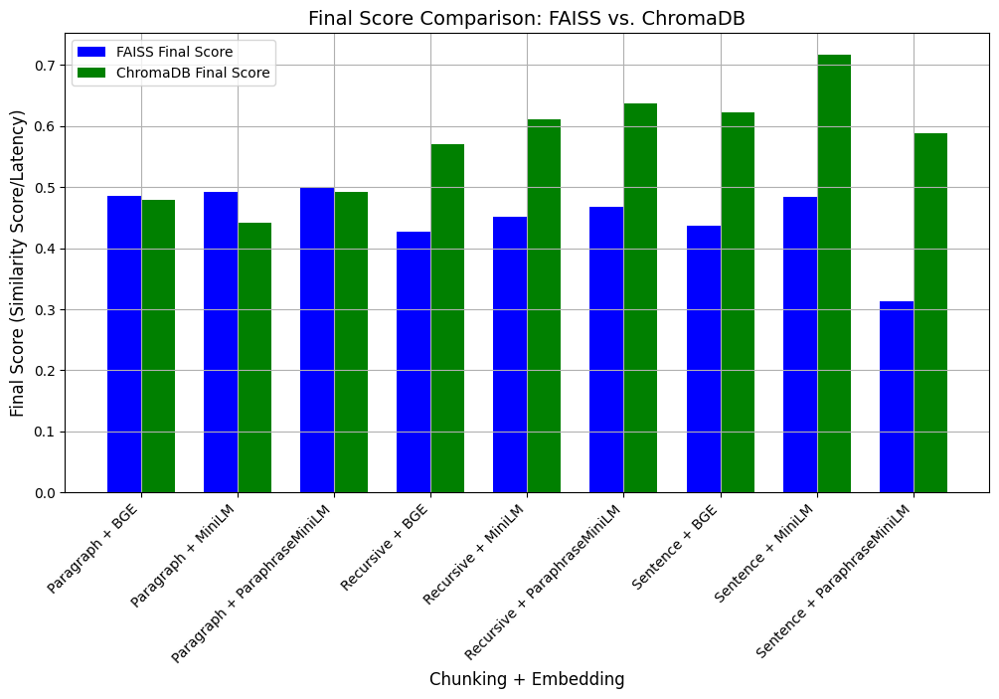
Comparison of Vector Databases, Chunking & Embedding Strategies
PAGE
11

Slide 12
DEMO

Slide 13
Future Work
Multimodal Support
Multilingual Support
Agent Dashboard
Data masking
PAGE
13

Slide 14
Thank You!
PAGE
14

Slide 15



Chatbot Features
Task Automation
Fallback Mechanism
Emotion Recognition
Chatbots can be programmed to perform specific tasks, such as making reservations, providing information, or guiding users through processes.
In cases where the chatbot doesn't understand a user's input, a fallback mechanism allows it to provide a default response or ask clarifying questions.
Advanced chatbots may incorporate emotion recognition to understand and respond appropriately to the emotional tone of the user.

Slide 16

Customer Service and Support
Automation of Repetitive Tasks
Chatbots aid customer service, offering instant responses and 24/7 availability for common queries and assistance.
Chatbots automate tasks like scheduling, tracking orders, and retrieving information, streamlining routine operations.
Several Key
Cost Savings
Scalability
Chatbot automation cuts costs by handling routine tasks, streamlining operations, and reducing support teams.
Chatbots scale efficiently, managing numerous conversations without proportional resource increase, ideal for engagement spikes.

