Slide 1
Control Theory Group Project
Project#2: Radar Control in 3-dimensional space

Slide 2
To simulate a target tracking system for a radar in 3-dimensional space controlled by changes in azimuth and elevation angles using two respective servo motors. Track a a traget taking a horizontal flight at an altitude of 10 km
Challenge:

Slide 3
Approach and Methodology

Slide 4
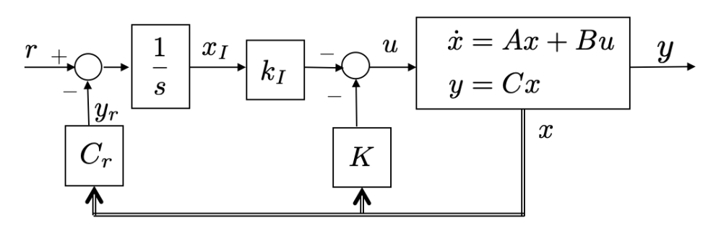
Procedure
To design a target tracking system, of realistic standards:
We need to create a model the accounts for disturbance and is not prone to error. To have such a model, we upgrade our controller with an integrator.
We add an observer to the system to sustain the controller with the input output ratio.
In a realistic model we also have to take into account the physical limitations of movement of the motors.

Slide 5
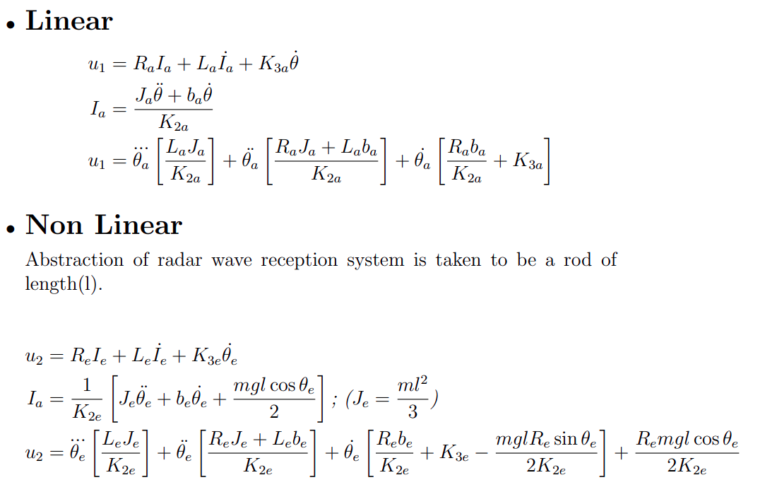

Slide 6
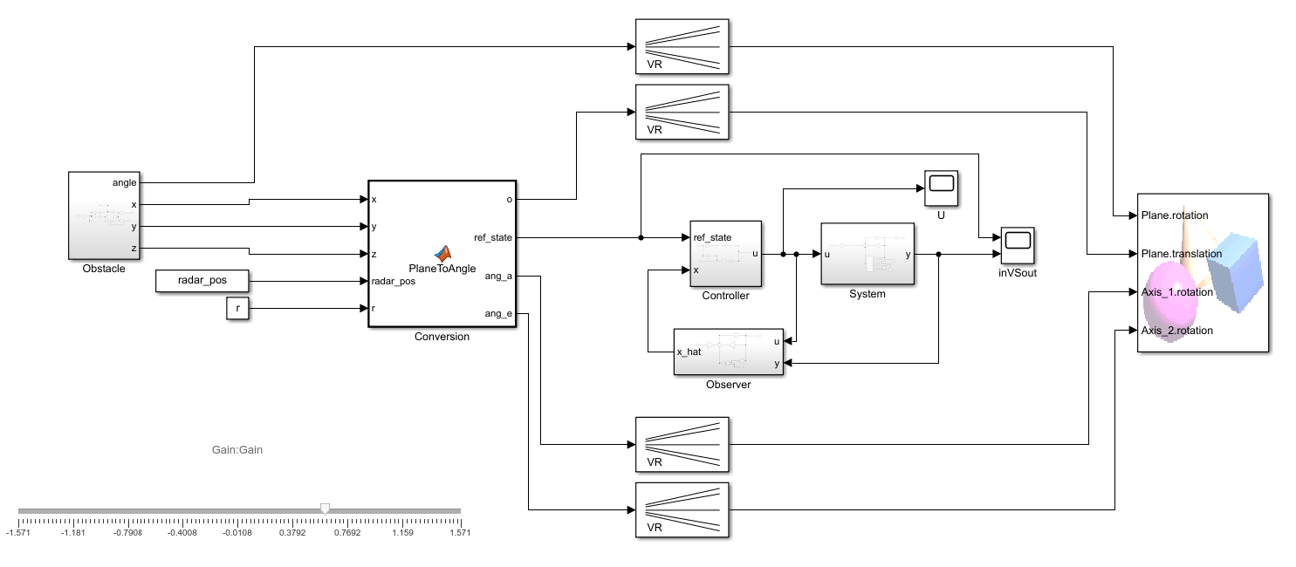
Simulink Model

Slide 7
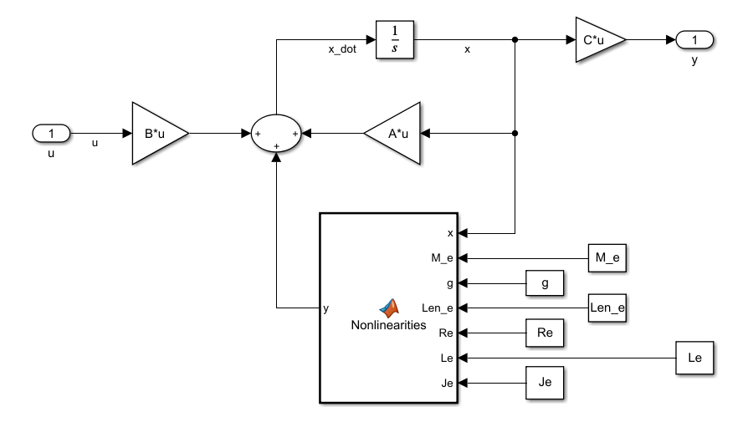
System

Slide 8
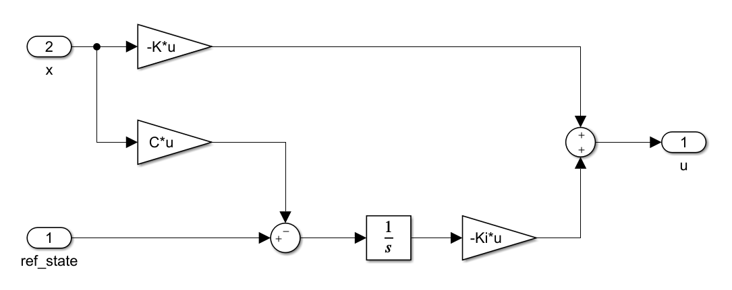
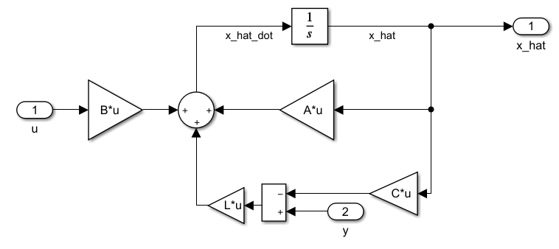
Controller
Observer

Slide 9
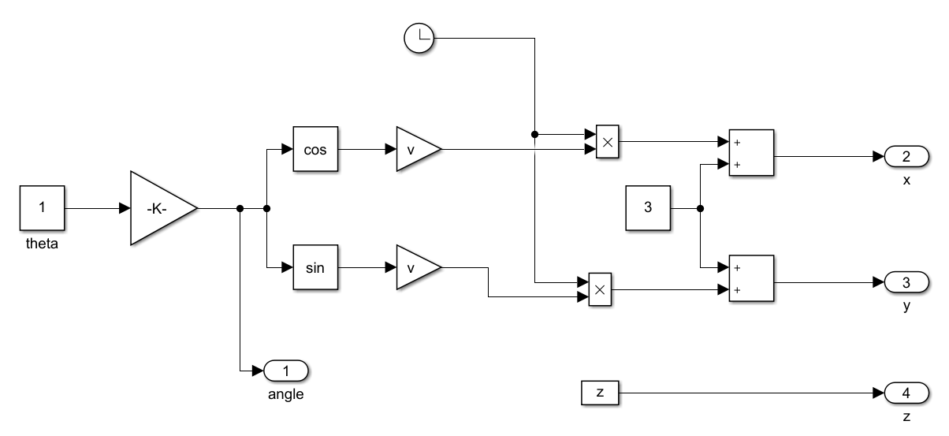
Object Manipulation

Slide 10
Result

Slide 11
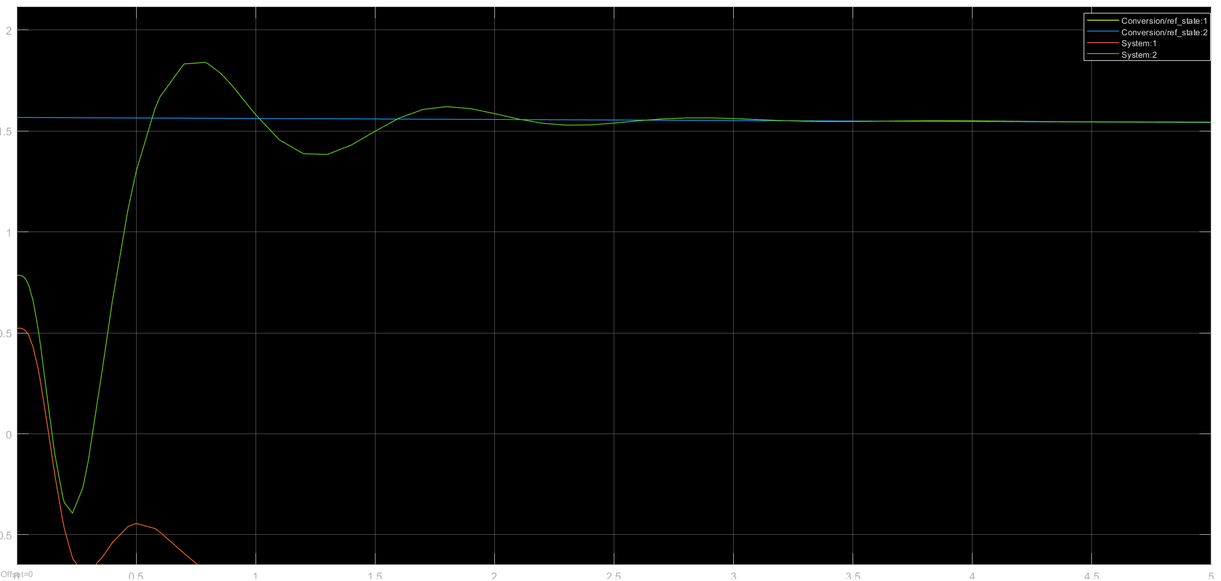
Input vs Output (first 5 seconds)

Slide 12
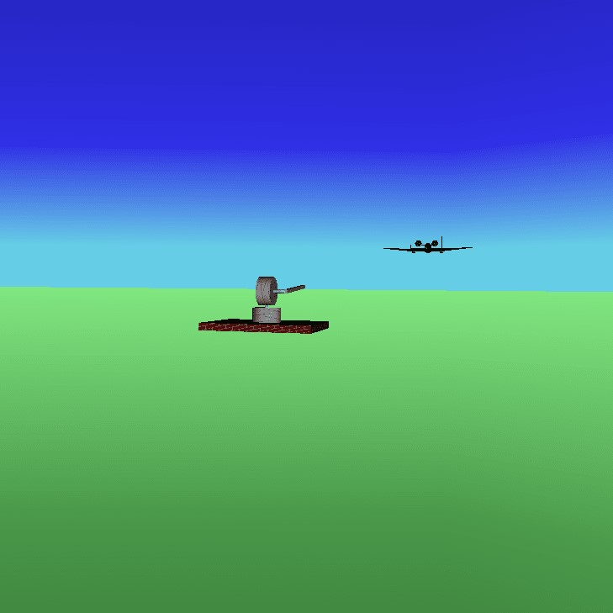
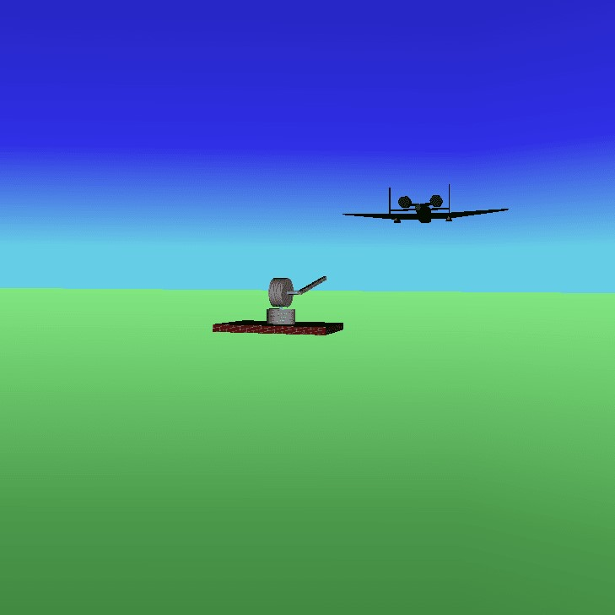
Simulation Screenshots

Slide 13
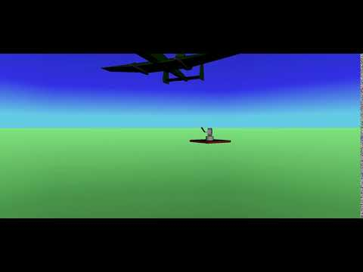
Simulation Glimpse

Slide 14
By:
Lavanya Verma [2018155]
Jayant Chhillar [2018151]

