Slide 1

STAT 639: Data Mining
Group 19
Anshul Sharma
Kushagra Jain
Udhav Gupta

Slide 2
Classification Problem
Implemented different classification models using data preprocessing techniques
Used techniques: scaling(min-max/robust), feature selection(recursive feature selection), dimensionality reduction (PCA)
Models Used: KNN, SVM, Naive Bayes, Random Forest & Boosting
Evaluated these models on the basis of model accuracy and misclassification error

Slide 3
KNN
Intuition - it's a non-parametric classification algorithm that does not make assumptions about data distribution
Implementation - hyperparameter tuning, using a hyperparameter grid for K values (k = 5:15) and cross-validation for fold size (5 to 30)
Results - got 75.26% accuracy with K = 9 and folds = 13.

Slide 4
SVM
One advantage of SVMs is that they are less prone to overfitting than other machine learning algorithms when the number of features is high.
SVMs work by identifying a hyperplane that separates the data into classes. In high-dimensional space, the hyperplane can be found even when the classes are not easily separable in lower dimensions.
With sigma = 10 and C = 0.01 we get accuracy of 53.5%.

Slide 5
LDA
LDA is particularly useful when the number of features is high relative to the number of samples, as it can help reduce the dimensionality of the data while retaining the most discriminative information.
With 26 fold cross validation we got an accuracy of 57.2%.

Slide 6
Naive Bayes
Intuition - as mean correlation of features is low, this seems like a good approach to try
Implementation - use naive_bayes api from caret package to train the model, selected the best fold combination based on accuracy,
Results - obtained 62.3% accuracy and fold value of 6

Slide 7
Random Forest
Intuition - decision tree based model which can handle a large number of features
Implementation - we use recursive feature selection for selecting optimal number of features, tune the hyperparameters using nested cv
Results - obtained accuracy of 68.5% and mtry = 23

Slide 8
Boosting
Intuition - it is a model ensemble technique which combines base models and can improve performance
Implementation - tuned the hyperparameters using “xgbTree” in train, predicted the response variable using optimal hyperparameters
Results - obtained accuracy of 72% with max_depth = 9 and nrounds = 100

Slide 9
Ensemble Model
Idea is to combine the predictions from multiple models, and vote for the prediction value on test data.
Combined KNN, Random Forest and Boosting to create an ensemble model.
Achieved Accuracy of around 72.5%.

Slide 10
Clustering Problem
Dataset - 784 dimensions and 1000 observations
Preprocessing: used PCA to take features which explain 95% of variance after scaling features across all dimensions
Result - reduced dimensionality from 784 to 250
Finding optimal number of clusters
Performing clustering algorithms

Slide 11
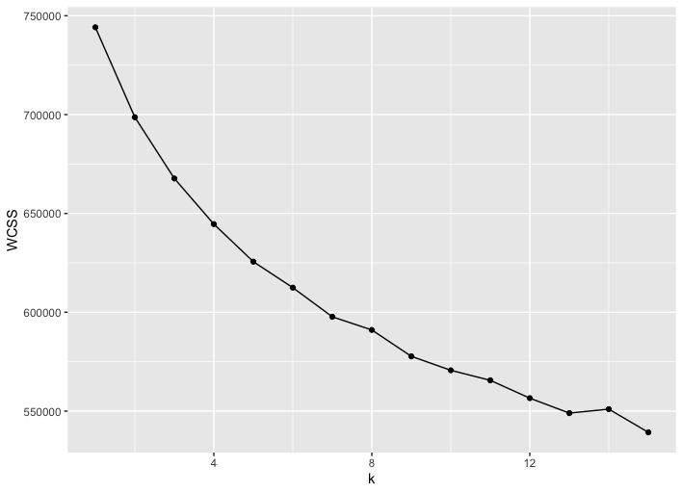
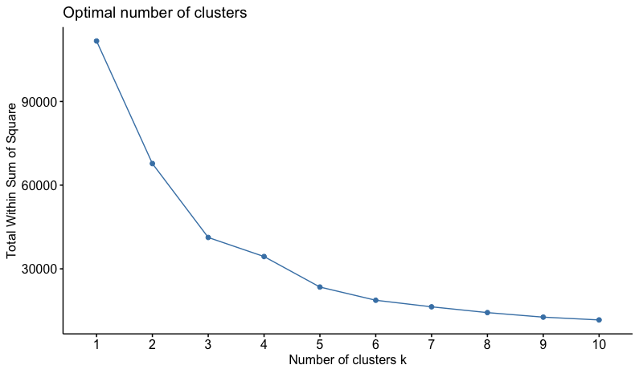
Elbow Method
Results for Elbow method are inconclusive for the pca processed data (having 250 dimensions, explaining 95% variance)
After taking the two dimensions contributing to the most variance, we can see “elbow” in the plot in contrast to above case

Slide 12
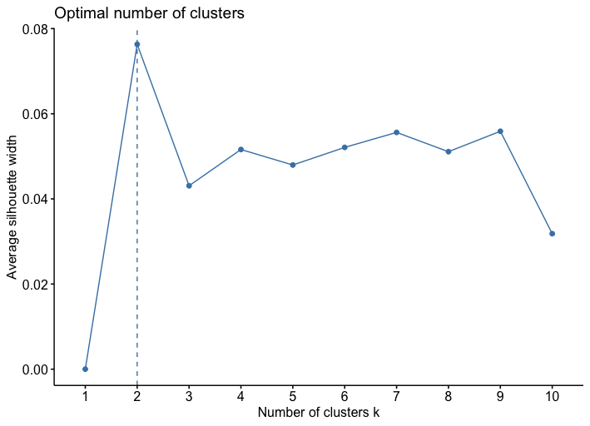
Silhouette Method
It measures how similar an object
is to its own cluster compared to
other clusters.
In general, a higher silhouette
score indicates better clustering,
and a K value that produces a
higher average silhouette score is
preferred

Slide 13
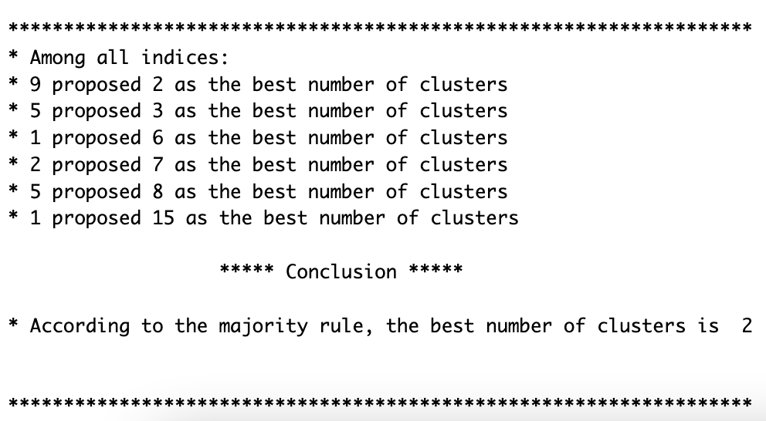
NbClust
NbClust is an R package that
offers a variety of methods for
determining the optimal number
of clusters in a dataset.
The NbClust function computes multiple clustering solutions for different values of K, and provides a recommended value of K.

Slide 14
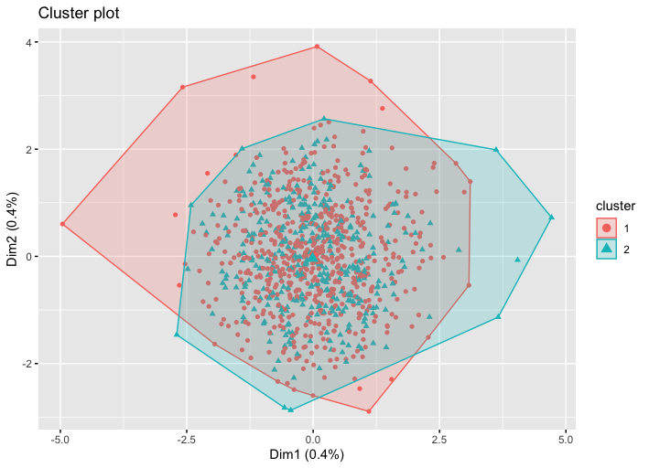
K-means Clustering
Minimizes the sum of squared distances
between the observations and their
assigned cluster centers. Re-computes
the center of each cluster, repeating
this process until convergence.
Also, used the PAM (Partitioning Around Medoids) algorithm [a more robust form of k-means] and obtained similar clusters

Slide 15
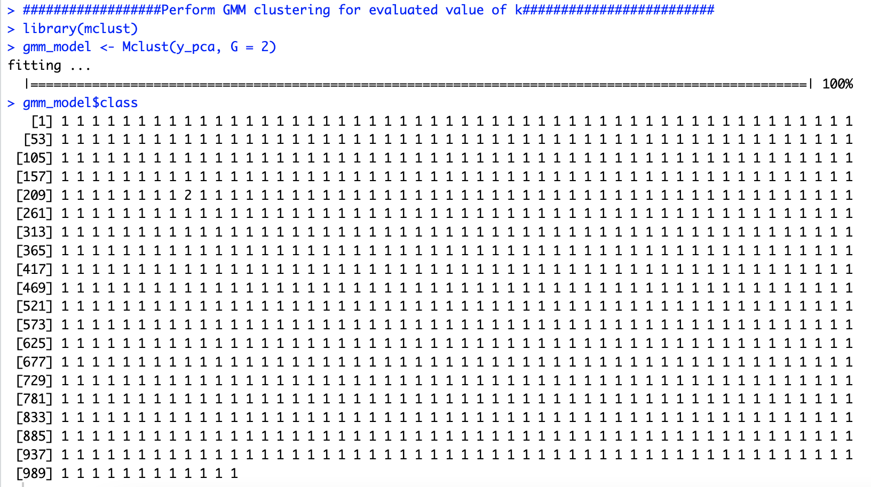
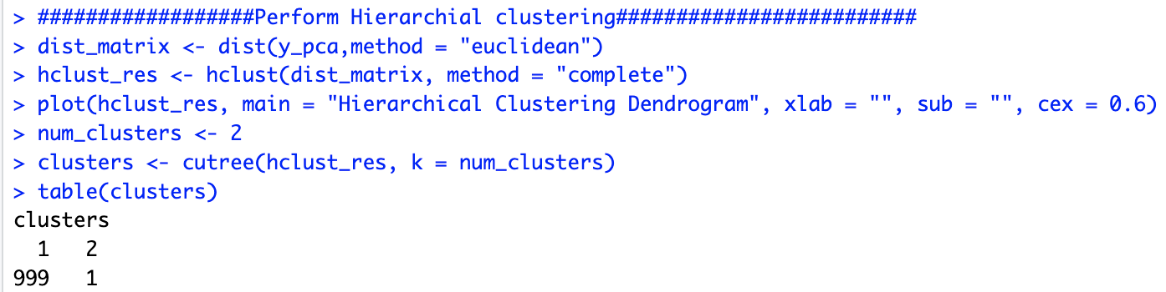
Hierarchical and GMM Models
For k=2 clusters, both algorithms not able to partition data in significant datapoint in both clusters.

Slide 16

Thank You!

