Slide 1
Manuscript images

Slide 2
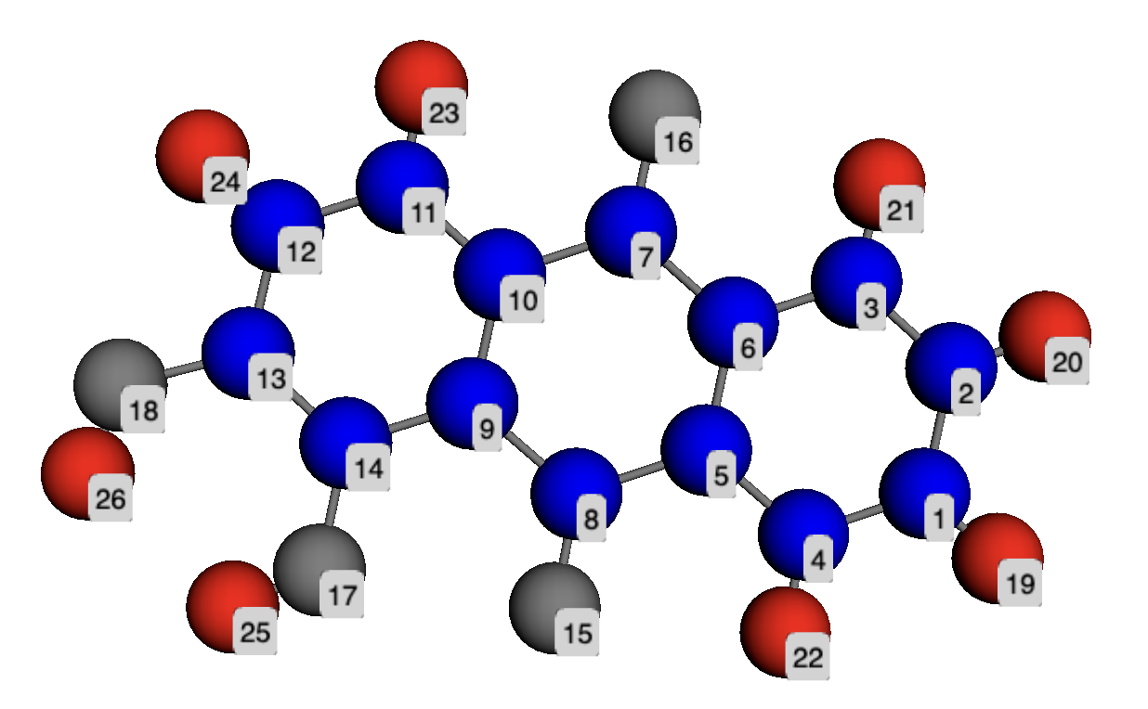
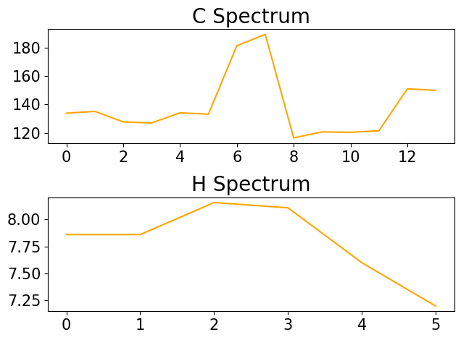
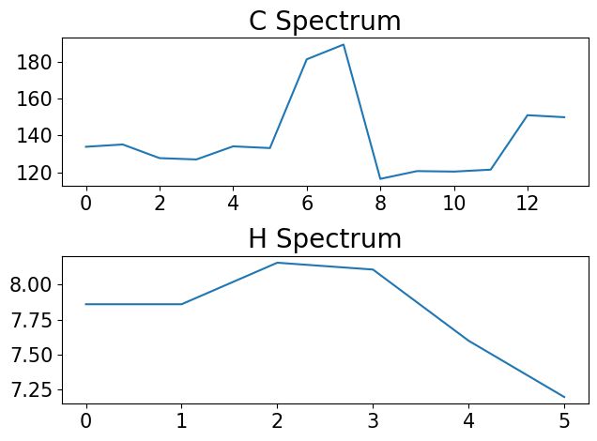
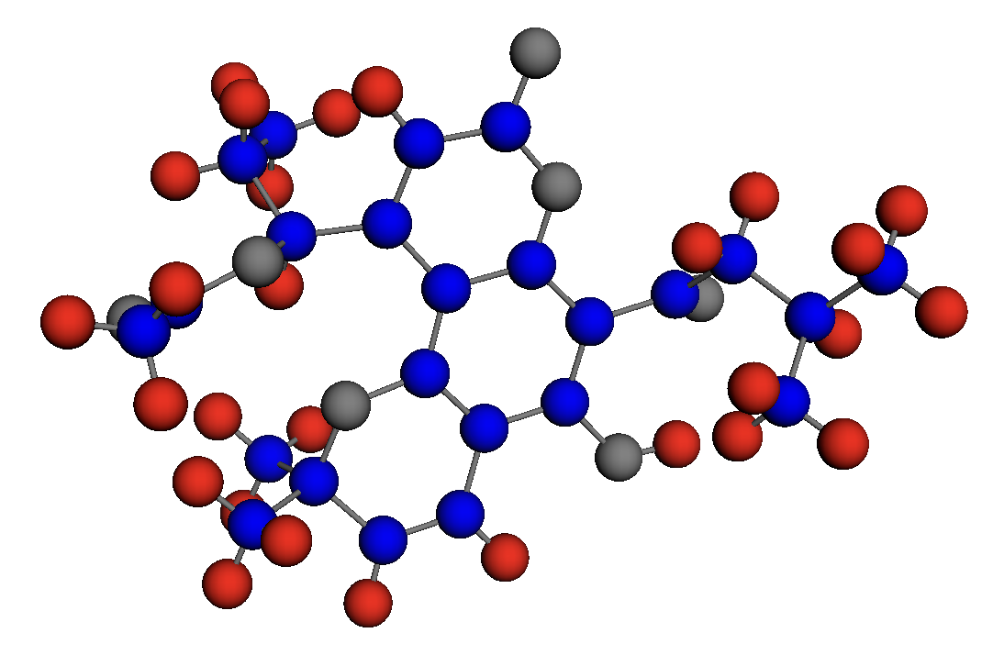
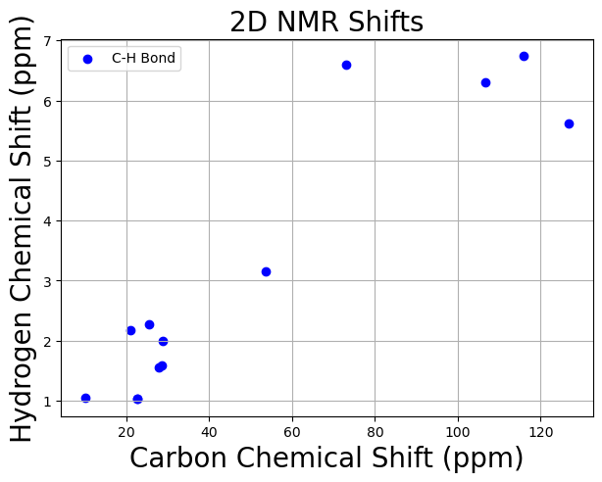

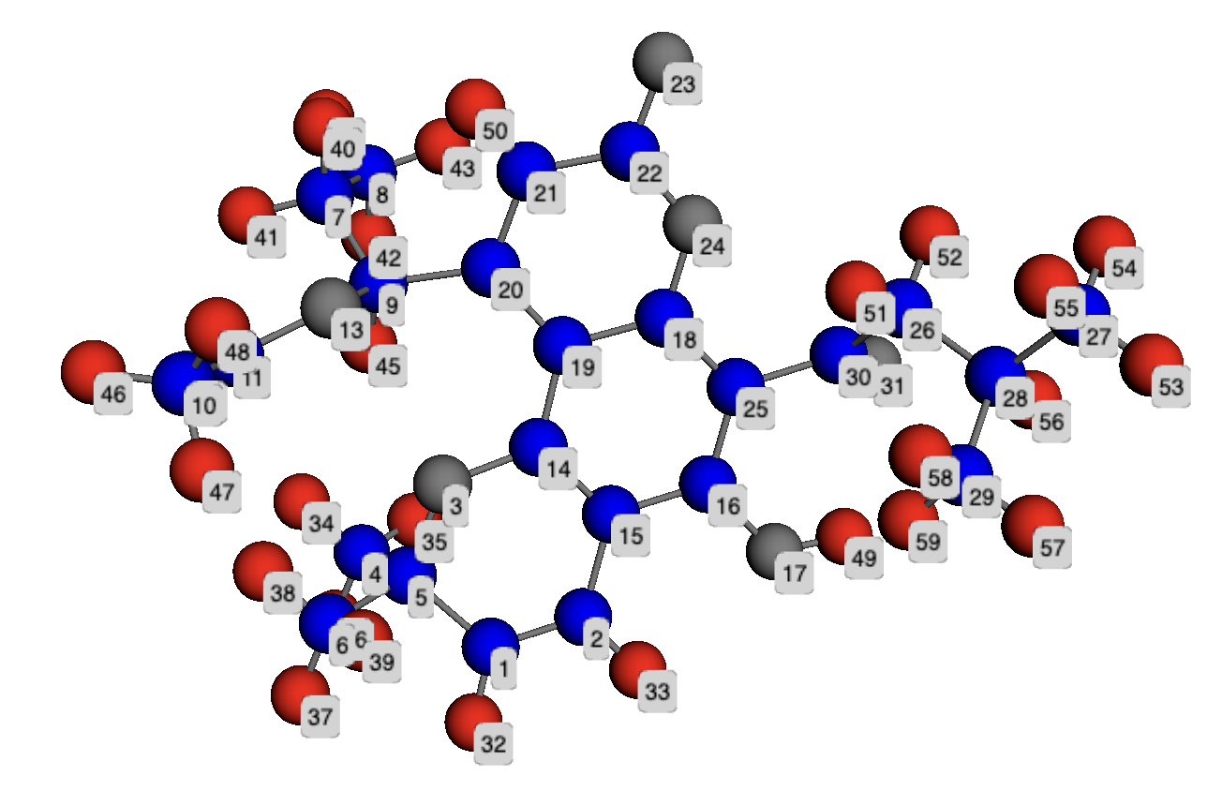
C features
GNN
OR
H features
Copied parameter
as initialization
Predicted C/H Spectrum
GNN
Predicted 2D
C - H Spectrum
Pseudo
alignment labels
Iterative matching with
observed 2D NMR signals to obtained refined labeling

