Slide 1
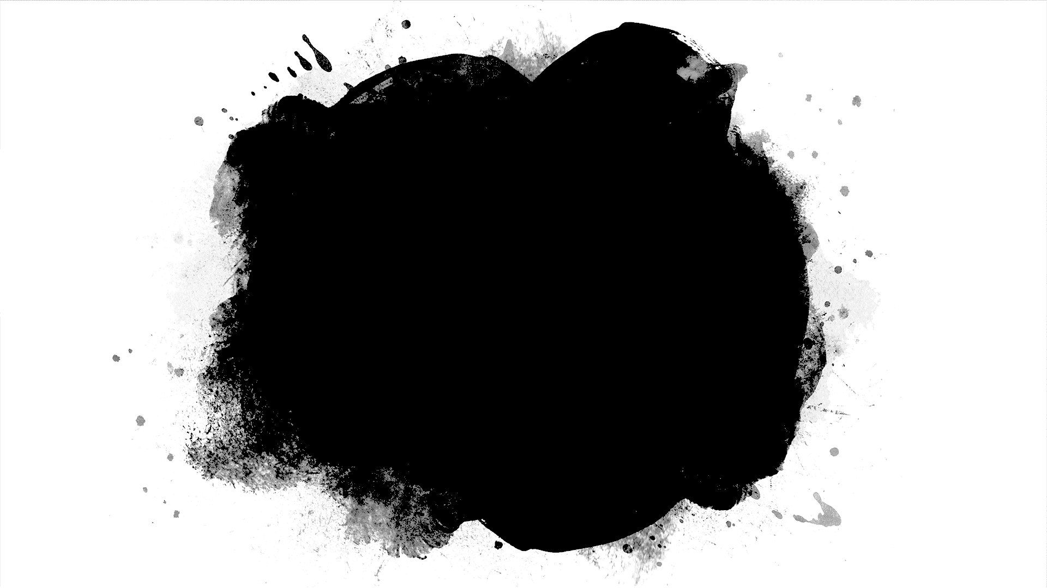
Fashion_MNIST
- Siri Vennela Chervela

Slide 2
Fashion-MNIST is a dataset of Zalando's (http://www.zalando.com) article images —consisting of a training set of 60,000 examples and a test set of 10,000 examples. Each example is a 28x28 grayscale image, associated with a label from 10 classes. Fashion-MNIST serves as a direct drop-in replacement for the original MNIST dataset for benchmarking machine learning algorithms. It shares the same image size and structure of training and testing splits.

Slide 3

OBJECTIVE
The objective of the project is to use Fashion-MNIST data set to identify the different fashion products from the given pictures using various best possible models (ML algorithms) and report the values of the performance measures for different models.

Slide 4
The class labels for Fashion MNIST are:
Label | Description
0 | T-Shirt/top
1 | Trouser
2 | Pullover
3 | Dress
4 | Coat
5 | Sandal
6 | Shirt
7 | Sneaker
8 | Bag
9 | Ankle Boot

Slide 5

Since, we have multiple classes (unique values - 0,1,2,...9) for the label in the target dataset y_train, its a 'multi-class' Classification problem.
There are basically two strategies using which we can use multiple binary classifiers for multiclass classification. They are
(1) One-versus-all (OvA) strategy also called one-versus-the-rest (2) One-versus-one (OvO) strategy
In OvA strategy, to create a system that can classify the digit images into 10 classes (from 0 to 9), we train 10 binary classifiers, one for each digit (a 0-detector, a 1-detector, a 2-detector, and so on). Then when we want to classify an image, we get the decision score from each classifier for that image and we select the class whose classifier outputs the highest score.
We will use OvA strategy for this multi-class Classification problem. When you try to use a 'Binary Classification Algorithm/Model(binary classifier)' for a multi-class classification problem using Scikit Learn, Scikit Learn by default uses OvA strategy internally.

Slide 6
I have applied:
SGDClassifier
Logistic Regression
Decision Tree Classifier
Random Forest Classifier
Voting Classifier
XGBClassifier

Slide 7
METRICS
 | Accuracy | Presicion | Recall | F1-Score
SGDClassifier | 0.8489 | 0.85 | 0.85 | 0.85
Logistic Regression | 0.87755 | 0.88 | 0.88 | 0.88
Decision Tree Classifier | 1.0 | 1.0 | 1.0 | 1.0
Random Forest Classifier | 1.0 | 1.0 | 1.0 | 1.0
Voting Classifier | 0.9653 | 0.97 | 0.97 | 0.97
XGBClassifier | 0.972 | 0.97 | 0.97 | 0.97

Slide 8
