Slide 1
Southbridge Public Schools Data Tasks
Sirjana Bhatta
Framingham State University
December 2024

Slide 2
1. Data Visualization and Observation Task - Composite Score at the Beginning of 2021 - Composite Score at the End of 2021 - Composite Score at the Beginning of 2022 - Composite Score at the End of 2022 2. Error Troubleshooting Task

Slide 3
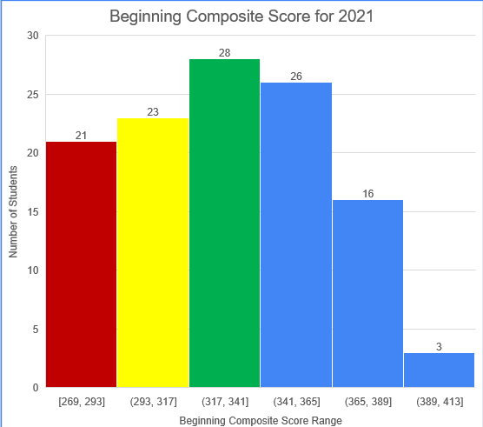
Task 1 : Composite Score at the Beginning of 2021
20th Percentile : 295.4
40th Percentile: 321.4
21 students in red with composite score range [269-293] needs intensive Support.
23 students in yellow with composite score range [293-317] needs Strategic Support.
28 students in green with score range [317,365] needs core support.
45 students in bule with score range [341, 365] , [365, 389], and [389, 423] needs Core plus support.

Slide 4
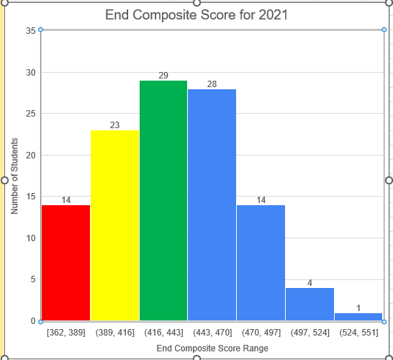
Task 1 : Composite Score at the End of 2021
20th Percentile : 403
40th Percentile: 427.8
14 students in red with composite score range [362-389] needs intensive Support.
23 students in yellow with composite score range [389-416] needs Strategic Support.
29 students in green with score range [416,443] needs core support.
47 students in bule with score range [443, 470] , [470, 497], [497, 524], and [524, 551] needs Core plus support.

Slide 5
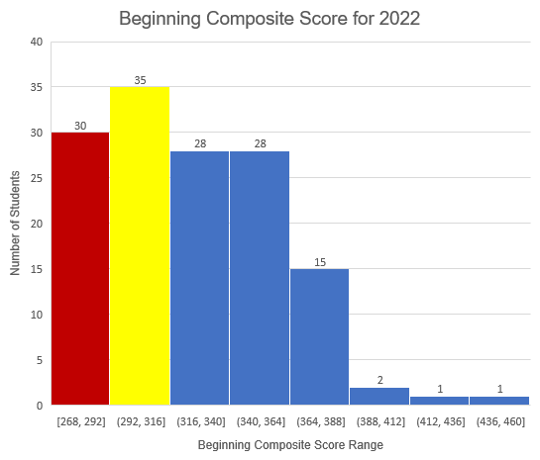
Task 2 : Composite Score at the Beginning of 2022
20th Percentile : 291.8
40th Percentile: 309.2
30 students in red with composite score range [268-292] needs intensive Support.
35 students in yellow with composite score range [292-316] needs Strategic Support.
There are no students needs core support.
75 students in bule with score range [316,340] , [340, 364] and [364, 388], [388,412], [412,436], [436,460] needs Core plus support.

Slide 6
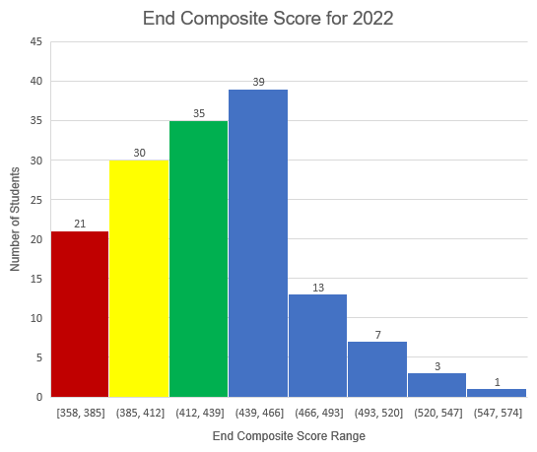
Task 2 : Composite Score at the End of 2022
20th Percentile : 395
40th Percentile: 419
21 students in red with composite score range [358-385] needs intensive Support.
30 students in yellow with composite score range [385-412] needs Strategic Support.
35 students in green with score range [412,439] needs core support.
63 students in bule with score range [439, 466] , [466, 493], [493, 520],[520, 547], and [547, 574] needs Core plus support.

Slide 7
Task 2

Slide 8
Summary
Improvement in Scores:
Student scores showed significant improvement from the beginning of 2021 to the end of 2021.
Support Levels:
Fewer students needed Intensive Support (Red), decreasing from 21 to 14.
More students moved into Core Support (Green) and Core Plus Support (Blue), showing better overall performance.
The data shows that more students improved their scores, requiring less support by the end of 2021.
Improvement in Scores:
Student scores improved significantly from the beginning of 2022 to the end of 2022.
Support Levels:
Fewer students needed Intensive Support (Red), down from 30 to 21.
More students required Strategic Support (Yellow) and Core Support (Green).
Core Plus Support (Blue) decreased from 75 to 63, but those remaining had higher scores.
Overall, more students improved, requiring less intensive support, and moved into higher support categories by the end of 2022.

