Slide 1
Southbridge Public Schools Data Tasks
Sirjana Bhatta
Framingham State University
December 2024

Slide 2
Task 1: Data Visualization and Observation Task 1. Composite Score at the Beginning of 2021 2. Composite Score at the End of 2021 3. Composite Score at the Beginning of 2022 4. Composite Score at the End of 2022 Task 2: Error Troubleshooting Task 1. EPIMS9400 - Missing WA08 Assignment Code 2. Missing Schedule Term Column 3. Missing Gradebook Access Column 4. EPIMS6750 - Co-Teaching Assignment Must Be Between 2 and 4 5. EPIMS6770 - At Least Two Co-Teachers Required

Slide 3
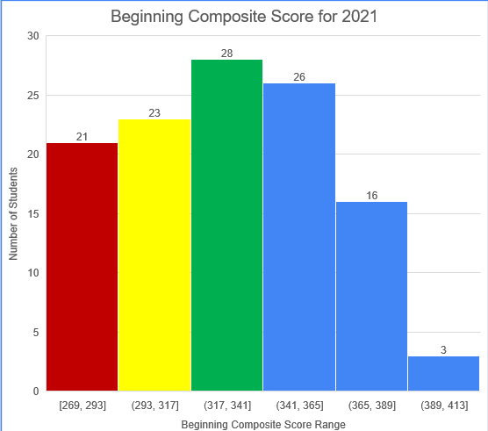
Task 1 : Composite Score at the Beginning of 2021
20th Percentile : 295.4
40th Percentile: 321.4
21 students in red with composite score range [269-293] needs intensive Support.
23 students in yellow with composite score range [293-317] needs Strategic Support.
28 students in green with score range [317,365] needs core support.
45 students in bule with score range [341, 365] , [365, 389], and [389, 423] needs Core plus support.

Slide 4
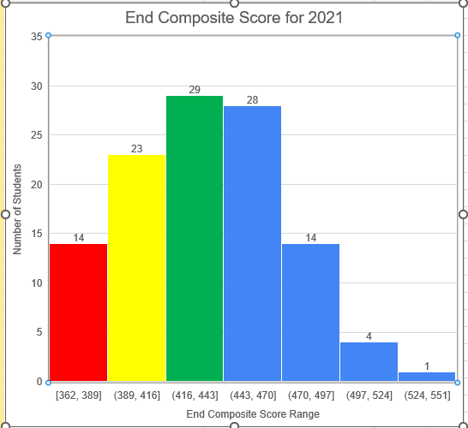
Task 1 : Composite Score at the End of 2021
20th Percentile : 403
40th Percentile: 427.8
14 students in red with composite score range [362-389] needs intensive Support.
23 students in yellow with composite score range [389-416] needs Strategic Support.
29 students in green with score range [416,443] needs core support.
47 students in bule with score range [443, 470] , [470, 497], [497, 524], and [524, 551] needs Core plus support.

Slide 5
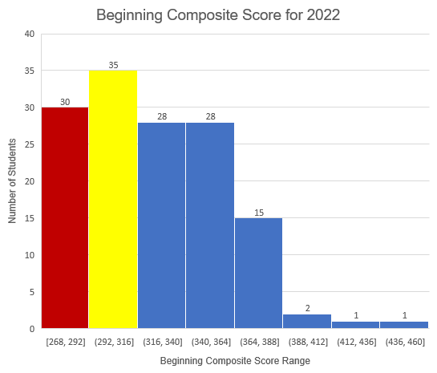
Task 1 : Composite Score at the Beginning of 2022
20th Percentile : 291.8
40th Percentile: 309.2
30 students in red with composite score range [268-292] needs intensive Support.
35 students in yellow with composite score range [292-316] needs Strategic Support.
There are no students needs core support.
75 students in bule with score range [316,340] , [340, 364] and [364, 388], [388,412], [412,436], [436,460] needs Core plus support.

Slide 6
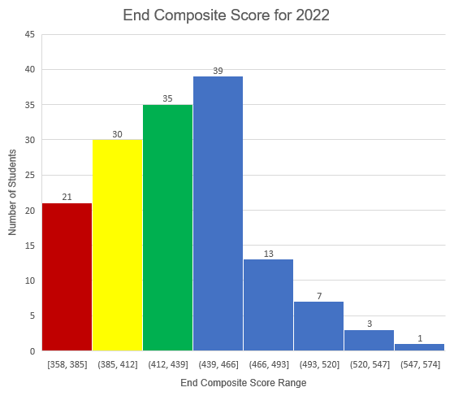
Task 1 : Composite Score at the End of 2022
20th Percentile : 395
40th Percentile: 419
21 students in red with composite score range [358-385] needs intensive Support.
30 students in yellow with composite score range [385-412] needs Strategic Support.
35 students in green with score range [412,439] needs core support.
63 students in bule with score range [439, 466] , [466, 493], [493, 520],[520, 547], and [547, 574] needs Core plus support.

Slide 7
Task 2: Error Troubleshooting Task
Error 1: EPIMS9400- Missing WA08 Assignment Code
Issue: The field "WA08" must contain a valid assignment code. It cannot be blank or null.
Example:
Rudd, Paul (WA08 is missing)
Joy Randolph, Da'Vine (WA08 is missing)
Gomez, Selena (WA08 is missing)
Martin, Steve (WA08 is missing)
Streep, Meryl (WA08 is missing)
Lynch, Jane (WA08 is missing)
Fix: Add the correct assignment code for each person.

Slide 8
Task 2: Error 2 & 3
Error 2: Missing Schedule Term Column
Issue: The "Schedule Term" column is missing from the schedule data.
Fix: Include the "Schedule Term" column to specify which term (e.g., Fall, Spring) the schedule applies to.
Error 3: Missing Gradebook Access Column
Issue: The "Gradebook Access" column is missing.
Fix: Add the "Gradebook Access" column to show who has access to the gradebook.

Slide 9
Task 2: Error 4 & 5
Error 4: EPIMS6750- Co-Teaching Assignment Must Be Between 2 and 4
Issue: The system requires between 2 and 4 co-teachers, but only 1 co-teacher (Steve Martin) is listed.
Fix: Add more co-teachers or adjust the assignment if only 1 co-teacher is needed.
Error 5: EPIMS6770- At Least Two Co-Teachers Required
Issue: The rule requires more than 1 co-teacher, but only 1 (Steve Martin) is listed.
Fix: Add another co-teacher or update the data to show that only 1 co-teacher is needed.

Slide 10
Summary
Based on the histogram, the composite score improved at the end of 2021 compared to the beginning of 2021. Fewer students required intensive support at the end of 2021.
Similarly, based on the histogram, the composite score improved at the end of 2022 compared to the beginning of 2022. Fewer students required intensive and strategic support at the end of 2022.

