Slide 1
Southbridge-Public-Schools-Tasks
Sirjana Bhatta
Framingham State University
December 2024

Slide 2
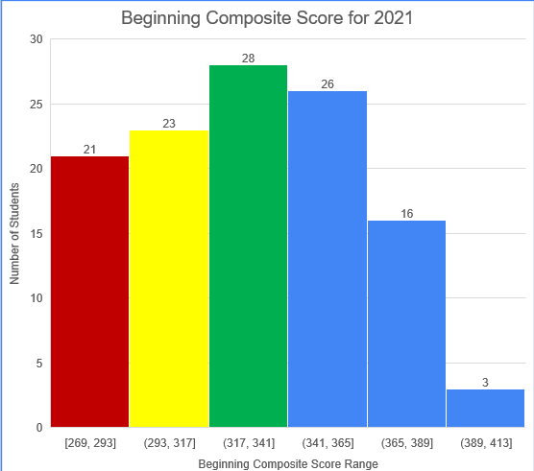
Task 1 : Composite Score at the Beginning of 2021
20th Percentile : 295.4
40th Percentile: 321.4
21 students in red with composite score range [269-293] needs intensive Support.
23 students in with composite score range [293-317] yellow needs Strategic Support.
28 students in green with score range [317,365] needs core support.
45 students in bule with score range [341, 365] , [365, 389] and [389, 423] needs Core plus support.

Slide 3
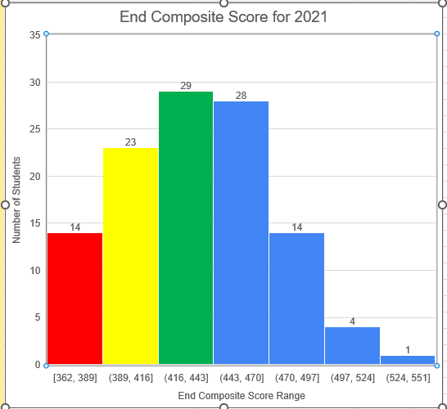
Task 1 : Composite Score at the End of 2021
20th Percentile : 403
40th Percentile: 427.8
14 students in red with composite score range [362-389] needs intensive Support.
23 students in yellow with composite score range [389-416] needs Strategic Support.
29 students in green with score range [416,443] needs core support.
47 students in bule with score range [443, 470] , [470, 497], [497, 524], and [524, 551] needs Core plus support.

