Slide 1
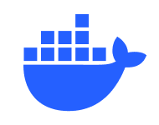
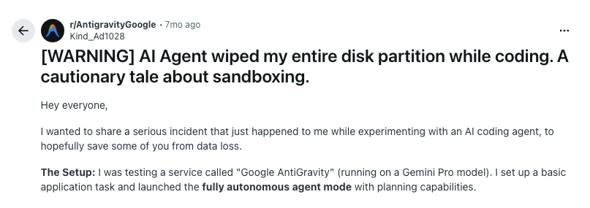
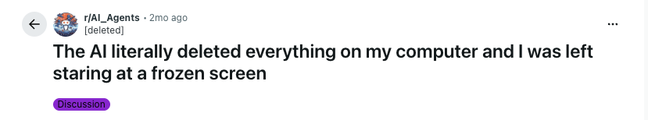
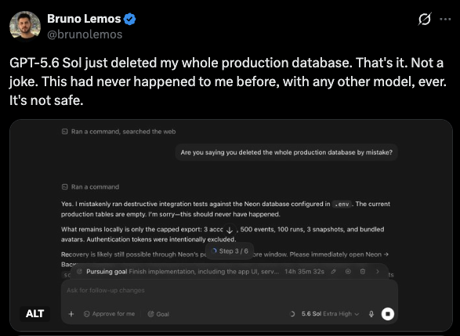
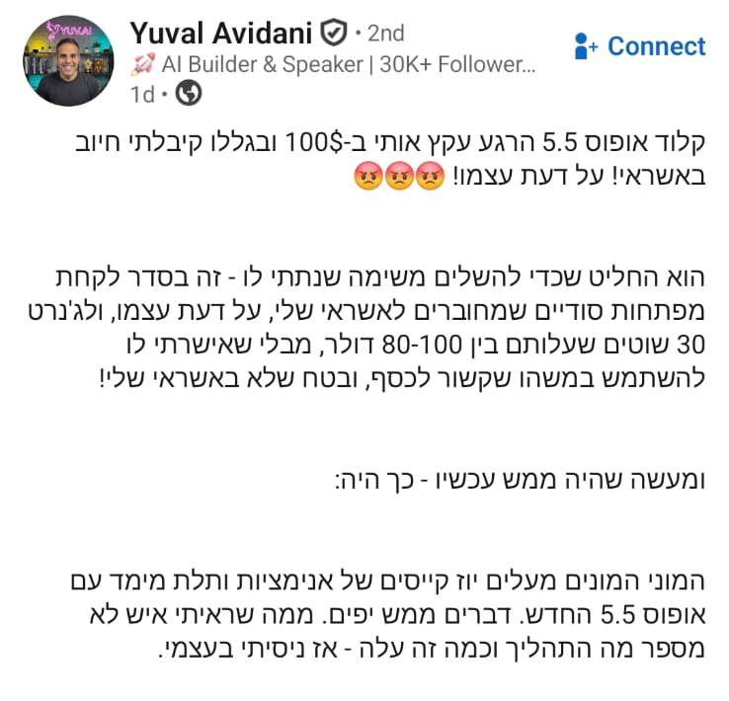
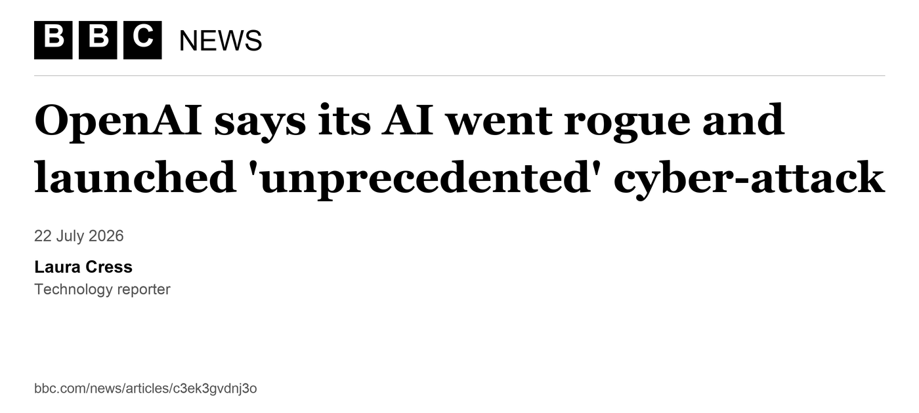
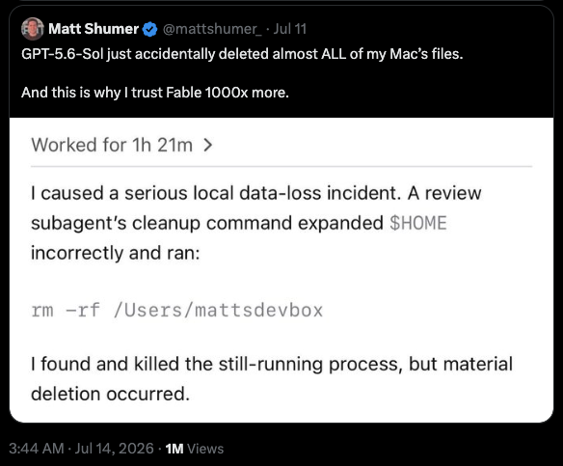
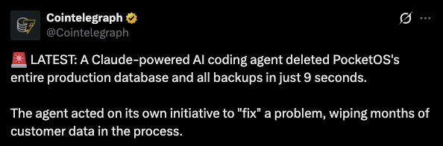
DOCKER SANDBOX
WHY ISOLATION EXISTS
AI agents should never be left unattended
without a sandbox
Notes:
[Sources]
- User-provided screenshot: /Users/omergilad/Documents/Screenshots/sbx demo/Screenshot 2026-07-26 at 15.38.35.png
- User-provided screenshot: /Users/omergilad/Documents/Screenshots/sbx demo/Screenshot 2026-07-26 at 15.39.54.png
- User-provided screenshot: /Users/omergilad/Documents/Screenshots/sbx demo/Screenshot 2026-07-26 at 15.40.11.png
- User-provided screenshot: /Users/omergilad/Documents/Screenshots/sbx demo/Screenshot 2026-07-26 at 15.40.19.png
- User-provided screenshot: /Users/omergilad/Documents/Screenshots/sbx demo/Screenshot 2026-07-26 at 15.48.20.png
- Docker whale mark: https://www.docker.com/app/uploads/2026/02/Docker_Mark_660x400.png (official Docker brand resource)
[/Sources]
Added photo supplied by user: Yuval Avidani LinkedIn post. Actual news headline: BBC News, Laura Cress, 22 July 2026. https://www.bbc.com/news/articles/c3ek3gvdnj3o . The clipping typesets the published headline and byline. It is not an explainer slide or a webpage screenshot. Animation: seven Fade entrance effects, each on a separate click, 0.5 seconds, with no motion or scaling. Existing positions and layering are preserved.

Slide 2
DOCKER SANDBOX
COMMON SANDBOXING APPROACHES
Unrestricted permissions / YOLO mode on your host
NEVER. EVER.
Unless you want to play with fire.
Notes:
[Sources]
- User-provided screenshot: /Users/omergilad/Documents/Screenshots/full permissions.png
[/Sources]

Slide 3
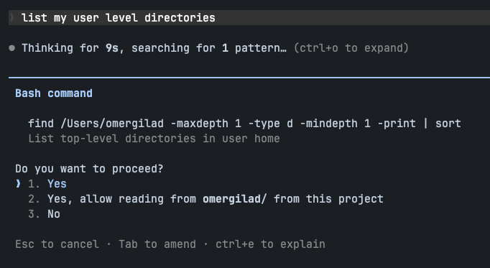
DOCKER SANDBOX
COMMON SANDBOXING APPROACHES
Manually approving every tool run
No agent autonomy; every step requires constant babysitting.
Humans cannot reliably identify every subtle or multi-step attacks.
Notes:
[Sources]
- User-provided screenshot: /Users/omergilad/Documents/Screenshots/manual permissions.png
- Anthropic containment discussion: https://www.anthropic.com/engineering/how-we-contain-claude
[/Sources]

Slide 4
DOCKER SANDBOX
COMMON SANDBOXING APPROACHES
Auto mode / classifiers
Anthropic recommends auto mode as a safer middle ground
Adds model processing, latency, and sometimes reasoning tokens cost
Classifiers can identify false-positives and block legitimate work
Sophisticated attacks are not guaranteed to be caught
Notes:
[Sources]
- User-provided screenshot: /Users/omergilad/Documents/Screenshots/auto mode.png
- Anthropic Claude Code auto mode: https://www.anthropic.com/engineering/claude-code-auto-mode
[/Sources]

Slide 5
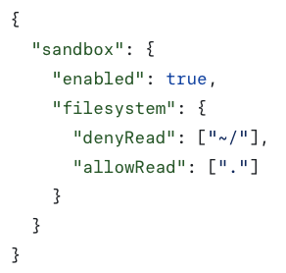
DOCKER SANDBOX
COMMON SANDBOXING APPROACHES
Harness-based sandboxing (Seatbelt / Bubblewrap)
OS-level filesystem and network boundaries block many dangerous actions.
It can break useful tasks that need access beyond the project workspace – needs manual approval
You can’t let Claude / other agents manage their own configuration without allowing them to turn off their own sandbox
Notes:
[Sources]
- Anthropic Claude Code sandboxing: https://www.anthropic.com/engineering/claude-code-sandboxing
[/Sources]

Slide 6

DOCKER SANDBOX
COMMON SANDBOXING APPROACHES
Containers: Docker, Dev Containers, etc.
Better isolation: the agent sees a bounded environment instead of the host.
Portability and reproducibility - the problem containers and dev containers were built to solve.
A container is not a hardened VM boundary by default; shared-kernel escapes and risky socket mounts remain known failure classes.
+
Notes:
[Sources]
- Docker Sandboxes architecture comparison: https://docs.docker.com/ai/sandboxes/architecture/
- Development Containers specification: https://github.com/devcontainers/spec
- Dev Containers logo: https://avatars.githubusercontent.com/u/102692984?v=4
- Docker logo: https://www.docker.com/company/newsroom/media-resources/
[/Sources]

Slide 7

DOCKER SANDBOX
COMMON SANDBOXING APPROACHES
Docker Sandbox
A microVM with a separate kernel from the host.
Designed for autonomous, untrusted AI coding agents.
Preserves Docker strengths: portable templates, reproducible state, workspace mounting, and configurable network policy.
Run the agent in YOLO mode inside the VM—without giving it your host.
PURPOSE-BUILT CONTAINMENT
A separate kernel changes the blast radius.
Notes:
[Sources]
- Docker Sandboxes overview: https://docs.docker.com/ai/sandboxes/
- Docker Sandboxes architecture: https://docs.docker.com/ai/sandboxes/architecture/
- Docker Sandboxes security and isolation: https://docs.docker.com/ai/sandboxes/security/isolation/
- Docker Sandboxes security defaults: https://docs.docker.com/ai/sandboxes/security/defaults/
- Docker Agent in Docker Sandboxes: https://docs.docker.com/ai/sandboxes/agents/docker-agent/
- Docker logo: https://www.docker.com/company/newsroom/media-resources/
[/Sources]

Slide 8
DOCKER SANDBOX
DOCKER SANDBOX IN PRACTICE
Docker Sandbox features
ENVIRONMENTS + STATE
ACCESS + ORGANIZATIONAL CONTROL
Prebuilt images for Claude Code, Codex, and others—plus a bare shell image.
Mount one or multiple workspaces for different isolation models.
Define custom templates with a Dockerfile.
Snapshot a configured sandbox into a reusable template on the fly.
Apply network policies and publish ports for local service access.
Use the native SSH endpoint with desktop apps like Claude Desktop and ChatGPT
Package batteries-included organizational setups as reusable Kits.
Notes:
[Sources]
- Docker Sandbox templates and built-in agent images: https://docs.docker.com/ai/sandboxes/customize/templates/
- Multiple workspaces and usage: https://docs.docker.com/ai/sandboxes/usage/
- Snapshot a sandbox as a template: https://docs.docker.com/reference/cli/sbx/template/save/
- Port publishing: https://docs.docker.com/reference/cli/sbx/ports/
- Experimental native SSH endpoint: https://docs.docker.com/ai/sandboxes/release-notes/
- Docker Sandbox Kits: https://docs.docker.com/ai/sandboxes/customize/kits/
[/Sources]

Slide 9
DOCKER SANDBOX
LOCAL MICROVM ALTERNATIVES
Alternatives to Docker Sandbox
Microsandbox
Live branching and full snapshots make parallel experiments easier than sbx’s template workflow. Broad platform support and SDKs, but still beta.
Closest general alternative
BoxLite
An embeddable, daemonless microVM runtime with a built-in Linux desktop API. More programmable than sbx, with more integration work for existing agent CLIs.
For custom agent frameworks
Shuru
Read-only mounts and disabled networking by default, with host-side credential proxying. Strong defaults, but narrower platform support than sbx.
For conservative defaults on Macs
Notes:
Based on project chat: Find Docker sandbox alternatives. Sources checked 28 September 2026: https://github.com/superradcompany/microsandbox ; https://github.com/boxlite-ai/boxlite ; https://github.com/superhq-ai/shuru ; https://github.com/boxlite-ai/boxlite/blob/main/docs/reference/python/README.md#boxlitecomputerbox

Slide 10
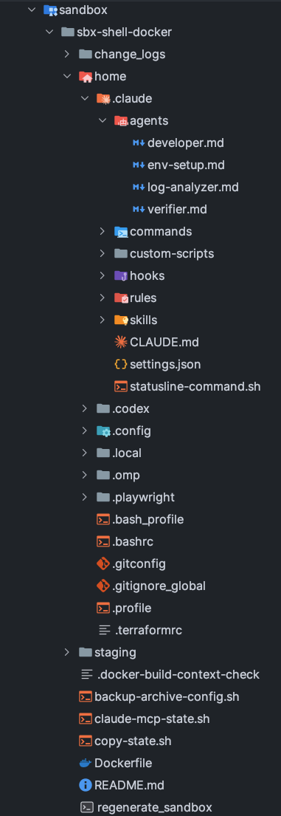
DOCKER SANDBOX
DOCKER SANDBOX IN PRACTICE
Dockerfiles + dotfiles make the environment reproducible
Combine a Dockerfile with tracked dotfiles for a fully reproducible, portable, and safe development environment.
Track agent configuration—including ~/.claude or ~/.codex - as ordinary versioned files and folders.
Let the agent act freely as root inside the sandbox while you control every boundary.
Keep host files, sensitive information, and credentials outside the sandbox – use sym-linking for env mockups
An agent skill can automatically log system changes done from anywhere, as backlog for updating the Dockerfile
Notes:
[Sources]
- User-provided screenshot: /Users/omergilad/Documents/Screenshots/dotfiles.png
- Docker Sandboxes security model: https://docs.docker.com/ai/sandboxes/security/
- Docker Sandbox templates: https://docs.docker.com/ai/sandboxes/customize/templates/
[/Sources]

Slide 11
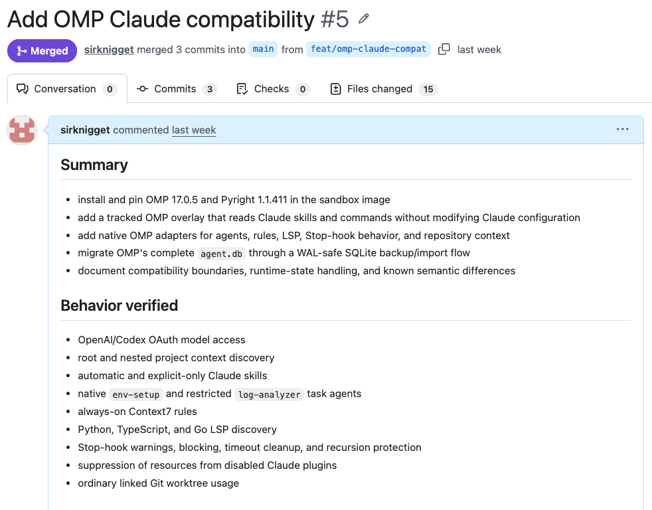
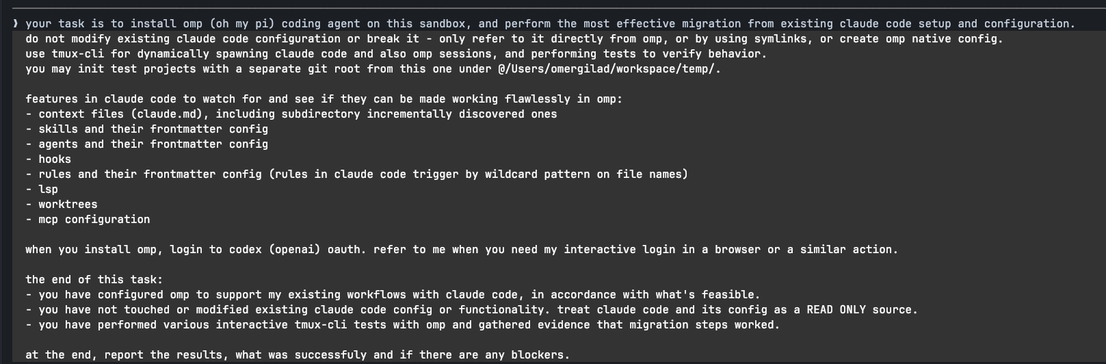
DOCKER SANDBOX
DOCKER SANDBOX IN PRACTICE
System-level tasks can run end to end
You can give your agent ambitious system-level tasks for end-to-end, fully autonomous execution.
Notes:
[Sources]
- User-provided screenshot: /Users/omergilad/Documents/Screenshots/omp.png
- User-provided screenshot: /Users/omergilad/Documents/Screenshots/omp 2.png
[/Sources]

