Slide 1
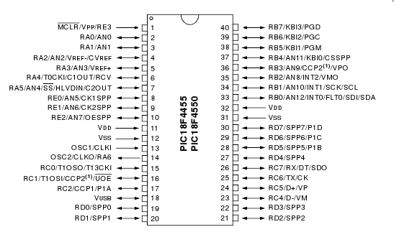
J5
GND
RESET
GND
3.3V
VIN
5V
0
RA0
RB7
31
1
RA1
RB6
30
J1
2
RA2
RB5
29
J2
RA3
3
RB4
28
RA4
4
RB3
27
RA5
5
RB2
26
RE0
25
6
RB1
24
7
RE1
RB0
8
RC0
RD7
23
9
RC1
RD6
22
J3
10
RC2
RD5
21
J4
11
RD0
RD4
20
12
RD1
RC7
19
13
RD2
RC6
18
14
RD3
RC5
17
15
RE2
RC4
16

Slide 2
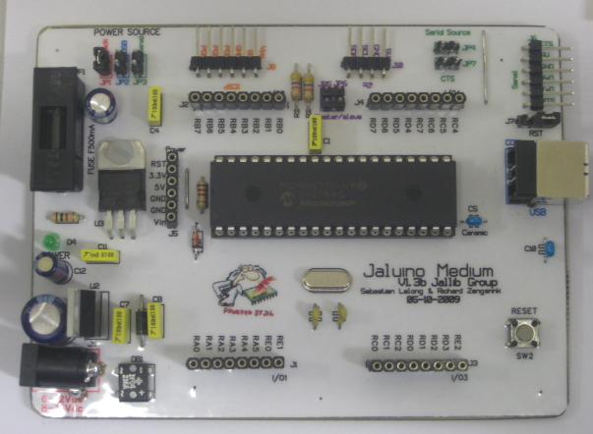
Power sources selection
I²C connector with
master/slave selection
Serial source CTS enabled selection
ICSP connector
Serial
Connector with Reset-via-RTS selection
Fuse protection
USB
Connector
3.3V regulation
Microchip PIC 18F4550 microcontroller
20MHz crystal (48MHz clocking with PLL)
5V regulation with diodes protection
Reset
Button
Shield connectors

Slide 3
USB
USB
jack
Serial
Serial source
jack
Serial
Serial source
JP4
JP4
JP1
JP2
JP3
JP1
JP2
JP3
Using AC/DC adapter, connected
to the jack, as power source
Also power the serial module
USB
USB
jack
Serial
Serial source
jack
Serial
Serial source
JP4
JP4
JP1
JP2
JP3
JP1
JP2
JP3
Using power coming from
USB connector
Also power the serial module
USB
USB
jack
Serial
Serial source
jack
Serial
Serial source
JP4
JP4
JP1
JP2
JP3
JP1
JP2
JP3
Using power coming from
the serial module
Invalid combination !
Don't do this !

Slide 4
J7
Reset-via-RTS enabled
RST
J7
RTS line enabled
(connected to pin RD4)
RST
J7
No RTS setup
RST

Slide 5
JP7
CTS line enabled
(connected to pin RD5)
CTS
JP7
No CTS setup
CTS

Slide 6
JP5
JP6
I²C master enabled
Master/slave
JP5
JP6
I²C slave enabled (use this setup
if you don't care about I²C)
Master/slave

