Slide 1
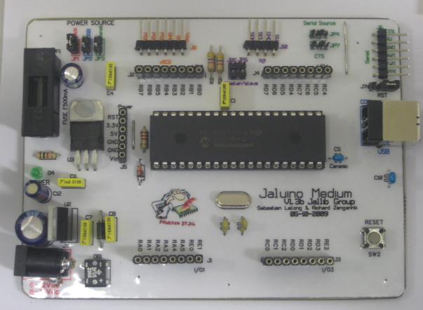
Power sources selection
I²C connector with
master/slave selection
Serial source CTS enabled selection
ICSP connector
Serial
Connector with Reset-via-RTS selection
Fuse protection
USB
Connector
3.3V regulation
Microchip PIC 18F4550 microcontroller
20MHz crystal (48MHz clocking with PLL)
5V regulation with diodes protection
Reset
Button
Shield connectors

