Slide 1

C
E
N
T
R
E
F
B
O
I
R
O
I
I
N
N
Lecture 19
aCGH and Microarray Data Analysis
Introduction to Bioinformatics
T
F
E
O
G
R
R
M
A
A
T
T
I
I
V
C
E
S
V
U

Slide 2
C
E
N
T
R
E
F
B
O
I
R
O
I
I
N
N
A.s. donderdag 22 mei
Practicum in S3.29 en S3.53
(niet S.3.45)
Introduction to Bioinformatics
T
F
E
O
G
R
R
M
A
A
T
T
I
I
V
C
E
S
V
U

Slide 3
Array-CGH
(Comparative Genomics Hybridisation)
New microarray-based method to determine local chromosomal copy numbers
Gives an idea how often pieces of DNA are copied
This is very important for studying cancers, which have been shown to often correlate with copy events!
Also referred to as ‘a-CGH’

Slide 4
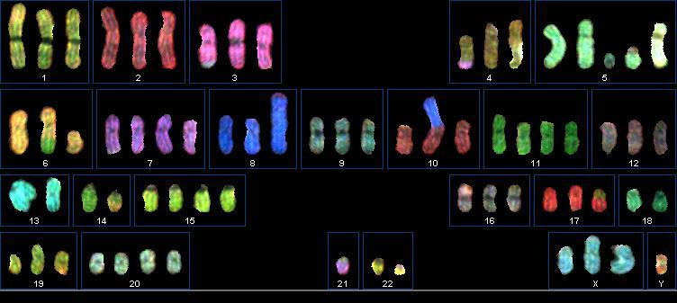
Tumor Cell
Chromosomes of tumor cell:
Notes:
Normal cells 23 pairs of chromosomes.
Each chromosome is built from two strands of bases labeled (ag tc)
Two connected bases are referred to as basepair
Male: XY
Female: XX
Some pieces of chromosomal DNA form genes. Processes in the cell ultimately form proteins from genes, which determine the way a cell behaves.
Each chromosome labeled with different color (SKY experiment).
You can see this cell does not at all have 2 copies of each chromosome… Pieces are lost, pieces have attached to other chromosomes, some pieces have more than 2 copies.

Slide 5
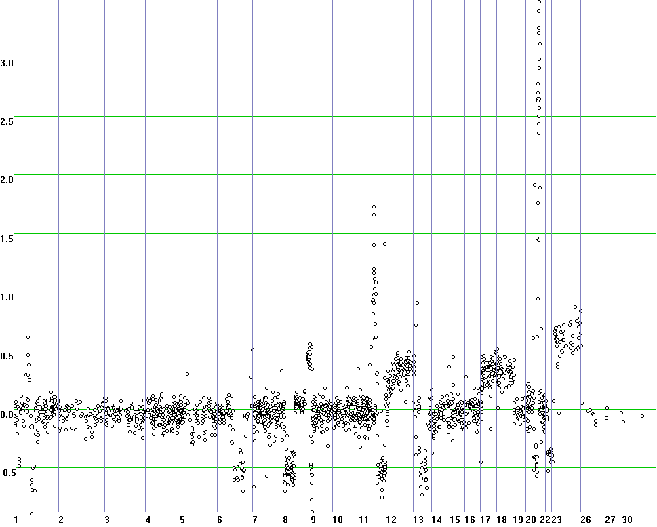
Example of a-CGH Tumor
⇑
V
a
l
u
e
Clones/Chromosomes ⇒
Notes:
Estimated time: 1 minute
Explain axis.
About the data:
Normalized (average 1)
Log2 (why?)
“1It is preferable to work with logged intensities rather than absolute intensities for a number of reasons
including the facts that: (i) the variation of logged intensities and ratios of intensities is less dependent on
absolute magnitude; (ii) normalization is additive for logged intensities; (iii) taking logs evens out highly
skew distributions; and (iv) taking logs gives a more realistic sense of variation.”
Point out some gains, losses and amplifications

Slide 6
a-CGH vs. Expression
a-CGH
DNA
  In Nucleus
  Same for every cell
DNA on slide
Measure Copy Number Variation
Expression
RNA
  In Cytoplasm
  Different per cell
cDNA on slide
Measure Gene Expression
Notes:
Estimated time: <= 2 minutes
This slide explains the difference between Array CGH and Microarray gene expression experiments.
Explain Copy Number: The copy number of a piece of DNA on the genome is the number of times this piece occurs in the nucleus of a cell.

Slide 7
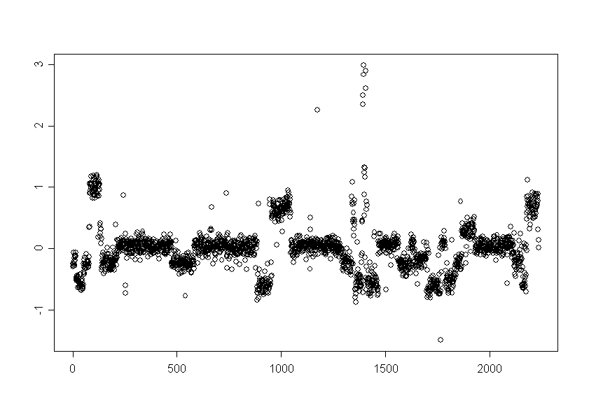
CGH Data
⇑
C
o
p
y
#
Clones/Chromosomes ⇒
Notes:
Estimated time: 1 minute
Explain axis.
About the data:
Normalized (average 1)
Log2 (why?)
“1It is preferable to work with logged intensities rather than absolute intensities for a number of reasons
including the facts that: (i) the variation of logged intensities and ratios of intensities is less dependent on
absolute magnitude; (ii) normalization is additive for logged intensities; (iii) taking logs evens out highly
skew distributions; and (iv) taking logs gives a more realistic sense of variation.”
Point out some gains, losses and amplifications

Slide 8
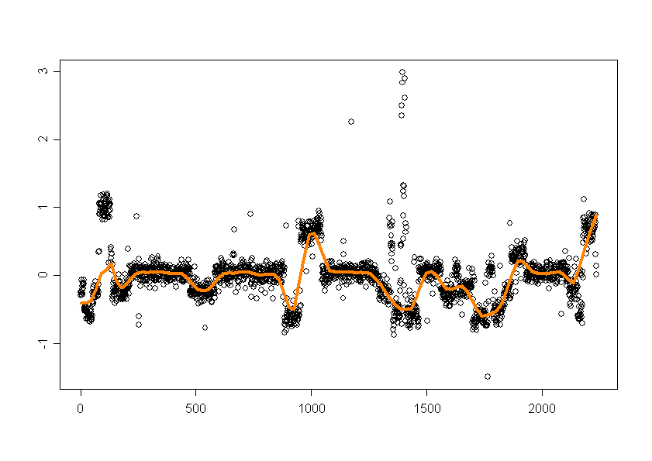
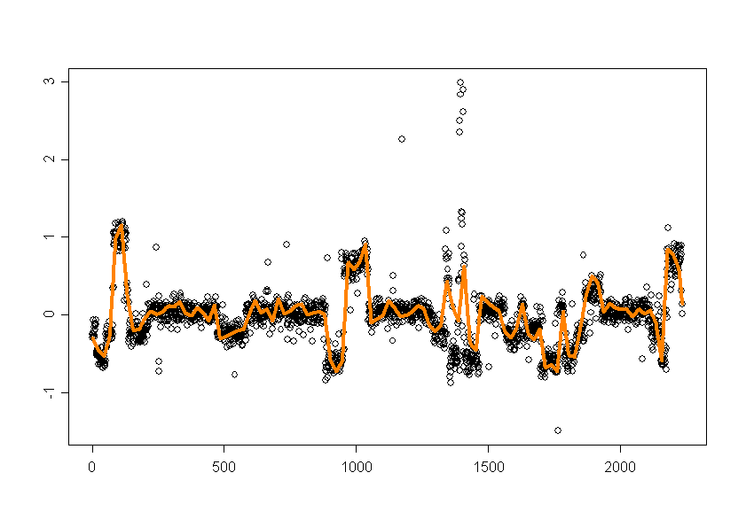
Naïve Smoothing

Slide 9
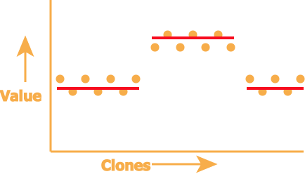
“Discrete” Smoothing
Copy numbers are integers
Question: how do we best break up the dataset in same-copy number regions (with breakpoints in between)?

Slide 10
Why Smoothing ?
Noise reduction
Detection of Loss, Normal, Gain, Amplification
Breakpoint analysis
Recurrent (over tumors) aberrations may indicate:
  an oncogene or
  a tumor suppressor gene
Notes:
Estimated time: about 1 minute
Explain and point at breakpoints: place where value changes.
Smoothing also makes it possible to do analysis on breakpoints.

Slide 11
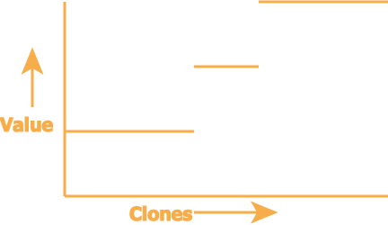
Is Smoothing Easy?
Measurements are relative to a reference sample
Printing, labeling and hybridization may be uneven
Tumor sample is inhomogeneous
do expect only few levels
vertical scale is relative
Notes:
Estimated time: 2 minutes
Unfortunately there are some problems with the experiment just described that prevent us from simply reading the copy number from the ratio’s.
1)
- Not every spot on the slide has the same amount of clones on it.
2)
In a tumor not every cell is the same, normal cells may occur, tumor cells of a previous stadium of the tumor may occur.
The amounts of cells for a type of cell is unknown.
- The amount of DNA material taken from the tumor cells may not be exactly equal to the amount taken from normal cells.
- The “green” and “red” molecules do not stick equally well
3)
Not every labeled fragment can stick stick to a clone, because it is on a part of the chromosome that does not occur on a clone.
Not every part that can stick to a clone, does actually stick
4)
Every clone has three spots on the slide.
If we assume that red and green fragments same distribution over the spots, the three spots should have the same value. Which is almost the case, since there is only a small standard deviation.
Problem:
Assume lowest line is normal
What is the real situation?
1 Cell type, then the middle line is single gain, the highest line is a double gain
2 Cell types, then possibly
Type 1 occurs twice as much as type 2 and has a gain corresponding to the upper line
Type 2 has a gain corresponding to the middle line

Slide 12
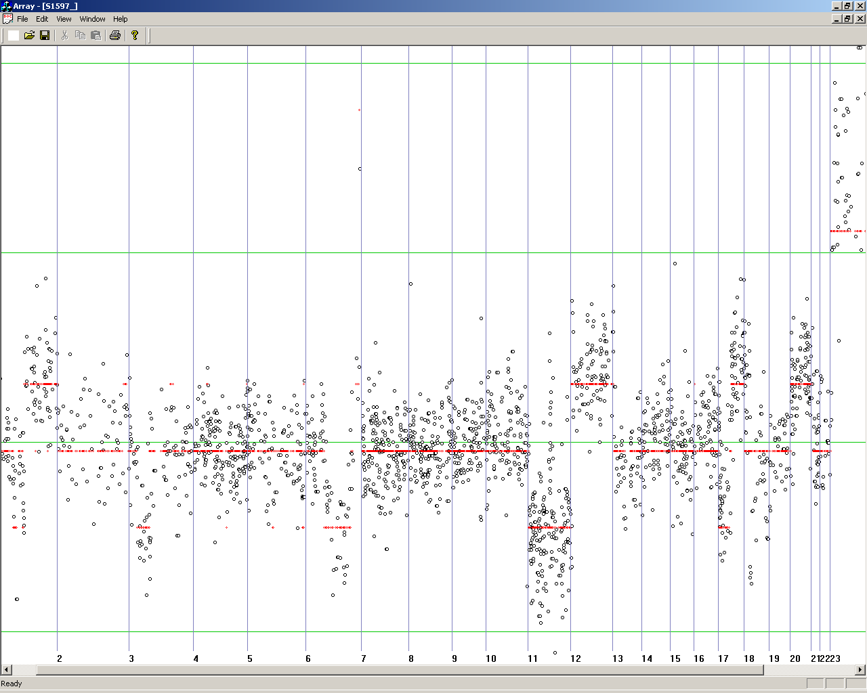
Smoothing: example
Notes:
Estimated time: < 20 seconds.

Slide 13
Problem Formalization
A smoothing can be described by
a number of breakpoints
corresponding levels
A fitness function scores each smoothing according to fitness to the data
An algorithm finds the smoothing with the highest
fitness score.
Notes:
Estimated time:
Details of function to optimize later.
What are we trying to model?
Do we want to find smoothings that resemble the expert or remove experimental noise?
Unfortunately not much known about the properties of the processes that take place during the experiments. We assume…
We do not have tumors with detailed data about the real composition of cell types, but the model seems to resemble the expert quite well as we will see.
We do have CGH data of a normal-normal experiment. A normal probability plot of that data shows that the noise in that experiment follows a normal distribution quite well.

Slide 14
Breakpoint Detection
Identify possibly damaged genes:
  These genes will not be expressed anymore
Identify recurrent breakpoint locations:
  Indicates fragile pieces of the chromosome
Accuracy is important:
  Important genes may be located in a region with (recurrent) breakpoints

Slide 15
Smoothing
breakpoints
variance
levels

Slide 16
Fitness Function
We assume that data are a realization of a Gaussian noise process and use the maximum likelihood criterion adjusted with a penalization term for taking into account model complexity
  The breakpoints should be placed between regions with minimal variation
  But we should not select each single point as a region (they have zero variance)
We could use better models given insight
in tumor pathogenesis
Notes:
Estimated time:
Details of function to optimize later.
What are we trying to model?
Do we want to find smoothings that resemble the expert or remove experimental noise?
Unfortunately not much known about the properties of the processes that take place during the experiments. We assume…
We do not have tumors with detailed data about the real composition of cell types, but the model seems to resemble the expert quite well as we will see.
We do have CGH data of a normal-normal experiment. A normal probability plot of that data shows that the noise in that experiment follows a normal distribution quite well.

Slide 17
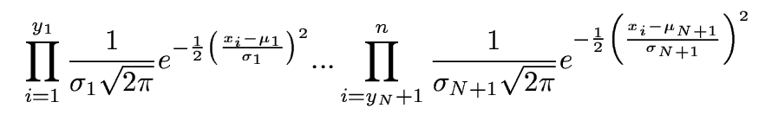
Fitness Function (2)
CGH values: x₁ , ... , x_{n}
breakpoints: 0 < y₁ ≤ … ≤ y_{N} ≤ x_{N}
levels: μ₁, . . ., μ_{Ν}
error variances: σ₁², . . ., σ_{Ν}²
likelihood of each discrete region:
Notes:
Estimated time: ?
Assume independence of all observations…

Slide 18
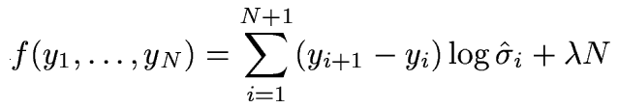
Fitness Function (3)
Maximum likelihood estimators of μ and σ ²
can be found explicitly
Need to add a penalty to log likelihood to
control number N of breakpoints, in order to avoid too many breakpoints
penalty
Notes:
Estimated time: ?
* Goal: Add penalty to make sure not every index becomes a breakpoint.

Slide 19
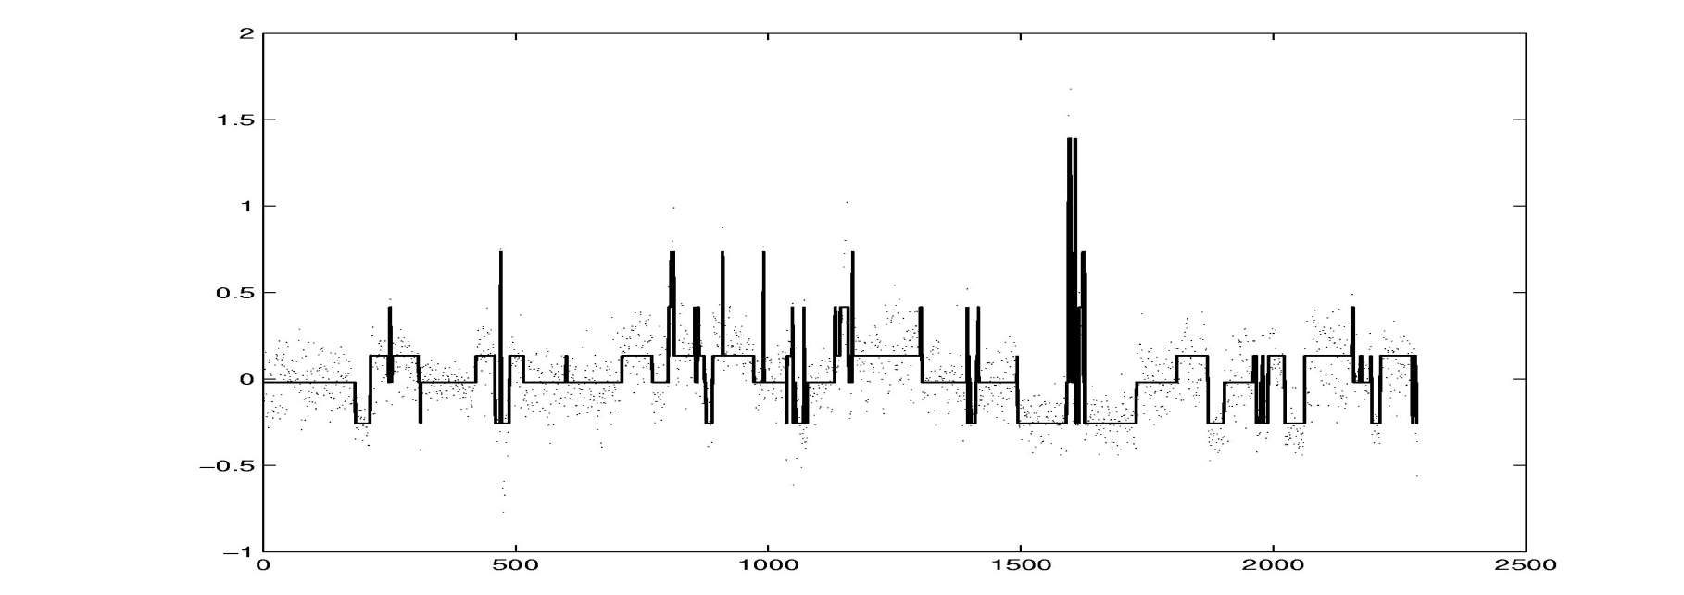
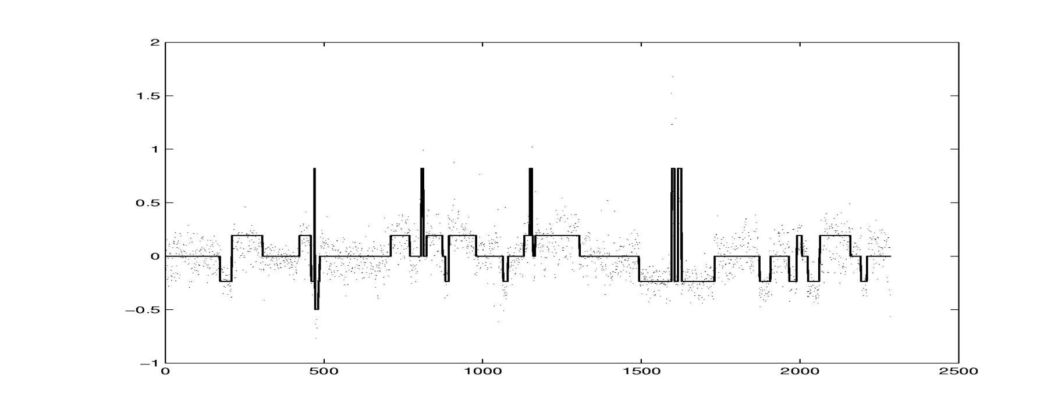
Comparison to Expert
algorithm
expert

Slide 20
aCGH data after smoothing
Patient | Clone 1 | Clone 2 | Clone 3 | Clone 4 | Clone 5 | Clone 6
1 | 5 | 6 | 18 | 110 | -2 | 10
2 | 7 | 6 | 3 | 98 | -1 | 11
3 | 18 | 17 | 24 | 75 | 0 | 8
REF | 5 | 6 | 35 | 62 | -1 | 9
Patient | Clone 1 | Clone 2 | Clone 3 | Clone 4 | Clone 5 | Clone 6
1 | 0 | 0 | -1 | 1 | -1 | 0
2 | 0 | 0 | -1 | 1 | 0 | 0
3 | 1 | 1 | 0 | 0 | 0 | 0
REF | 0 | 6 | 0 | 0 | 0 | 0
Often, gain, no-difference and loss are indicated by 1, 0 and -1 respectively

Slide 21
aCGH Summary
Chromosomal gains and losses tell about diseases
Need (discrete) smoothing (breakpoint assignment) of data
Problem: large variation between patients
Identify consistent gains and losses and relate those to a given cancer type
Chances for treatment and drugs
Important question: what do gained or lost fragments do and how do they relate to disease?

Slide 22
Analysing microarray expression profiles

Slide 23
Some statistical research stimulated by microarray data analysis
Experimental design : Churchill & Kerr
Image analysis: Zuzan & West, ….
Data visualization: Carr et al
Estimation: Ideker et al, ….
Multiple testing: Westfall & Young , Storey, ….
Discriminant analysis: Golub et al,…
Clustering: Hastie & Tibshirani, Van der Laan, Fridlyand & Dudoit, ….
Empirical Bayes: Efron et al, Newton et al,…. Multiplicative models: Li &Wong
Multivariate analysis: Alter et al
Genetic networks: D’Haeseleer et al and more

Slide 24
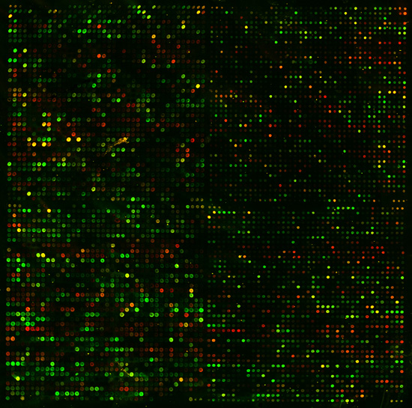
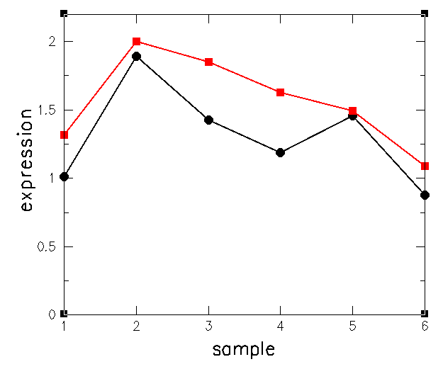
Comparing gene expression profiles

Slide 25
Normalising microarray data (z-scores)
z = (x_{i} - μ)/σ, where μ is mean and σ is standard deviation of a series of measurements x₁ .. x_{n}. This leads to normalised z-scores (measurements) with zero mean (μ=0) and unit standard deviation (σ=1)
If M normally distributed, then probability that z lies outside range -1.96 < z < 1.96 is 5%
There is evidence that log(R/G) ration are normally distributed. Therefore, R/G is said to be log-normally distributed

Slide 26
The Data
• each measurement represents
Log(Red_{i}/Green_{i})
where red is the test expression level, and green is
the reference level for gene G in the i th experiment
• the expression profile of a gene is the vector of
measurements across all experiments [G₁ .. G_{n}]

Slide 27
The Data
m genes measured in n experiments:
g_{1,1 ………} g_{1,n}
g_{2,1 ……….} g_{2,n}
g_{m,1 ……….} g_{m,n}
Vector for 1 gene

Slide 28
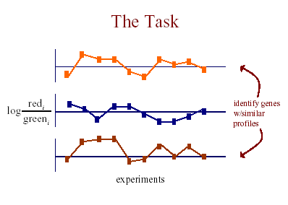

Slide 29
Which similarity or dissimilarity measure?
A metric is a measure of the similarity or dissimilarity between two data objects
Two main classes of metric:
  Correlation coefficients (similarity)
    Compares shape of expression curves
    Types of correlation:
      Centered.
      Un-centered.
      Rank-correlation
  Distance metrics (dissimilarity)
    City Block (Manhattan) distance
    Euclidean distance

Slide 30
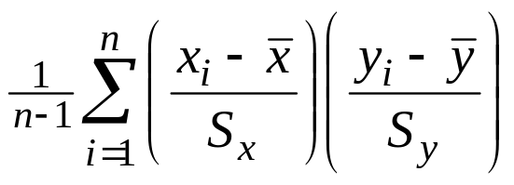
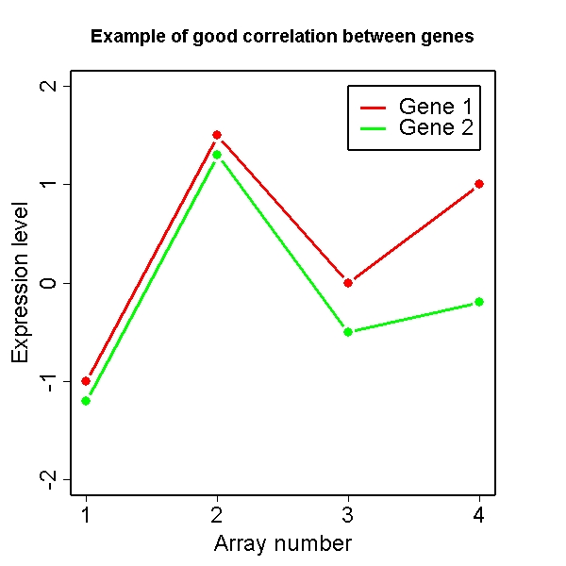
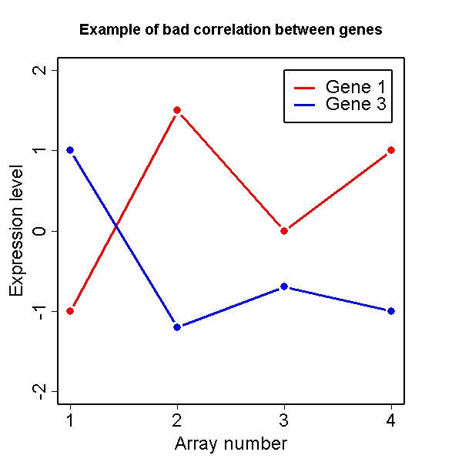
Correlation (a measure between -1 and 1)
Pearson Correlation Coefficient (centered correlation)
S_{x} = Standard deviation of x
S_{y} = Standard deviation of y
You can use absolute correlation to capture both positive and negative correlation
Positive correlation
Negative correlation

Slide 31
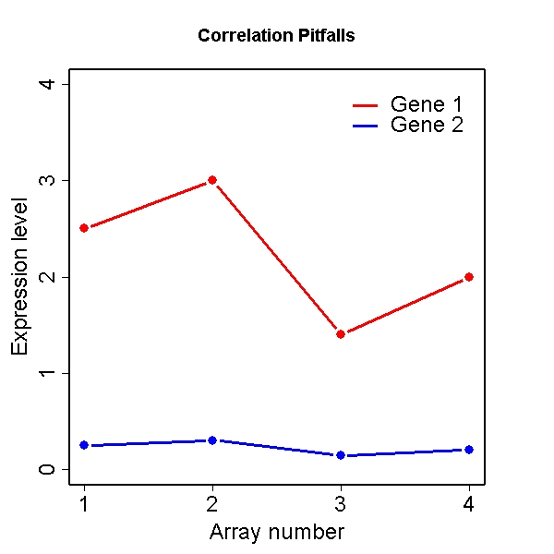
Potential pitfalls
Correlation = 1

Slide 32
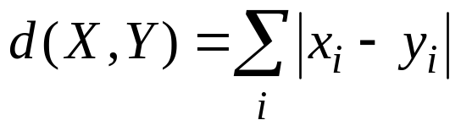
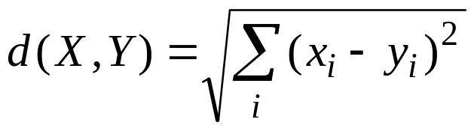
Distance metrics
City Block (Manhattan) distance:
  Sum of differences across dimensions
  Less sensitive to outliers
  Diamond shaped clusters
Euclidean distance:
  Most commonly used distance
  Sphere shaped cluster
  Corresponds to the geometric distance into the multidimensional space
Y
Y
Condition 2
Condition 2
X
X
Condition 1
Condition 1
where gene X = (x₁,…,x_{n}) and gene Y=(y₁,…,y_{n})

Slide 33
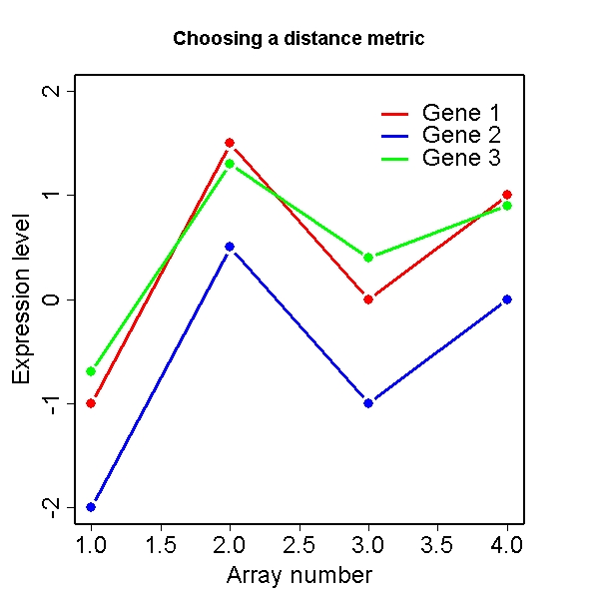
Euclidean vs Correlation (I)
Euclidean distance
Correlation
Euclidean
Correleation

Slide 34
Similarity measures for expression profiles
S(X, Y) = Σ(X_{i}-μ_{x})(Y_{i}-μ_{y})/((Σ(X_{i}-μ_{x})²)^{½} (Σ(X_{i}-μ_{x})²)^{½})
Correlation coefficient with centering
S(X, Y) = ΣX_{i}Y_{i}/((ΣX_{i}²)^{½} (ΣX_{i}²)^{½}) Correlation coefficient (without centering)
S(X, Y) = (Σ(X_{i}-Y_{i})²)^{½ Euclidean distance}
S(X, Y) = Σ|X_{i}-Y_{i}| Manhattan (City-block) distance
is the summation over i = 1..n
μ_{x} is the mean value of X₁, X₂, .., X_{n}
See Higgs & Attwood P. 321

Slide 35
Classification Using Gene Expression Data
Three main types of problems associated with tumor classification:
Identification of new/unknown tumor classes using gene expression profiles (unsupervised learning – clustering)
Classification of malignancies into known classes (supervised learning – discrimination)
Identification of “marker” genes that characterize the different tumor classes (feature or variable selection).
Notes:
4 relevant to other types of classification problems, not just tumors

Slide 36
Partitional Clustering
• divide instances into disjoint clusters (non-overlapping groups of genes)
– flat vs. tree structure
• key issues
– how many clusters should there be?
– how should clusters be represented?

Slide 37
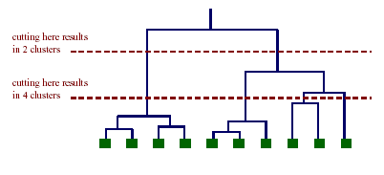
Partitional Clustering from a
Hierarchical Clustering
we can always generate a partitional clustering from a
hierarchical clustering by “cutting” the tree at some level

Slide 38
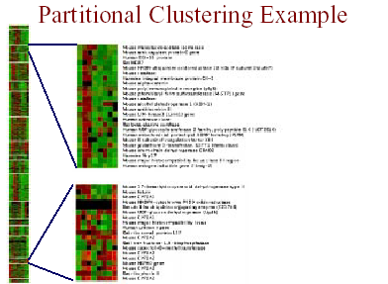
White lines divide genes into non-overlapping gene clusters

Slide 39
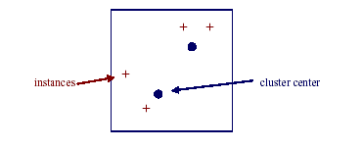
K-Means Clustering
• Method for partitional clustering into K groups
assume our instances are represented by vectors of real values (here only 2 coordinates [x, y])
• put k cluster centers in same space as instances
• now iteratively move cluster centers

Slide 40
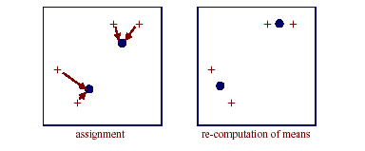
K-Means Clustering
each iteration involves two steps:
  assignment of instances to clusters
  re-computation of the means

Slide 41
Supervised Learning
property of interest
observations
System (unknown)
supervisor
Train dataset
?
ML algorithm
new observation
model
prediction
Classification

Slide 42

Unsupervised Learning
ML for unsupervised
learning attempts to discover interesting
structure in the available data
Data mining, Clustering

Slide 43
What is your question?
What are the targets genes for my knock-out gene?
Look for genes that have different time profiles between different cell types.
Gene discovery, differential expression
Is a specified group of genes all up-regulated in a specified conditions?
Gene set, differential expression
Can I use the expression profile of cancer patients to predict survival?
Identification of groups of genes that are predictive of a particular class of tumors?
Class prediction, classification
Are there tumor sub-types not previously identified?
Are there groups of co-expressed genes?
Class discovery, clustering
Detection of gene regulatory mechanisms.
Do my genes group into previously undiscovered pathways?
Clustering. Often expression data alone is not enough, need to incorporate functional and other information

Slide 44
Basic principles of discrimination
Each object associated with a class label (or response) Y ∈ {1, 2, …, K} and a feature vector (vector of predictor variables) of G measurements: X = (X₁, …, X_{G})
Aim: predict Y from X.
1
2
K
Predefined
Class
{1,2,…K}
Objects
Y = Class Label = 2
X = Feature vector
{colour, shape}
Classification rule ?
X = {red, square}
Y = ?

Slide 45
Discrimination and Prediction
Learning Set
Data with known classes
Prediction
Classification
rule
Data with unknown classes
Classification
Technique
Class
Assignment
Discrimination

Slide 46
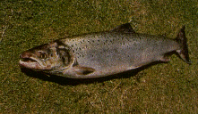
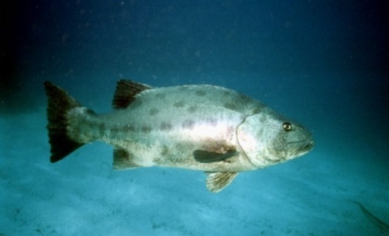
Example: A Classification Problem
Categorize images of fish—say, “Atlantic salmon” vs. “Pacific salmon”
Use features such as length, width, lightness, fin shape & number, mouth position, etc.
Steps
  Preprocessing (e.g., background subtraction)
  Feature extraction/feature weighting
  Classification
example from Duda & Hart

Slide 47
Classification in Bioinformatics
Computational diagnostic: early cancer detection
Tumor biomarker discovery
Protein structure prediction (threading)
Protein-protein binding sites prediction
Gene function prediction
…

Slide 48
Example 1
Breast tumor classification
van 't Veer et al (2002) Nature 415, 530
Dutch Cancer Institute (NKI)
Prediction of clinical outcome of breast cancer
DNA microarray experiment
117 patients
25000 genes

Slide 49
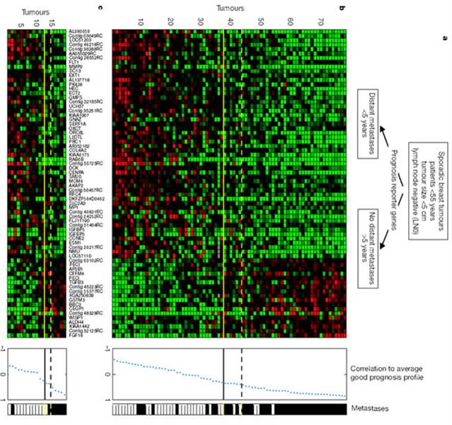
Learning set
Bad prognosis
recurrence < 5yrs
Good Prognosis
recurrence > 5yrs
Good Prognosis
recurrence > 5 yrs
?
Predefine
classes
Clinical
outcome
Objects
Array
Feature vectors
Gene
expression
new
array
Reference
L van’t Veer et al (2002) Gene expression profiling predicts clinical outcome of breast cancer. Nature, Jan.
.
Classification
rule

Slide 50
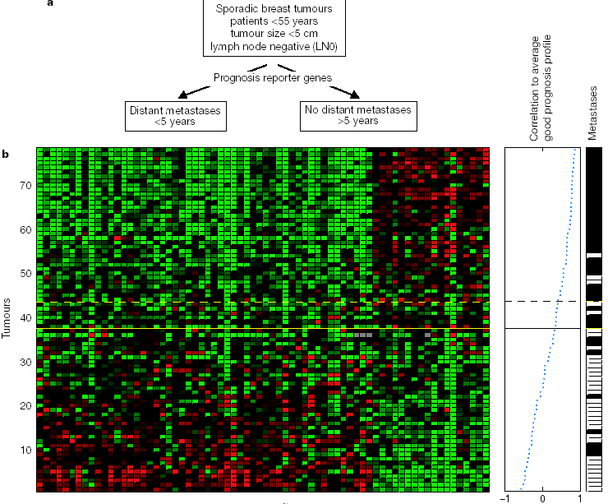

Slide 51
Validation set:
2 out of 19 incorrect
78 sporadic breast tumors
70 prognostic markers genes
Good prognosis
Bad prognosis

Slide 52
Is there work to do on van 't Veer et al. data ?
What is the minimum number of genes required in these classification models (to avoid chance classification)
What is the maximum number of genes (avoid overfitting)
What is the relation to the number of samples that must be measured?
Rule of thumb: minimal number of events per variable (EPV)>10
  NKI study ~35 tumors (events) in each group → 35/10=3.5 genes should maximally have been selected (70 were selected in the breast cancer study) → overfitting? Is the classification model adequate?

Slide 53
Classification Techniques
K Nearest Neighbor classifier
Support Vector Machines
…

Slide 54
Instance Based Learning (IBL)
Key idea: just store all training examples <x_{i},f(x_{i})>
Nearest neighbor:
Given query instance x_{q}, first locate nearest training example x_{n}, then estimate f(x_{q})=f(x_{n})
K-nearest neighbor:
Given x_{q}, take vote among its k nearest neighbors (if discrete-valued target function)
Take mean of values of k nearest neighbors (if real-valued) f(x_{q})=Σ_{i=1}^{k} f(x_{i})/k

Slide 55
K-Nearest Neighbor
The k-nearest neighbor algorithm is amongst the simplest of all machine learning algorithms.
An object is classified by a majority vote of its neighbors, with the object being assigned to the class most common amongst its k nearest neighbors.
k is a positive integer, typically small. If k = 1, then the object is simply assigned to the class of its nearest neighbor.
K-NN can do multiple class prediction (more than two cancer subtypes, etc.)
In binary (two class) classification problems, it is helpful to choose k to be an odd number as this avoids tied votes.
Adapted from Wikipedia
Notes:
prova

Slide 56
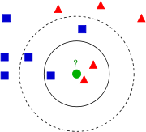
K-Nearest Neighbor
A lazy learner …
Issues:
  How many neighbors?
  What similarity measure?
Example of k-NN classification. The test sample (green circle) should be classified either to the first class of blue squares or to the second class of red triangles. If k = 3 it is classified to the second class because there are 2 triangles and only 1 square inside the inner circle. If k = 5 it is classified to first class (3 squares vs. 2 triangles inside the outer circle).
From Wikipedia
Notes:
prova

Slide 57
When to Consider Nearest Neighbors
Instances map to points in R^{N}
Less than 20 attributes per instance
Lots of training data
Advantages:
Training is very fast
Learn complex target functions
Do not loose information
Disadvantages:
Slow at query time
Easily fooled by irrelevant attributes

Slide 58
Voronoi Diagrams
Voronoi diagrams partition a space with objects in the same way as happens when you throw a number of pebbles in water -- you get concentric circles that will start touching and by doing so delineate the area for each pebble (object).
The area assigned to each object can now be used for weighting purposes
A nice example from sequence analysis is by Sibbald, Vingron and Argos (1990)
Sibbald, P. and Argos, P. 1990. Weighting aligned protein or nucleic acid sequences to correct for unequal representation. JMB 216:813-818.

Slide 59
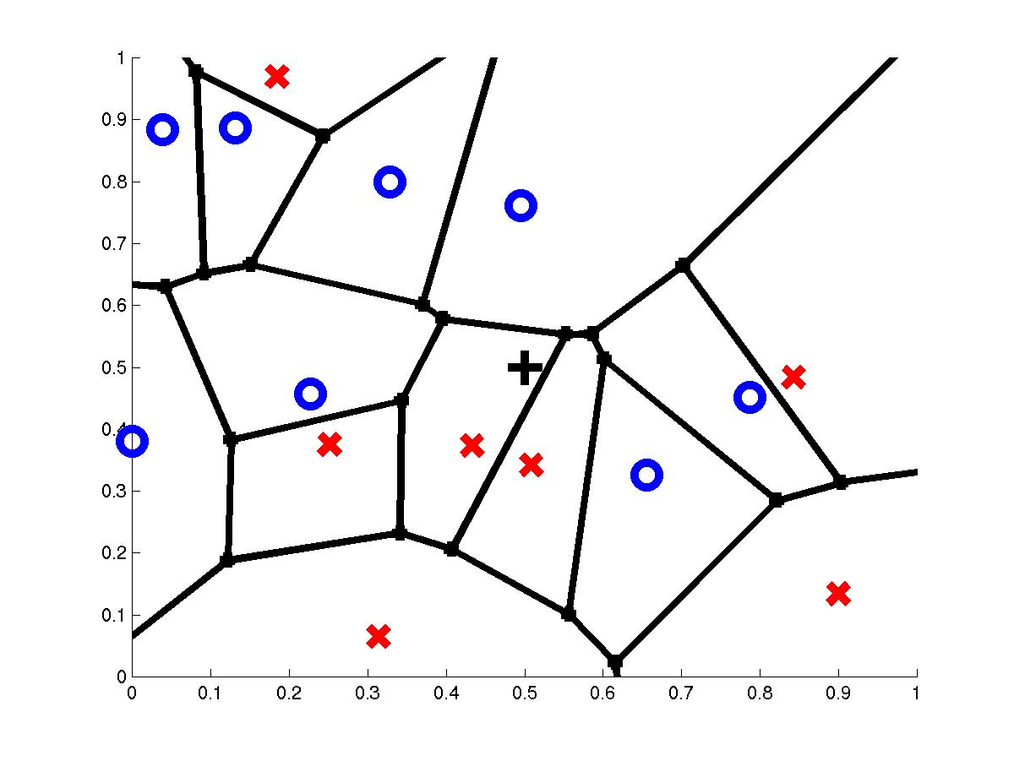
Voronoi Diagram
query point q_{f}
nearest neighbor q_{i}

Slide 60
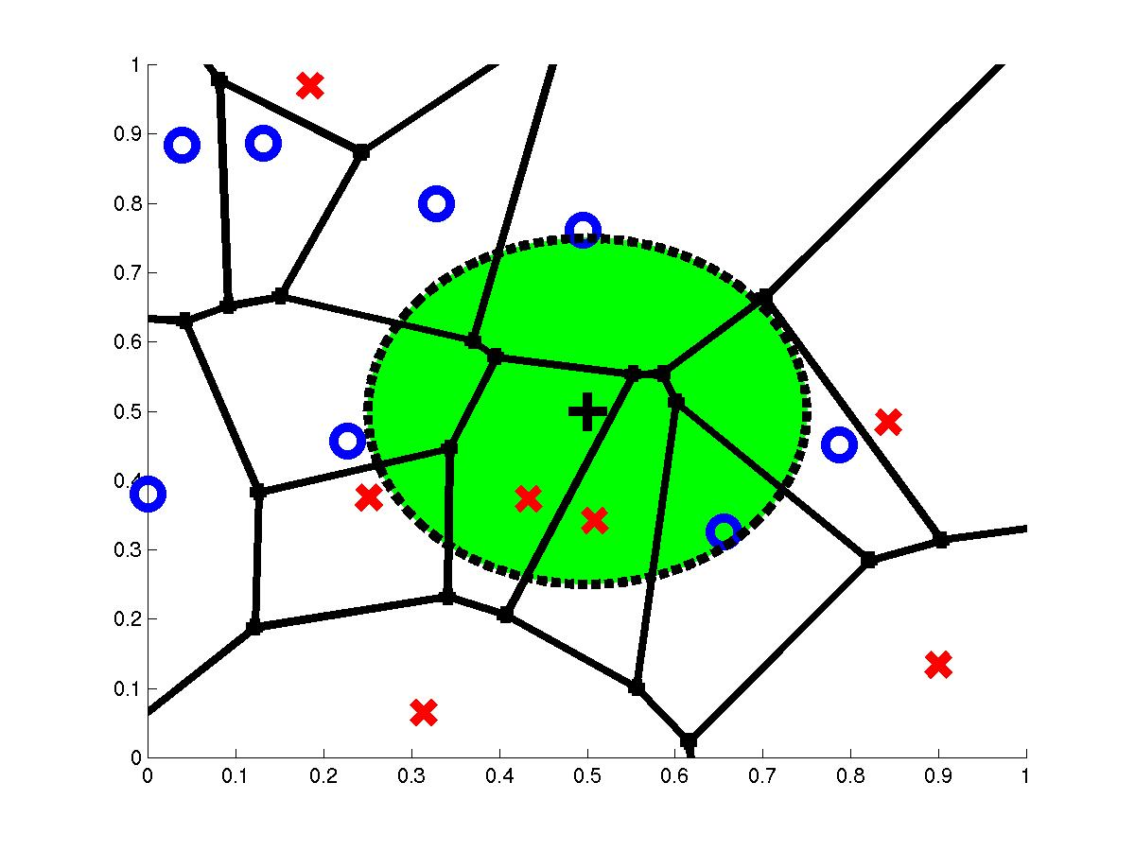
3-Nearest Neighbors
query point q_{f}
3 nearest neighbors
2x,1o
Can use Voronoi areas for weighting

Slide 61
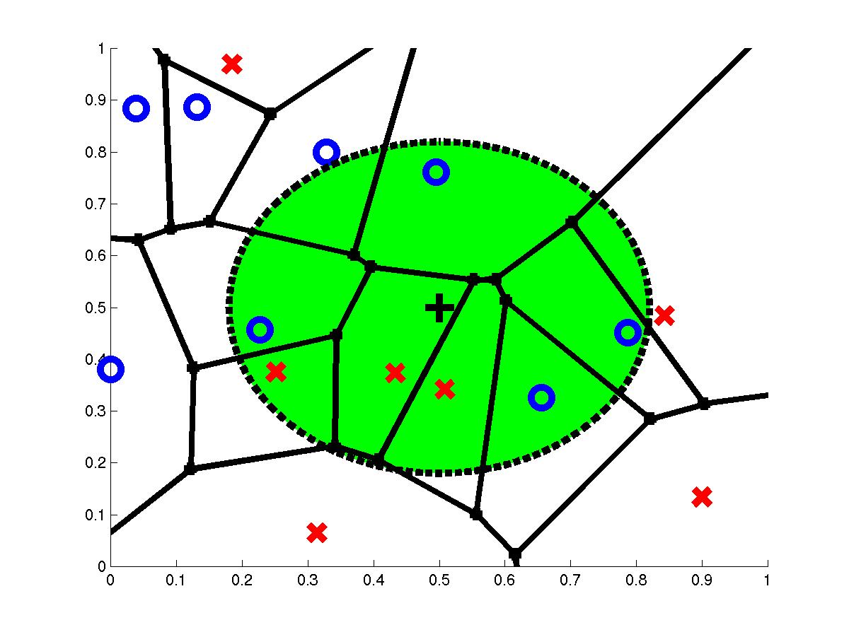
7-Nearest Neighbors
query point q_{f}
7 nearest neighbors
3x,4o

Slide 62
k-Nearest Neighbors
The best choice of k depends upon the data; generally, larger values of k reduce the effect of noise on the classification, but make boundaries between classes less distinct.
A good k can be selected by various heuristic techniques, for example, cross-validation. If k = 1, the algorithm is called the nearest neighbor algorithm.
The accuracy of the k-NN algorithm can be severely degraded by the presence of noisy or irrelevant features, or if the feature scales are not consistent with their importance.
Much research effort has been put into selecting or scaling features to improve classification, e.g. using evolutionary algorithms to optimize feature scaling.

Slide 63
The curse of dimensionality
Term introduced by Richard Bellman¹
Problems caused by the exponential increase in volume associated with adding extra dimensions to a (mathematical) space.
So: the ‘problem space’ increases with the number of variables/features.
¹Bellman, R.E. 1957. Dynamic Programming. Princeton University Press, Princeton, NJ

Slide 64
Example: Tumor Classification
Reliable and precise classification essential for successful cancer treatment
Current methods for classifying human malignancies rely on a variety of morphological, clinical and molecular variables
Uncertainties in diagnosis remain; likely that existing classes are heterogeneous
Characterize molecular variations among tumors by monitoring gene expression (microarray)
Hope: that microarrays will lead to more reliable tumor classification (and therefore more appropriate treatments and better outcomes)
Notes:
4

Slide 65
Tumor Classification Using Gene Expression Data
Three main types of ML problems associated with tumor classification:
Identification of new/unknown tumor classes using gene expression profiles (unsupervised learning – clustering)
Classification of malignancies into known classes (supervised learning – discrimination)
Identification of “marker” genes that characterize the different tumor classes (feature or variable selection).
Notes:
4 relevant to other types of classification problems, not just tumors

Slide 66
Example
Leukemia experiments (Golub et al 1999)
Goal. To identify genes which are differentially expressed in acute lymphoblastic leukemia (ALL) tumours in comparison with acute myeloid leukemia (AML) tumours.
38 tumour samples: 27 ALL, 11 AML.
Data from Affymetrix chips, some pre-processing.
Originally 6,817 genes; 3,051 after reduction.
Data therefore 3,051 × 38 array of expression values.
Acute lymphoblastic leukemia (ALL) is the most common malignancy in children 2-5 years in age, representing nearly one third of all pediatric cancers.
Acute Myeloid Leukemia (AML) is the most common form of myeloid leukemia in adults (chronic lymphocytic leukemia is the most common form of leukemia in adults overall). In contrast, acute myeloid leukemia is an uncommon variant of leukemia in children. The median age at diagnosis of acute myeloid leukemia is 65 years of age.

Slide 67
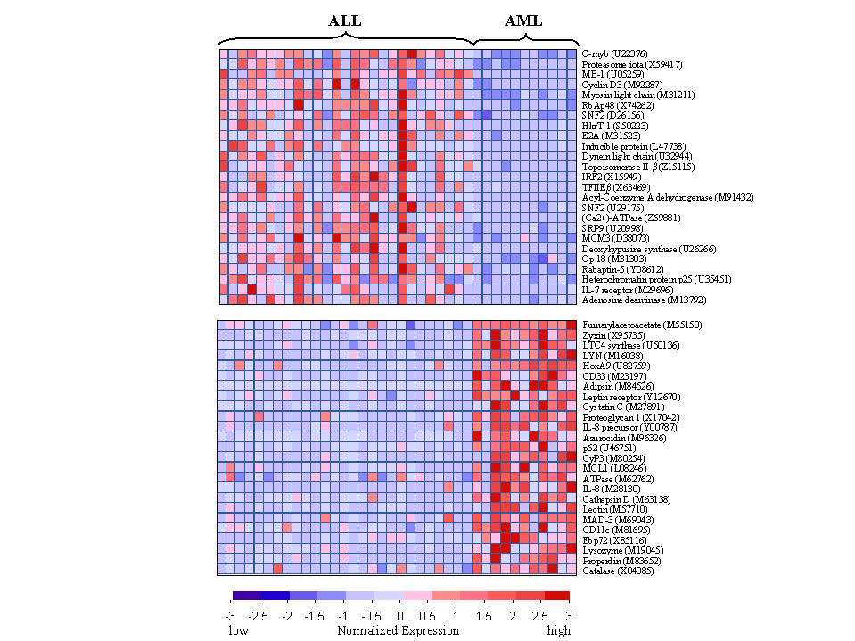
Learning set
Predefine
classes
Tumor type
B-ALL
T-ALL
AML
T-ALL
?
Objects
Array
Feature vectors
Gene
expression
new
array
Reference
Golub et al (1999) Molecular classification of cancer: class discovery and class prediction by gene expression monitoring. Science 286(5439): 531-537.
Classification
Rule

Slide 68
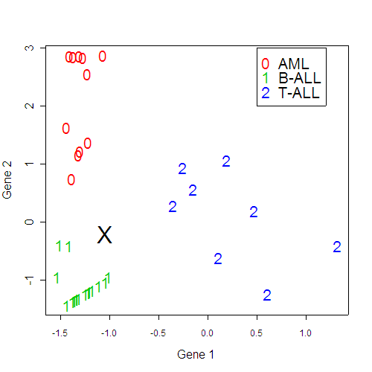
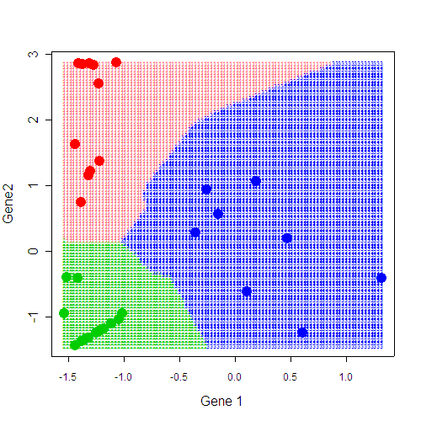
Nearest neighbor rule

Slide 69
SVM
SVMs were originally proposed by Boser, Guyon and Vapnik in 1992 and gained increasing popularity in late 1990s.
SVMs are currently among the best performers for a number of classification tasks ranging from text to genomic data.
SVM techniques have been extended to a number of tasks such as regression [Vapnik et al. ’97], principal component analysis [Schölkopf et al. ’99], etc.
Most popular optimization algorithms for SVMs are SMO [Platt ’99] and SVM^{light} [Joachims’ 99], both use decomposition to hill-climb over a subset of α_{i}’s at a time.
Tuning SVMs remains a black art: selecting a specific kernel and parameters is usually done in a try-and-see manner.

Slide 70
SVM
In order to discriminate between two classes, given a training dataset
  Map the data to a higher dimension space (feature space)
  Separate the two classes using an optimal linear separator

Slide 71
Feature Space Mapping
Map the original data to some higher-dimensional feature space where the training set is linearly separable:
Φ: x → φ(x)

Slide 72
The “Kernel Trick”
The linear classifier relies on inner product between vectors K(x_{i},x_{j})=x_{i}^{T}x_{j}
If every datapoint is mapped into high-dimensional space via some transformation Φ: x → φ(x), the inner product becomes:
K(x_{i},x_{j})= φ(x_{i}) ^{T}φ(x_{j})
A kernel function is some function that corresponds to an inner product in some expanded feature space.
Example:
2-dimensional vectors x=[x₁ x₂]; let K(x_{i},x_{j})=(1 + x_{i}^{T}x_{j})²,
Need to show that K(x_{i},x_{j})= φ(x_{i}) ^{T}φ(x_{j}):
K(x_{i},x_{j})=(1 + x_{i}^{T}x_{j})²,= 1+ x_{i1}²x_{j1}² + 2 x_{i1}x_{j1} x_{i2}x_{j2}+ x_{i2}²x_{j2}² + 2x_{i1}x_{j1} + 2x_{i2}x_{j2}=
= [1 x_{i1}² √2 x_{i1}x_{i2} x_{i2}² √2x_{i1} √2x_{i2}]^{T} [1 x_{j1}² √2 x_{j1}x_{j2} x_{j2}² √2x_{j1} √2x_{j2}] =
= φ(x_{i}) ^{T}φ(x_{j}), where φ(x) = [1 x₁² √2 x₁x₂ x₂² √2x₁ √2x₂]

Slide 73
Linear Separators
Which one is the best?

Slide 74
Optimal hyperplane
Support vectors uniquely characterize optimal hyper-plane
ρ
margin
Optimal hyper-plane
Support vector

Slide 75
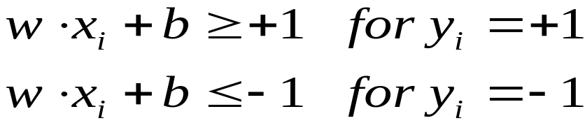
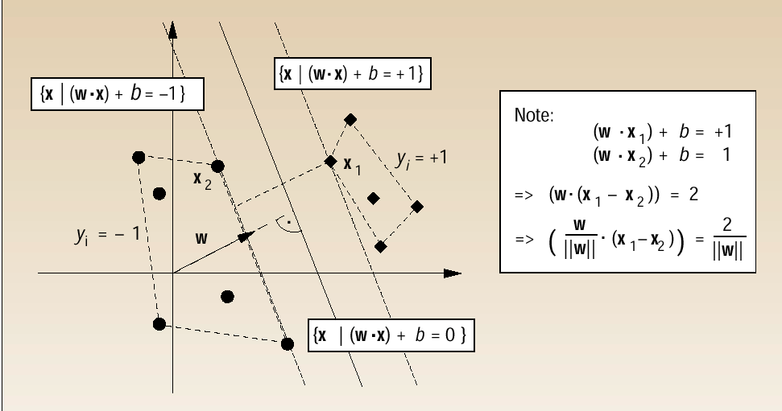
Optimal hyperplane: geometric view
The first class
The second class

Slide 76
Soft Margin Classification
What if the training set is not linearly separable?
Slack variables ξ_{i} can be added to allow misclassification of difficult or noisy examples.
ξ_{j}
ξ_{k}

Slide 77
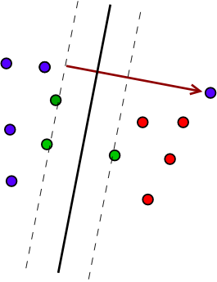




Weakening the constraints
Weakening the constraints
Allow that the objects do not strictly obey the constraints
Introduce ‘slack’-variables

Slide 78
SVM
Advantages:
  maximize the margin between two classes in the feature space characterized by a kernel function
  are robust with respect to high input dimension
Disadvantages:
  difficult to incorporate background knowledge
  Sensitive to outliers

Slide 79
SVM and outliers
outlier

Slide 80
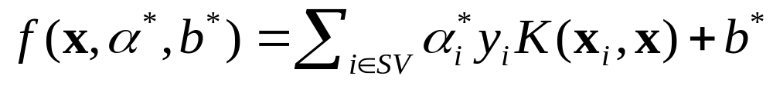
Classifying new examples
Given new point x, its class membership is
sign[f(x, α*, b*)], where
Data enters only in the form of dot products!
and in general
Kernel function

Slide 81
What is feature selection?
Reducing the feature space by removing some of the (non-relevant) features.
Also known as:
  variable selection
  feature reduction
  attribute selection
  variable subset selection

Slide 82
Why select features?
It is cheaper to measure less variables.
The resulting classifier is simpler and potentially faster.
Prediction accuracy may improve by discarding irrelevant variables.
Identifying relevant variables gives more insight into the nature of the corresponding classification problem (biomarker detection).
Alleviate the “curse of dimensionality”.

Slide 83
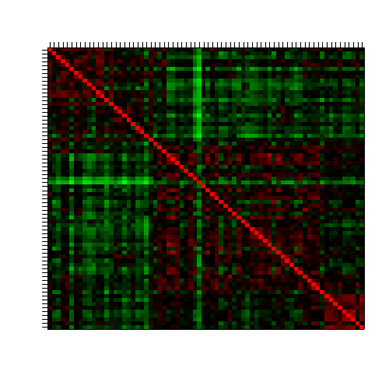
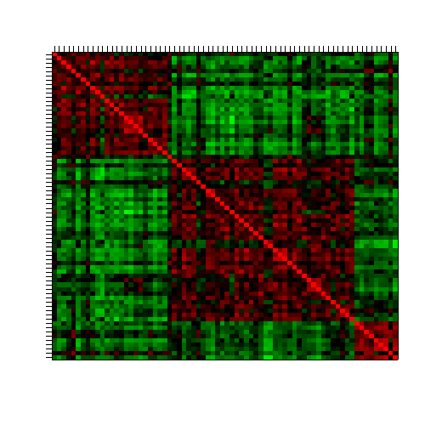
Why select features?
No feature
selection
Top 100
feature selection
Selection based on variance
Correlation plot
Data: Leukemia, 3 class
-1
+1
Notes:
That should go under clustering as well?

Slide 84
The curse of dimensionality (see also earlier slide)
A high dimensional feature space leads to problems in for example:
  Machine learning: danger of overfitting with too many variables.
  Optimization: finding the global optimum is (virtually) infeasible in a high-dimensional space.
  Microarray analysis: the number of features (genes) is much larger than the number of objects (samples). So a huge amount of observations is needed to obtain a good estimate of the function of a gene.

Slide 85
Microarray Data Challenges to Machine Learning Algorithms:
Few samples for analysis (38 labeled).
Extremely high-dimensional data (7129 gene expression values per sample).
Noisy data.
Complex underlying mechanisms, not fully understood.

Slide 86
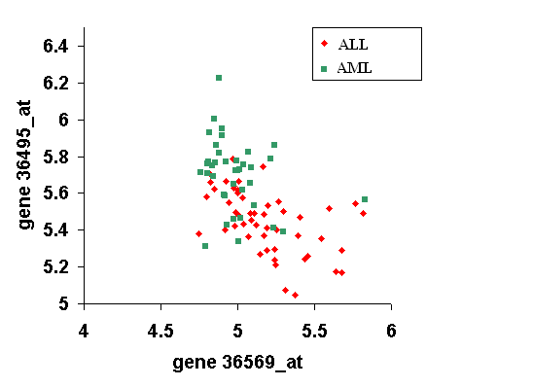
Some genes are more useful than others for building classification models
Example: genes 36569_at and 36495_at are useful

Slide 87
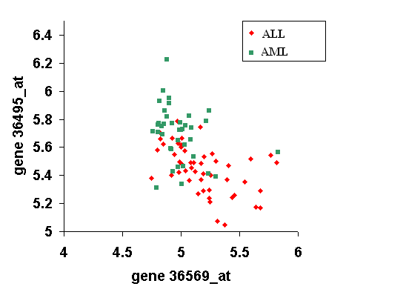
Some genes are more useful than others for building classification models
Example: genes 36569_at and 36495_at are useful
AML
ALL

Slide 88
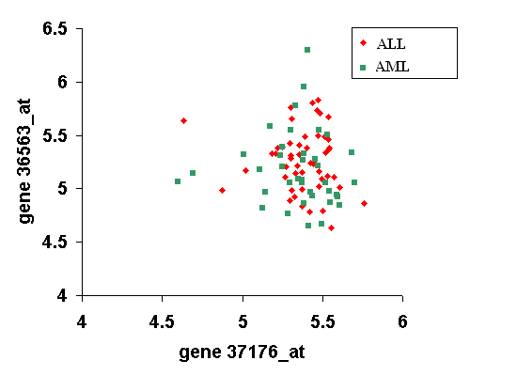
Some genes are more useful than others for building classification models
Example: genes 37176_at and 36563_at not useful

Slide 89
Importance of feature (gene) selection
Majority of genes are not directly related to leukemia.
Having a large number of features enhances the model’s flexibility, but makes it prone to overfitting.
Noise and the small number of training samples makes this even more likely.
Some types of models, like kNN do not scale well with many features.

Slide 90
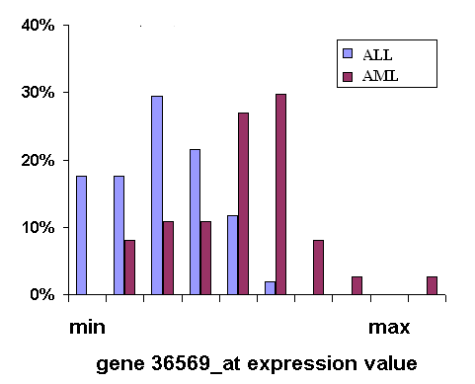
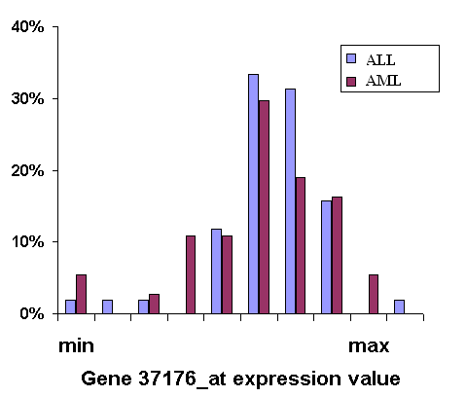
How do we choose the most relevant of the 7219 genes?
Distance metrics to capture class separation.
Rank genes according to distance metric score.
Choose the top n ranked genes.
HIGH score
LOW score

Slide 91
Classical example
Genome-Wide Cluster Analysis
Eisen dataset (a classic)
Eisen et al., PNAS 1998
S. cerevisiae (baker’s yeast)
– all genes (~ 6200) on a single array
– measured during several processes
human fibroblasts
– 8600 human transcripts on array
– measured at 12 time points during serum stimulation

Slide 92
The Eisen Data
• 79 measurements for yeast data
• collected at various time points during
– diauxic shift (shutting down genes for metabolizing sugars, activating those for metabolizing ethanol)
– mitotic cell division cycle
– sporulation
– temperature shock
– reducing shock

Slide 93
Eisen et al. cDNA array results
redundant representations of genes cluster together
  but individual genes can be distinguished from related genes by subtle differences in expression
genes of similar function cluster together
  e.g. 126 genes were observed to be strongly down-regulated in response to stress

Slide 94
Eisen et al. Results
126 genes down-regulated in response to stress
  112 of these 126 genes encode ribosomal and other proteins related to translation
  agrees with previously known result that yeast responds to favorable growth conditions by increasing the production of ribosomes

