Slide 1
Recommender Systems with capacity Group: Marava2
CSCI 4110/6110 Project
Seyed Shahab Mofidi
Anders Maraviglia
Fall 2016

Slide 2

Example
System
Intervention
Class Project Assignment
System Assignment Results
One Group Happy (First Choice)
Others, well, partially satisfied
Results
Better: 2
Same: 7
Worse: 2

Slide 3
Example
System preferences are considered
User preferences are also considered
Central System
Personalized Recommendations
Research Question:
What is the best recommendation set for each user? Given system and users preferences.
Agents have discretion
System faces duplicates and rejections

Slide 4
Similarities (1)
Matching Theory (two-sided)
Examples:
Deferred acceptance algorithm (Gale and Shapely, 1962)
Boston mechanism (Roth, 1991)
Stability constraint
Strategy proofness
Ordinal preferences of agents are given
No systematic objective

Slide 5
Similarities (2)
Classical Assignment problem (one-sided)
System Optimal
System’s benefit (cost) is the only objective
Benefits associated with assignments of alternatives to agents are given
Agent’s preferences are not considered
Capacity (budget) constraints exist

Slide 6
Recommender systems (3)
Classical Assignment problem (one-sided)
Improving agent’s utilities
Some predictions of cardinal preferences of agents
No capacity constraints
System’s benefit (cost) is the only objective
Maximizing social welfare is the objective

Slide 7
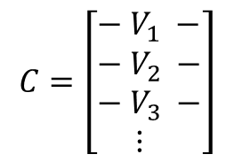
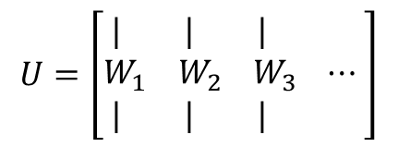
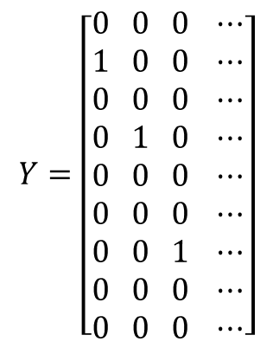
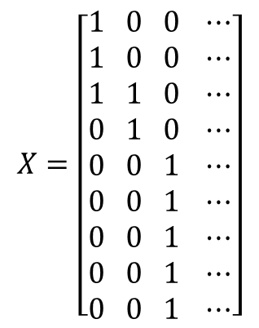
Goal
recommendation sets for each user? Given system and users preferences.
Central System
Personalized Recommendations
Groups
$$C=\left[\begin{aligned}&− V_{1} − \\ &− V_{2} − \\ &− V_{3} − \\ & ⋮\end{aligned}\right]$$
Groups
Groups
Projects
$$X=\left[\begin{aligned}&1 0 0 ⋯ \\ &1 0 0 ⋯ \\ &1 1 0 ⋯ \\ &0 1 0 ⋯ \\ &0 0 1 ⋯ \\ &0 0 1 ⋯ \\ &0 0 1 ⋯ \\ &0 0 1 ⋯ \\ &0 0 1 ⋯\end{aligned}\right]$$
$$Y=\left[\begin{aligned}&0 0 0 ⋯ \\ &1 0 0 ⋯ \\ &0 0 0 ⋯ \\ &0 1 0 ⋯ \\ &0 0 0 ⋯ \\ &0 0 0 ⋯ \\ &0 0 1 ⋯ \\ &0 0 0 ⋯ \\ &0 0 0 ⋯\end{aligned}\right]$$
Groups
Projects
Projects
$$U=\left[\begin{aligned}& | | | \\ &W_{1} W_{2} W_{3} ⋯ \\ & | | | \end{aligned}\right]$$
Projects

Slide 8
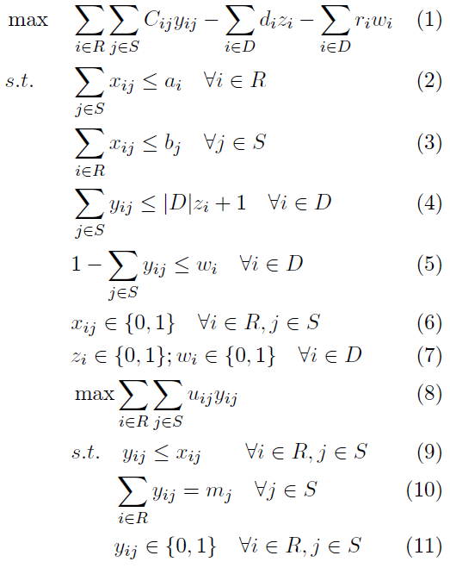
Bilevel Optimization
Network Representation

Slide 9
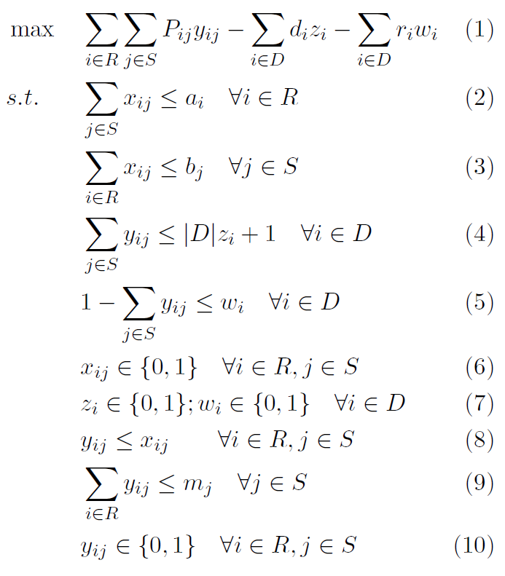










Heuristic (single level)
Capture the concept of allignment
System preferences vs. User preferences
$\overset{⃑}{p}={Proj}_{\overset{⃑}{c}} \overset{⃑}{u}$
$${\overset{⃑}{u}}_{1}$$
$${\overset{⃑}{c}}_{1}$$
$$U=\left[\begin{aligned}1 1 \\ 2 2\end{aligned}\right]$$
$${\overset{⃑}{p}}_{1}$$
$$P=\left[\begin{aligned}1 1.6 \\ 2 0.8\end{aligned}\right]$$
$$C=\left[\begin{aligned}1 2 \\ 2 1\end{aligned}\right]$$
$${\overset{⃑}{u}}_{2}$$
$${\overset{⃑}{c}}_{2}$$
$${\overset{⃑}{p}}_{2}$$

Slide 10
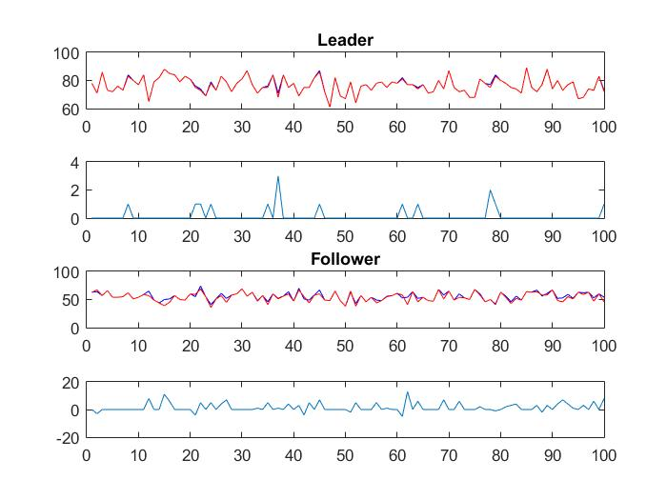
Preformance
Computationally efficient
Near optimal (System)
Some inconsistencies (user)

Slide 11
New “Greedy” Assignment Algorithm
Anders slides

