Slide 1
Recommender Systems with capacity Group: Marava2
CSCI 4110/6110 Project
Seyed Shahab Mofidi
Anders Maraviglia
Fall 2016

Slide 2

Example
System
Intervention
Class Project Assignment
All projects available to all groups
No groups work on the same project
Groups have discretion to choose
System faces duplicates and/or rejections
System also has some incentives for specific matches.
Results
Better: 2
Same: 7
Worse: 2

Slide 3
Example
System preferences are considered
User preferences are also considered
Central System
Personalized Recommendations
Research Question:
What is the best recommendation set for each user? Given system and users preferences.
Agents have discretion
System faces duplicates and rejections

Slide 4
Similarities
Matching Theory
Examples:
Deferred acceptance
Boston mechanism
Stability constraint
Strategy proofness
Ordinal preferences of agents are given
No systematic objective
Classical Assignment
Example:
Vehicle routing problems
Capacity (budget) constraints
Only system preferences
System optimal
Recommender Systems
Examples:
Google, Netflix
No constraints.
Predictions of agents’ preferences
Maximizing social welfare

Slide 5
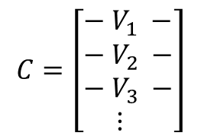
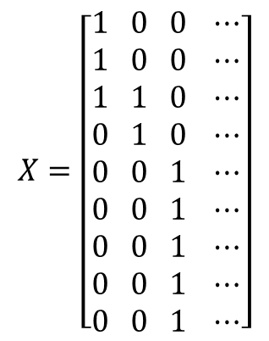
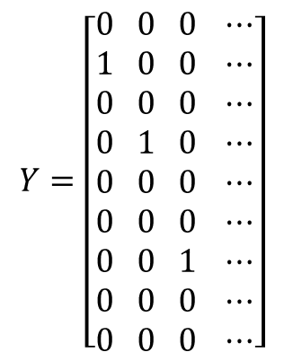
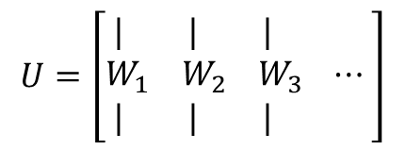
Goal
recommendation sets for each user? Given system and users preferences.
Central System
Personalized Recommendations
Groups
Groups
Groups
Projects
Groups
Projects
Projects
Projects

Slide 6
Bilevel Optimization
Network Representation
System objective in the upper level
System maximizes flow from s to t and establish edges.
Agents objective in the lower level
Agents maximize flow from t to s using the edges defined by the system in the previous round.

Slide 7
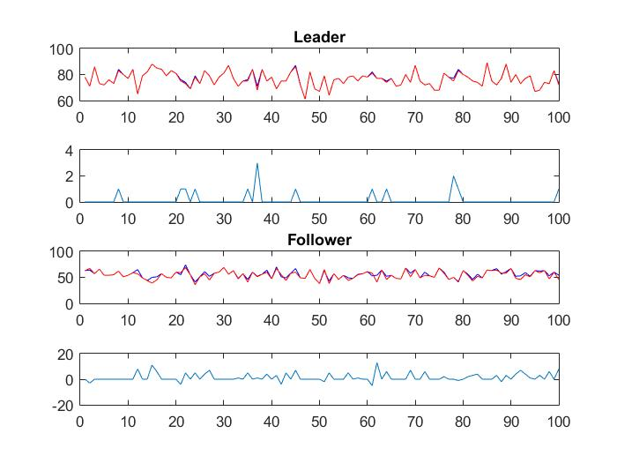






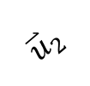



Heuristic (Projection method)
Alignment of the system vs. agent’s preferences
Single level optimization model
Faster run time
Near optimal (System)
Some inconsistencies (user)

Slide 8
New “Greedy” Assignment Algorithm
Alternative to Bilevel Optimization
Trying a new algorithm, much like Gale Shapley, but where pick order is based on which user has the highest (or lowest) combined “desirability” as ranked by the system.
“Desirability”: sum of system utilities for a user.
Allows for one to one and many to many matchings.
Fundamentally different from Gale Shapley because match stability is not a concern.

Slide 9
Many to Many Matching Example (New Algorithm)
System matrix (systems: E, F, G, H):
E F G H
A [3 2 2 2]
B [4 3 4 3]
C [2 4 1 1]
D [1 1 3 4]
Desirability based on user matrix:
[10, 8, 11, 11]
User Matrix (users: A,B,C,D):
E F G H
A [3 1 4 2]
B [4 2 1 3]
C [1 4 2 3]
D [2 1 4 3]
Result Matrix (m=2):
E F G H
A [1 1 0 0]
B [0 0 1 1]
C [1 1 0 0]
D [0 0 1 1]
System Utility = 25, User Utility = 20

Slide 10
Gale Shapley Many to Many Matching Extension
Just like one to one matching, but each iteration try to find as many matches as we are looking for.
If a system tries to match to a user that already has the max matches, remove the system that has the lowest utility that the current one beats (if one exists).
With this approach, a complete many to many matching may not exist for any two given matrices.

Slide 11
Many to Many Matching Example (Gale Shapley)
User Matrix (users: A,B,C,D):
E F G H
A [3 1 4 2]
B [4 2 1 3]
C [1 4 2 3]
D [2 1 4 3]
Result Matrix (m=2):
E F G H
A [1 0 1 0]
B [1 0 0 1]
C [0 1 0 0]
D [0 0 1 1]
System Utility = 23, User Utility = 25
System matrix (systems: E, F, G, H):
E F G H
A [3 2 2 2]
B [4 3 4 3]
C [2 4 1 1]
D [1 1 3 4]
Algorithm (systems are proposers):
Iter. 1: E → B, A
F → C, B
G → D, A
H → D, B (removes B’s match to F)
Iter. 2: F is left without 2 matches.

Slide 12
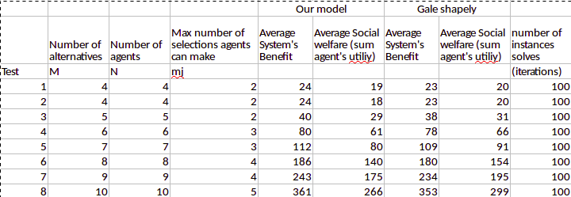
Algorithm Comparison Results

