Slide 1
Recommender Systems
with capacity
Group: Marava2
CSCI 4110/6110 Project
Seyed Shahab Mofidi
Anders Maraviglia
Fall 2016

Slide 2

Example
System
Intervention
Class Project Assignment
System Assignment Results
One Group Happy (First Choice)
Others, well, partially satisfied
Results
Better: 2
Same: 7
Worse: 2

Slide 3
Example
System preferences are considered
User preferences are also considered
Central System
Personalized Recommendations
Research Question:
What is the best recommendation set for each user? Given system and users preferences.
Agents have discretion
System faces duplicates and rejections

Slide 4
Similarities (1)
Matching Theory (two-sided)
Examples:
Deferred acceptance algorithm (Gale and Shapely, 1962)
Boston mechanism (Roth, 1991)
Stability constraint
Strategy proofness
Ordinal preferences of agents are given
No systematic objective

Slide 5
Similarities (2)
Classical Assignment problem (one-sided)
System Optimal
System’s benefit (cost) is the only objective
Benefits associated with assignments of alternatives to agents are given
Agent’s preferences are not considered
Capacity (budget) constraints exist

Slide 6
Recommender systems (3)
Classical Assignment problem (one-sided)
Improving agent’s utilities
Some predictions of cardinal preferences of agents
No capacity constraints
System’s benefit (cost) is the only objective
Maximizing social welfare is the objective

Slide 7
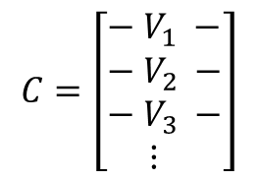
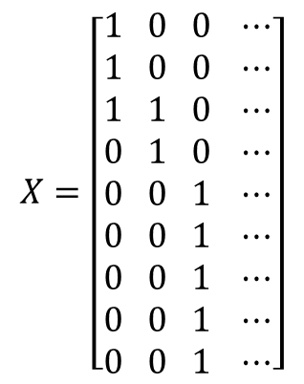
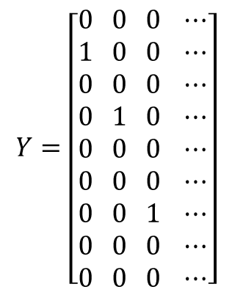
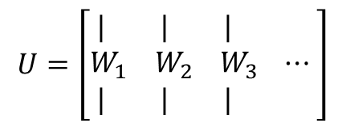
Goal
recommendation sets for each user? Given system and users preferences.
Central System
Personalized Recommendations
Groups
Groups
Groups
Projects
Groups
Projects
Projects
Projects

Slide 8
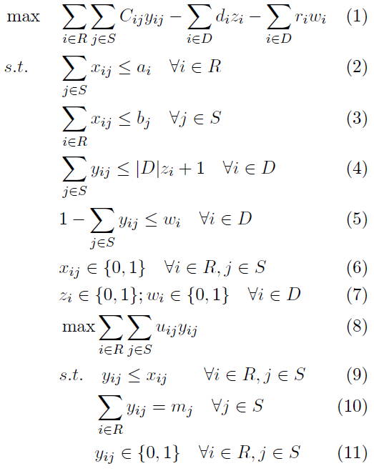
Bilevel Optimization
Network Representation

Slide 9
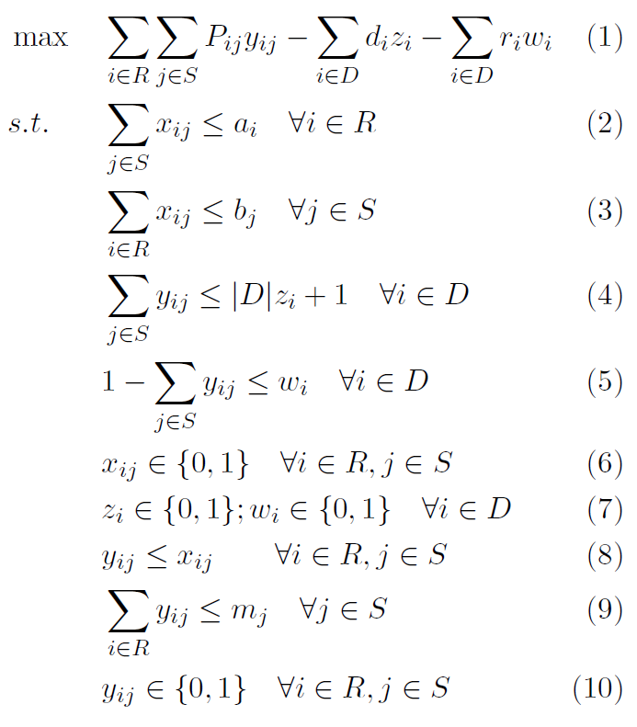
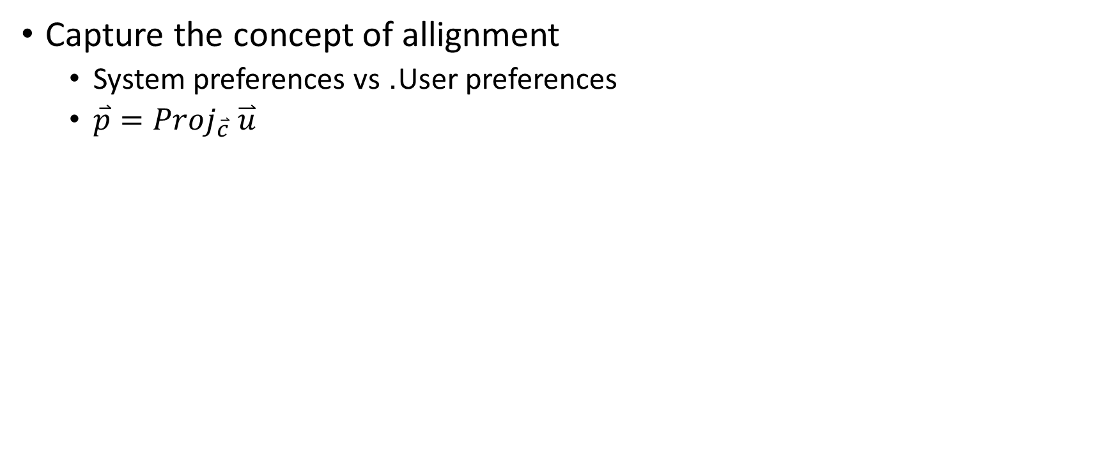






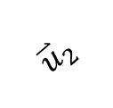


Heuristic (single level)
Capture the concept of allignment
System preferences vs. User preferences

Slide 10
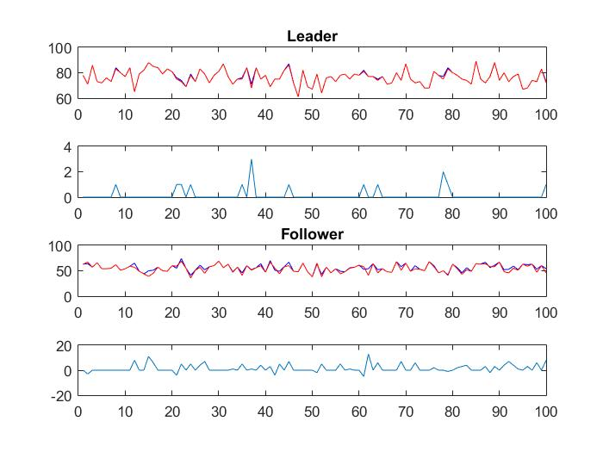
Preformance
Computationally efficient
Near optimal (System)
Some inconsistencies (user)

Slide 11
New “Greedy” Assignment Algorithm
Alternative to Bilevel Optimization
Trying a new algorithm, much like Gale Shapley, but where pick order is based on which user has the highest (or lowest) combined “desirability” as ranked by the system.
“Desirability”: sum of system utilities for a user.
Allows for one to one and many to many matchings.
Fundamentally different from Gale Shapley because match stability is not a concern.

Slide 12
Many to Many Matching Example (New Algorithm)
System matrix (systems: E, F, G, H):
E F G H
A [3 2 2 2]
B [4 3 4 3]
C [2 4 1 1]
D [1 1 3 4]
Desirability based on user matrix:
[10, 8, 11, 11]
User Matrix (users: A,B,C,D):
E F G H
A [3 1 4 2]
B [4 2 1 3]
C [1 4 2 3]
D [2 1 4 3]
Result Matrix (m=2):
E F G H
A [1 1 0 0]
B [0 0 1 1]
C [1 1 0 0]
D [0 0 1 1]
System Utility = 25, User Utility = 20

Slide 13
Gale Shapley Many to Many Matching Extension
Just like one to one matching, but each iteration try to find as many matches as we are looking for.
If a system tries to match to a user that already has the max matches, remove the system that has the lowest utility that the current one beats (if one exists).
With this approach, a complete many to many matching may not exist for any two given matrices.

Slide 14
Many to Many Matching Example (Gale Shapley)
User Matrix (users: A,B,C,D):
E F G H
A [3 1 4 2]
B [4 2 1 3]
C [1 4 2 3]
D [2 1 4 3]
Result Matrix (m=2):
E F G H
A [1 0 1 0]
B [1 0 0 1]
C [0 1 0 0]
D [0 0 1 1]
System Utility = 23, User Utility = 25
System matrix (systems: E, F, G, H):
E F G H
A [3 2 2 2]
B [4 3 4 3]
C [2 4 1 1]
D [1 1 3 4]
Algorithm (systems are proposers):
Iter. 1: E → B, A
F → C, B
G → D, A
H → D, B (removes B’s match to F)
Iter. 2: F is left without 2 matches.

Slide 15
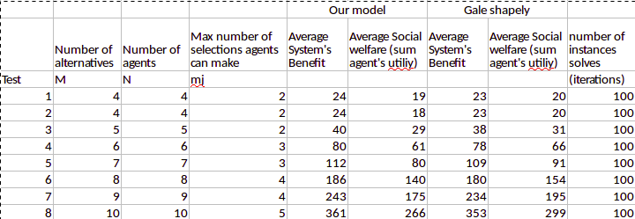
Algorithm Comparison Results

