Slide 1
Develop, Build, and Test AWS Lambda Python Functions using Docker
Michael Wehrle - “mDub”
Lead Cloud Solutions Engineer - Scripps Networks
github.com/sirmdub/pythonLambdaDevWithDocker

Slide 2
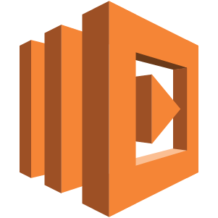
AWS Lambda
Run code without thinking about servers.
Pay for only the compute time you consume.

Slide 3
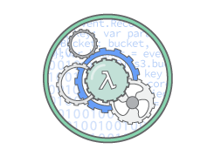
No Servers To Manage
AWS Lambda automatically runs your code without requiring you to provision or manage servers. Just write the code and upload it to Lambda.

Slide 4
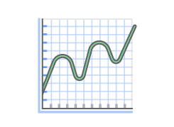
Continuous Scaling
AWS Lambda automatically scales your application by running code in response to each trigger. Your code runs in parallel and processes each trigger individually, scaling precisely with the size of the workload.

Slide 5
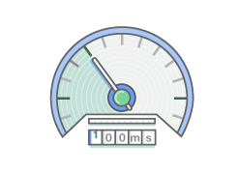
Sub-second Metering
With AWS Lambda, you are charged for every 100ms your code executes and the number of times your code is triggered. You don't pay anything when your code isn't running.

Slide 6
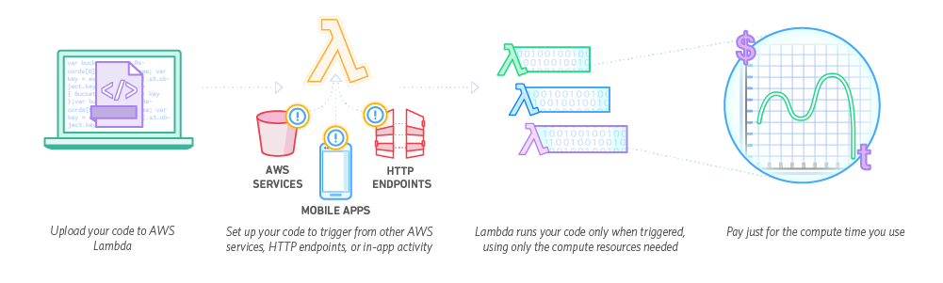
How It Works

Slide 7
What can you build with AWS Lambda?
Data Processing
Real-time File Processing
Real-time Stream Processing
Extract, Transform, Load
Backends
IoT Backends
Mobile Backends
Web Applications

Slide 8
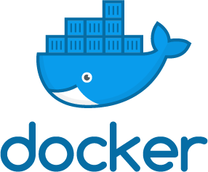
Docker
What is a container?... Package software into a standardized unit for development, shipment and deployment

Slide 9
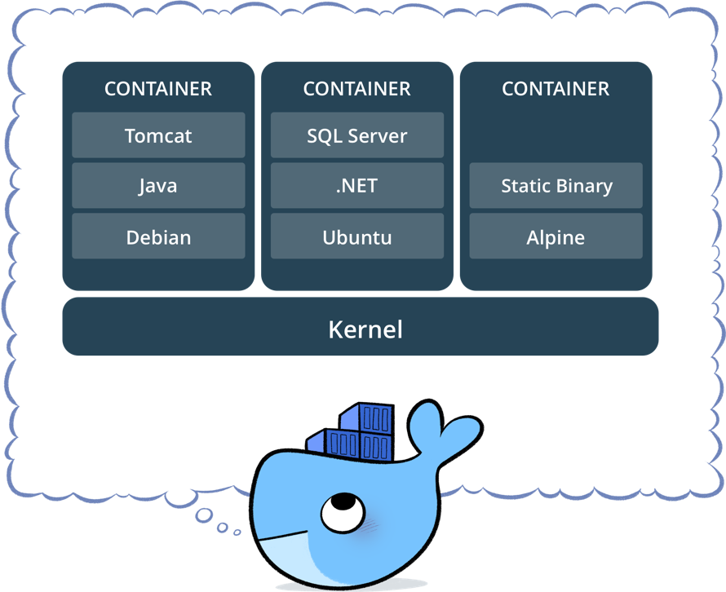
...everything required to make a piece of software run is packaged into isolated containers. ...only libraries and settings required to make the software work are needed. ...efficient, lightweight, self-contained systems guarantee that software will always run the same, regardless of where it’s deployed.

Slide 10

Docker for Developers
ANY APP, LANGUAGE, OR STACK Build, test, debug and deploy Linux and Windows Server container apps written in any programming language without risk of incompatibilities or version conflicts.

Slide 11

Docker for Developers
AWESOME DEVELOPER EXPERIENCE Reduce onboarding time by 65%: Quickly build, test and run complex multi-container apps and stop wasting time installing and maintaining software on servers and developer machines. All dependencies run in containers, eliminating “works on my machine” problems.
“anyone with Docker and an editor installed”

Slide 12

Docker for Developers
BUILT-IN CONTAINER ORCHESTRATION Docker comes with built-in swarm clustering that’s easy to configure. Test and debug apps in environments that mimic production with minimal setup.

Slide 13
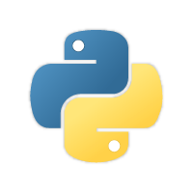
AWS Lambda Development with Python

Slide 14

AWS Lambda Development with Python
Install Python 2.7 and/or 3.6
System default? PATH? Install pyenv?
Install pip ‘python get-pip.py’
“Be cautious if you're using a Python install that's managed by your operating system or another package manager. get-pip.py does not coordinate with those tools, and may leave your system in an inconsistent state.”
virtualenv?
AWS CLI Install (If you want to automate )
OK… I think I’m ready!

Slide 15
AWS Lambda Development with Python
Write profitable CODE!
Install dependencies in project dir
pip install -r requirements.txt -t .
Zip project
zip -r pythonLambdaDevWithDocker.zip . -x *.git* *tests\/* super_secrets.txt
Deploy to AWS!
AWS Console Point & Click
OR
AWS CLI / API’s

Slide 16
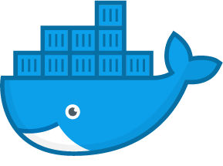
AWS Lambda Development with Python + Docker!

Slide 17
Install Python 2.7 and/or 3.6
System default? PATH? Install pyenv?
Install pip ‘python get-pip.py’
“Be cautious if you're using a Python install that's managed by your operating system or another package manager. get-pip.py does not coordinate with those tools, and may leave your system in an inconsistent state.”
Virtualenv?
AWS CLI Install
$ cat Dockerfile FROM python:2-alpine RUN apk add --no-cache zip RUN mkdir -p /usr/src/app WORKDIR /usr/src/app COPY requirements.txt /usr/src/app RUN pip install -r requirements.txt -t . COPY . /usr/src/app RUN chmod +x *.py RUN zip -r pythonLambdaDevWithDocker.zip . -x *.git* *tests\/* aws_secrets.txt ENTRYPOINT [ "python" ] CMD [ "./run.py" ]

Slide 18
Which Python would you like?
3.6.2-slim, 3.6-slim, 3-slim, slim (3.6/jessie/slim/Dockerfile) 3.6.2-onbuild, 3.6-onbuild, 3-onbuild, onbuild (3.6/jessie/onbuild/Dockerfile) 3.6.2-alpine3.6, 3.6-alpine3.6, 3-alpine3.6, alpine3.6 (3.6/alpine3.6/Dockerfile) 3.6.2-alpine3.4, 3.6-alpine3.4, 3-alpine3.4, alpine3.4, 3.6.2-alpine, 3.6-alpine, 3-alpine, alpine (3.6/alpine3.4/Dockerfile) 3.6.2-windowsservercore, 3.6-windowsservercore, 3-windowsservercore, windowsservercore (3.6/windows/windowsservercore/Dockerfile) 3.5.3-jessie, 3.5-jessie, 3.5.3, 3.5 (3.5/jessie/Dockerfile) 3.5.3-slim, 3.5-slim (3.5/jessie/slim/Dockerfile) 3.5.3-onbuild, 3.5-onbuild (3.5/jessie/onbuild/Dockerfile) 3.5.3-alpine3.4, 3.5-alpine3.4, 3.5.3-alpine, 3.5-alpine (3.5/alpine3.4/Dockerfile) 3.5.3-windowsservercore, 3.5-windowsservercore (3.5/windows/windowsservercore/Dockerfile) 3.4.6-jessie, 3.4-jessie, 3.4.6, 3.4 (3.4/jessie/Dockerfile) 3.4.6-slim, 3.4-slim (3.4/jessie/slim/Dockerfile) 3.4.6-onbuild, 3.4-onbuild (3.4/jessie/onbuild/Dockerfile) 3.4.6-wheezy, 3.4-wheezy (3.4/wheezy/Dockerfile) 3.4.6-alpine3.4, 3.4-alpine3.4, 3.4.6-alpine, 3.4-alpine (3.4/alpine3.4/Dockerfile) 3.3.6-jessie, 3.3-jessie, 3.3.6, 3.3 (3.3/jessie/Dockerfile) 3.3.6-slim, 3.3-slim (3.3/jessie/slim/Dockerfile) 3.3.6-onbuild, 3.3-onbuild (3.3/jessie/onbuild/Dockerfile) 3.3.6-wheezy, 3.3-wheezy (3.3/wheezy/Dockerfile) 3.3.6-alpine3.4, 3.3-alpine3.4, 3.3.6-alpine, 3.3-alpine (3.3/alpine3.4/Dockerfile) 2.7.13-stretch, 2.7-stretch, 2-stretch (2.7/stretch/Dockerfile) 2.7.13-jessie, 2.7-jessie, 2-jessie, 2.7.13, 2.7, 2 (2.7/jessie/Dockerfile) 2.7.13-slim, 2.7-slim, 2-slim (2.7/jessie/slim/Dockerfile) 2.7.13-onbuild, 2.7-onbuild, 2-onbuild (2.7/jessie/onbuild/Dockerfile) 2.7.13-wheezy, 2.7-wheezy, 2-wheezy (2.7/wheezy/Dockerfile) 2.7.13-alpine3.6, 2.7-alpine3.6, 2-alpine3.6 (2.7/alpine3.6/Dockerfile) 2.7.13-alpine3.4, 2.7-alpine3.4, 2-alpine3.4, 2.7.13-alpine, 2.7-alpine, 2-alpine (2.7/alpine3.4/Dockerfile) 2.7.13-windowsservercore, 2.7-windowsservercore, 2-windowsservercore (2.7/windows/windowsservercore/Dockerfile)

Slide 19
Install Python 2.7 and/or 3.6
System default? PATH? Install pyenv?
Install pip ‘python get-pip.py’
“Be cautious if you're using a Python install that's managed by your operating system or another package manager. get-pip.py does not coordinate with those tools, and may leave your system in an inconsistent state.”
Virtualenv?
AWS CLI Install
$ cat Dockerfile.deploy FROM python:2-alpine RUN pip install awscli COPY --from=pldwd:build /usr/src/app/pythonLambdaDevWithDocker.zip / CMD aws lambda update-function-code --function-name pythonLambdaDevWithDocker --zip-file fileb://pythonLambdaDevWithDocker.zip

Slide 20
Write profitable CODE!
Install dependencies in project dir
pip install -r requirements.txt -t .
Zip project
zip -r pythonLambdaDevWithDocker.zip . -x *.git* *tests\/* super_secrets.txt
Deploy to AWS!
AWS Console Point & Click
OR
AWS CLI / API’s
$ cat Dockerfile FROM python:2-alpine RUN apk add --no-cache zip RUN mkdir -p /usr/src/app WORKDIR /usr/src/app COPY requirements.txt /usr/src/app RUN pip install -r requirements.txt -t . COPY . /usr/src/app RUN chmod +x *.py RUN zip -r pythonLambdaDevWithDocker.zip . -x *.git* *tests\/* aws_secrets.txt ENTRYPOINT [ "python" ] CMD [ "./run.py" ]

Slide 21
Write profitable CODE!
Install dependencies in project dir
pip install -r requirements.txt -t .
Zip project
zip -r pythonLambdaDevWithDocker.zip . -x *.git* *tests\/* super_secrets.txt
Deploy to AWS!
AWS Console Point & Click
OR
AWS CLI / API’s
$ cat Dockerfile.deploy FROM python:2-alpine RUN pip install awscli COPY --from=pldwd:build /usr/src/app/pythonLambdaDevWithDocker.zip / CMD aws lambda update-function-code --function-name pythonLambdaDevWithDocker --zip-file fileb://pythonLambdaDevWithDocker.zip

Slide 22
github.com/sirmdub/pythonLambdaDevWithDocker
Michael Wehrle - “mDub”
Lead Cloud Solutions Engineer - Scripps Networks
mdub@snilabs.com

