Slide 1
ATHLETE ANALYTICS · 2017 – 2026
The Data Geek
8
Swimmer
YEARS
1,990 swims · 2,349 km · 1,047 hours · 8 years
Marcin Durlak · March 2026

Slide 2
OVERVIEW
8 Years by the Numbers
TOTAL SWIMS
TOTAL DISTANCE
HOURS IN WATER
WEEKS ACTIVE
1,990
2,349 km
1,047 hrs
390 weeks
Dec 2017 – Mar 2026
≈ 1,460 miles
43 full days of swimming
of ~435 possible
AVG PER SESSION
BEST YEAR PACE
OPEN WATER
LONGEST SWIM
1050 yd
1:46/100yd
124 swims
5,258 m
median session distance
2018 – fastest median year
6.2% of all sessions
Jan 7, 2026 · 1:45/100yd

Slide 3
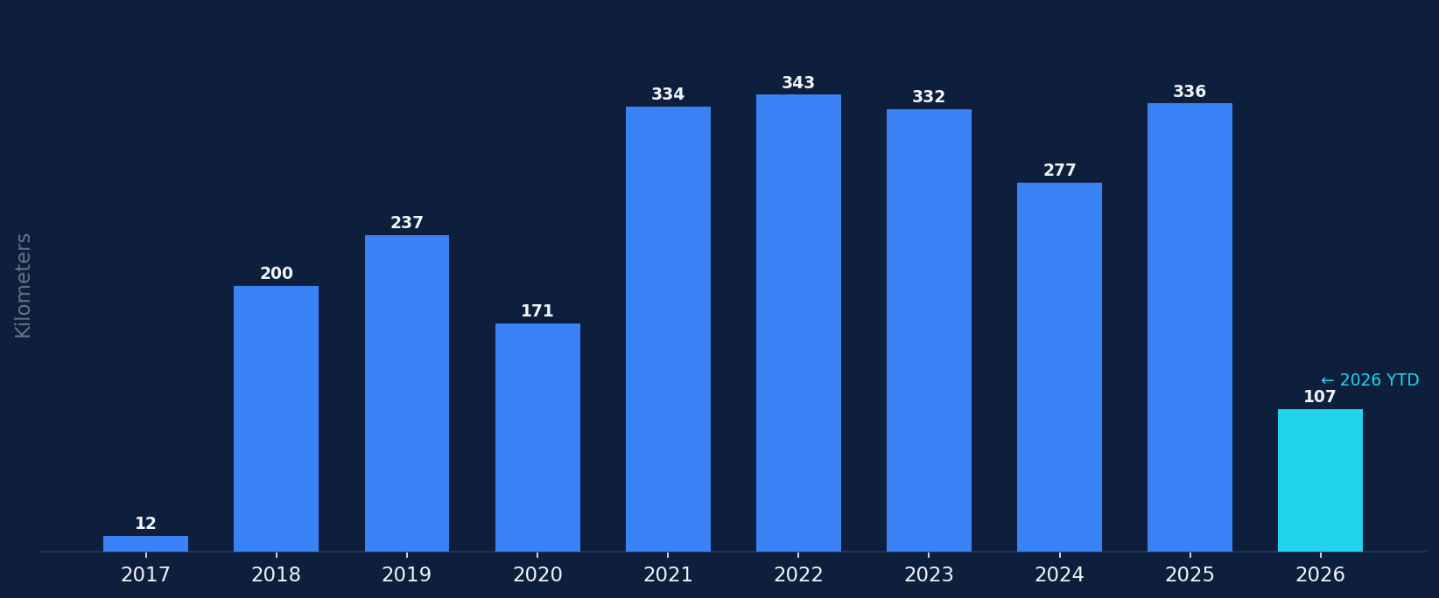
VOLUME
The Journey: Kilometers by Year

Slide 4
MILESTONE
2,349
≈ NYC to Denver, twice over
≈ 94,000 laps of a 25m pool
kilometers
swum since Dec 2017
≈ crossing the English Channel 89×
Still counting →

Slide 5
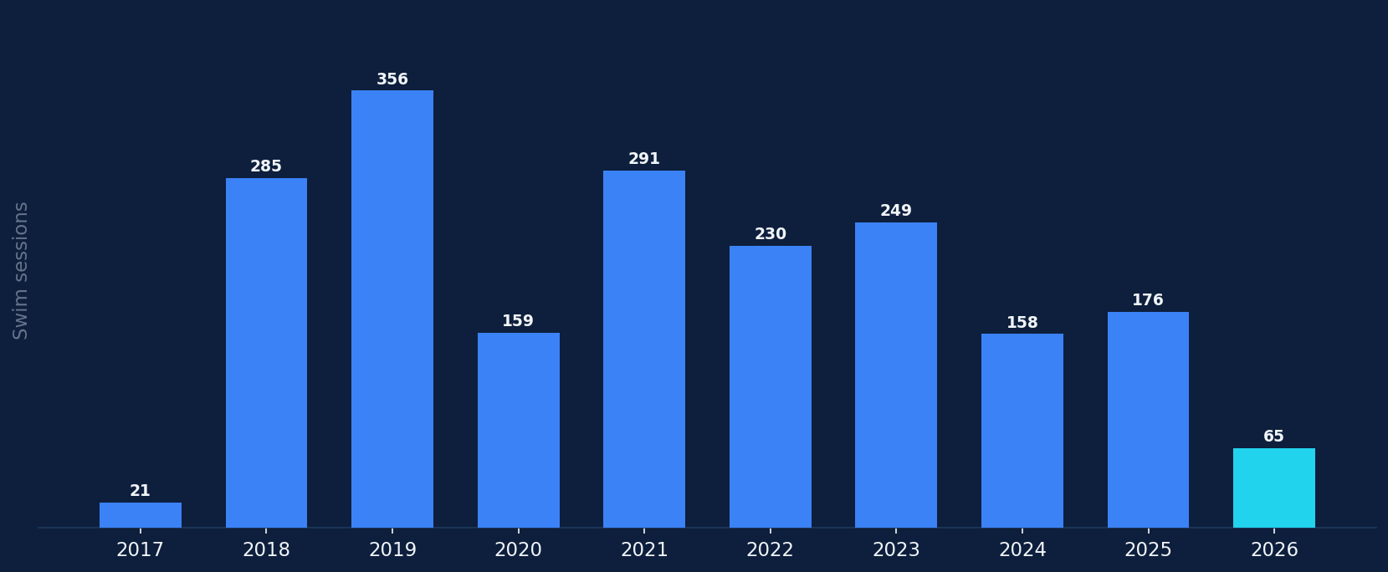
VOLUME
Sessions per Year

Slide 6
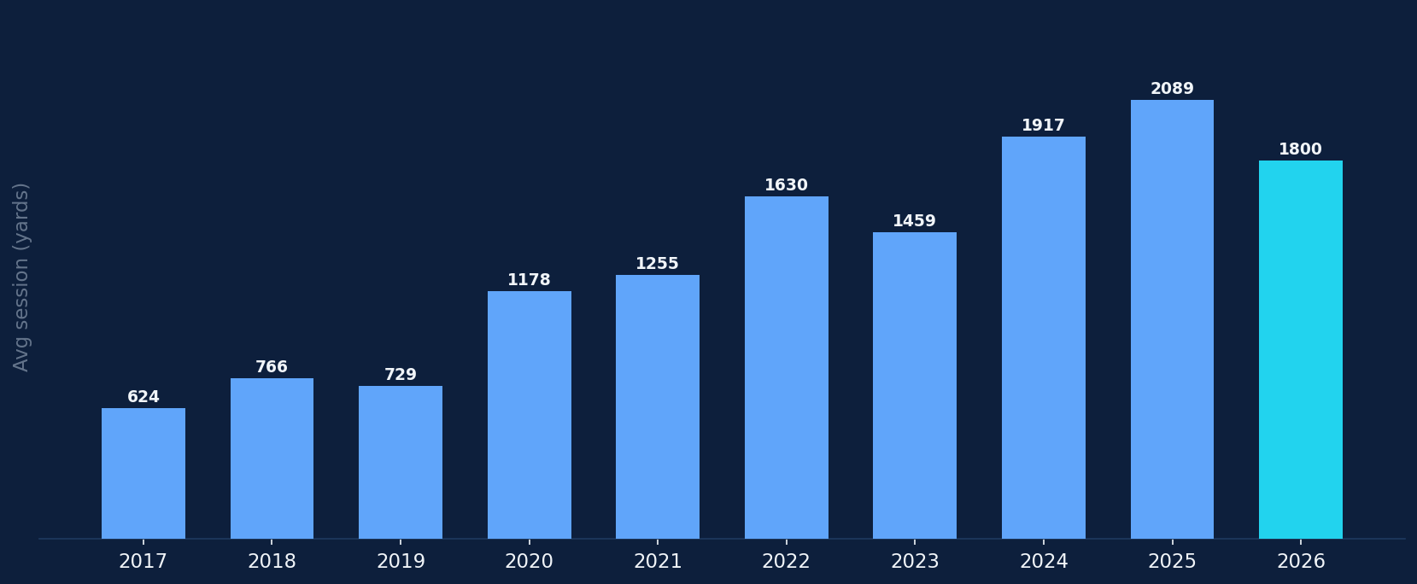
VOLUME
The Average Session Has Tripled
570 yd avg in 2017 → 1,960 yd avg in 2026

Slide 7
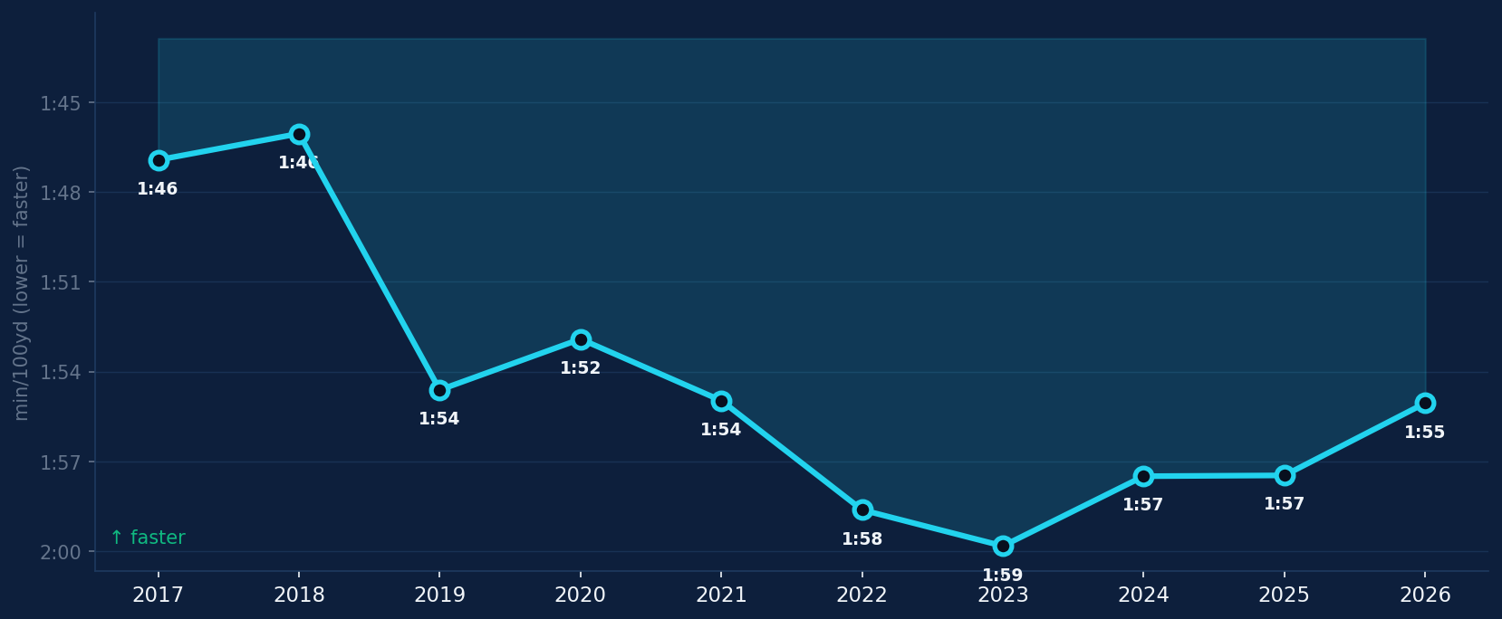
PERFORMANCE
Pace Through the Years
Lower = faster · pace in min/100yd

Slide 8
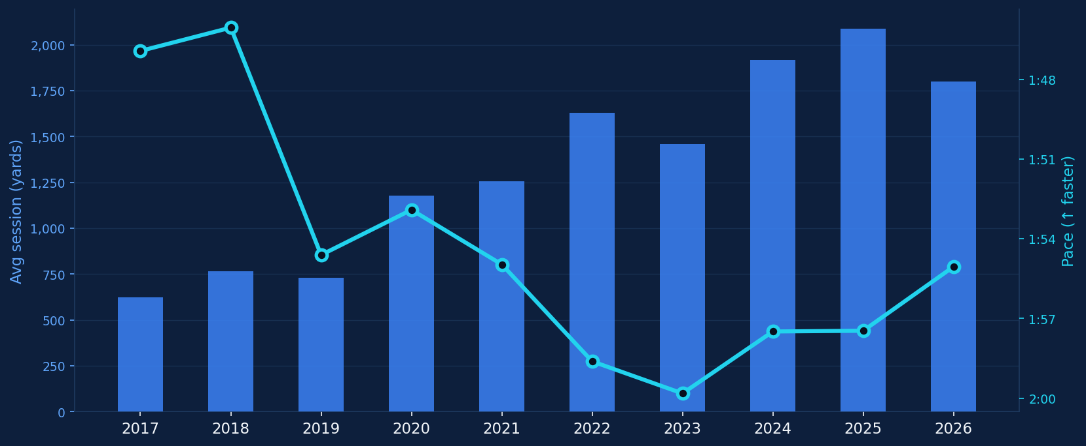
PERFORMANCE
The Paradox: Longer Sessions, Faster Pace
Blue bars = avg session distance (yards) · Cyan line = pace per 100yd

Slide 9
2026 SPOTLIGHT
2026: The Best Year Yet — and It's Only March
YTD DISTANCE
SESSIONS
MEDIAN PACE
PROJECTED
107 km
65
1:55/100yd
~454 km
thru Mar 27
in 86 days = 1 per 1.3d
best year so far
if rate holds
▸
Sessions averaging 1,646 yards — longer than any prior full year
▸
Pace improving despite longer distances — the paradox deepening
▸
16-week unbroken streak entering Q2
▸
Longest-ever swim recorded: 5,258m on Jan 7 at 1:45/100yd pace

Slide 10
MILESTONE
The Longest
PACE
1:45/100yd
Swim
DURATION
~110 min
January 7, 2026
5,258
POOL
25 yd
meters · 5,750 yards
EQUIVALENT
230 lengths

Slide 11
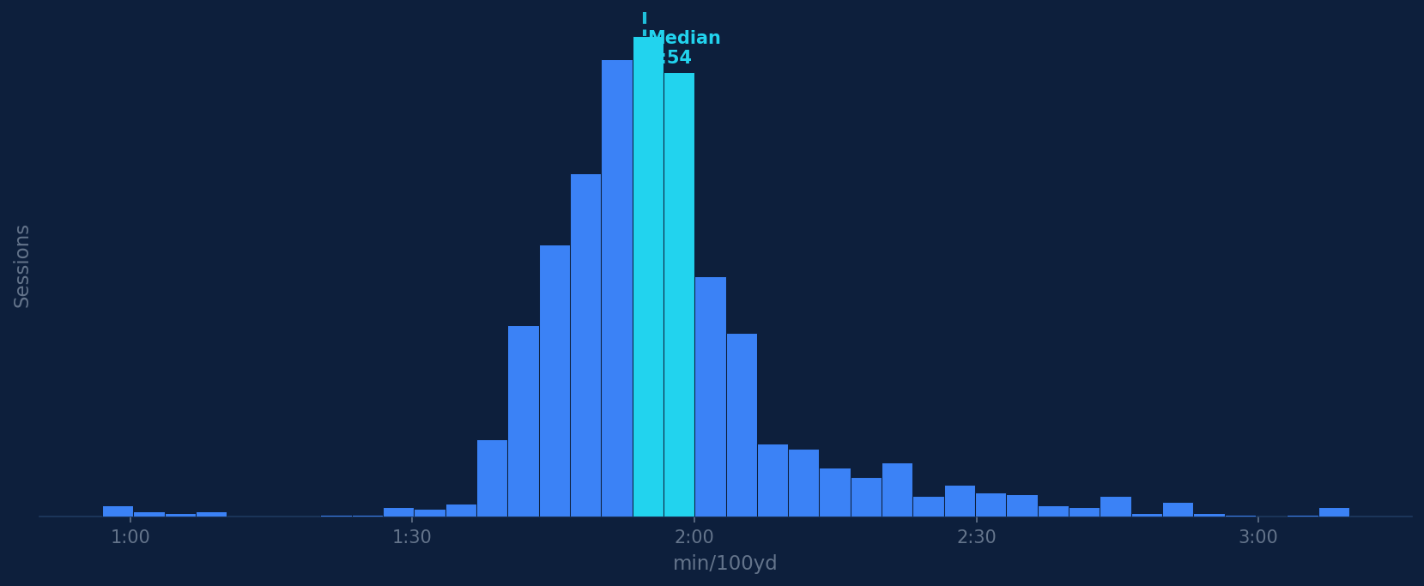
PERFORMANCE
Pace Distribution: 1,990 Sessions
Tight cluster around 1:52–2:00/100yd with a long tail of slower open-water & recovery swims

Slide 12
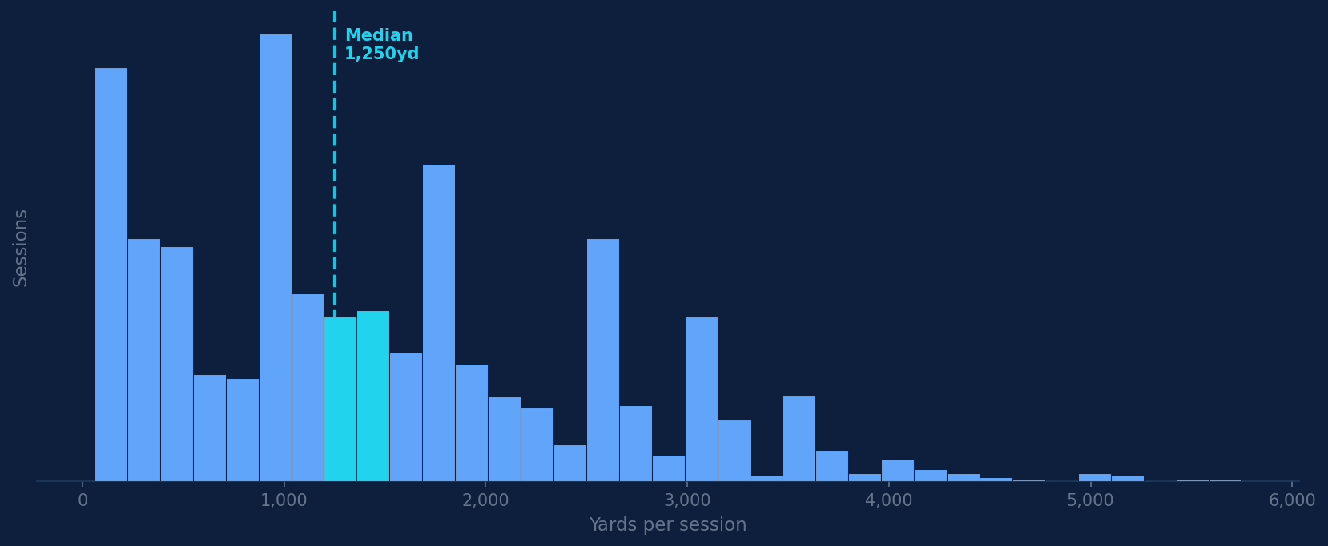
PERFORMANCE
Session Length Distribution
Median session: 1,250 yd · ranging from quick 200yd dips to 5,750yd epics

Slide 13
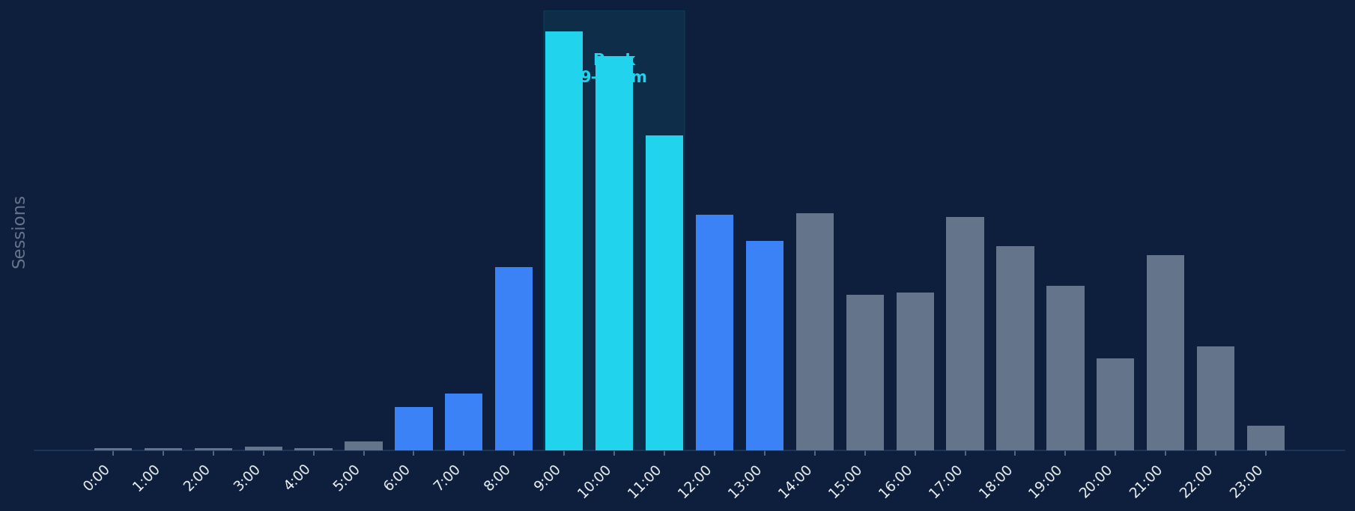
HABITS
When Does the Swimming Happen?

Slide 14
HABITS
The 9am
Morning vs Evening
Window
Morning (6–11am)
1:54/100yd
9–11am accounts for 452 of 1,990 sessions — the single most productive two-hour window, and consistently fastest pace.
816 sessions
Evening (5–10pm)
1:55/100yd
9am sessions
242
574 sessions
10am sessions
228
Morning is 1.2s/100yd faster
11am sessions
182

Slide 15
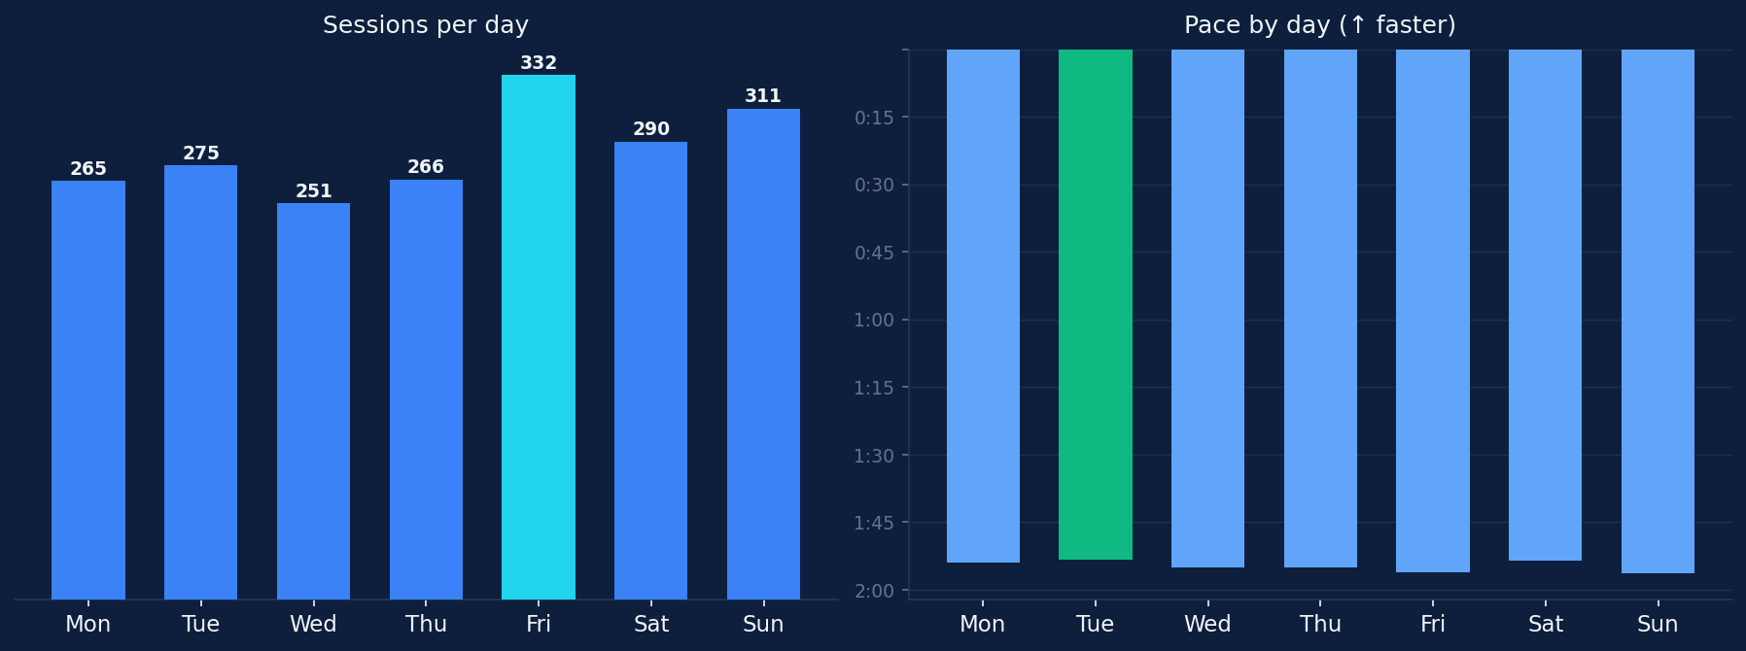
HABITS
Day of Week: Volume vs Performance

Slide 16
HABITS
The Friday Phenomenon
Most swims
Best pace days
Friday
Mon & Tue
332 sessions — 17% more than any other weekday. Friday has become the anchor day of the training week.
Monday 1:54/100yd · Tuesday 1:54/100yd Starting the week fresh delivers measurably faster swimming. Friday energy is high — but Monday has the edge.
Mon 265
Tue 275
Wed 251
Thu 266
Fri 332
Sat 290
Sun 311

Slide 17
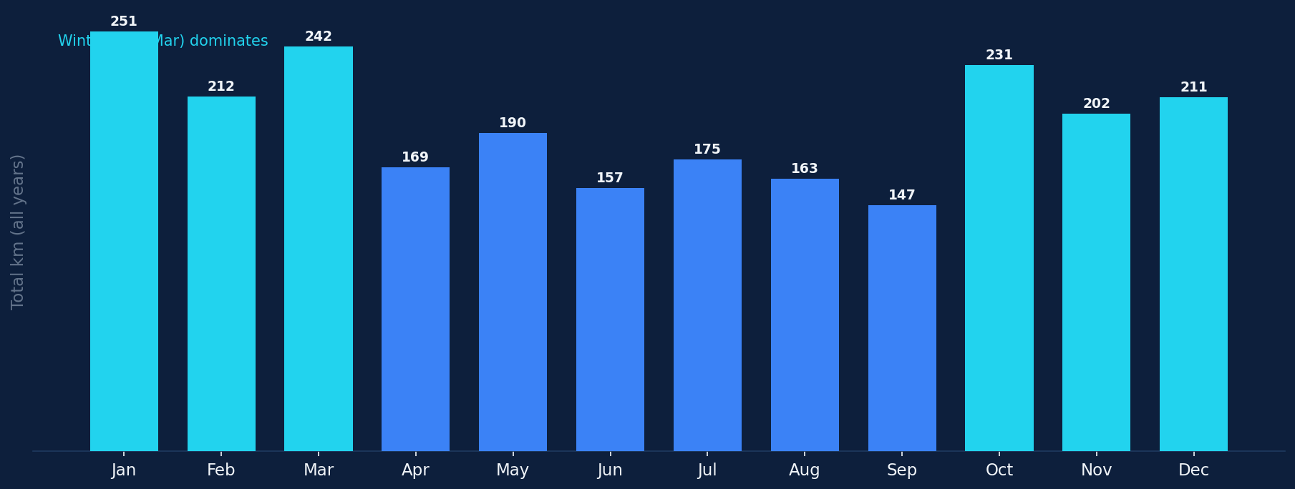
HABITS
Monthly Patterns Across 8 Years

Slide 18
HABITS
Winter is When It Happens
Winter Oct–Mar
Summer Apr–Sep
1016
974
sessions
sessions
1349 km
1001 km
total distance
total distance
July is the surprise — highest session count despite summer, likely driven by outdoor open water swims.

Slide 19
CONSISTENCY
390
That's consistency behind elite performance. No single month without swimming. Through travel, illness, life.
weeks with at least one swim
out of ~435 possible since Dec 2017 · 89.7% week adherence rate

Slide 20
CONSISTENCY
Current Streak: 16 Consecutive Weeks
Active since week of December 29, 2025 · still going
W1
W2
W3
W4
W5
W6
W7
W8
W9
W10
W11
W12
W13
W14
W15
W16
▸
16 weeks = 112 consecutive days with at least one swim per week
▸
Longest streak observed in the 8-year dataset
▸
Streak began during a period of increasing session distances — correlated with motivation peak
▸
Current avg session in streak window: 1,750 yd — above the 8-year median

Slide 21
OPEN WATER
Open
TOTAL OW DISTANCE
1 km
Water
AVG OW SESSION
124 Adventures
8 yd
6.2% of all sessions — a different discipline, a different pace, a different mindset. From 2018 to 2026.
PEAK OW YEAR
2023 — 28 swims
FIRST OW SWIM
June 2018

Slide 22
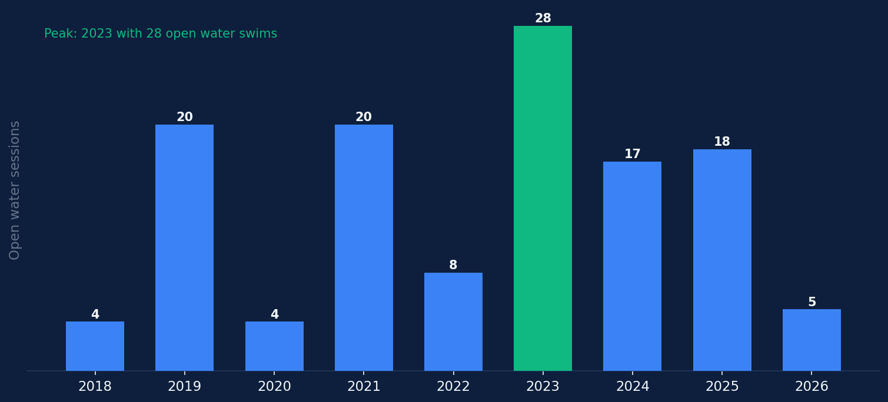
OPEN WATER
Open Water Sessions by Year

Slide 23
OPEN WATER
Pool vs Open Water: A Different Beast
Pool
Open Water
1866
124
sessions
sessions
1:54/100yd
2:48/100yd
median pace
median pace
94% of all swims · controlled environment · flip turns
6% of all swims · currents · sighting · wetsuit
Open water is 53s/100yd slower — natural water, no walls, sighting overhead.

Slide 24
DATA COLLECTION
How Every Swim Gets Measured
Apple Watch (early era)
Apple Watch (Marcin's)
swim.com (aggregate)
Strava archive (pending)
Dec 2017 – Mar 2020
Jun 2020 – Mar 2026
2016–2017
2020–present
GPS + HR data requested
Each swim: distance · duration · pace · laps · pool length · heart rate · calories → pre-processed into swims.json

Slide 25
BODY & RECOVERY
Beyond the Pool: The Body's Data
HRV AVERAGE
RESTING HR
SLEEP AVERAGE
43.8 ms
59 bpm
6.1 hrs
Heart Rate Variability
Athlete-level baseline
Tracked since Oct 2024
Min: 12ms
Max: 116ms
Min: 43bpm
Max: 93bpm
n=156 nights
2,744 daily records · May 2018 – Mar 2026
Available since May 2018
Oct 2024 – Mar 2026
HRV and resting HR are early signals of readiness — surfaced daily in the swim coach dashboard.

Slide 26
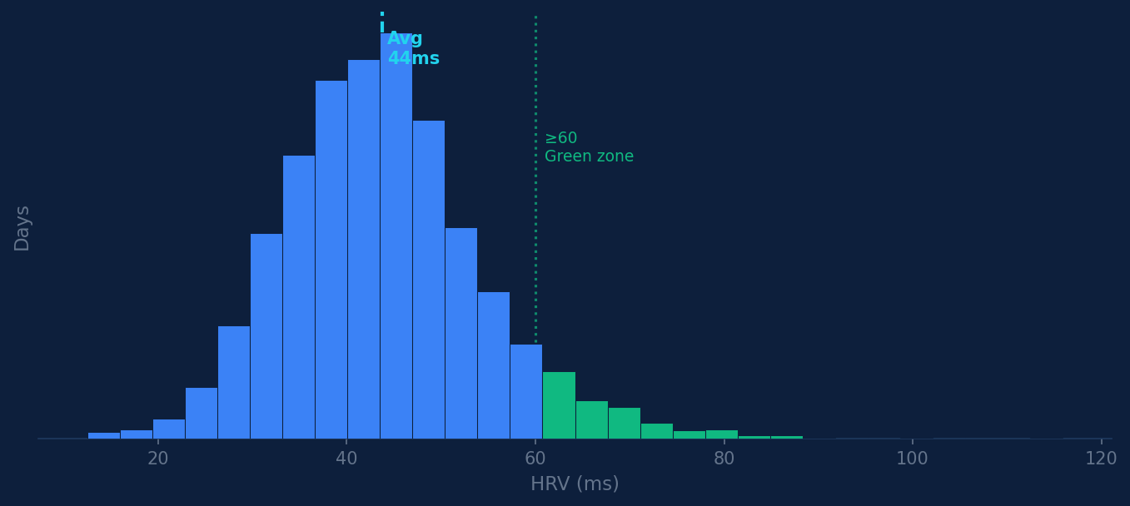
BODY & RECOVERY
HRV: The Performance Predictor
Correlation with pace
HRV ≥ 60ms vs < 30ms
5.1s faster per 100yd
Resting HR low vs high
3.7s faster per 100yd
Sleep > 7h vs < 6h
4.1s faster per 100yd
n=1,247 days with matched swim data

Slide 27
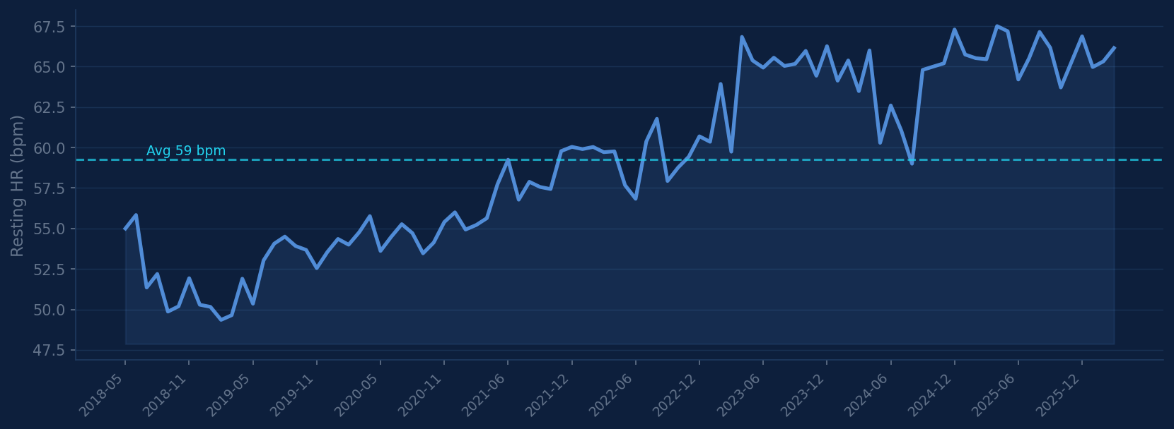
BODY & RECOVERY
Resting Heart Rate: Athlete Territory
ALL-TIME LOW
AVERAGE
ALL-TIME HIGH
43 bpm
59 bpm
93 bpm

Slide 28
BODY & RECOVERY
What Recovery Predicts About Tomorrow's Swim
WHEN YOU HAVE…
VS…
IMPACT
INSIGHT
HRV ≥ 60ms
< 30ms HRV
5s faster / 100yd
High readiness → attack the pace
RHR < 52 bpm
RHR > 63 bpm
4s faster / 100yd
Low HR → body is recovered
Sleep > 7h
Sleep < 6h
4s faster / 100yd
Sleep is the cheapest performance drug
Morning swim
Evening swim
2s faster / 100yd
Circadian rhythm favors morning

Slide 29
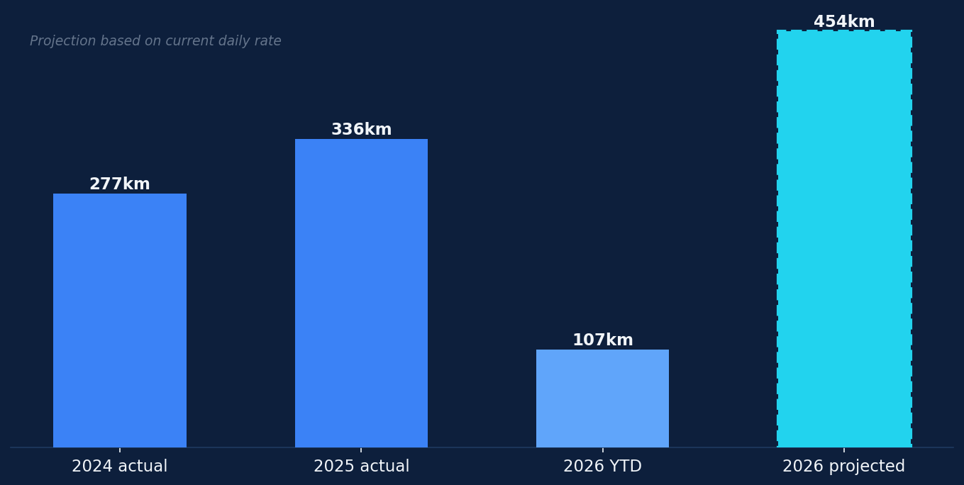
LOOKING FORWARD
2026: On Track for a Record Year
CURRENT DAILY RATE
1.24 km/day
ANNUALIZED
~454 km
2025 ACTUAL
336 km
GAP TO RECORD
+35% vs 2025
SESSIONS/WEEK
~5.3
Projection assumes current pace rate holds. Strava archive (GPS + HR) will further enrich data once imported.

Slide 30
Still
Swims
KM
Hours
1,990
2,349
1,047
Swimming.
1,990 sessions. 2,349 km. 1,047 hours. 8 years.
The data keeps growing. The pace keeps improving. The streak keeps running.
Next: Strava GPS data · open water mapping · predictive readiness · Kaggle dataset release
Marcin Durlak · March 2026 · @sirmortimer

