Slide 1
Amazon Product Evaluation
Final Predictions – Individual Part Dataset used: Toys and Games
Due Date: May 29
Joris Chomarat

Slide 2
Goal
The goal of this individual project part was to further increase classification performance (using the f1 score as metric) by training a neural network.
Features were examined and adapted to try to increase performance
The dataset used was Toys_and_Games.
Training was done using train and final predictions were made on test3.

Slide 3
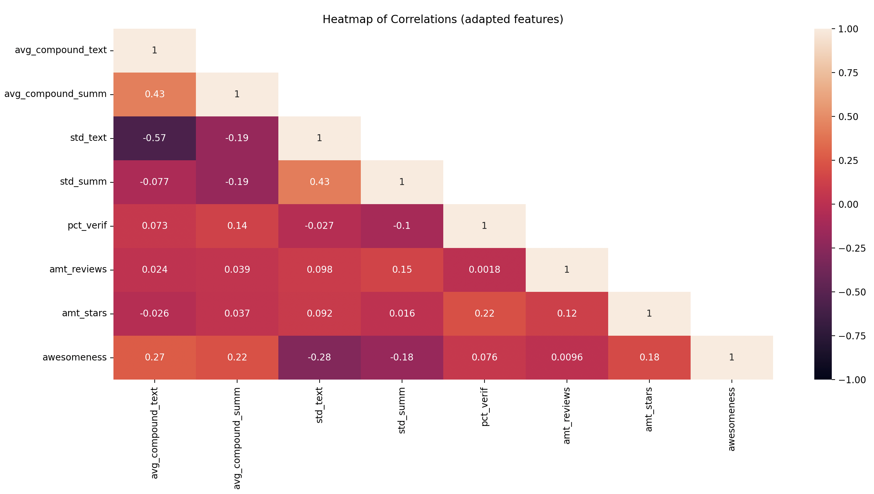
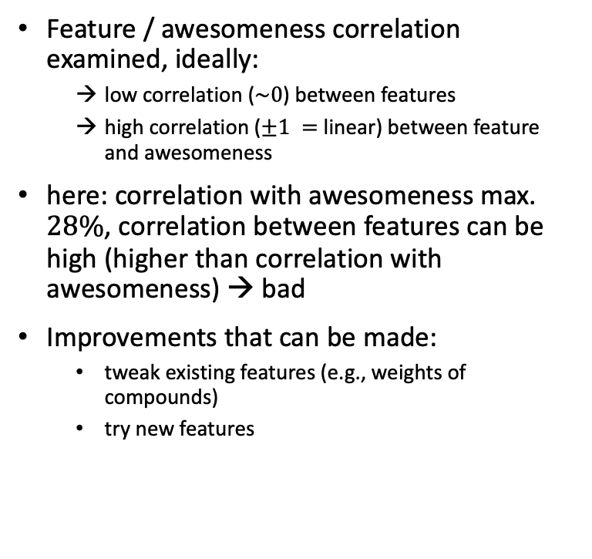
Feature Selection – Correlation
Feature / awesomeness correlation examined, ideally:
low correlation ($\sim 0$) between features
high correlation ($±1 =$ linear) between feature and awesomeness
here: correlation with awesomeness max. $28\%$, correlation between features can be high (higher than correlation with awesomeness) → bad
Improvements that can be made:
tweak existing features (e.g., weights of compounds)
try new features
→ Recap of features used for group part in last two slides of presentation

Slide 4
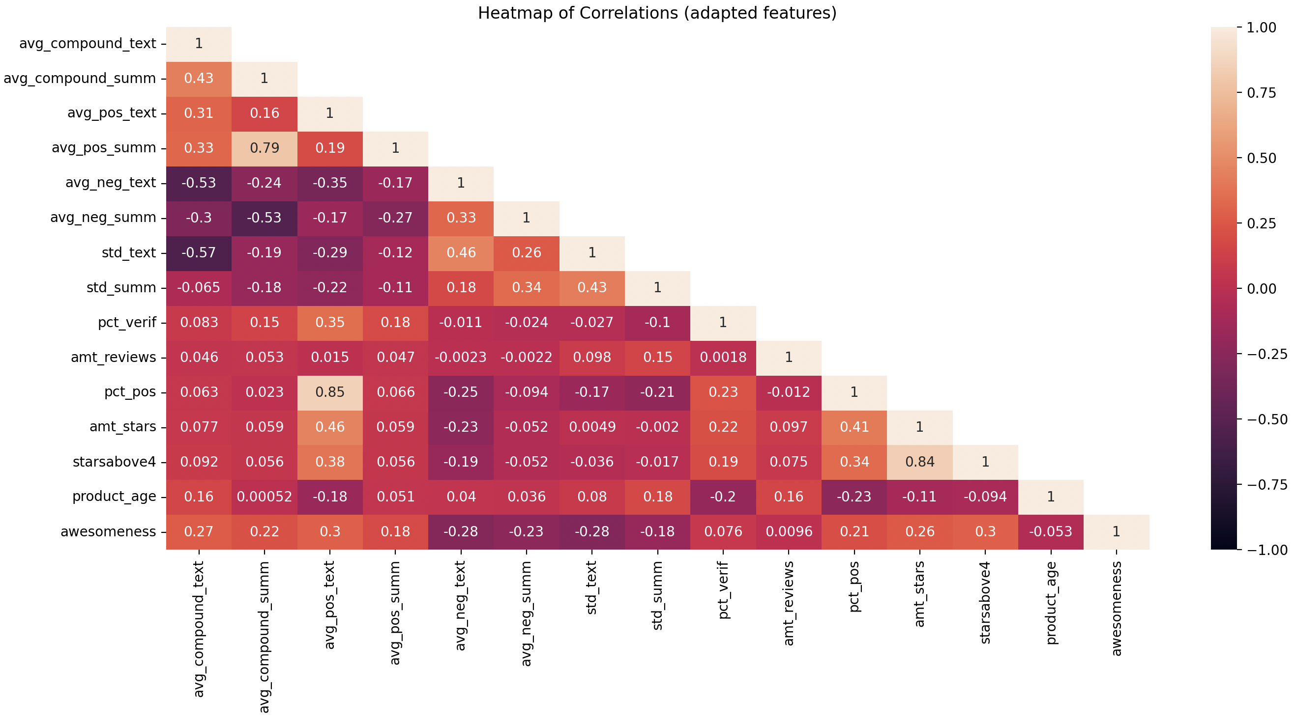
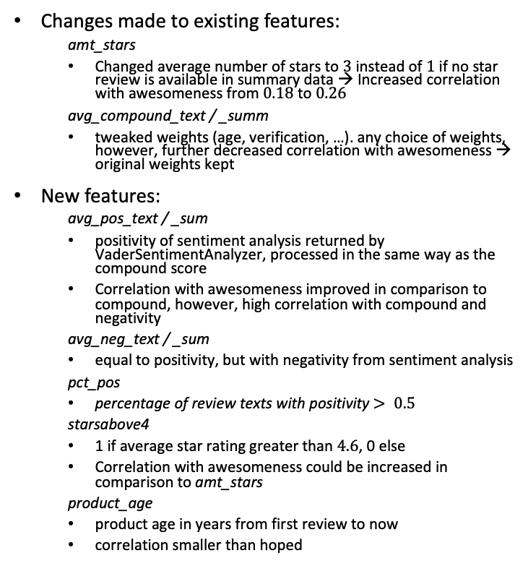
Feature Selection – Correlation
Changes made to existing features:
amt_stars
Changed average number of stars to $3$ instead of $1$ if no star review is available in summary data → Increased correlation with awesomeness from $0.18$ to $0.26$
avg_compound_text / _summ
tweaked weights (age, verification, …). any choice of weights, however, further decreased correlation with awesomeness → original weights kept
New features:
avg_pos_text / _sum
positivity of sentiment analysis returned by VaderSentimentAnalyzer, processed in the same way as the compound score
Correlation with awesomeness improved in comparison to compound, however, high correlation with compound and negativity
avg_neg_text / _sum
equal to positivity, but with negativity from sentiment analysis
pct_pos
percentage of review texts with positivity $> 0.5$
starsabove4
1 if average star rating greater than $4.6$, 0 else
Correlation with awesomeness could be increased in comparison to amt_stars
product_age
product age in years from first review to now
correlation smaller than hoped
Total: 14 features (7 original/tweaked, 7 new)

Slide 5
Feature Selection – PCA
Situation:
14 features (a lot, some with very low correlation with awesomeness)
high correlation between features, in general lower correlation with awesomeness
Principal Component Analysis
feature vector transformed such that correlation between features is reduced
often at cost of accuracy, as correlation with awesomeness is not considered. Overall model performance, however, can still increase
dimensionality reduction (improve computational time)
Tradeoff computational time vs. performance
Procedure:
PCA with dimensionality reduction of 1 fitted to training data, data transformed
dimensionality reductions tried: 12, 13, 14 remaining features. Dimensionality reduction of 1 (13 remaining transformed features) resulted in good performance with reasonable training time. Other reductions worsened performance a lot, since a lot of features don’t have high correlations with each other → difficult to preserve information when reducing dimensionality
testing data transformed with same PCA fitted to training data

Slide 6
Classification – MLP
The goal of this deliverable was to train a neural network, specifically a multi-layer perceptron (MLP). Sklearn’s mlp classifier was used.
Instead of a normal grid search available through sklearn, hyperparameter optimization was done using an evolutionary search:
Algorithms tried out: sklearn-deap, sklearn-genetic-opt
both packages are an evolutionary algorithm with the goal to reduce time spent on optimization
sklearn-deap tried out first, however only compatible with older sklean version and other difficulties encountered during implementation
sklearn-genetic-opt successfully implemented afterwards
evolutionary search performed using a population size of 20 and 40 generations
Tables on next slide show optimized hyperparameters
model_nn1
Hidden layer choices following standard mlp procedure: hidden layer choices around size of feature vector
model_nn2
Hidden layer choices very broad

Slide 7
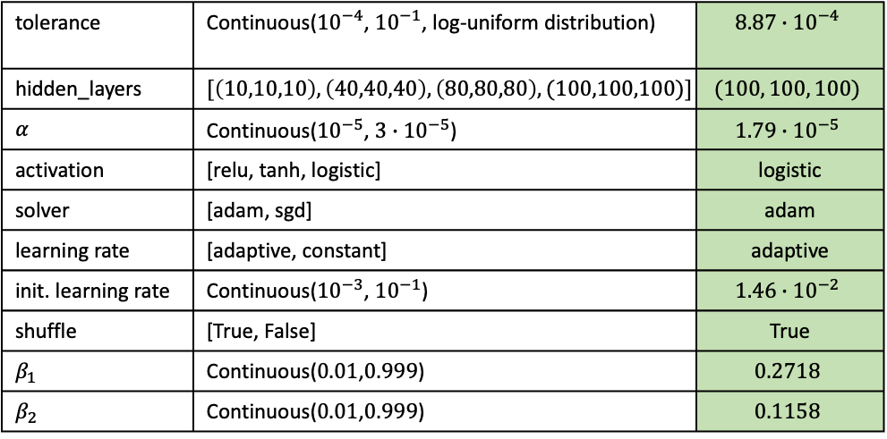
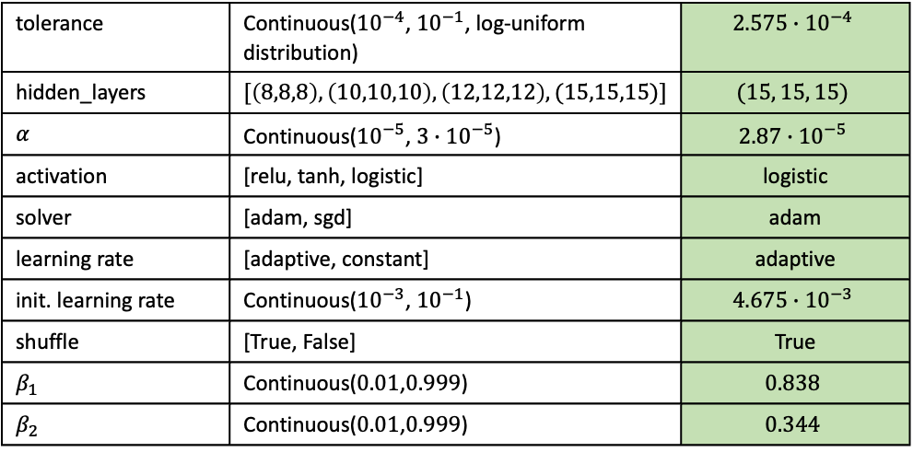
Classification – MLP
model_nn1
model_nn2
tolerance | Continuous(${10}^{−4}$, ${10}^{−1}$, log-uniform distribution) | $$2.575∙{10}^{−4}$$
hidden_layers | $$[\left(8,8,8\right),\left(10,10,10\right),\left(12,12,12\right),(15,15,15)]$$ | $$(15, 15, 15)$$
$$α$$ | Continuous(${10}^{−5}$, $3∙{10}^{−5}$) | $$2.87∙{10}^{−5}$$
activation | [relu, tanh, logistic] | logistic
solver | [adam, sgd] | adam
learning rate | [adaptive, constant] | adaptive
init. learning rate | Continuous(${10}^{−3}$, ${10}^{−1}$) | $$4.675∙{10}^{−3}$$
shuffle | [True, False] | True
$$β_{1}$$ | Continuous($0.01$,$0.999$) | $$0.838$$
$$β_{2}$$ | Continuous($0.01$,$0.999$) | $$0.344$$
tolerance | Continuous(${10}^{−4}$, ${10}^{−1}$, log-uniform distribution) | $$8.87∙{10}^{−4}$$
hidden_layers | $$[\left(10,10,10\right),\left(40,40,40\right),\left(80,80,80\right),(100,100,100)]$$ | $$(100, 100, 100)$$
$$α$$ | Continuous(${10}^{−5}$, $3∙{10}^{−5}$) | $$1.79∙{10}^{−5}$$
activation | [relu, tanh, logistic] | logistic
solver | [adam, sgd] | adam
learning rate | [adaptive, constant] | adaptive
init. learning rate | Continuous(${10}^{−3}$, ${10}^{−1}$) | $$1.46∙{10}^{−2}$$
shuffle | [True, False] | True
$$β_{1}$$ | Continuous($0.01$,$0.999$) | $$0.2718$$
$$β_{2}$$ | Continuous($0.01$,$0.999$) | $$0.1158$$

Slide 8
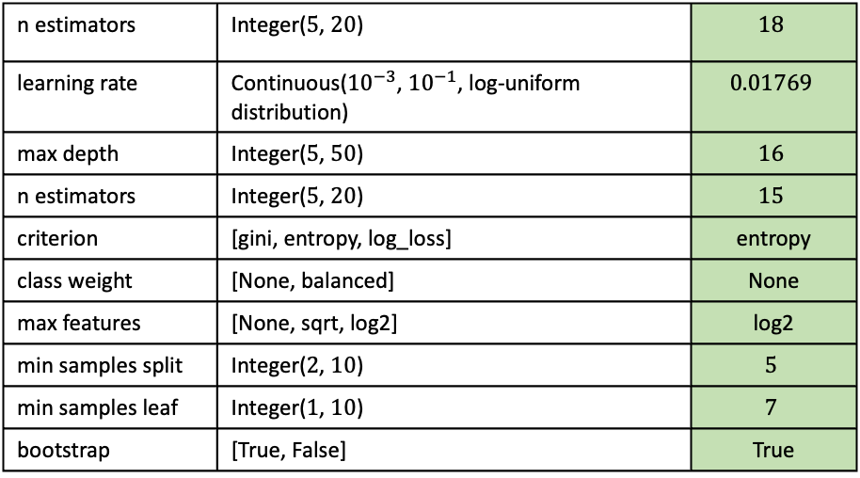
Classification – AdaBoost & random forest
Due to unsatisfactory performance of the mlp classifier, the boosted random forest classifier from last deliverable was trained again
Hyperparameter optimization was done using evolutionary search as well
→ evolutionary search does not only optimize on max fitness (f1 score), but also reduces fitness std of optimization population
while lower performance was achieved than in the last deliverable, there should be less overfitting → better performance overall (hopefully)
A random forest model without Adaboost was trained once more as well, with optimal hyperparameters being slightly different from the Adaboost random forest:
Hyperparameters optimized:
n estimators | Integer($5$, $20$) | $$18$$
learning rate | Continuous(${10}^{−3}$, ${10}^{−1}$, log-uniform distribution) | $$0.01769$$
max depth | Integer($5$, $50$) | $$16$$
n estimators | Integer($5$, $20$) | $$15$$
criterion | [gini, entropy, log_loss] | entropy
class weight | [None, balanced] | None
max features | [None, sqrt, log2] | log2
min samples split | Integer($2$, $10$) | $$5$$
min samples leaf | Integer($1$, $10$) | $$7$$
bootstrap | [True, False] | True
AB
Hyperparameters RF
max depth | n estimators | criterion | class weight | max features | min samples split | min smaples leaf | bootstrap
$$12$$ | 17 | log_loss | None | log2 | $$7$$ | $$8$$ | True

Slide 9
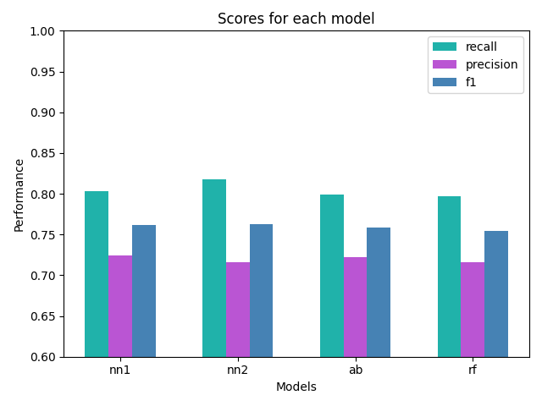
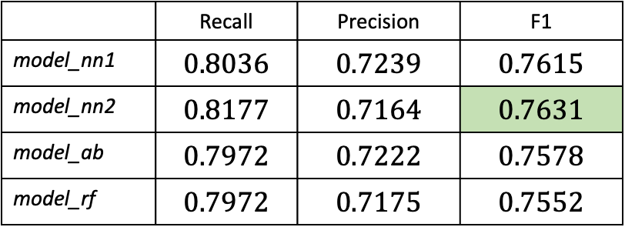
Results – Training
The following table shows all models tried out in this part of the project. With exception of the mlp classifier (model_nn), the other two models were the best performing models in earlier deliverables. They obviously had to be retrained, however, as the features do not match anymore.
while training performance is lower than for the second team deliverable, the best performing model here is the multi-layer perceptron model_nn2. This is surprising, as it is contradictory of general guidelines on the amount of hidden layers and nodes of a neural network.
 | Recall | Precision | F1
model_nn1 | $$0.8036$$ | $$0.7239$$ | $$0.7615$$
model_nn2 | $$0.8177$$ | $$0.7164$$ | $$0.7631$$
model_ab | $$0.7972$$ | $$0.7222$$ | $$0.7578$$
model_rf | $$0.7972$$ | $$0.7175$$ | $$0.7552$$

Slide 10
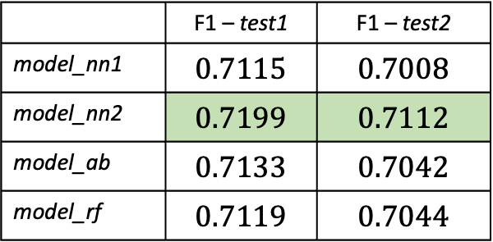
Results – Prediction on available ground truth
The trained models were used to predict on test1 and test2, for which ground truth labels are available
Examine possible overfitting of model during training
In agreement with training performance, model_nn2 performed best.
Not even model_rf was able to match the performance achieved after the first team deliverable (0.722). Thus, the choice of features may not have been the best. PCA on the other side was definitely beneficial, as performance decreased if the features were not transformed using PCA (not shown here).
 | F1 – test1 | F1 – test2
model_nn1 | $$0.7115$$ | $$0.7008$$
model_nn2 | $$0.7199$$ | $$0.7112$$
model_ab | $$0.7133$$ | $$0.7042$$
model_rf | $$0.7119$$ | $$0.7044$$

Slide 11
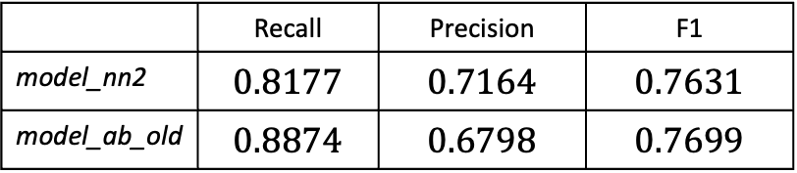
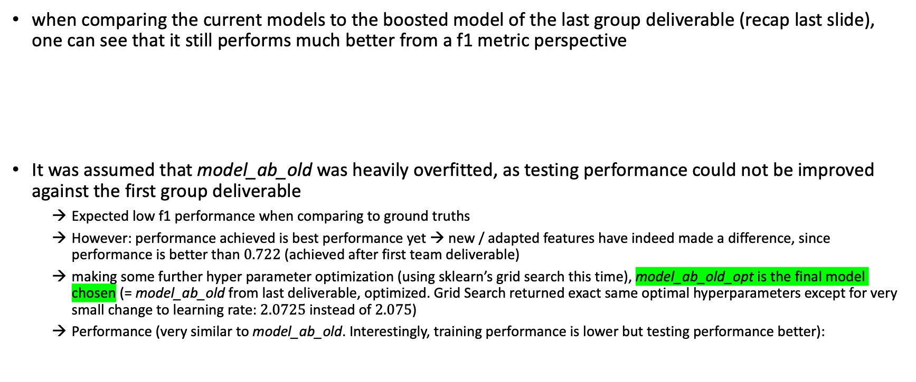
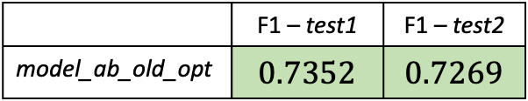
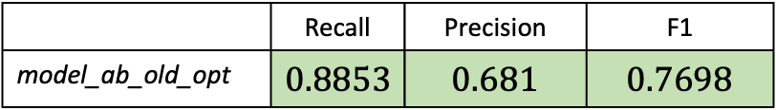
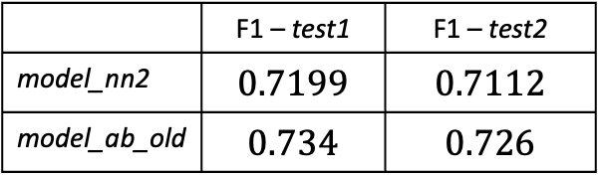
Results – Comparison to group deliverable
when comparing the current models to the boosted model of the last group deliverable (recap last slide), one can see that it still performs much better from a f1 metric perspective
It was assumed that model_ab_old was heavily overfitted, as testing performance could not be improved against the first group deliverable
Expected low f1 performance when comparing to ground truths
However: performance achieved is best performance yet → new / adapted features have indeed made a difference, since performance is better than $0.722$ (achieved after first team deliverable)
making some further hyper parameter optimization (using sklearn’s grid search this time), model_ab_old_opt is the final model chosen (= model_ab_old from last deliverable, optimized. Grid Search returned exact same optimal hyperparameters except for very small change to learning rate: $2.0725$ instead of $2.075$)
Performance (very similar to model_ab_old. Interestingly, training performance is lower but testing performance better):
 | Recall | Precision | F1
model_nn2 | $$0.8177$$ | $$0.7164$$ | $$0.7631$$
model_ab_old | $$0.8874$$ | $$0.6798$$ | $$0.7699$$
 | F1 – test1 | F1 – test2
model_nn2 | $$0.7199$$ | $$0.7112$$
model_ab_old | $$0.734$$ | $$0.726$$
 | Recall | Precision | F1
model_ab_old_opt | $$0.8853$$ | $$0.681$$ | $$0.7698$$
 | F1 – test1 | F1 – test2
model_ab_old_opt | $$0.7352$$ | $$0.7269$$

Slide 12
Lessons learned
Overfitting is easily possible for a lot of classifiers
Even when using cross-validation, possible overfitting does not always become apparent
here: predictions were checked on test1, test2 to check for overfitting
However: predictions on test2 perform worse than on test1 in general (if f1 score of same model on both sets is compared), so this is not necessarily due to overfitting
Feature selection has a big impact on performance
this point seems obvious, since predictions are obviously going to be bad if no feature has good correlation with the class
However, the following is worth noting:
Increased number of features increases computational time of algorithm (especially during training) → using the most features possible is surely not the best choice!
Algorithms & models
fancy, new algorithms aren’t always the best! The evolutionary search returned hyperparameters for the boosted model that led to worse result than sklearn grid search → do better research before implementing algorithms available online
don’t just assume a cnn is going to perform best just because it is a deep learning algorithm → don’t discard older/easier models too soon (as can be seen in this case: older model is actually the best!)

Slide 13
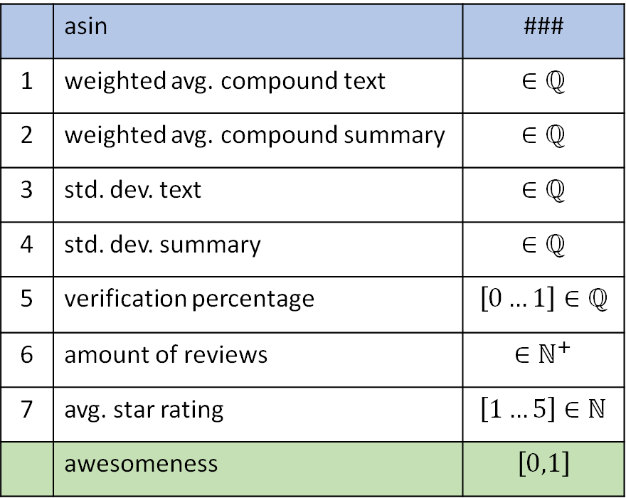
Recap: Features used (in group project part)
 | asin | ###
1 | weighted avg. compound text | $$∈ℚ$$
2 | weighted avg. compound summary | $$∈ℚ$$
3 | std. dev. text | $$∈ℚ$$
4 | std. dev. summary | $$∈ℚ$$
5 | verification percentage | $$\left[0…1\right]∈ℚ$$
6 | amount of reviews | $$∈ℕ^{+}$$
7 | avg. star rating | $$\left[1…5\right]∈ℕ$$
 | awesomeness | $$\left[0,1\right]$$
1) 2) 3) 4) on next slide
5) Verification percentage
Self-explanatory. Percentage of verified reviews out of all reviews of one product.
6) Amount of reviews
Self-explanatory. Amount of reviews a product has.
7) Average star rating
Summary data in dataset contains star rating left by reviewer, if no summary was left. The average of all ratings from these reviews was taken. If no review of a product has a star rating, the lowest possible Amazon star rating of ”1” is assigned.

Slide 14
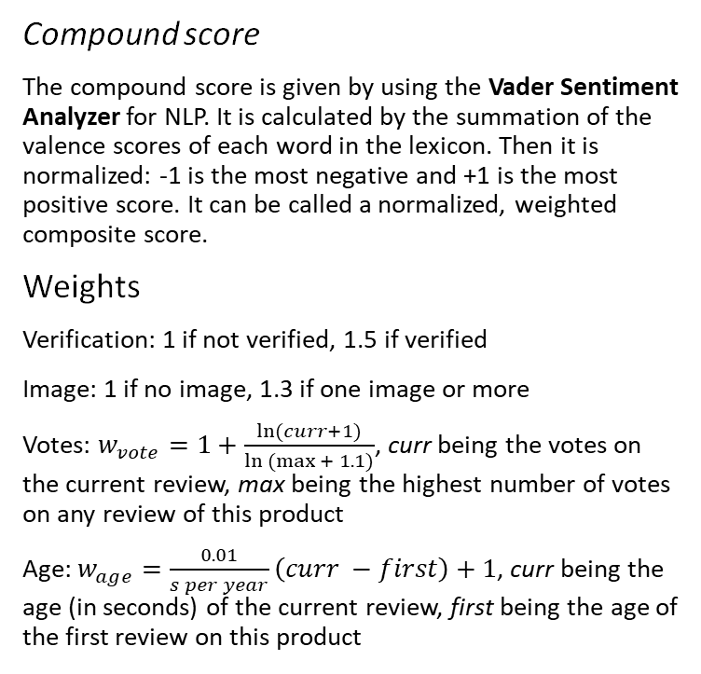
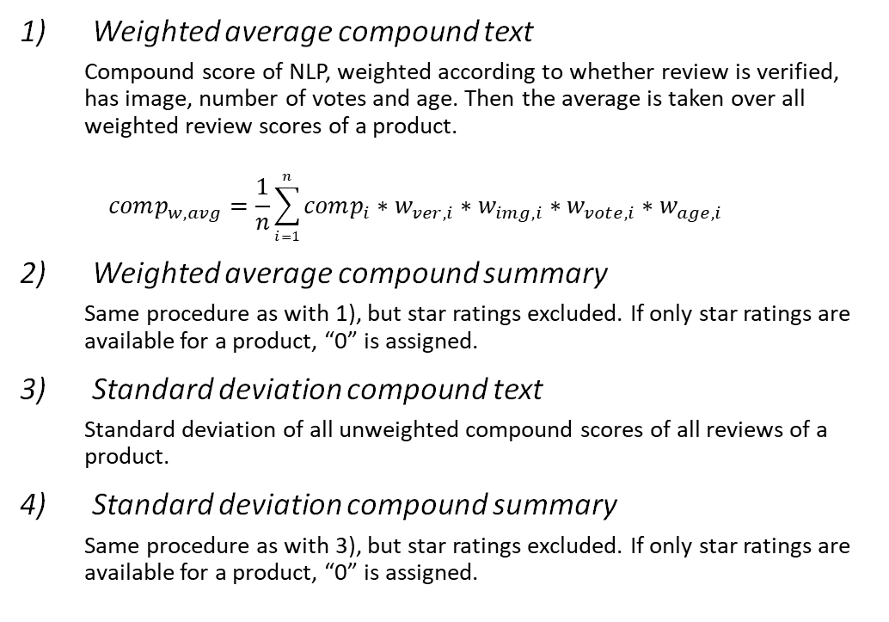
Recap: Features used (continued)
Weighted average compound text
Compound score of NLP, weighted according to whether review is verified, has image, number of votes and age. Then the average is taken over all weighted review scores of a product.
$$comp_{w,avg}=\frac{1}{n}\sum_{i=1}^{n}{comp_{i}∗w_{ver,i}∗w_{img,i}∗w_{vote,i}∗w_{age,i}}$$
Weighted average compound summary
Same procedure as with 1), but star ratings excluded. If only star ratings are available for a product, “0” is assigned.
Standard deviation compound text
Standard deviation of all unweighted compound scores of all reviews of a product.
Standard deviation compound summary
Same procedure as with 3), but star ratings excluded. If only star ratings are available for a product, “0” is assigned.
Compound score
The compound score is given by using the Vader Sentiment Analyzer for NLP. It is calculated by the summation of the valence scores of each word in the lexicon. Then it is normalized: -1 is the most negative and +1 is the most positive score. It can be called a normalized, weighted composite score.
Weights
Verification: 1 if not verified, 1.5 if verified
Image: 1 if no image, 1.3 if one image or more
Votes: $w_{vote}=1+\frac{\ln{(curr+1)}}{\ln{(max{+ 1.1)}}}$, curr being the votes on the current review, max being the highest number of votes on any review of this product
Age: $w_{age}=\frac{0.01}{s per year}\left(curr −first\right)+1$, curr being the age (in seconds) of the current review, first being the age of the first review on this product

Slide 15
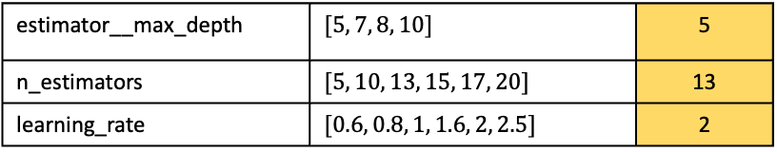
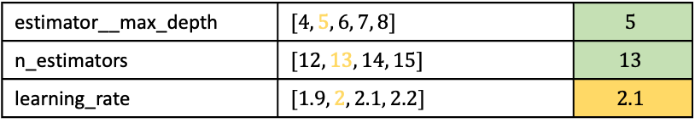
Recap: Boosting
AdaBoost (model_ab)
AdaBoost yielded better results than gradient boost →AdaBoost was used
Scaling of feature vectors did not have any impact on performance
Logistic Regression and KNN did not work with AdaBoost → Random Forest used
Grid searches over ranges getting finer:
estimator__max_depth | $$[5, 7, 8, 10]$$ | 5
n_estimators | $$[5, 10, 13, 15, 17, 20]$$ | 13
learning_rate | $$[0.6, 0.8, 1, 1.6, 2, 2.5]$$ | 2
estimator__max_depth | $$[4, 5, 6, 7, 8]$$ | $$5$$
n_estimators | $$[12, 13, 14, 15]$$ | $$13$$
learning_rate | $$[1.9, 2, 2.1, 2.2]$$ | $$2.1$$
learning_rate | $$[2.05, 2.075, 2.1, 2.125, 2.15]$$ | $$2.075$$
learning_rate | $$[2.0725, 2.075, 2.0775]$$ | $$2.075$$

