Slide 1
Amazon Product Evaluation
Final Predictions – Individual Part Dataset used: Toys and Games
Due Date: May 26
Joris Chomarat

Slide 2
Goal
The goal of this individual project part was to further increase classification performance (using the f1 score as metric) using neural networks. Features were examined and adapted to
The dataset used was Toys_and_Games, training was done using train and final predictions were made on test3.

Slide 3
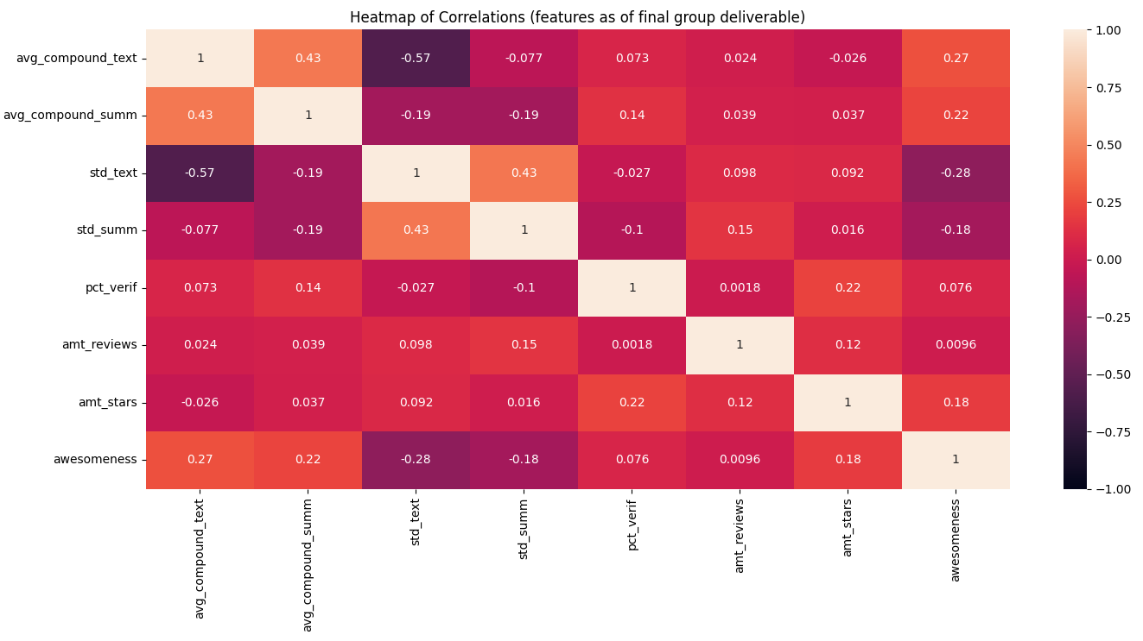

Feature Selection
Feature / awesomeness correlation examined
ideally: low correlation (~0) between features, high correlation between feature and awesomeness
Improvements:
Changed average number of stars to $3$ instead of $1$ if no star review is available in summary data
→ Increased correlation with awesomeness from $0.18$ to $0.26$

Slide 4
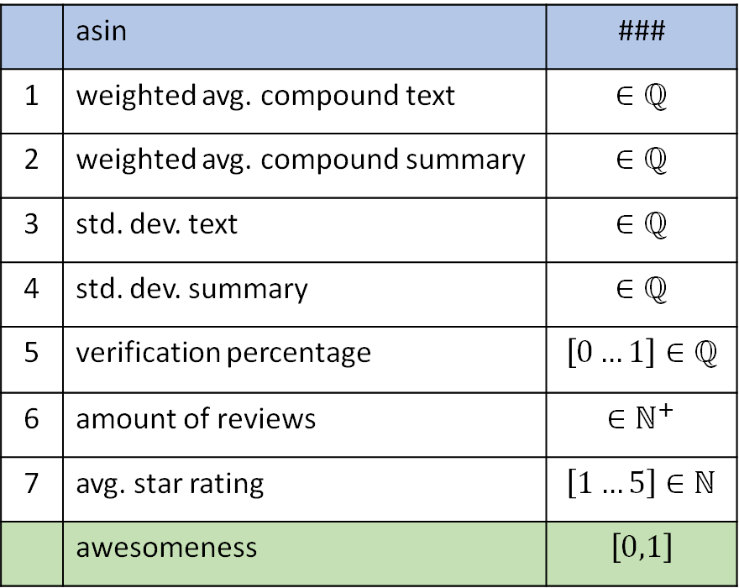
Recap: Features used
 | asin | ###
1 | weighted avg. compound text | $$∈ℚ$$
2 | weighted avg. compound summary | $$∈ℚ$$
3 | std. dev. text | $$∈ℚ$$
4 | std. dev. summary | $$∈ℚ$$
5 | verification percentage | $$\left[0…1\right]∈ℚ$$
6 | amount of reviews | $$∈ℕ^{+}$$
7 | avg. star rating | $$\left[1…5\right]∈ℕ$$
 | awesomeness | $$\left[0,1\right]$$
1) 2) 3) 4) on next slide
5) Verification percentage
Self-explanatory. Percentage of verified reviews out of all reviews of one product.
6) Amount of reviews
Self-explanatory. Amount of reviews a product has.
7) Average star rating
Summary data in dataset contains star rating left by reviewer, if no summary was left. The average of all ratings from these reviews was taken. If no review of a product has a star rating, the lowest possible Amazon star rating of ”1” is assigned.

Slide 5
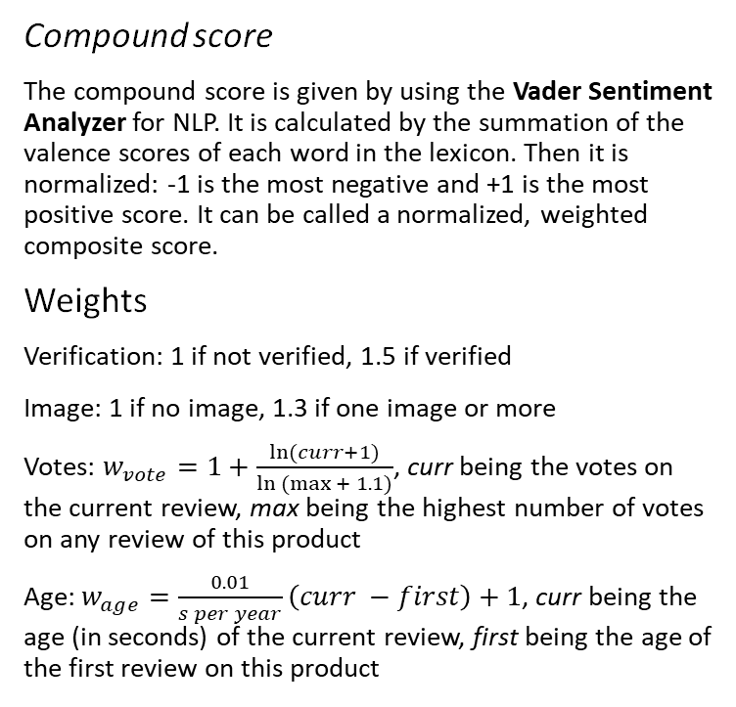
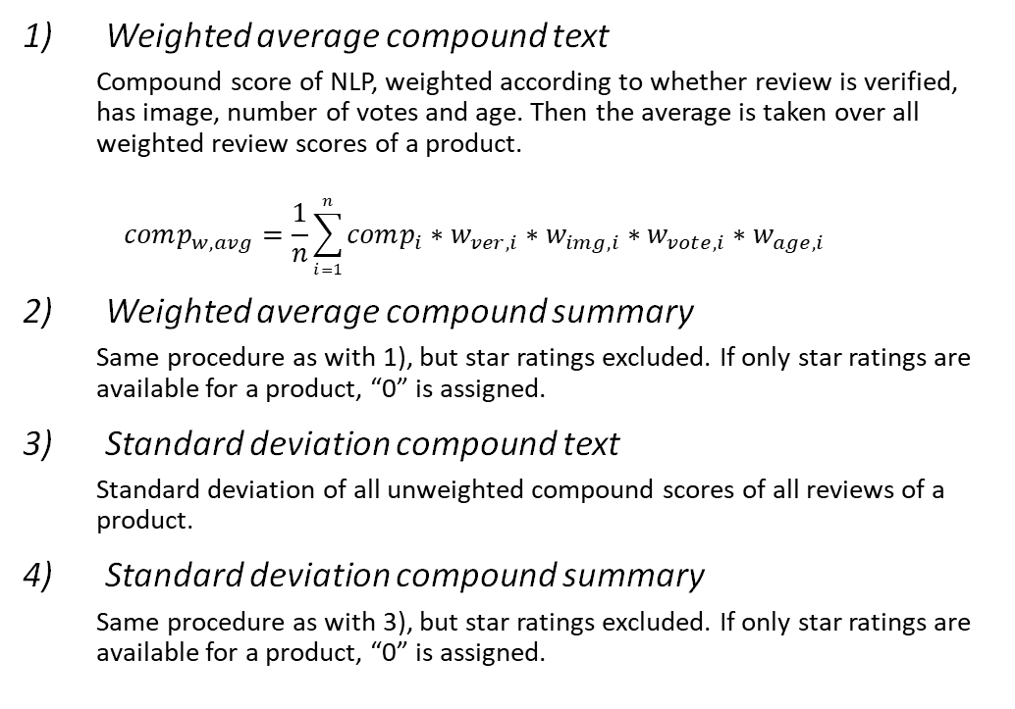
Recap: Features used (continued)
Weighted average compound text
Compound score of NLP, weighted according to whether review is verified, has image, number of votes and age. Then the average is taken over all weighted review scores of a product.
$$comp_{w,avg}=\frac{1}{n}\sum_{i=1}^{n}{comp_{i}∗w_{ver,i}∗w_{img,i}∗w_{vote,i}∗w_{age,i}}$$
Weighted average compound summary
Same procedure as with 1), but star ratings excluded. If only star ratings are available for a product, “0” is assigned.
Standard deviation compound text
Standard deviation of all unweighted compound scores of all reviews of a product.
Standard deviation compound summary
Same procedure as with 3), but star ratings excluded. If only star ratings are available for a product, “0” is assigned.
Compound score
The compound score is given by using the Vader Sentiment Analyzer for NLP. It is calculated by the summation of the valence scores of each word in the lexicon. Then it is normalized: -1 is the most negative and +1 is the most positive score. It can be called a normalized, weighted composite score.
Weights
Verification: 1 if not verified, 1.5 if verified
Image: 1 if no image, 1.3 if one image or more
Votes: $w_{vote}=1+\frac{\ln{(curr+1)}}{\ln{(max{+ 1.1)}}}$, curr being the votes on the current review, max being the highest number of votes on any review of this product
Age: $w_{age}=\frac{0.01}{s per year}\left(curr −first\right)+1$, curr being the age (in seconds) of the current review, first being the age of the first review on this product

Slide 6
Recap: Algorithms & Results
Model performance was evaluated using 10-fold cross validation for each model
Classifier hyper-parameters were optimized using a grid search algorithm maximizing the F1 score
Hyper-parameters not mentioned on next slides were kept at their default value
Where possible, the amount of CPU cores was increased to the maximum
Classifiers evaluated:
Decision Tree (model_dt)
Naïve Bayes (model_nb)
Logistic Regression (model_lr)
Random Forest Classifier (model_rf)
based on performance of the optimized classifiers tried out, predictions on test1 were done with model_rf
Feedback test1: F1 score of 0.7176 achieved

Slide 7
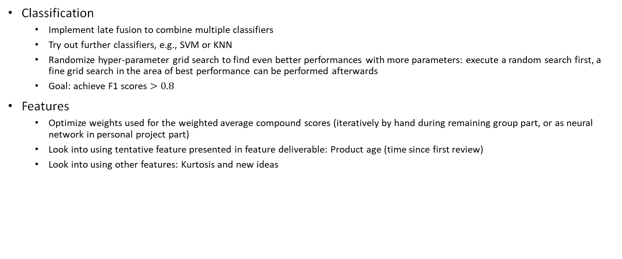
Recap: possible next steps (as of April 28)
Classification
Implement late fusion to combine multiple classifiers
Try out further classifiers, e.g., SVM or KNN
Randomize hyper-parameter grid search to find even better performances with more parameters: execute a random search first, a fine grid search in the area of best performance can be performed afterwards
Goal: achieve F1 scores $>0.8$
Features
Optimize weights used for the weighted average compound scores (iteratively by hand during remaining group part, or as neural network in personal project part)
Look into using tentative feature presented in feature deliverable: Product age (time since first review)
Look into using other features: Kurtosis and new ideas

Slide 8
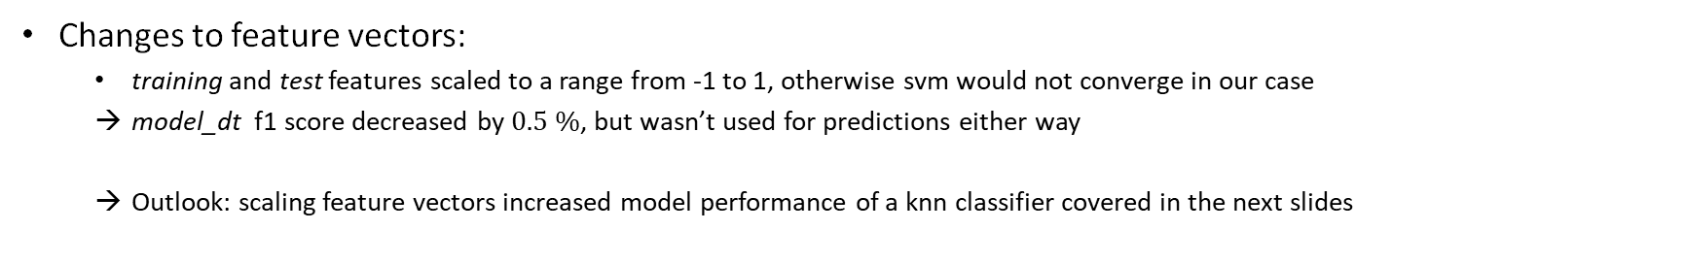
Feature vectors
Changes to feature vectors:
training and test features scaled to a range from -1 to 1, otherwise svm would not converge in our case
model_dt f1 score decreased by $0.5 \%$, but wasn’t used for predictions either way
Outlook: scaling feature vectors increased model performance of a knn classifier covered in the next slides

Slide 9
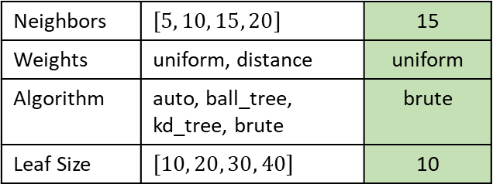
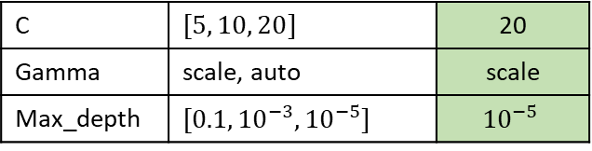
Classifiers
The following classifiers were implemented (doing a grid search over them and 10-fold cross validation)
Results on next slide
KNN – K Nearest Neighbors
SVM – Support Vector Machine
Neighbors | $$[5, 10, 15, 20]$$ | 15
Weights | uniform, distance | uniform
Algorithm | auto, ball_tree, kd_tree, brute | brute
Leaf Size | $$[10, 20, 30, 40]$$ | 10
Kernel: rbf (other kernels wouldn’t converge)
max_iterations were increased to 1,000,000 so that (nearly) every iteration converged
C | $$[5, 10, 20]$$ | 20
Gamma | scale, auto | scale
Max_depth | $$[0.1, {10}^{−3}, {10}^{−5}]$$ | $${10}^{−5}$$

Slide 10
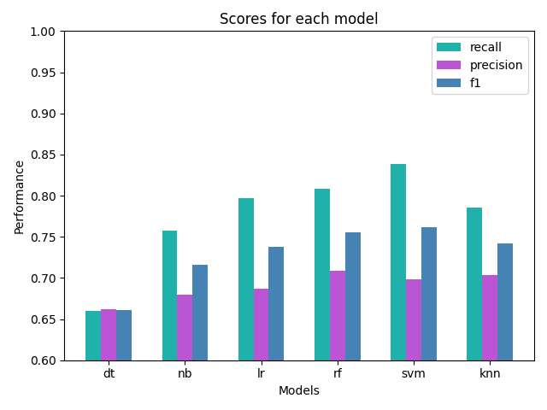
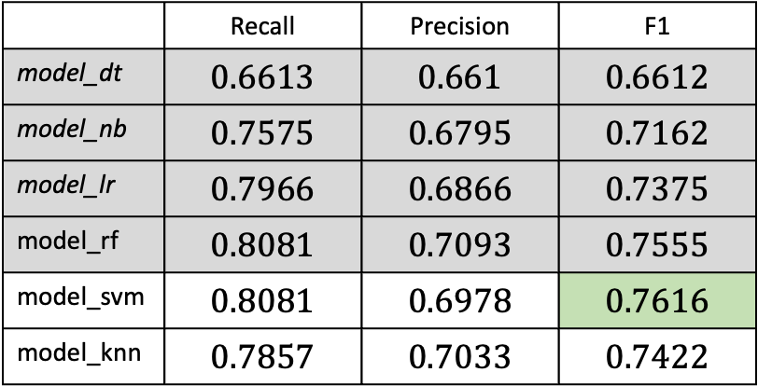
Results (single classifiers)
 | Recall | Precision | F1
model_dt | $$0.6613$$ | $$0.661$$ | $$0.6612$$
model_nb | $$0.7575$$ | $$0.6795$$ | $$0.7162$$
model_lr | $$0.7966$$ | $$0.6866$$ | $$0.7375$$
model_rf | $$0.8081$$ | $$0.7093$$ | $$0.7555$$
model_svm | $$0.8081$$ | $$0.6978$$ | $$0.7616$$
model_knn | $$0.7857$$ | $$0.7033$$ | $$0.7422$$

Slide 11
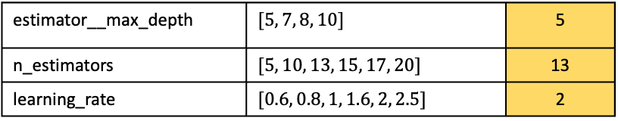
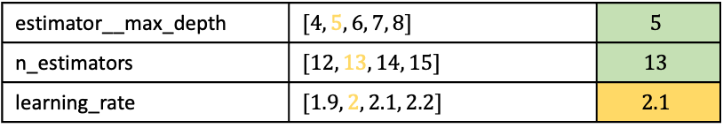
Fusion & Boosting
Late Fusion (model_vc)
AdaBoost (model_ab)
models used: model_lr, model_rf, model_knn
svm could not be used, as probabilities are not computed and forcing the model to do so increased computational time too much
Grid search over model combination:
Coarse (steps of 5% weight) first
Fine (steps of 1% weight) in vicinity of coarse result
Optimal weights found:
AdaBoost yielded better results than gradient boost →AdaBoost was used
Scaling of feature vectors did not have any impact on performance
Logistic Regression and KNN did not work with AdaBoost → Random Forest used
Grid searches over ranges getting finer:
estimator__max_depth | $$[5, 7, 8, 10]$$ | 5
n_estimators | $$[5, 10, 13, 15, 17, 20]$$ | 13
learning_rate | $$[0.6, 0.8, 1, 1.6, 2, 2.5]$$ | 2
LR | RF | KNN
0.12 | 0.72 | 0.16
estimator__max_depth | $$[4, 5, 6, 7, 8]$$ | $$5$$
n_estimators | $$[12, 13, 14, 15]$$ | $$13$$
learning_rate | $$[1.9, 2, 2.1, 2.2]$$ | $$2.1$$
learning_rate | $$[2.05, 2.075, 2.1, 2.125, 2.15]$$ | $$2.075$$
learning_rate | $$[2.0725, 2.075, 2.0775]$$ | $$2.075$$

Slide 12
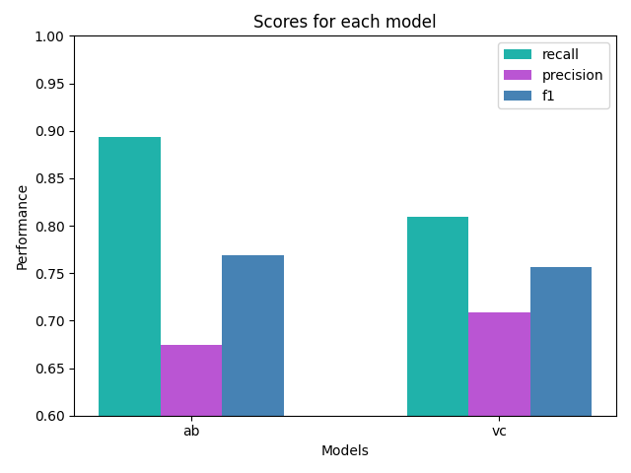
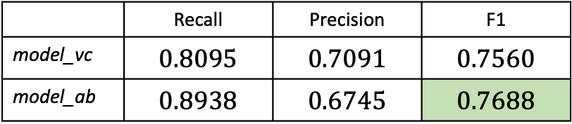

Results (fusion & boosting)
AdaBoost (model_ab) performs best overall (better than svm, best score of single classifiers) and is thus chosen as final model
Tradeoffs regarding computational time and submission on next slide.
Looking back at next steps of last deliverable: all next steps for classifiers implemented, some with more and less success than others. The goal of reaching an f1 score of $80 \%$ was unfortunately not reached.
 | Recall | Precision | F1
model_vc | $$0.8095$$ | $$0.7091$$ | $$0.7560$$
model_ab | $$0.8938$$ | $$0.6745$$ | $$0.7688$$

Slide 13

Tradeoffs: Time vs. Score
SVM
Late Fusion with Boosted Model
SVM takes long enough to predict by itself (multiple minutes per iteration)
To perform grid search with SVM would take days if not weeks
If unlimited computational time was allowed, we would try Adaboost with SVM
This would likely increase F1 score
For this project, this does not make sense
being allowed to submit an already trained model was communicated very late
Earlier communication may have influenced training approaches chosen
Running grid search to find the optimal weights returned a weight of $100 \%$ for AdaBoost since it had significantly better performance.
→ Late fusion was thus not used in the final predictions

