Slide 1
Amazon Product Evaluation
Final Predictions – Individual Part Dataset used: Toys and Games
Due Date: May 26
Joris Chomarat

Slide 2
Goal
The goal of this individual project part was to further increase classification performance (using the f1 score as metric) using neural networks. Features were examined and adapted to
The dataset used was Toys_and_Games, training was done using train and final predictions were made on test3.

Slide 3
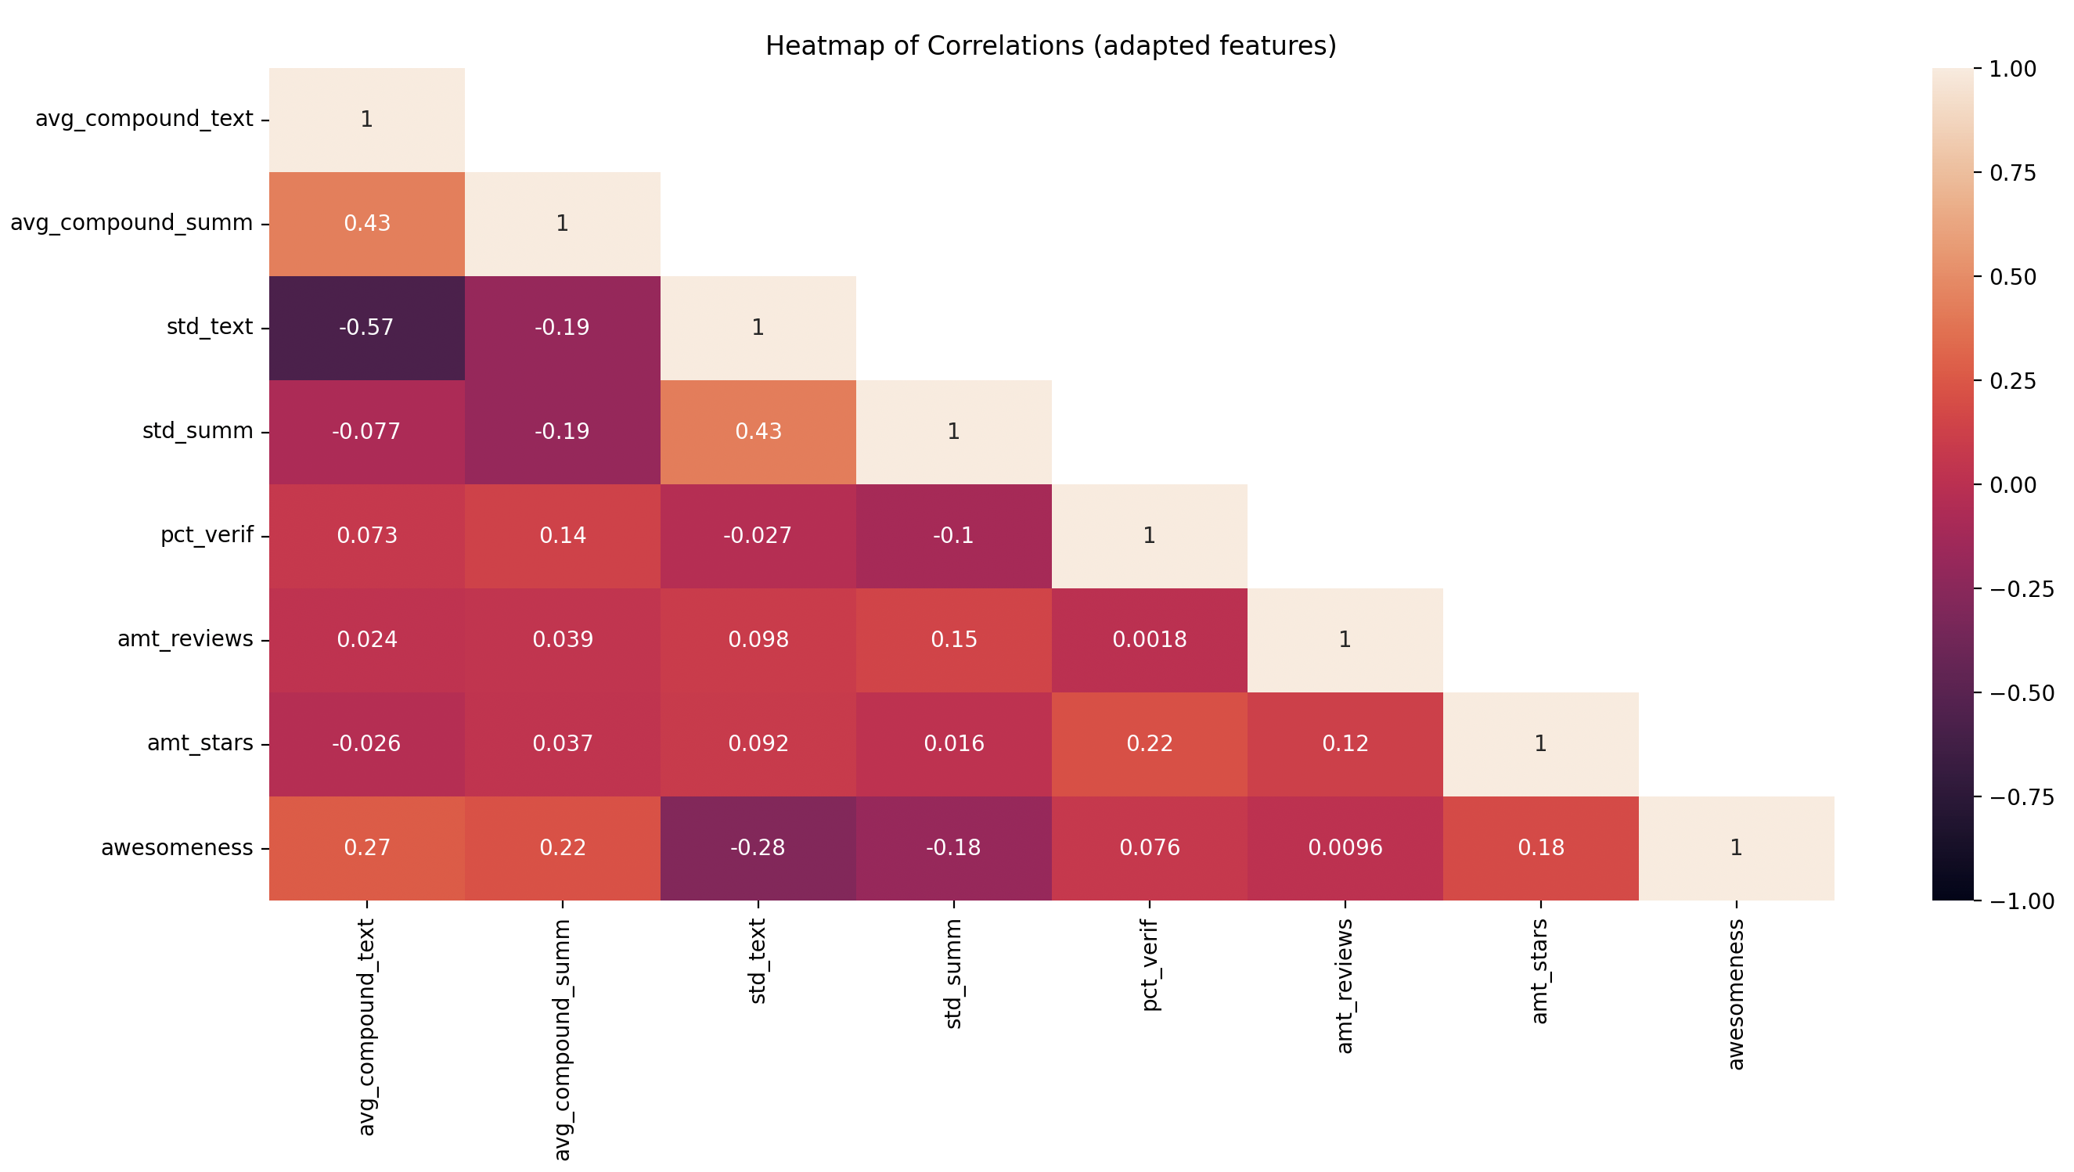
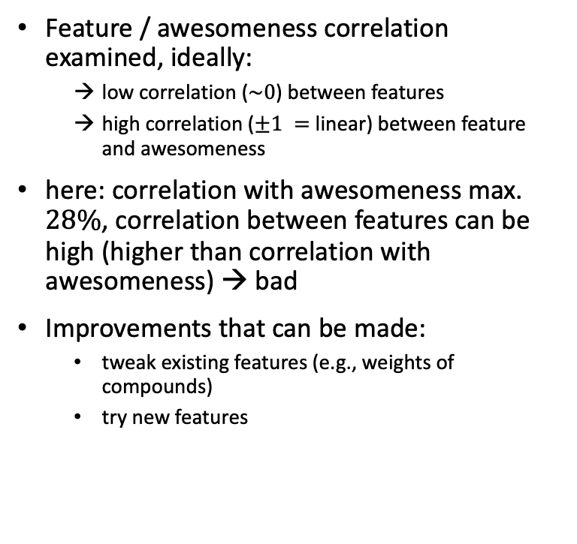
Feature Selection – Correlation
Feature / awesomeness correlation examined, ideally:
low correlation ($\sim 0$) between features
high correlation ($±1 =$ linear) between feature and awesomeness
here: correlation with awesomeness max. $28\%$, correlation between features can be high (higher than correlation with awesomeness) → bad
Improvements that can be made:
tweak existing features (e.g., weights of compounds)
try new features
→ Recap of features used for group part in last two slides of presentation

Slide 4
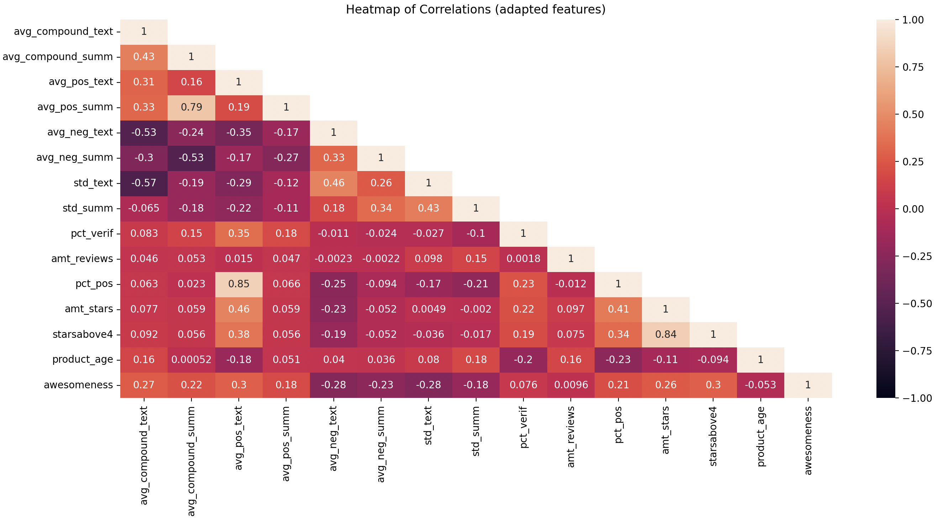
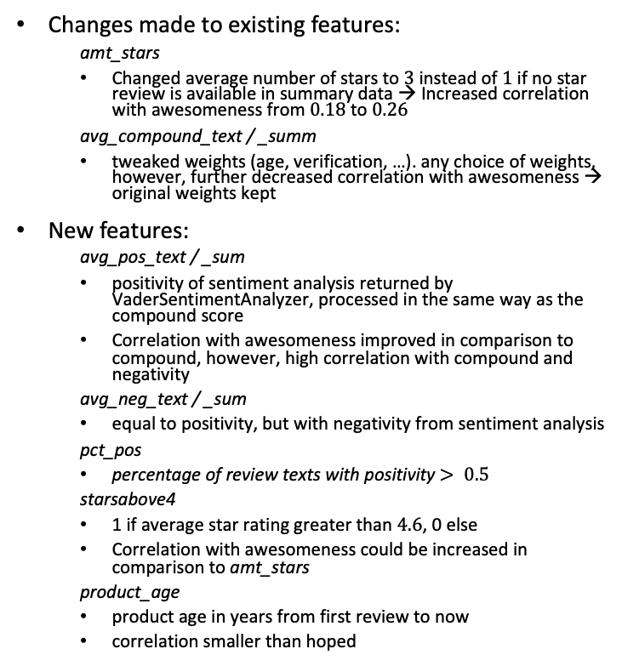
Feature Selection – Correlation
Changes made to existing features:
amt_stars
Changed average number of stars to $3$ instead of $1$ if no star review is available in summary data → Increased correlation with awesomeness from $0.18$ to $0.26$
avg_compound_text / _summ
tweaked weights (age, verification, …). any choice of weights, however, further decreased correlation with awesomeness → original weights kept
New features:
avg_pos_text / _sum
positivity of sentiment analysis returned by VaderSentimentAnalyzer, processed in the same way as the compound score
Correlation with awesomeness improved in comparison to compound, however, high correlation with compound and negativity
avg_neg_text / _sum
equal to positivity, but with negativity from sentiment analysis
pct_pos
percentage of review texts with positivity $> 0.5$
starsabove4
1 if average star rating greater than $4.6$, 0 else
Correlation with awesomeness could be increased in comparison to amt_stars
product_age
product age in years from first review to now
correlation smaller than hoped
→ Total: 14 features (7 original/tweaked, 7 new)

Slide 5
Feature Selection – PCA
Situation:
14 features (a lot, some with very low correlation with awesomeness)
high correlation between features, in general lower correlation with awesomeness
Principal Component Analysis
feature vector transformed such that correlation between features is reduced
often at cost of accuracy, as correlation with awesomeness is not considered. Overall model performance, however, can still increase
dimensionality reduction (improve computational time)
Tradeoff computational time vs. performance
Procedure:
PCA with dimensionality reduction of 1 fitted to training data, data transformed
dimensionality reductions tried: 12, 13, 14 remaining features. Dimensionality reduction of 1 (13 remaining transformed features) resulted in good performance with reasonable training time. Other reductions worsened performance a lot, since a lot of features don’t have high correlations with each other → difficult to preserve information when reducing dimensionality
testing data transformed with same PCA fitted to training data

Slide 6
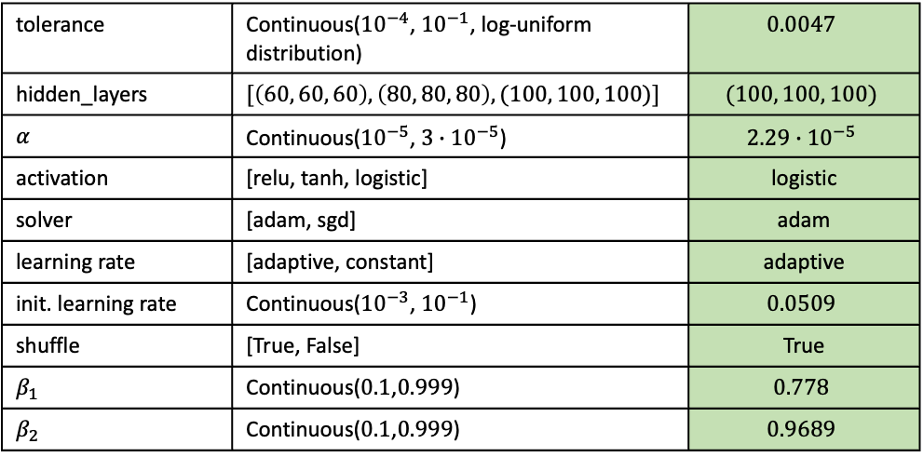
Classification – MLP
The goal of this deliverable was to train a neural network, specifically a multi-layer perceptron (MLP). Sklearn’s mlp classifier was used.
Instead of a normal grid search available through sklearn, hyperparameter optimization was done using an evolutionary search:
Algorithms tried out: sklearn-deap, sklearn-genetic-opt
both packages are an evolutionary algorithm with the goal to reduce time spent on optimization
sklearn-deap tried out first, however only compatible with older sklean version and other difficulties encountered during implementation
sklearn-genetic-opt successfully implemented afterwards
evolutionary search performed using a population size of 20 and 40 generations
Hyperparameters optimized:
→ table shows hyperparameters optimized during last evolutionary search. Broader searches were performed before (e.g., hidden layers with 10 nodes, or 4 layers,…). Max. number of epochs fixed to 2,000.
tolerance | Continuous(${10}^{−4}$, ${10}^{−1}$, log-uniform distribution) | $$0.0047$$
hidden_layers | $$[\left(60, 60, 60\right),\left(80, 80, 80\right),(100, 100, 100)]$$ | $$(100, 100, 100)$$
$$α$$ | Continuous(${10}^{−5}$, $3∙{10}^{−5}$) | $$2.29∙{10}^{−5}$$
activation | [relu, tanh, logistic] | logistic
solver | [adam, sgd] | adam
learning rate | [adaptive, constant] | adaptive
init. learning rate | Continuous(${10}^{−3}$, ${10}^{−1}$) | $$0.0509$$
shuffle | [True, False] | True
$$β_{1}$$ | Continuous($0.1$,$0.999$) | $$0.778$$
$$β_{2}$$ | Continuous($0.1$,$0.999$) | $$0.9689$$

Slide 7
Results – Training

Slide 8
Results – Prediction on test2
The trained model was used to predict on test2, for which ground truth labels are available
→ Examine possible overfitting of model during training

Slide 9
Results – Comparison to group deliverable

Slide 10
Lessons learned
Overfitting is easily possible for a lot of classifiers
Even when using cross-validation, possible overfitting does not always become apparent
here: predictions were checked on test2 to check for overfitting
last group deliverable: predictions were not checked on available ground truth labels of test1 – Mistake!
while training performance increased, prediction performance on untrained data was worse than in the first group deliverable

Slide 11
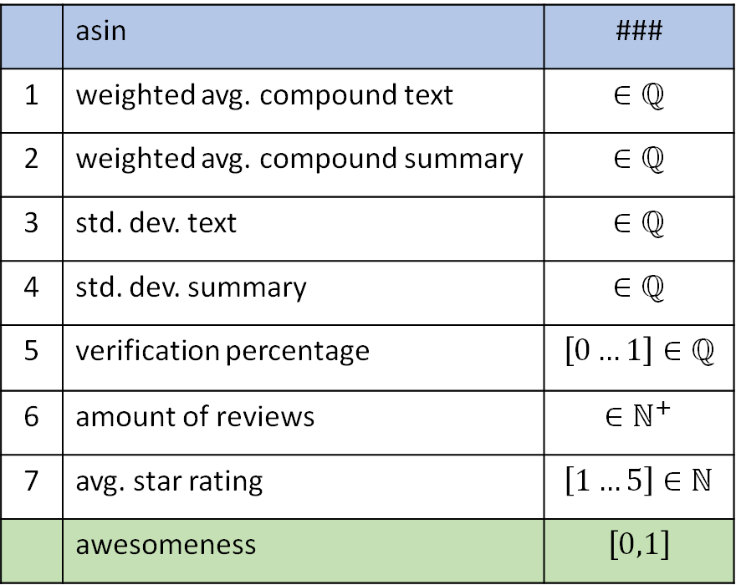
Recap: Features used (in group project part)
 | asin | ###
1 | weighted avg. compound text | $$∈ℚ$$
2 | weighted avg. compound summary | $$∈ℚ$$
3 | std. dev. text | $$∈ℚ$$
4 | std. dev. summary | $$∈ℚ$$
5 | verification percentage | $$\left[0…1\right]∈ℚ$$
6 | amount of reviews | $$∈ℕ^{+}$$
7 | avg. star rating | $$\left[1…5\right]∈ℕ$$
 | awesomeness | $$\left[0,1\right]$$
1) 2) 3) 4) on next slide
5) Verification percentage
Self-explanatory. Percentage of verified reviews out of all reviews of one product.
6) Amount of reviews
Self-explanatory. Amount of reviews a product has.
7) Average star rating
Summary data in dataset contains star rating left by reviewer, if no summary was left. The average of all ratings from these reviews was taken. If no review of a product has a star rating, the lowest possible Amazon star rating of ”1” is assigned.

Slide 12
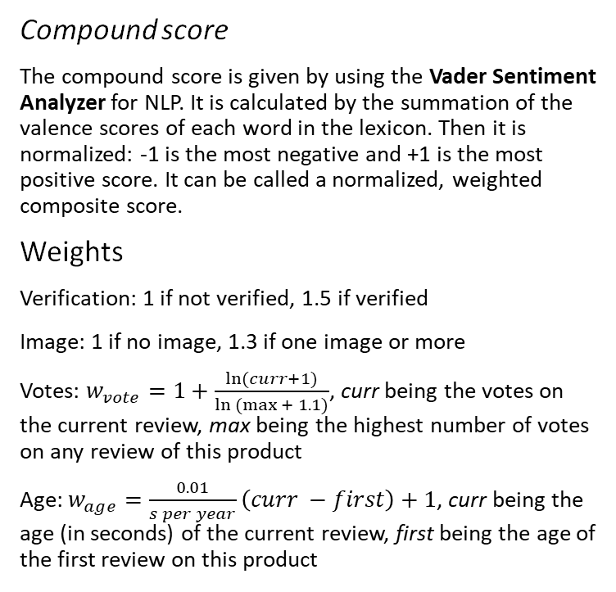
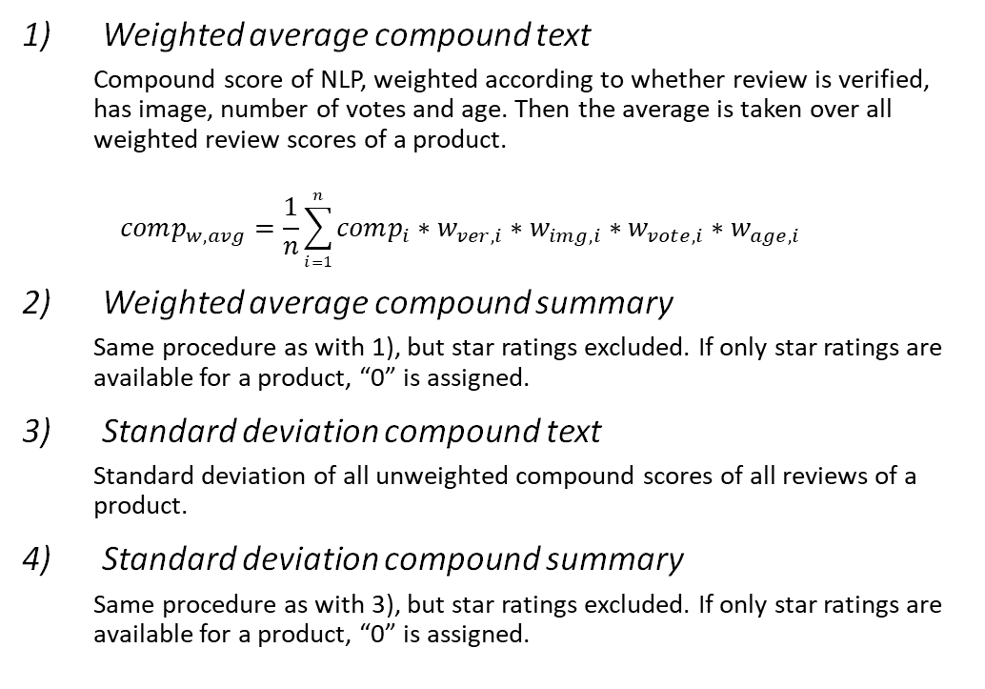
Recap: Features used (continued)
Weighted average compound text
Compound score of NLP, weighted according to whether review is verified, has image, number of votes and age. Then the average is taken over all weighted review scores of a product.
$$comp_{w,avg}=\frac{1}{n}\sum_{i=1}^{n}{comp_{i}∗w_{ver,i}∗w_{img,i}∗w_{vote,i}∗w_{age,i}}$$
Weighted average compound summary
Same procedure as with 1), but star ratings excluded. If only star ratings are available for a product, “0” is assigned.
Standard deviation compound text
Standard deviation of all unweighted compound scores of all reviews of a product.
Standard deviation compound summary
Same procedure as with 3), but star ratings excluded. If only star ratings are available for a product, “0” is assigned.
Compound score
The compound score is given by using the Vader Sentiment Analyzer for NLP. It is calculated by the summation of the valence scores of each word in the lexicon. Then it is normalized: -1 is the most negative and +1 is the most positive score. It can be called a normalized, weighted composite score.
Weights
Verification: 1 if not verified, 1.5 if verified
Image: 1 if no image, 1.3 if one image or more
Votes: $w_{vote}=1+\frac{\ln{(curr+1)}}{\ln{(max{+ 1.1)}}}$, curr being the votes on the current review, max being the highest number of votes on any review of this product
Age: $w_{age}=\frac{0.01}{s per year}\left(curr −first\right)+1$, curr being the age (in seconds) of the current review, first being the age of the first review on this product

