Slide 1
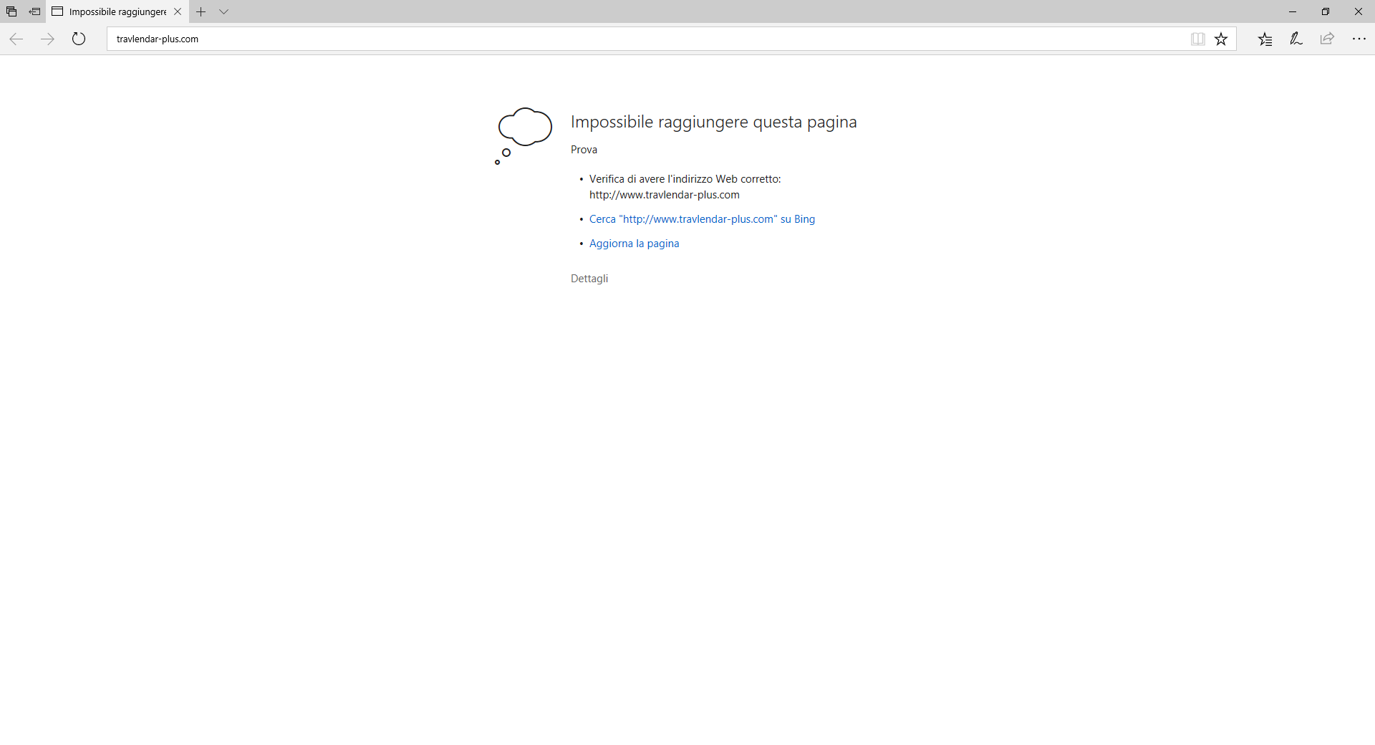

Travlendar +
Home
Info
Sign Up
Log In
Username
someone.11
Password
*****************
Discard
Log In

Slide 2
Travlendar +
Home
Profile
Calendar
Map
Welcome someone.11
Log Out
Sun | Mon | Tue | Wed | Thu | Fri | Sat
T1
T1
T2
Change Preferences
Reschedule Calendar
T2
T3
B
B
T3
B
T4

Slide 3


Travlendar +
Task T2
Home
Info
Calendar
Map
Welcome someone.11
Log Out
Preference 1
Sun | Mon | Tue | Wed | Thu | Fri | Sat
T1
T1
Preference 2
T2
Change Preferences
Preference 3
Reschedule Calendar
T2
Time
12:58
13:58
Date
T3
24/07/17
B
B
T3
B
T4
Show Map

Slide 4
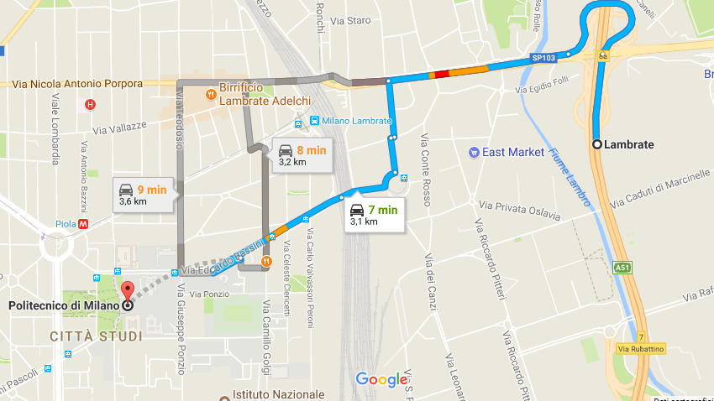
Travlendar +
Home
Info
Calendar
Map
Welcome someone.11
Log Out
Sun | Mon | Tue | Wed | Thu | Fri | Sat
T1
T1
T2
T2
B
T3
T3
B
T4
B
Show Info
Buy Ticket
Rent a Vehicle

Slide 5
Travlendar +
Insert Username
Insert Password
Log In

Slide 6
Sun | Mon | Tue | Wed | Thu | Fri | Sat
T1
T1
T2
T2
B
T3
T3
B
T4
B

Slide 7

Welcome someone.11
Add Task
Sun | Mon | Tue | Wed | Thu | Fri | Sat
Change Global Preferences
T1
T1
T2
Profile
Reschedule Calendar
T2
B
T3
T3
B
T4
B
Log Out

Slide 8
Task T2
Sun | Mon | Tue | Wed | Thu | Fri | Sat
T1
Preference 1
T1
Preference 2
T2
Preference 3
T2
Time
12:58
13:58
B
Date
24/07/17
T3
T3
B
T4
B
Show Map

Slide 9
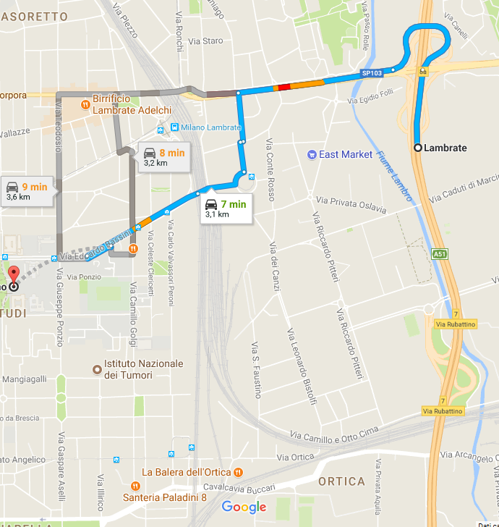
Task T2
Show Info
Close

