Slide 1

DR. REYNA TRUJILLO
A website for the full professional journey
Six designs.
One professional story.
Design comparisons, section-by-section explanations,
and a guide to the visitor experience.
Leadership · Education · Research · Community
DR. REYNA TRUJILLO / SIX WEBSITE DESIGNS
01
Notes:
Introduce the deck as a walkthrough of six existing website formats. The goal is to explain the visual choices and the function of the sections.
Source: current website source at /workspace/sites/reyna-trujillo/dist. Screenshots captured from website previews. Static screenshots do not play website motion.

Slide 2
PURPOSE & AUDIENCE
What the website helps people do
Understand her work
See evidence
See how executive leadership, teaching, entrepreneurship, and community service connect.
Review roles, program scope, research, education, partnerships, and milestone photos.
Find a reason to connect
Take the next step
Choose advisory support, coaching, speaking, a proposal, a partnership, or a giving inquiry.
Open a focused email request, review the full CV, or read the dissertation.
DR. REYNA TRUJILLO / SIX WEBSITE DESIGNS
02
Notes:
Understand her work: See how executive leadership, teaching, entrepreneurship, and community service connect.
See evidence: Review roles, program scope, research, education, partnerships, and milestone photos.
Find a reason to connect: Choose advisory support, coaching, speaking, a proposal, a partnership, or a giving inquiry.
Take the next step: Open a focused email request, review the full CV, or read the dissertation.
Source: current website source at /workspace/sites/reyna-trujillo/dist. Screenshots captured from website previews. Static screenshots do not play website motion.

Slide 3
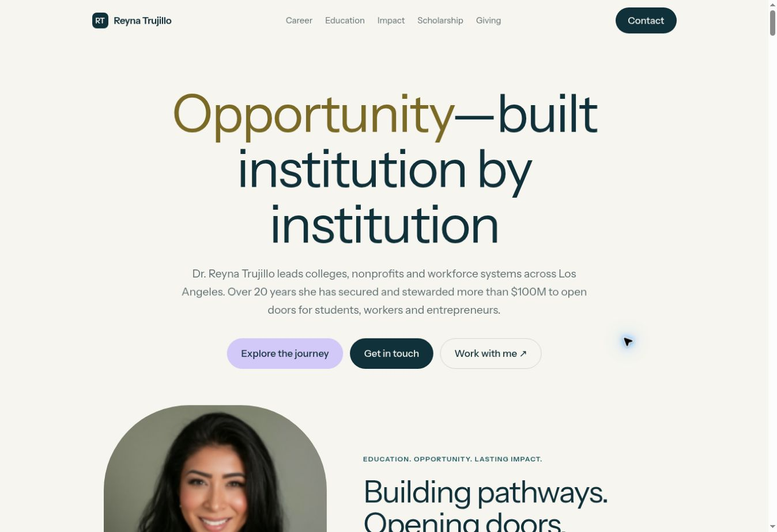
THE SIX DESIGN DIRECTIONS
Format 1 — Professional & detailed
Visual direction
Cream, teal, and gold create a calm professional introduction.
How it works
Expandable career history and topic tabs help visitors explore a long CV.
Who it suits
Best for institutions, boards, academic colleagues, and people reviewing credentials.
DR. REYNA TRUJILLO / SIX WEBSITE DESIGNS
03
Notes:
Format 1. Professional & detailed Cream, teal, and gold create a calm professional introduction. Expandable career history and topic tabs help visitors explore a long CV. Best for institutions, boards, academic colleagues, and people reviewing credentials.
Demo route: /
Source: current website source at /workspace/sites/reyna-trujillo/dist. Screenshots captured from website previews. Static screenshots do not play website motion.

Slide 4
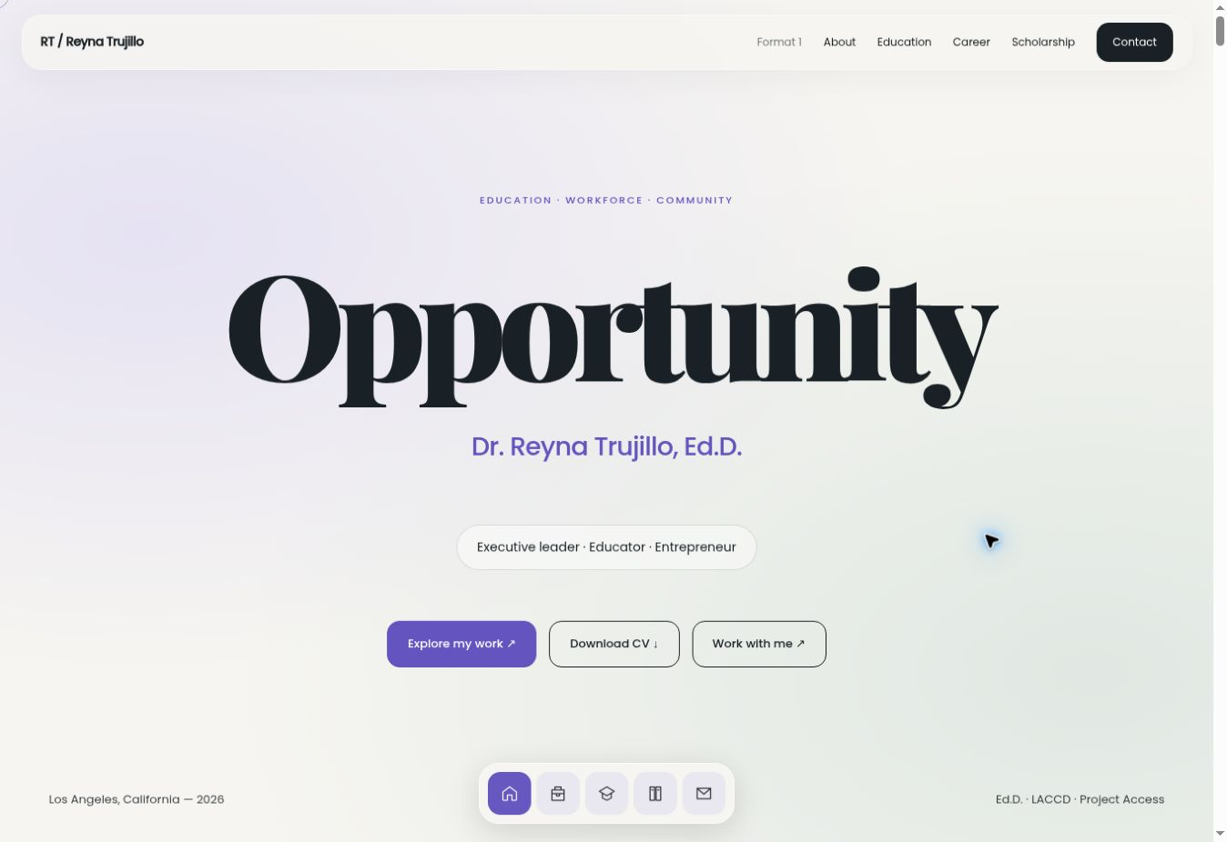
THE SIX DESIGN DIRECTIONS
Format 2 — Modern portfolio
Visual direction
Large editorial type, generous space, and a floating navigation dock.
How it works
Scroll reveals, hover feedback, and animated numbers add movement.
Who it suits
Best for a contemporary personal brand with quick access to key areas.
DR. REYNA TRUJILLO / SIX WEBSITE DESIGNS
04
Notes:
Format 2. Modern portfolio Large editorial type, generous space, and a floating navigation dock. Scroll reveals, hover feedback, and animated numbers add movement. Best for a contemporary personal brand with quick access to key areas.
Demo route: /format-2/
Source: current website source at /workspace/sites/reyna-trujillo/dist. Screenshots captured from website previews. Static screenshots do not play website motion.

Slide 5
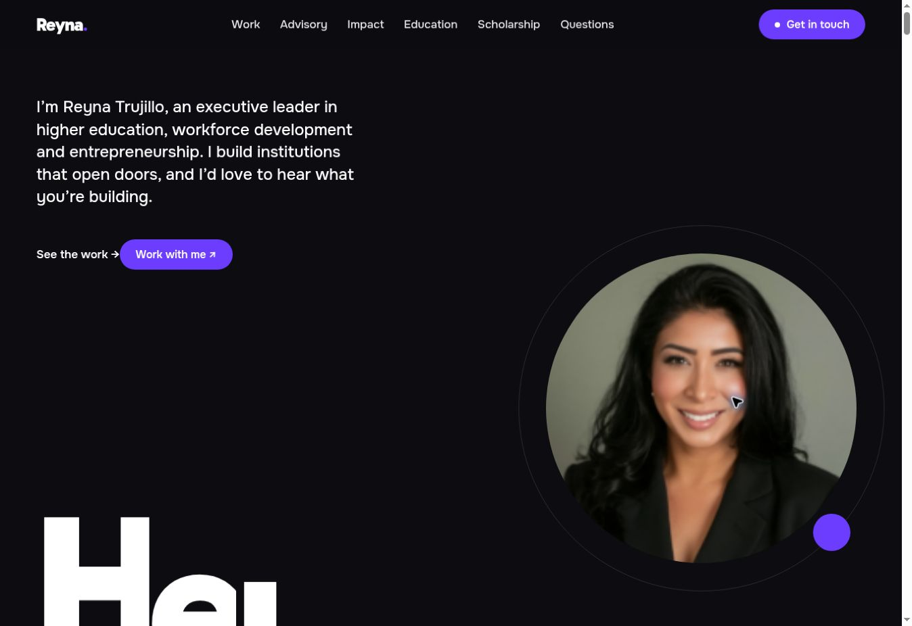
THE SIX DESIGN DIRECTIONS
Format 3 — Bold studio
Visual direction
Dark backgrounds, oversized type, purple accents, and circular portraits.
How it works
Work and service cards create a more visual route through her experience.
Who it suits
Best for a confident, expressive presentation of leadership and collaboration.
DR. REYNA TRUJILLO / SIX WEBSITE DESIGNS
05
Notes:
Format 3. Bold studio Dark backgrounds, oversized type, purple accents, and circular portraits. Work and service cards create a more visual route through her experience. Best for a confident, expressive presentation of leadership and collaboration.
Demo route: /format-3/
Source: current website source at /workspace/sites/reyna-trujillo/dist. Screenshots captured from website previews. Static screenshots do not play website motion.

Slide 6
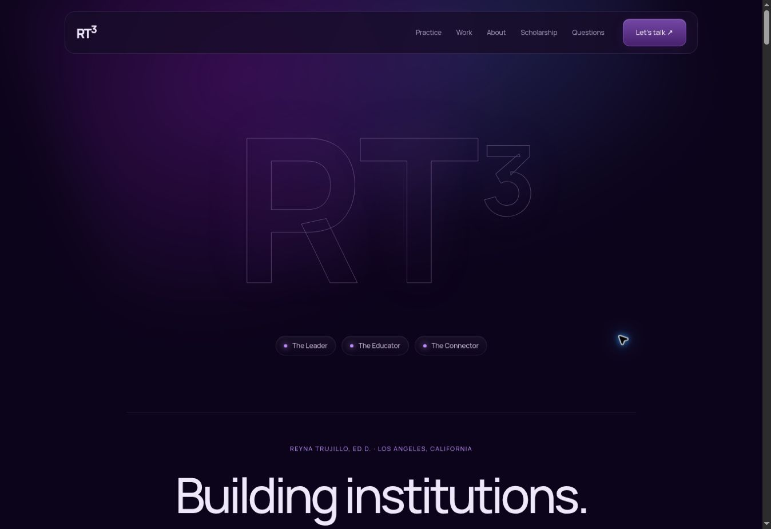
THE SIX DESIGN DIRECTIONS
Format 4 — Purple & layered
Visual direction
Hencubed-inspired direction with outlined lettering, gradients, and glass-like cards.
How it works
Practice cards, expandable projects, and questions keep information in clear groups.
Who it suits
Best for innovation, strategy, and entrepreneurship conversations.
DR. REYNA TRUJILLO / SIX WEBSITE DESIGNS
06
Notes:
Format 4. Purple & layered Hencubed-inspired direction with outlined lettering, gradients, and glass-like cards. Practice cards, expandable projects, and questions keep information in clear groups. Best for innovation, strategy, and entrepreneurship conversations.
Demo route: /format-4/
Source: current website source at /workspace/sites/reyna-trujillo/dist. Screenshots captured from website previews. Static screenshots do not play website motion.

Slide 7
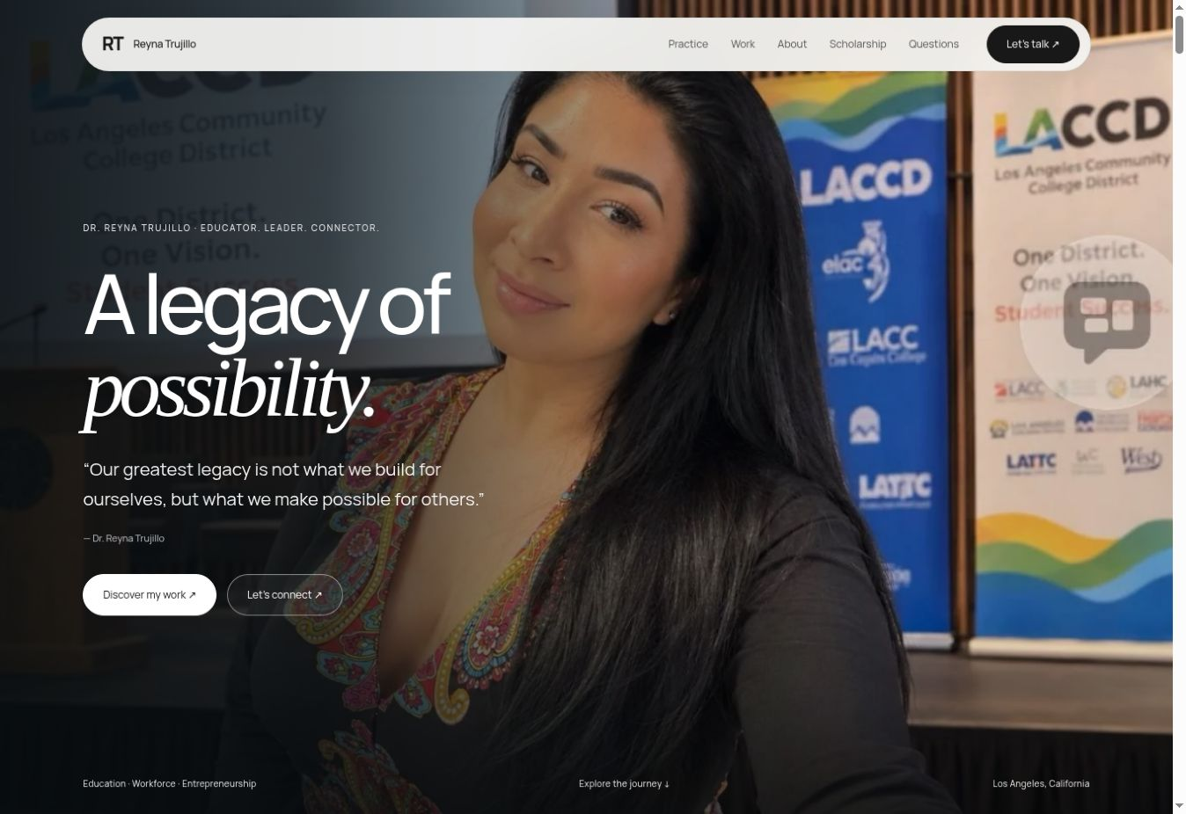
THE SIX DESIGN DIRECTIONS
Format 5 — Photo-led & minimal
Visual direction
A full-height hero photo, a quote, simple type, and a compact pill navigation.
How it works
Large milestone photos move horizontally as the visitor scrolls through the gallery.
Who it suits
Best for a personal introduction with a strong photographic story.
DR. REYNA TRUJILLO / SIX WEBSITE DESIGNS
07
Notes:
Format 5. Photo-led & minimal A full-height hero photo, a quote, simple type, and a compact pill navigation. Large milestone photos move horizontally as the visitor scrolls through the gallery. Best for a personal introduction with a strong photographic story.
Demo route: /format-5/
Source: current website source at /workspace/sites/reyna-trujillo/dist. Screenshots captured from website previews. Static screenshots do not play website motion.

Slide 8
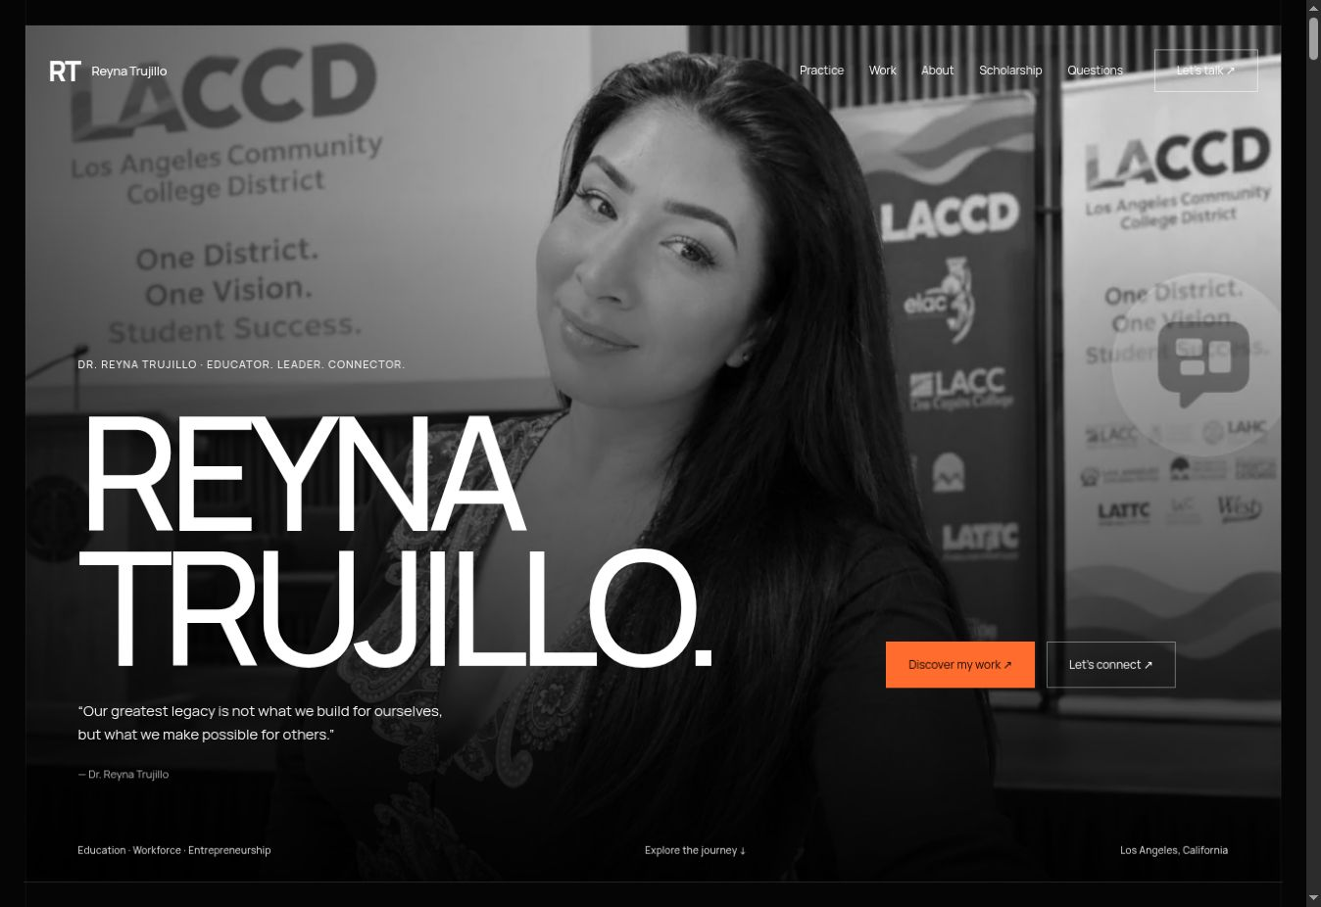
THE SIX DESIGN DIRECTIONS
Format 6 — Editorial & expressive
Visual direction
Olivia-inspired black and orange design, oversized name, and numbered sections.
How it works
Milestones become an alternating photo journal with captions and image enlargement.
Who it suits
Best for a bold visual story with room for each achievement.
DR. REYNA TRUJILLO / SIX WEBSITE DESIGNS
08
Notes:
Format 6. Editorial & expressive Olivia-inspired black and orange design, oversized name, and numbered sections. Milestones become an alternating photo journal with captions and image enlargement. Best for a bold visual story with room for each achievement.
Demo route: /format-6/
Source: current website source at /workspace/sites/reyna-trujillo/dist. Screenshots captured from website previews. Static screenshots do not play website motion.

Slide 9
CONTENT MAP
The sections tell a connected story
01 / First impression
02 / Professional scope
03 / Academic journey
Hero, portrait, quote or statement, and clear links into the page.
Practice areas, career history, selected initiatives, and impact figures.
Education, teaching, research, writing, and the published dissertation.
04 / People & milestones
05 / Ways to work together
06 / Keep in touch
Community photographs, partnership moments, recognition, and captions.
Compact cards for focused inquiries and meeting requests.
Questions, email, phone, LinkedIn, CV, and return-to-top links.
DR. REYNA TRUJILLO / SIX WEBSITE DESIGNS
09
Notes:
01 / First impression: Hero, portrait, quote or statement, and clear links into the page.
02 / Professional scope: Practice areas, career history, selected initiatives, and impact figures.
03 / Academic journey: Education, teaching, research, writing, and the published dissertation.
04 / People & milestones: Community photographs, partnership moments, recognition, and captions.
05 / Ways to work together: Compact cards for focused inquiries and meeting requests.
06 / Keep in touch: Questions, email, phone, LinkedIn, CV, and return-to-top links.
Source: current website source at /workspace/sites/reyna-trujillo/dist. Screenshots captured from website previews. Static screenshots do not play website motion.

Slide 10
SECTION GUIDE / ARRIVAL
Hero, header & navigation
Hero
Main actions
Introduces who she is. The portrait makes the page personal; the headline gives visitors an immediate sense of her work.
Links such as “Discover my work” and “Let’s connect” move visitors to the relevant section.
Header or dock
Scroll cues
Section links let people jump straight to work, scholarship, or contact. Format 2 uses a floating icon dock.
Explore links and progress indicators help visitors understand that more content follows below.
DR. REYNA TRUJILLO / SIX WEBSITE DESIGNS
10
Notes:
Hero: Introduces who she is. The portrait makes the page personal; the headline gives visitors an immediate sense of her work.
Main actions: Links such as “Discover my work” and “Let’s connect” move visitors to the relevant section.
Header or dock: Section links let people jump straight to work, scholarship, or contact. Format 2 uses a floating icon dock.
Scroll cues: Explore links and progress indicators help visitors understand that more content follows below.
Source: current website source at /workspace/sites/reyna-trujillo/dist. Screenshots captured from website previews. Static screenshots do not play website motion.

Slide 11
SECTION GUIDE / IMPACT
Impact figures show the scale of the work
20+ years
$100M+
$15M+
Executive leadership experience.
Grant and investment stewardship.
Operating budgets.
4 organizations
50+ programs
200+ partnerships
Organizations founded.
Workforce and academic programs.
Strategic partnerships.
DR. REYNA TRUJILLO / SIX WEBSITE DESIGNS
11
Notes:
20+ years: Executive leadership experience.
$100M+: Grant and investment stewardship.
$15M+: Operating budgets.
4 organizations: Organizations founded.
50+ programs: Workforce and academic programs.
200+ partnerships: Strategic partnerships.
Source: current website source at /workspace/sites/reyna-trujillo/dist. Screenshots captured from website previews. Static screenshots do not play website motion.

Slide 12
MOTION & INFORMATION
Format 2: the numbers move as they enter view
Count-up animation
0 → 20+
Figures rise to their final values when the section appears. Currency symbols and “+” stay connected to the number.
Years of executive leadership
The animation draws attention to the evidence without changing its meaning.
Illustration of the count-up behavior
Reduced-motion preference shows the final figures directly.
DR. REYNA TRUJILLO / SIX WEBSITE DESIGNS
12
Notes:
The six figures describe different kinds of professional scope; the monetary figures should not be added together. Layouts vary: formats 4–6 foreground a smaller selection of four figures. The count-up behavior is documented in Format 2 source.
Source: current website source at /workspace/sites/reyna-trujillo/dist. Screenshots captured from website previews. Static screenshots do not play website motion.

Slide 13
SECTION GUIDE / EXPERIENCE
Career & projects explain the responsibility
Career history
Selected initiatives
Roles, dates, organizations, and responsibilities give context beyond a job title. Format 1 offers the most detailed CV-style reading.
Cards highlight the entrepreneurship center, Project Access, workforce pathways, and scholarship support.
Expand for detail
CV download
Project and career disclosures reveal more information when a visitor wants to explore a role.
The full CV is available for visitors who need a complete professional record.
DR. REYNA TRUJILLO / SIX WEBSITE DESIGNS
13
Notes:
Career history: Roles, dates, organizations, and responsibilities give context beyond a job title. Format 1 offers the most detailed CV-style reading.
Selected initiatives: Cards highlight the entrepreneurship center, Project Access, workforce pathways, and scholarship support.
Expand for detail: Project and career disclosures reveal more information when a visitor wants to explore a role.
CV download: The full CV is available for visitors who need a complete professional record.
Source: current website source at /workspace/sites/reyna-trujillo/dist. Screenshots captured from website previews. Static screenshots do not play website motion.

Slide 14
SECTION GUIDE / CREDENTIALS
Expertise, teaching & education
Practice areas
Advisory experience
Explain the kinds of work she supports: strategy, learning, innovation, leadership, and partnerships.
Connects her professional background to the problems an organization might bring to her.
Academic preparation
Teaching
Shows degrees and institutions as part of her professional and educational journey.
Explains the classroom side of the work, including college teaching and workforce education.
DR. REYNA TRUJILLO / SIX WEBSITE DESIGNS
14
Notes:
Practice areas: Explain the kinds of work she supports: strategy, learning, innovation, leadership, and partnerships.
Advisory experience: Connects her professional background to the problems an organization might bring to her.
Academic preparation: Shows degrees and institutions as part of her professional and educational journey.
Teaching: Explains the classroom side of the work, including college teaching and workforce education.
Source: current website source at /workspace/sites/reyna-trujillo/dist. Screenshots captured from website previews. Static screenshots do not play website motion.

Slide 15
SECTION GUIDE / BEYOND THE ROLE
Speaking, mentoring, writing & enterprise
Speaking
Mentoring
Keynotes, workshops, panels, and facilitation give event organizers a route into her areas of expertise.
Leadership development and guidance connect her experience with emerging professionals, students, and founders.
Writing
Ventures & governance
The scholarship section distinguishes doctoral research from a memoir in editorial development and a leadership book in development.
Business ventures, board service, and ecosystem building show the entrepreneurial and civic sides of her work.
DR. REYNA TRUJILLO / SIX WEBSITE DESIGNS
15
Notes:
Speaking: Keynotes, workshops, panels, and facilitation give event organizers a route into her areas of expertise.
Mentoring: Leadership development and guidance connect her experience with emerging professionals, students, and founders.
Writing: The scholarship section distinguishes doctoral research from a memoir in editorial development and a leadership book in development.
Ventures & governance: Business ventures, board service, and ecosystem building show the entrepreneurial and civic sides of her work.
Source: current website source at /workspace/sites/reyna-trujillo/dist. Screenshots captured from website previews. Static screenshots do not play website motion.

Slide 16
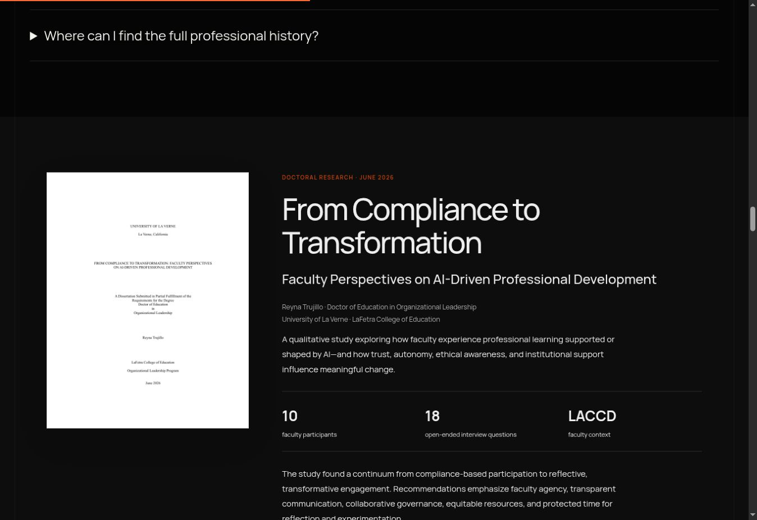
SECTION GUIDE / PUBLISHED RESEARCH
Research belongs in the professional story
What it presents
Doctoral research on faculty perspectives on AI-driven professional development.
What visitors can do
Read the dissertation, download the PDF, or follow the ProQuest link.
Why it is here
Connects her academic journey with leadership, institutional change, and faculty learning.
DR. REYNA TRUJILLO / SIX WEBSITE DESIGNS
16
Notes:
Research title: From Compliance to Transformation: Faculty Perspectives on AI-Driven Professional Development. University of La Verne, June 2026. The site describes a qualitative study with ten faculty participants and eighteen open-ended interview questions.
Source: current website source at /workspace/sites/reyna-trujillo/dist. Screenshots captured from website previews. Static screenshots do not play website motion.

Slide 17
SECTION GUIDE / PEOPLE & PURPOSE
Community, philanthropy & leadership
Community portraits
Milestone photographs
Photographs show her at college and community events, with context about education, leadership, and service.
Launches, scholarships, workshops, and partnerships make the professional story easier to understand.
Philanthropy & governance
Captions & sources
Scholarship support, mentoring, and service show how her work extends beyond executive roles.
Captions explain the event. LinkedIn source links help visitors follow the wider professional story.
DR. REYNA TRUJILLO / SIX WEBSITE DESIGNS
17
Notes:
Community portraits: Photographs show her at college and community events, with context about education, leadership, and service.
Milestone photographs: Launches, scholarships, workshops, and partnerships make the professional story easier to understand.
Philanthropy & governance: Scholarship support, mentoring, and service show how her work extends beyond executive roles.
Captions & sources: Captions explain the event. LinkedIn source links help visitors follow the wider professional story.
Source: current website source at /workspace/sites/reyna-trujillo/dist. Screenshots captured from website previews. Static screenshots do not play website motion.

Slide 18
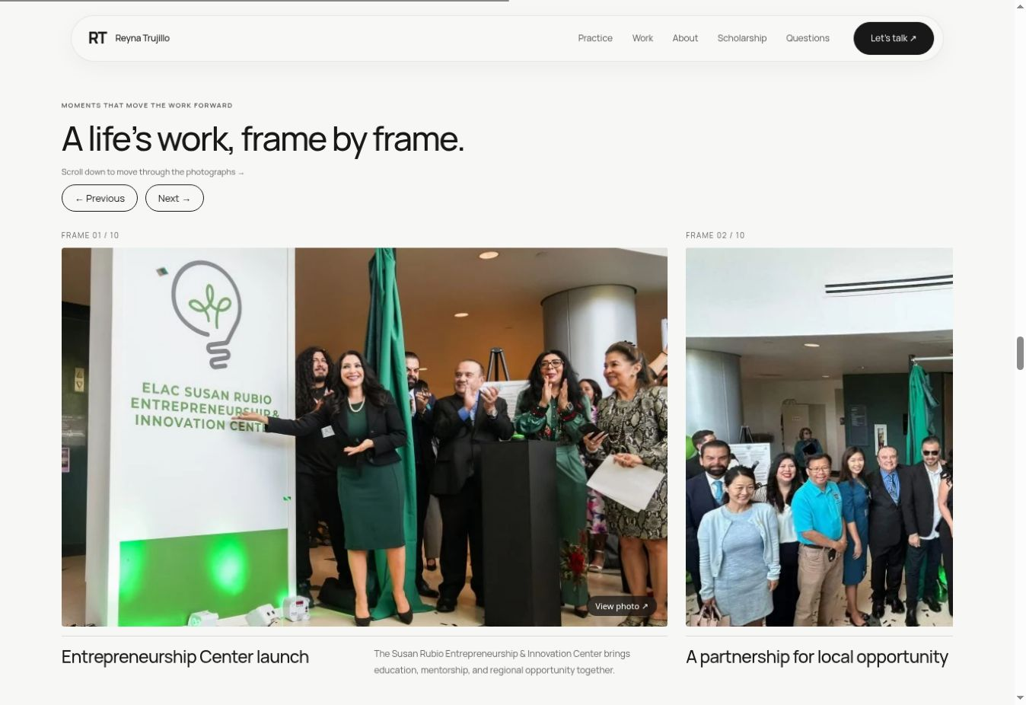
PHOTO GALLERY / FORMAT 5
Format 5 — large photos that pass as you scroll
Large filmstrip
Wide photographs retain their visual presence, with titles and captions below.
Scroll interaction
On desktop, scrolling through the pinned gallery moves the sequence horizontally.
Other ways to browse
Previous/next controls and arrow keys provide alternatives. Clicking a photo opens it larger.
DR. REYNA TRUJILLO / SIX WEBSITE DESIGNS
18
Notes:
Demonstrate on the live website: enter the milestone gallery, continue scrolling, and observe the next large photograph. Reduced-motion and smaller-screen behavior use a regular browsing layout. A slide screenshot cannot demonstrate the motion itself.
Source: current website source at /workspace/sites/reyna-trujillo/dist. Screenshots captured from website previews. Static screenshots do not play website motion.

Slide 19
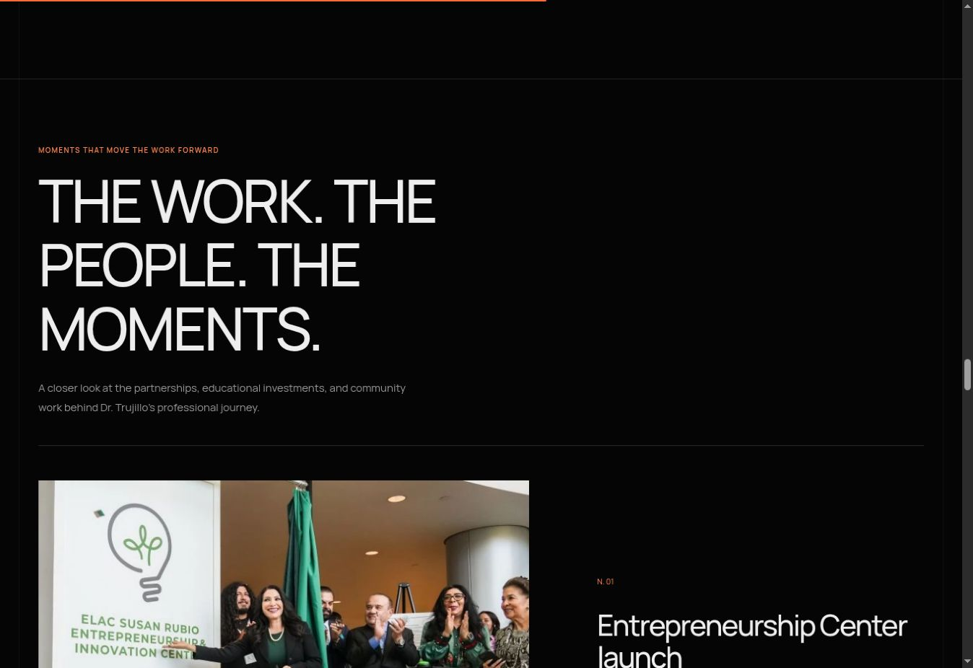
PHOTO GALLERY / FORMAT 6
Format 6 — a photo journal with room for context
Different structure
Milestones use alternating photo and caption arrangements instead of the filmstrip.
Story rhythm
Numbered entries make each partnership, event, and achievement its own moment.
Closer inspection
Visitors can open individual images at a larger size and return to the journal.
DR. REYNA TRUJILLO / SIX WEBSITE DESIGNS
19
Notes:
The gallery contains ten milestone photographs and graphics drawn from saved public LinkedIn posts and reposts. Captions explain the context; photos should not be treated as standalone proof of outcomes.
Source: current website source at /workspace/sites/reyna-trujillo/dist. Screenshots captured from website previews. Static screenshots do not play website motion.

Slide 20
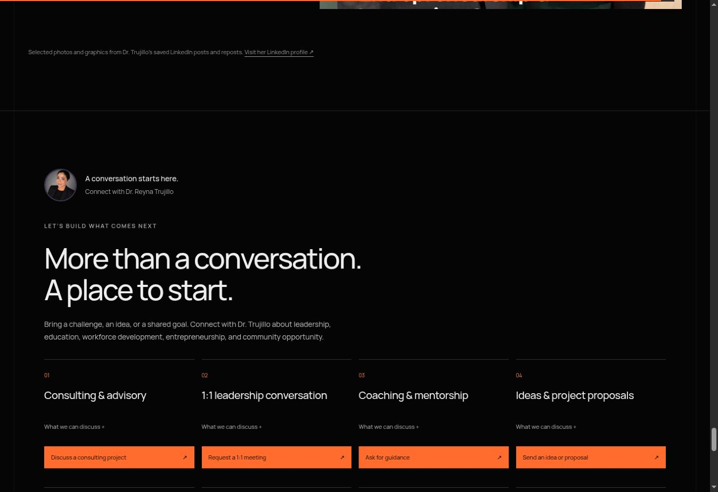
SECTION GUIDE / WORK TOGETHER
Compact cards make contact easier
Choose a purpose
Visitors select the type of conversation they want to start.
Read a little more
“What we can discuss” expands the card with useful context.
Start an email
The action opens an email draft with a relevant subject and prompts.
DR. REYNA TRUJILLO / SIX WEBSITE DESIGNS
20
Notes:
Each card is a request route. The website does not automatically send the email, confirm appointments, provide live chat, or process payments.
Source: current website source at /workspace/sites/reyna-trujillo/dist. Screenshots captured from website previews. Static screenshots do not play website motion.

Slide 21
CONTACT OPTIONS
Eight ways to start a conversation
Advisory + 1:1
Coaching + proposals
Discuss an organizational challenge or request a focused leadership conversation.
Ask for guidance or share a project idea, audience, and intended outcome.
Speaking + partnerships
Giving + general help
Invite her to an event or discuss collaboration and project sponsorship.
Ask for the appropriate scholarship giving process or send a general question.
DR. REYNA TRUJILLO / SIX WEBSITE DESIGNS
21
Notes:
Advisory + 1:1: Discuss an organizational challenge or request a focused leadership conversation.
Coaching + proposals: Ask for guidance or share a project idea, audience, and intended outcome.
Speaking + partnerships: Invite her to an event or discuss collaboration and project sponsorship.
Giving + general help: Ask for the appropriate scholarship giving process or send a general question.
Source: current website source at /workspace/sites/reyna-trujillo/dist. Screenshots captured from website previews. Static screenshots do not play website motion.

Slide 22
REQUEST FLOW
What happens after a visitor clicks
1
2
3
Choose a card
Add the details
Send & follow up
Pick the reason for getting in touch.
An email draft includes prompts for scope, dates, audience, or goals.
The visitor sends the email. Arrangements are confirmed in conversation.
Giving and sponsorship inquiries lead to the relevant organization’s official process.
DR. REYNA TRUJILLO / SIX WEBSITE DESIGNS
22
Notes:
Meeting links are email-based requests, not a live booking calendar. The site has no payment checkout or live chat backend.
Source: current website source at /workspace/sites/reyna-trujillo/dist. Screenshots captured from website previews. Static screenshots do not play website motion.

Slide 23
SECTION GUIDE / SUPPORTING FEATURES
Small details that help people use the site
Questions & disclosures
Footer & return links
Expandable answers keep the page shorter and clarify how to request a meeting or find the full history.
Email, phone, LinkedIn, CV, and back-to-top links give visitors a useful way out of the page.
Responsive layouts
Accessible interaction
Cards and page sections adapt to smaller screens so the same information remains available.
Keyboard focus, descriptive image text, and reduced-motion handling support different ways of browsing.
DR. REYNA TRUJILLO / SIX WEBSITE DESIGNS
23
Notes:
Questions & disclosures: Expandable answers keep the page shorter and clarify how to request a meeting or find the full history.
Footer & return links: Email, phone, LinkedIn, CV, and back-to-top links give visitors a useful way out of the page.
Responsive layouts: Cards and page sections adapt to smaller screens so the same information remains available.
Accessible interaction: Keyboard focus, descriptive image text, and reduced-motion handling support different ways of browsing.
Source: current website source at /workspace/sites/reyna-trujillo/dist. Screenshots captured from website previews. Static screenshots do not play website motion.

