Slide 1
Programs for a Frozen Machine
The description length of language and task in optimized prefixes
Georgii Sirotenko

Slide 2
The idea
A frozen LM is a fixed machine. A soft prefix that makes it do a task is a program for that machine.
The shortest such program is a model‑relative description length of the task (Shaw et al. 2026; Cosma 2026).
Grid: tasks {translation from English, factual recall, continuation} × output languages {ru, de, en}, Qwen2.5‑1.5B base, frozen.
Questions: how many bits does a cell cost, how are they split between task and language, do the parts compose, how far apart are programs, where does the model read them.

Slide 3
Two units, one distortion
Slots: number $k$ of prefix positions (capacity).
Bits: prefix = diagonal Gaussian posterior; its KL to a prior fitted to the embedding matrix is the code length (bits‑back; Hinton & van Camp 1993).
Distortion: teacher‑forced bits per target token, normalised per cell
$$\hat{D}=\frac{L−L_{\text{floor}}}{L_{\text{none}}−L_{\text{floor}}}, L_{\text{floor}}=min\left(\text{LoRA},\text{best prefix}\right)$$
Preregistered operating points $\hat{D}≤0.25$ and $≤0.10$.
8 cells; ~36 A100 hours; every figure regenerated from CSVs.

Slide 4
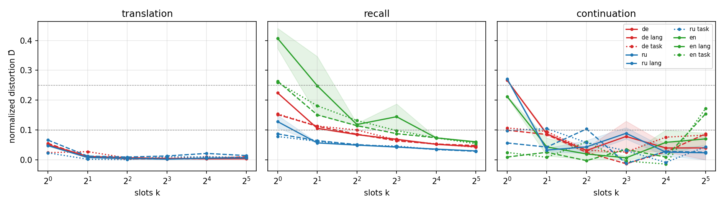
Result 1: slots are not a description length

Slide 5
Translation: one slot reaches $\hat{D}≤0.10$ in every language. Recall needs 2–16 and is still improving at $k=32$.
One trained slot beats the natural‑language prompt: recall NL prompt $\hat{D}$ 0.91–0.96, one slot 0.13–0.41.
Telling the model the language or the task saves 1.8 slots on average, 8 of them from recall‑en. Continuation: floor ≈ no prefix, unmeasurable.

Slide 6
Result 2: description length in bits
cell | bits at $\hat{D}≤0.10$ | bits at $\hat{D}≤0.25$
translation‑de | 436 | 436
translation‑ru | 542 | 542
recall‑ru | 2,419 | 2,419
recall‑de | — (best 0.14) | 3,343
recall‑en | — (best 0.23) | 7,155

Slide 7
A translation program ≈ 500 bits; Russian recall 5×; English recall dearest, also on the 4,212 items shared by all three recall test sets.
Task ordering follows the learning gap (H1 yes); language ordering does not follow exposure (H1 no).
Replication seed (corrected protocol): within 4% on three cells, 17–22% on recall‑de / translation‑de in opposite directions; same ordering.

Slide 8
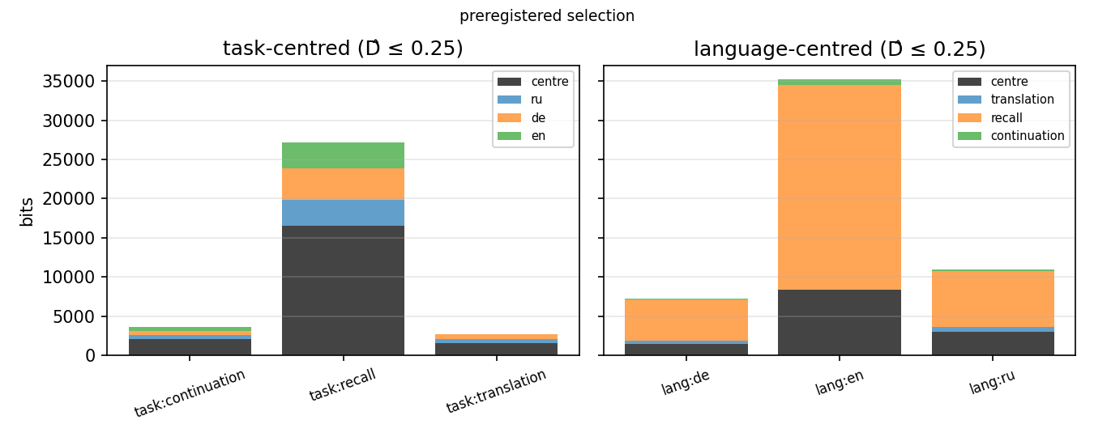
Result 3: neither nesting is cheaper, and sharing does not compress

Slide 9
Centre paid once per group, each deviation once per member; cheapest run with every member at $\hat{D}≤0.25$.

Slide 10
Three codes for the same eight cells
code (all 8 cells, $\hat{D}≤0.25$) | protocol | bits
task centres + language deviations | prereg. selection | 33,500
eight independent programs | prereg. | 37,600
language centres + task deviations | prereg. selection | 53,500
task centres + language deviations | corrected | 26,700
language centres + task deviations | corrected | not reached (ru+de 8,900)
eight independent programs | corrected | 17,600

Slide 11
Prereg. rule: task‑centred wins by 37%. Corrected: the nestings tie within 25% at matched (k, β); language‑centred never gets recall‑en under 0.25.
A shared centre saves no bits: 1.87× the independent programs on the five measurable cells; parity on translation (1,029 vs 978), 1.9× on recall (24,972 vs 12,917).
At matched (k, β) a hierarchy costs 0.94–1.5× the flat2 sum.

Slide 12
What a language costs, what a task costs
Given the translation centre (604 bits): Russian 225, German 200 bits, 0.41–0.46 of a standalone program (corrected protocol; 485 / 662 under the preregistered rule).
Given the recall centre (14,600 bits): a language costs 3,200–3,950 bits, more than a standalone Russian or German program.
Given a language centre retrained on translation + recall (975 / 770 bits): translation 137 / 139, recall 2,251 / 2,774 (ru / de); the group is at parity with independent programs (1.14 / 0.97). Compare with the task‑centred costs; the prereg. asymmetry (recall 5,300–26,200 given a language) was the optimiser.
Recall dominates every code that contains it: 2,250–3,950 bits as a deviation from either kind of centre.
For translation alone the hierarchy is at best at parity: 1,029 vs 978 bits (corrected), 2,733 vs 1,893 (prereg.).

Slide 13
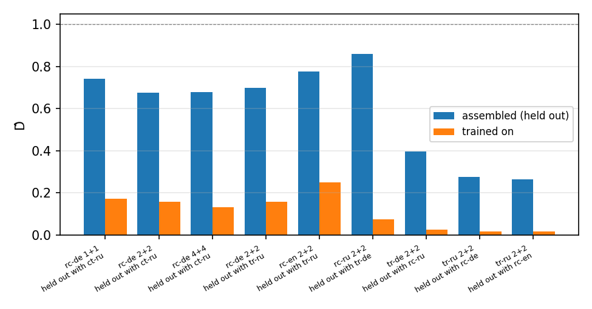
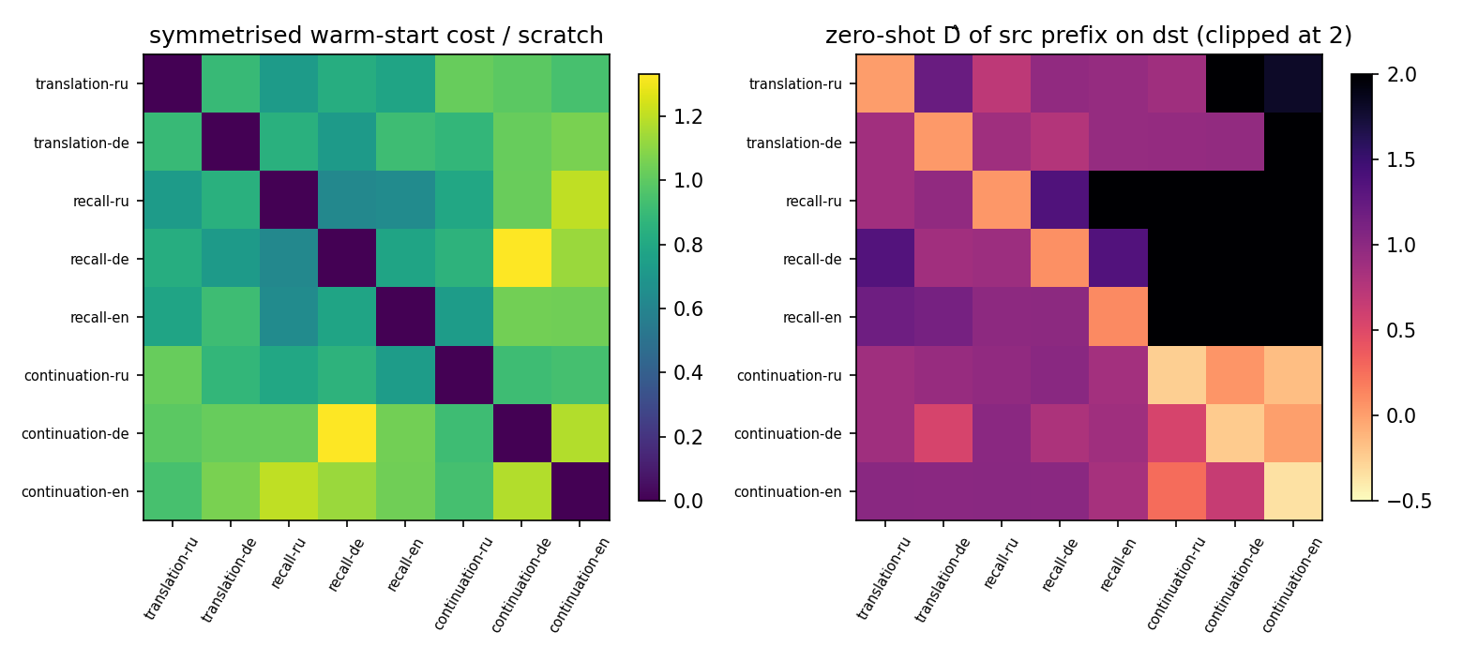
Result 4: composition and distance

Slide 14
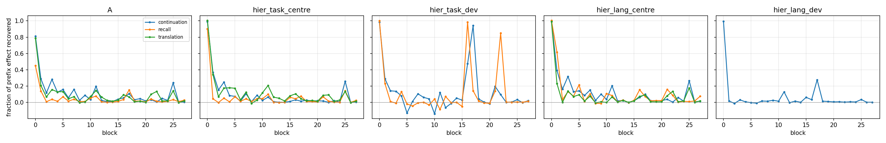
Result 5: where the program is read

Slide 15
Patching the prefix positions into block 0 alone recovers 70–94% of the effect for translation and continuation, 36–58% for recall (secondary peak at block 17).
A translation program is copied into the token stream in the first block; a recall program is read in several places, deep in the network.
H5: every probe peaks at block 0, but the language deviation is read again at blocks 16–17 (late mass 1.9 vs early 1.6 on recall) while the task centre is not (0.5 vs 1.0): a split by part, opposite to H5’s direction.

Slide 16
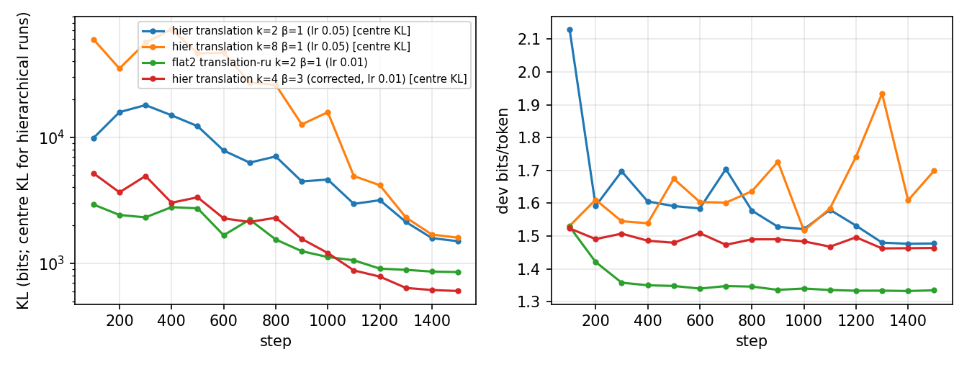
Result 6: the objective is right, the search is hard

Slide 17
lr 0.05 = 2 prior σ per step: the centre KL peaks at a median 26k bits (k=2) to 144k (k=8), up to 549k, between steps 100 and 800, then decays.
Selecting the checkpoint by mean‑posterior distortion picks a high‑rate step (up to 20× the final rate); the mean is not the coded object (translation, β=3: mean $\hat{D}$ 0.35–0.56, samples 0.06–0.17).
Corrected protocol (lr 0.01, select on the objective, score samples): frontier 20–71% lower with 4 runs per cell instead of 9; hierarchy reruns show no overshoot (selected step within 2% of final).
Shaw et al. (2026): 870 bits from a compiled init vs 2.8M from random init. Here the gap closes by selection and step size.

Slide 18
Preregistered comparisons
 | outcome
H1 cost orderings | task yes (recall far above translation); language no (English dearest)
H2 cheap language | slots: equal; bits: equal under the corrected protocol (prereg. 1.3–7.8× asymmetry does not replicate)
H3 separability | partial on translation, not on recall; a shared centre saves no bits (1.87× independent on measurable cells; language groups at parity); nestings equal within 25%
H4 task‑organised distance | direction yes, structure no, not significant (silhouette 0.004 vs −0.09)
H5 depth split | language deviation read early and late, task centre early: opposite to H5
H6 input compressibility | one vector suffices with the task prefix (exploratory)

Slide 19
Limitations and next steps
Two seeds; recall budget‑bound (3000 steps: $\hat{D}$ 0.043 to 0.032 and falling); continuation unmeasurable; distance matrix one seed.
Variational protocol corrected after preregistration; both reported. Both nestings rerun under it; every corrected rate still falling at 1500 steps.
Research version, same code: scale axis 0.5B–7B, 20+ languages by resource level, per‑column mixture prior, charge $\log_{2}\left|k\text{-grid}\right|$ bits for $k$, step size in prior‑σ units.
All figures and tables regenerate from the result tables with one notebook.

