Slide 1
LED–PHOTODIODE CHARACTERIZATION
Operating-voltage comparison
Photocurrent and background measurements using a Hamamatsu S2281 photodiode and Keithley 6487 picoammeter
LED: 470 nm • FEB Mach II • Channel 5
Measurement campaign: 02 November 2026
01

Slide 2
Executive summary
Main outcome from the comparative voltage scans
Net photocurrent is essentially unchanged when the PD bias is varied from 10 mV to 100 mV.
Measured dark background rises from approximately 12 pA at 10 mV to 22 pA at 25 mV, 31 pA at 50 mV, and 36 pA at 100 mV.
The 10 mV PD-bias setting therefore gives the lowest measured background without a demonstrated loss of useful signal.
Increasing LED bias from 12 V to 15 V raises net photocurrent by about 45% (approximately 133 pA to 192 pA).
12 V versus 15 V remains an application/LED-board decision; the higher signal at 15 V should be weighed against operating limits and the required diffuser sensitivity.
Preliminary operating preference: PD bias = 10 mV; LED bias = 12 V or 15 V pending system-level validation.
LED / photodiode voltage characterization • 02 November 2026
2

Slide 3
System under test
Detector, readout, and illumination source
Component | Identification / setting
Photodiode | Hamamatsu S2281 silicon photodiode (BNC package)
Picoammeter | Keithley 6487 Picoammeter / Voltage Source
LED driver | LED FEB Mach II
LED channel / wavelength | Channel 5 • 470 nm
LED bias scan | 8 V, 10 V, 12 V, 15 V
PD bias scan | 10 mV, 25 mV, 50 mV, 100 mV
The LED was operated with the same channel and frequency setting throughout the comparison; LED frequency was not varied.
LED / photodiode voltage characterization • 02 November 2026
3

Slide 4
Measurement procedure
Same acquisition sequence used for each LED-voltage point
Configure PD bias and Keithley measurement settings.
Acquire 30 dark readings before illumination.
Turn on the LED; wait 5 s for settling.
Acquire 200 LED-on readings.
Turn off the LED; wait 5 s.
Acquire 30 dark readings after illumination.
Keithley / acquisition parameter | Setting
Measurement mode | DC current
NPLC | 10
Current range | 2.1 nA
Source current limit | 25 µA
Autozero | ON
Zero correction | Fresh correction at initialization; zero-check OFF during acquisition
Photocurrent is calculated using dark readings before and after illumination to account for baseline drift.
LED / photodiode voltage characterization • 02 November 2026
4

Slide 5
Signal definition
Raw current, background, and net photocurrent
Average dark background = (Dark before + Dark after) / 2
Net photocurrent = LED-on mean − Average dark background
Raw LED-on current contains both the optical response and the measured baseline.
Net photocurrent is the quantity used to compare useful optical signal across voltage settings.
The reported LED-on SD describes the spread of individual LED-on current readings; it is not the uncertainty on the mean or a voltage uncertainty.
All currents in this presentation are expressed in picoamperes (pA).
LED / photodiode voltage characterization • 02 November 2026
5

Slide 6
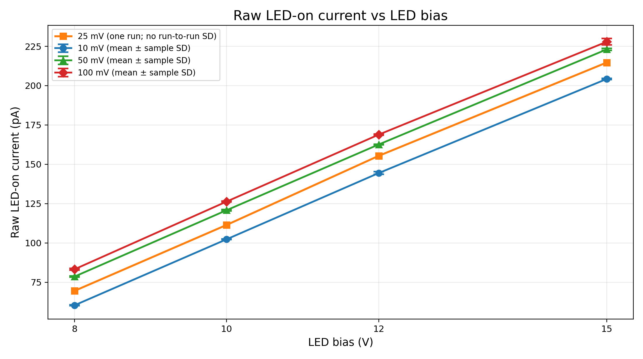
Raw LED-on current
Raw current increases with LED bias and includes the background
Raw readings are higher at larger PD bias because the measured background is also higher.
Comparing raw current alone would therefore mix optical signal and baseline changes.
Background subtraction is required for a fair comparison.
Error bars: between-run sample SD for repeated PD-bias scans; 25 mV has one scan and is shown without run-to-run SD.
LED / photodiode voltage characterization • 02 November 2026
6

Slide 7
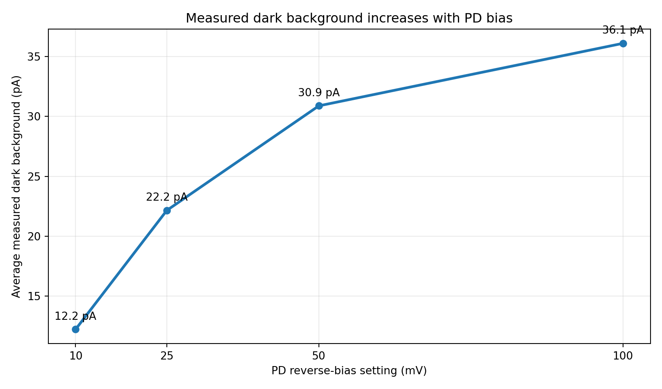
PD bias and measured background
Background averaged over the four LED-voltage points
PD bias | Mean background
10 mV | 12.23 pA
25 mV | 22.15 pA
50 mV | 30.88 pA
100 mV | 36.09 pA
Observed trend: background rises with PD bias. Its physical origin was not isolated in this test.
LED / photodiode voltage characterization • 02 November 2026
7

Slide 8
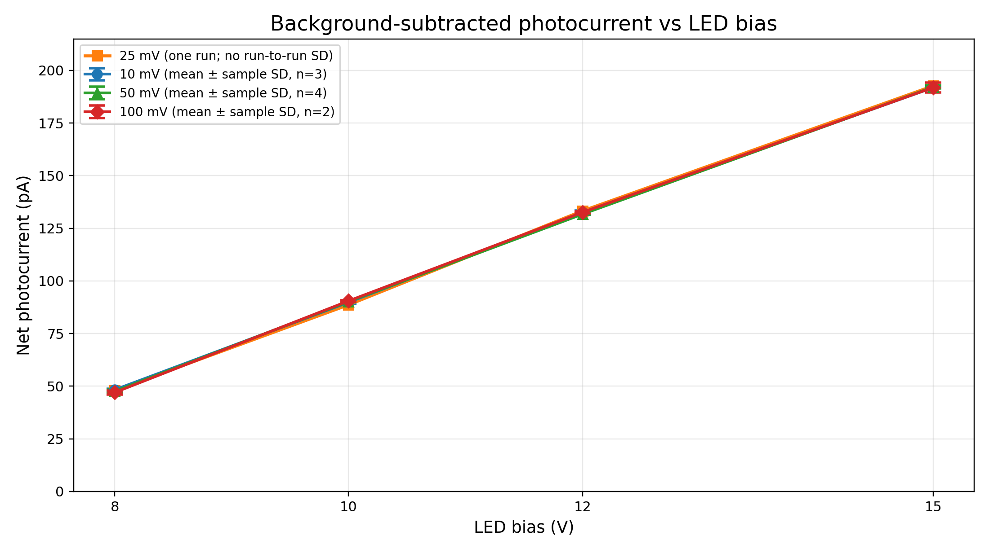
Net photocurrent vs LED bias
Background-subtracted signal; error bars show run-to-run SD where repeat runs exist
At each PD bias, net photocurrent rises approximately linearly over the tested LED-bias range.
The 15 V setting produces approximately 45% more net photocurrent than 12 V.
The 25 mV series is a single scan, so no run-to-run SD is available.
Error bars show between-run sample SD (n = 3 at 10 mV; n = 3–4 at 50 mV; n = 2 at 100 mV). 25 mV: one run, no SD bar.
LED / photodiode voltage characterization • 02 November 2026
8

Slide 9
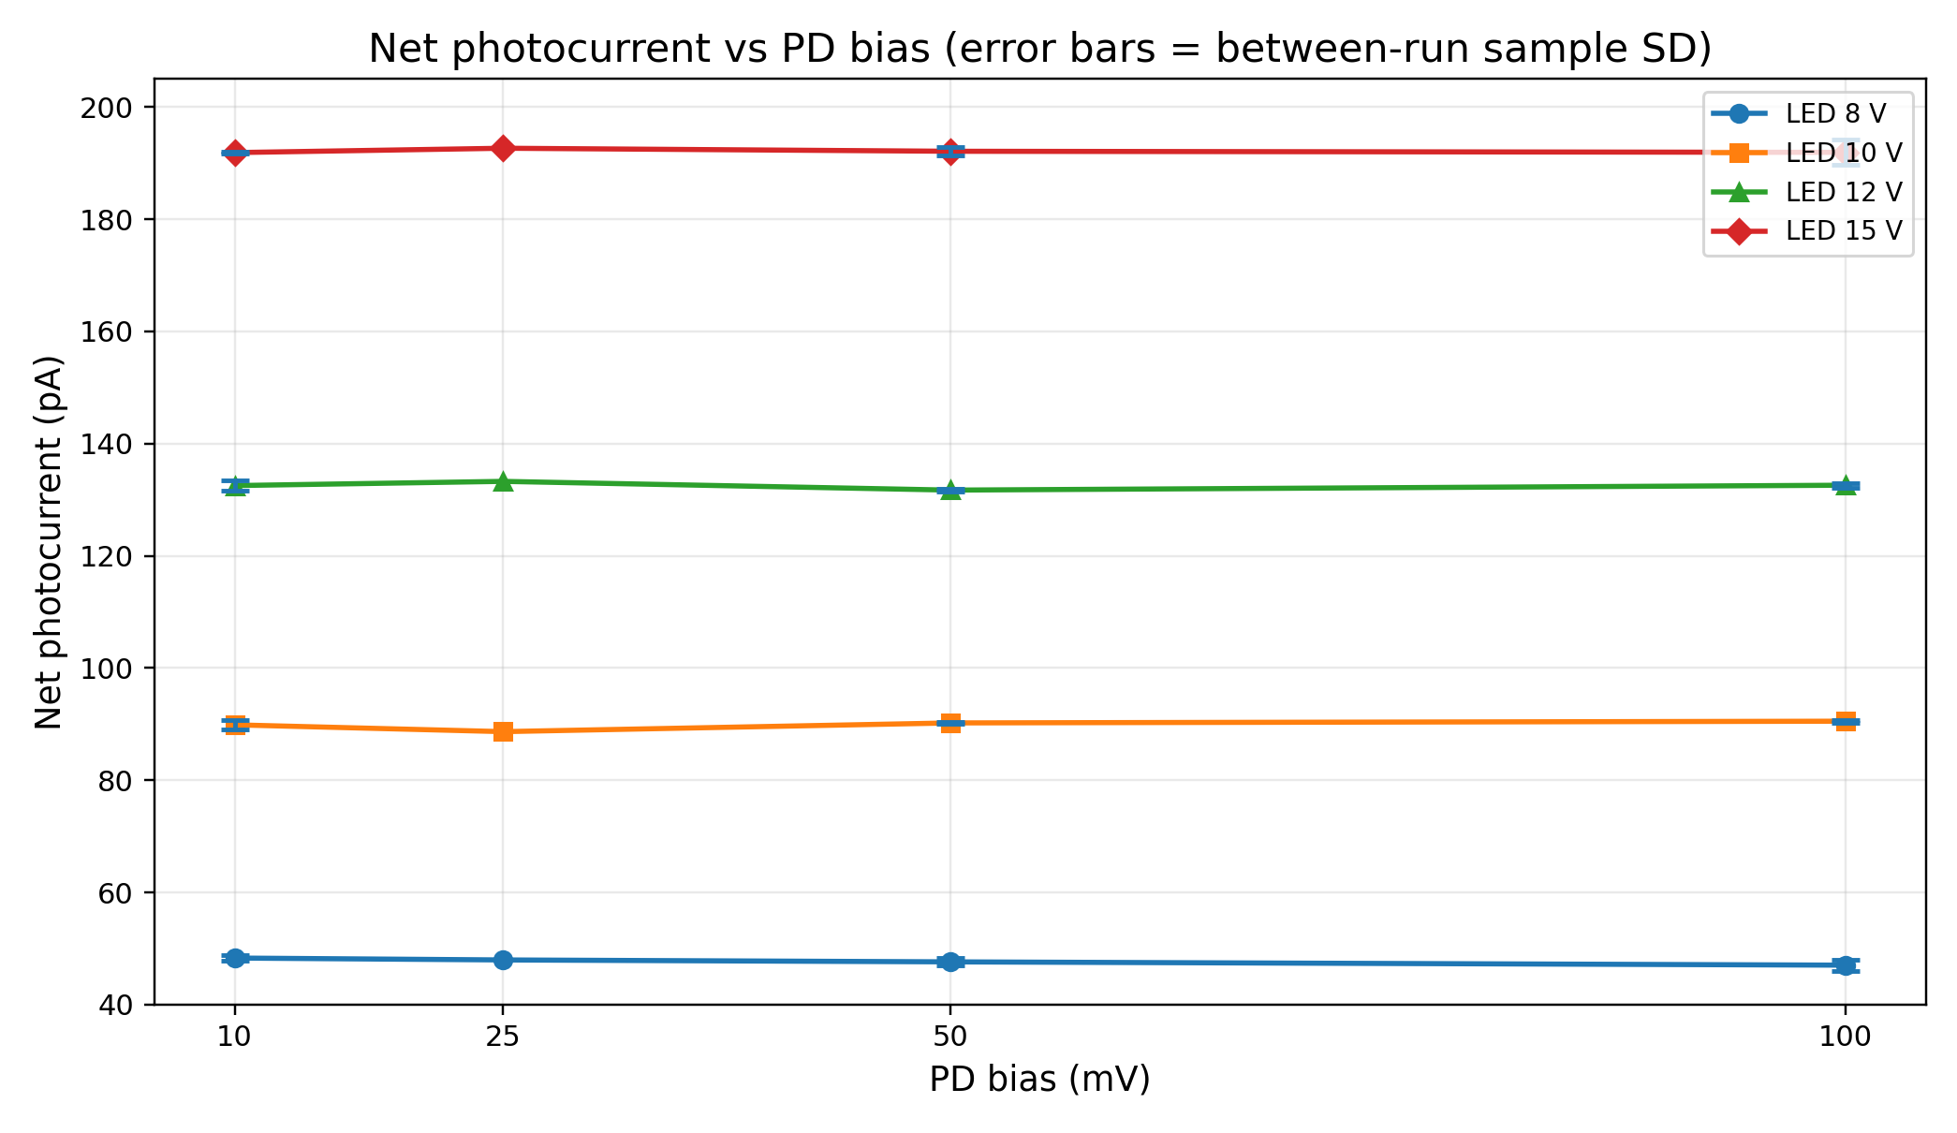
Net photocurrent vs PD bias
At fixed LED bias, net signal changes very little across PD-bias settings
All four PD-bias series remain close together.
There is no clear net-signal benefit from increasing PD bias.
This supports selecting the lowest tested PD bias, subject to verifying the bias circuit and detector operating configuration.
Error bars show between-run sample SD where repeat scans exist. No between-run SD is available at 25 mV (one scan).
LED / photodiode voltage characterization • 02 November 2026
9

Slide 10
Comprehensive results table
Mean dark background / raw LED-on current / net photocurrent for each setting
PD bias | LED bias | Dark (pA) | LED-on (pA) | Net (pA) | n | Net SD (pA)
10 mV | 8 V | 12.12 | 60.43 | 48.32 | 3 | 0.53
10 mV | 10 V | 12.49 | 102.37 | 89.89 | 3 | 0.81
10 mV | 12 V | 11.92 | 144.45 | 132.53 | 3 | 0.92
10 mV | 15 V | 12.39 | 204.27 | 191.88 | 3 | 0.18
25 mV | 8 V | 21.63 | 69.61 | 47.98 | 1 | —
25 mV | 10 V | 22.81 | 111.49 | 88.67 | 1 | —
25 mV | 12 V | 22.11 | 155.39 | 133.28 | 1 | —
25 mV | 15 V | 22.06 | 214.72 | 192.65 | 1 | —
50 mV | 8 V | 31.05 | 78.69 | 47.64 | 4 | 0.65
50 mV | 10 V | 30.63 | 120.85 | 90.22 | 4 | 0.19
50 mV | 12 V | 30.89 | 162.61 | 131.72 | 3 | 0.22
50 mV | 15 V | 30.94 | 223.06 | 192.11 | 4 | 0.76
100 mV | 8 V | 36.27 | 83.32 | 47.05 | 2 | 0.99
100 mV | 10 V | 35.81 | 126.35 | 90.53 | 2 | 0.27
100 mV | 12 V | 36.29 | 168.88 | 132.59 | 2 | 0.40
100 mV | 15 V | 35.99 | 227.90 | 191.92 | 2 | 2.30
For 50 mV at 12 V, the anomalous run (30.85 pA net) is excluded; n = 3 for that cell.
Net SD is between-run sample SD; 25 mV has one run, so SD is unavailable.
LED / photodiode voltage characterization • 02 November 2026
10

Slide 11
Repeatability and data-quality notes
Number of runs and treatment of the anomalous 50 mV point
PD bias | Runs per LED point | Analysis note
10 mV | 3 | Three retained runs; run-to-run SD shown on plots.
25 mV | 1 | One scan only; descriptive result, no run-to-run SD.
50 mV | 4 | One anomalous 12 V result (30.85 pA net) excluded; remaining three used at 12 V.
100 mV | 2 | Two scans; repeatability checked between the two runs.
At 100 mV, the two scans agree closely: differences in net photocurrent range from about 0.4 pA to 3.3 pA.
The 25 mV result falls between the 10 mV and 50 mV background levels, consistent with a rising background trend.
LED / photodiode voltage characterization • 02 November 2026
11

Slide 12
Interpretation and recommended settings
What the comparative measurements support
Decision | Evidence-based conclusion
PD bias | 10 mV is the preferred starting point: lowest measured background (~12 pA) with essentially unchanged net photocurrent.
LED bias | 15 V gives ~45% more net signal than 12 V; keep 12 V and 15 V as candidates until diffuser sensitivity and LED-board limits are considered.
Scope | These measurements characterize this bench setup; they do not independently establish hardware safety limits or long-term LED stability.
Practical next step: carry the selected PD bias into the main DAQ review, verify actual applied polarity/voltage, and perform a short fixed-position end-to-end test.
LED / photodiode voltage characterization • 02 November 2026
12

Slide 13
Detector and instrument reference points
Manufacturer documentation relevant to interpreting the measurements
Hamamatsu S2281 series: silicon photodiode in a metal package with BNC connector; manufacturer lists a maximum reverse voltage of 5 V.
For the S2281, the datasheet lists typical dark current of 50 pA at VR = 10 mV (Ta = 25 °C). The measured system background here is not a direct isolated measurement of detector dark current.
Keithley 6487 combines a picoammeter with a voltage source; the applied PD bias and current-measurement configuration should be verified in the main DAQ.
Hamamatsu S2281 series datasheet (PDF)
Keithley 6487 Picoammeter / Voltage Source documentation
The S2281 datasheet identifies the BNC centre/core as cathode and the case as anode; confirm the actual cable/bias arrangement before final DAQ operation.
LED / photodiode voltage characterization • 02 November 2026
13

Slide 14
Transition to the main DAQ
Items to verify before a full diffuser scan
Confirm S2281 wiring, polarity, and actual voltage applied at the detector.
Confirm Keithley 6487 source-voltage command, source limit, current mode, range, NPLC, zero correction, and zero-check state.
Remove assumptions or calibration constants inherited from the previous photodiode.
Check LED on/off timing and ensure the LED is not left continuously illuminated unintentionally.
Run a short fixed-position dark → LED-on → dark test and inspect saved data before enabling motorized scans.
Then verify motor movement, angular position recording, and synchronization with PD acquisition.
Comparative voltage study complete; the next stage is DAQ compatibility and end-to-end validation.
LED / photodiode voltage characterization • 02 November 2026
14

Slide 15
Data provenance and analysis notes
Files and analysis choices represented in this deck
10 mV: three retained runs from the earlier comparative scan.
25 mV: PD_LED_scan_summary_PD_25mV_20261102_123538.csv (one run).
50 mV: four PD_LED_scan_summary_PD_50mV_*.csv files; the 12 V point in the 11:31 run is flagged anomalous and excluded only from the 50 mV / 12 V aggregate.
100 mV: PD_LED_scan_summary_PD_100mV_20261102_120940.csv and PD_LED_scan_summary_PD_100mV_20261102_122320.csv.
Net photocurrent is calculated as LED-on mean minus the average of dark-before and dark-after means.
Error bars on repeated-bias series represent sample SD between runs. The 25 mV series is shown without run-to-run error bars.
Interpretation is limited to the tested settings and this measurement configuration.
LED / photodiode voltage characterization • 02 November 2026
15

