Slide 1
INSTRUMENT CONNECTION GUIDE
Hamamatsu S2281 photodiode\nwith Keithley 6487
Series bias connection • current limiting • polarity • safe setup checks
Previously discussed series resistor: 5 kΩ (verify installed component)
01

Slide 2
Purpose and equipment
What this connection is intended to do
Use the Keithley 6487 to measure the S2281 photodiode current while applying a small reverse-bias voltage.
A series resistor provides passive current limiting if the photodiode path is accidentally shorted or a fault occurs.
The photodiode current is read by the 6487 ammeter input; the voltage source establishes the detector bias.
This deck records the previously discussed wiring topology and 5 kΩ design choice; verify the actual installed resistor and terminal mapping before powering the circuit.
Item | Relevant detail
Photodiode | Hamamatsu S2281, BNC package
BNC centre | Cathode
BNC shell / metal case | Anode
Instrument | Keithley 6487 Picoammeter / Voltage Source
Previously selected series resistor | 5 kΩ
S2281 photodiode connection and current-limiting guide • 02 November 2026
2

Slide 3
S2281: relevant manufacturer limits
Values taken from the Hamamatsu S2281 series datasheet
Datasheet item | S2281 specification | How it matters
Absolute maximum reverse voltage | 5 V | Do not exceed; use margin and prevent overshoot.
Dark current at VR = 10 mV | 50 pA typical; 500 pA max | Dark-current reference under datasheet conditions; not a current-limit rating.
Short-circuit current at 100 lx | 64 µA min; 80 µA typ | Photocurrent can be much larger than the pA-scale dark current.
Shunt resistance at VR = 10 mV | 20 MΩ min; 200 MΩ typ | Detector has a finite shunt path.
BNC polarity | Centre = cathode; case = anode | Defines reverse-bias polarity.
Important: the 5 V rating is a reverse-voltage absolute maximum, not a recommended operating voltage.
S2281 photodiode connection and current-limiting guide • 02 November 2026
3

Slide 4
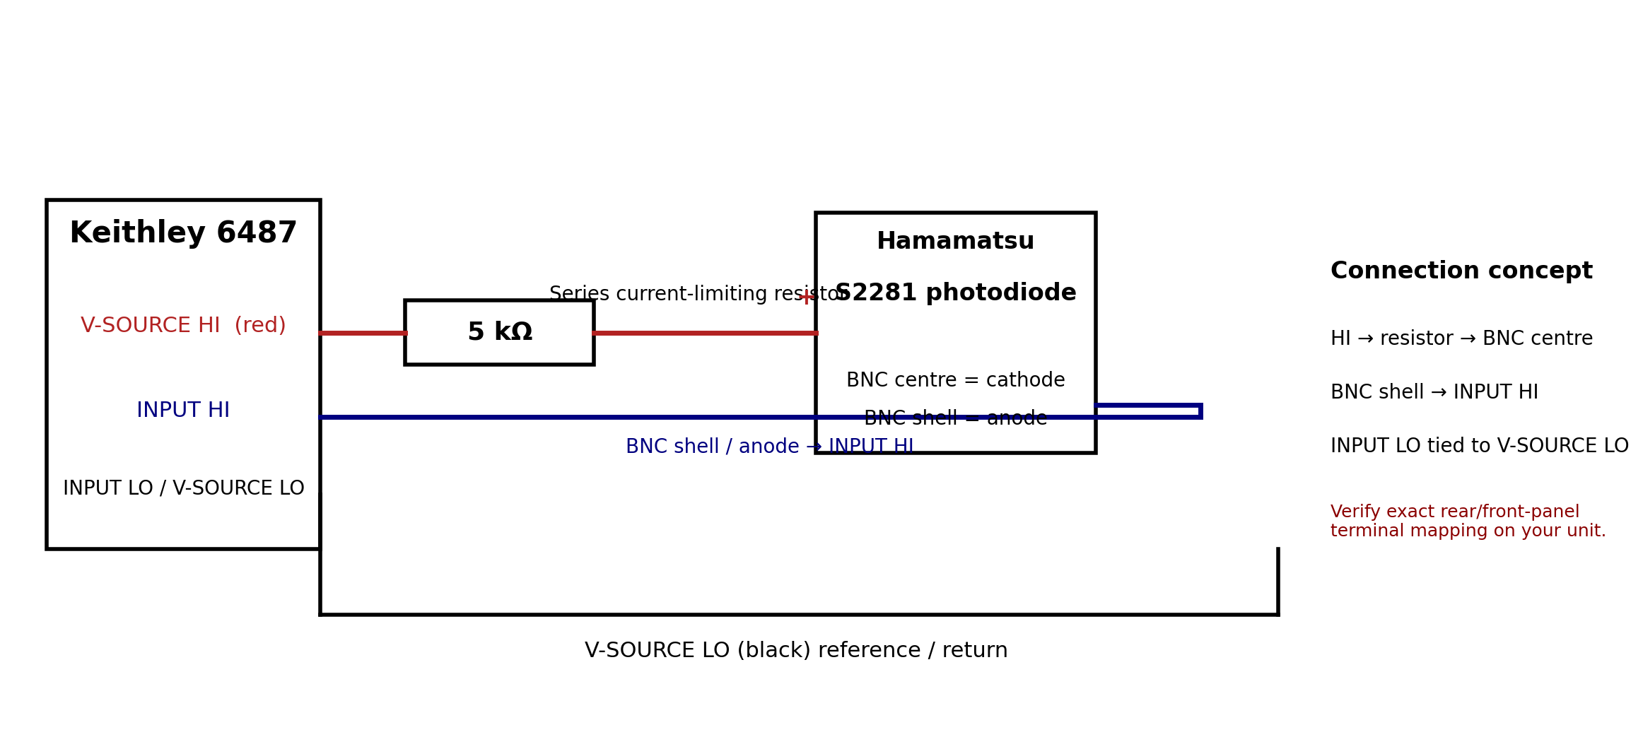
Previously agreed wiring topology
Series resistor between V-SOURCE HI and the photodiode cathode
This is the topology recorded in the earlier discussion. Check the 6487 manual and actual lead/terminal labels before connecting.
S2281 photodiode connection and current-limiting guide • 02 November 2026
4

Slide 5
Connection list
Point-to-point wiring as previously discussed
From | To | Purpose
6487 V-SOURCE HI (red) | One end of 5 kΩ resistor | Positive bias feed, through series resistor
Other end of 5 kΩ resistor | S2281 BNC centre / cathode | Applies positive potential to cathode for reverse bias
S2281 BNC shell / anode | 6487 INPUT HI | Ammeter current input path
6487 INPUT LO | 6487 V-SOURCE LO (black) | Common return / source reference
Do not infer connector polarity from cable colour alone. The S2281 datasheet explicitly identifies BNC centre as cathode and case as anode.
S2281 photodiode connection and current-limiting guide • 02 November 2026
5

Slide 6
Why a 5 kΩ series resistor?
Fault-current limiting calculation using the 5 V reverse-voltage ceiling
Worst-case resistive estimate if the photodiode path is shorted:
I_fault ≈ V_source / R_series = 5 V / 5,000 Ω = 1 mA
5 kΩ was selected from the available 1 kΩ, 5 kΩ, and 10 kΩ resistor options discussed previously.
At 5 V, 5 kΩ limits the ideal short-circuit current to approximately 1 mA.
This is well below the 20 mA fault-current ceiling cited in the earlier discussion of the Hamamatsu protective-resistor guidance.
The resistor is a fault-current limiter; it is not intended to set the normal pA-scale photocurrent.
The physical resistor value was not independently measured/recorded in the conversation; confirm it is actually 5 kΩ.
S2281 photodiode connection and current-limiting guide • 02 November 2026
6

Slide 7
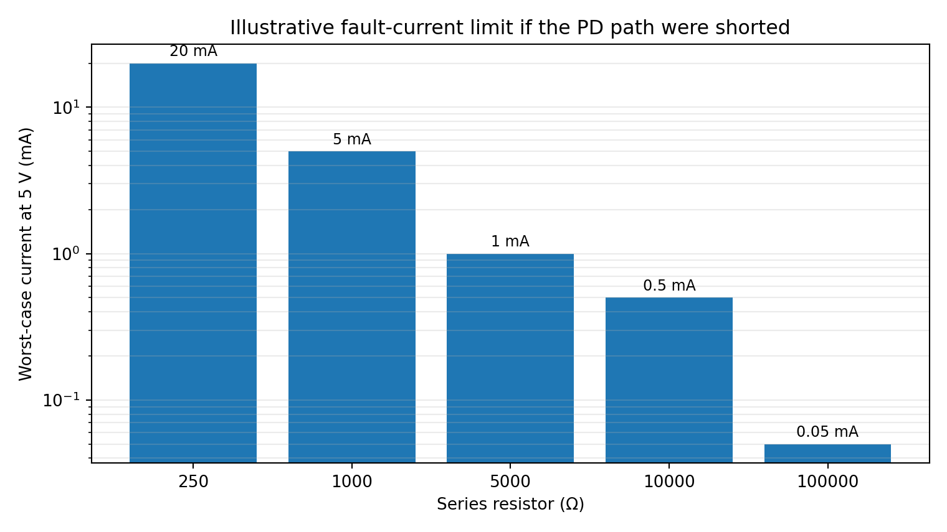
Resistor value comparison
Ideal short-circuit current at 5 V
Rseries | I = 5 V / R
250 Ω | 20 mA
1 kΩ | 5 mA
5 kΩ | 1 mA
10 kΩ | 0.5 mA
100 kΩ | 0.05 mA
The 5 kΩ choice gives substantial margin below 20 mA while avoiding an unnecessarily large series resistance.
S2281 photodiode connection and current-limiting guide • 02 November 2026
7

Slide 8
Operating bias: polarity and magnitude
Do not confuse the detector reverse-bias rating with the chosen working point
For the S2281, reverse bias means the cathode (BNC centre) is at a higher potential than the anode (BNC shell).
The previous bench comparison tested nominal PD-bias settings of 10, 25, 50, and 100 mV.
The photocurrent was essentially unchanged across these settings, while the measured dark background increased with bias.
The 10 mV setting was the preferred starting point from the comparative measurements, subject to verifying the actual applied voltage and polarity.
The 5 V datasheet maximum is an absolute limit; it is not a target setting for this measurement.
S2281 photodiode connection and current-limiting guide • 02 November 2026
8

Slide 9
Keithley 6487 setup checklist
Confirm these settings in the instrument and the main DAQ
Parameter | Bench-test configuration / check
Measurement function | DC current (CURR:DC)
Current range | 2.1 nA
NPLC | 10
Autozero | ON
Zero check | OFF during acquisition
Zero correction | Fresh zero correction at initialization
Source current limit | 25 µA (verify it is a suitable instrument setting)
Voltage source | Set to chosen small PD reverse bias; verify actual output with a DMM before attaching PD
S2281 photodiode connection and current-limiting guide • 02 November 2026
9

Slide 10
Safe connection and power-up sequence
Avoid changing wiring with the source output enabled
Turn the 6487 voltage source output OFF and set the source to 0 V before wiring or changing connections.
Verify the resistor value with a DMM and check continuity of the BNC centre and shell.
Wire the resistor and photodiode using the point-to-point list; inspect for shorts between BNC centre and shell.
With the photodiode disconnected, verify source polarity and the intended low voltage at the relevant output nodes using a DMM.
Turn output OFF again, connect the photodiode, then enable the source at the selected small bias.
Confirm measured dark current is plausible and stable before illuminating the detector.
After the test, return source to 0 V and turn output OFF before disconnecting.
S2281 photodiode connection and current-limiting guide • 02 November 2026
10

Slide 11
Additional practical considerations
Details that help preserve low-current measurement quality
Keep the BNC cable and connections clean and dry; contamination and moisture can create leakage paths comparable to small photodiode currents.
Use a shielded coaxial connection and avoid touching exposed high-impedance nodes during measurements.
Keep the photodiode shield/case connection consistent with the agreed topology; avoid accidental ground loops.
Allow the instrument and detector to settle after changing bias or illumination conditions.
The S2281 has a large active area (100 mm²) and typical terminal capacitance around 1300 pF at the datasheet condition; settling and cable capacitance can matter after voltage changes.
The datasheet lists a 3 µs typical rise time under its specified test condition; the complete measurement chain is slower and dominated by the 6487 integration settings in this experiment.
S2281 photodiode connection and current-limiting guide • 02 November 2026
11

Slide 12
Important verification before reusing this circuit
The resistor does not replace instrument protection or correct terminal configuration
Confirm the 6487 manual’s exact V-SOURCE and ammeter terminal architecture for the intended series-bias arrangement.
Confirm the 6487 source output is floating/isolated as required by the circuit; do not assume arbitrary terminals can be tied together.
Check whether the resistor is located in the intended branch and that no unintended parallel path bypasses it.
Confirm the selected source voltage is the voltage across the photodiode, not merely the programmed source voltage; resistor drop depends on current.
For the current pA-scale measurements, voltage drop across 5 kΩ is negligible (e.g., 200 pA × 5 kΩ = 1 µV), but fault behaviour is a separate case.
Do not exceed the S2281 reverse-voltage absolute maximum of 5 V, including transient overshoot.
S2281 photodiode connection and current-limiting guide • 02 November 2026
12

Slide 13
Manufacturer references
Use the original documents when checking wiring and absolute maximum ratings
Hamamatsu S2281 series datasheet (PDF)
Keithley 6487 Picoammeter / Voltage Source product documentation
Hamamatsu S2281 datasheet: reverse-voltage maximum, BNC polarity, dark current, short-circuit current, shunt resistance, and capacitance.
Keithley 6487 documentation: instrument source and ammeter terminals, source limits, operating modes, and safety instructions.
The earlier discussion recorded a 20 mA fault-current limit in the Hamamatsu protective-resistor guidance; check the exact manual wording/page before treating this as a manufacturer specification.
S2281 photodiode connection and current-limiting guide • 02 November 2026
13

Slide 14
Before the main DAQ is run
Final confirmation checklist
Check | Status to establish
Installed resistor | Measure with DMM; confirm 5 kΩ nominal
Photodiode polarity | BNC centre = cathode; shell/case = anode
Wiring topology | Confirm against 6487 manual and instrument labels
Bias voltage | Verify actual PD reverse voltage and polarity
Protection | Check resistor path cannot be bypassed; never exceed 5 V reverse
DAQ configuration | Confirm source command, current mode, range, NPLC, zero correction, output OFF/ON logic
The prior circuit values are documented here, but the installed resistor and final wiring must be physically verified before operation.
S2281 photodiode connection and current-limiting guide • 02 November 2026
14

