Slide 1


SACMI – Production Errors
Root Cause Analysis -Group 4

Slide 2





Business Understanding
Data Understanding
CRISP-DM
Approach
Data Preparation
Modeling
Evaluation

Slide 3
Business
Understanding
Our client is an important Italian company active in the metal industry producing semi-finished products for multiple transnational value chains.

Slide 4


Business Understanding
Business Goals
Determine the reasons behind the defects occuring in the production of the metal coils in order to improve business and decision making process
Data Mining Goals
Utilize the extensively collected data during the production process
Prepare the data for it to be used to train a model
Build a model that can determine the causes of defects that occur during metal coil production
Project Plan
Understand and prepare the datasets
Develop a classification model and evaluate it for effectiveness
Determine which factors can be associated with a given error
Conclude findings

Slide 5
Data
Understanding
Due to investments in extensive data collection during production process, we are able to utilize a wealth of data for root cause analyses

Slide 6
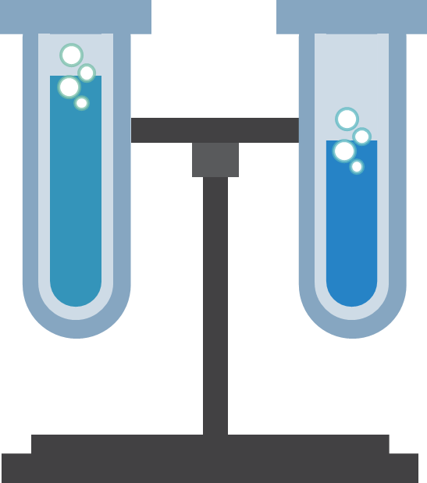
Data Understanding
The data was collected over the period of two months and is divided amongst two separate datasets where one corresponds to production dataset and the other to defect dataset
Production Dataset
Defect Dataset
This data was collected over 2.5 months and includes:
Includes 110 features
Observations occurs every 7 meters
Every COIL is assigned an ID on whose basis data is recorded
This dataset refers to data related with COIL defects and includes:
Location in terms of from which meter to what meter defects occurs
There are 6 distinct type of errors recorded
Data is recorded on the basis of ID of COILS

Slide 7
Data Understanding
Data Quality Assessment
Timeliness
Completeness
Other than some NaN values, the completeness of the data is deemed acceptable
Given the purpose of the analysis, the timeliness of the data is not particularly valid
6
1
Accuracy
Uniqueness
The data is collected using an automated process every 7 meters for every COIL, thus the accuracy of data is high
5
2
Given that COIL ID is used in both datasets to assign respective observed values, the data is considered unique
Validity
4
3
Consistency
Most of the data is within the defined requirement such as format, type and range; hence, the data is deemed valid
Some consistency issues are noticed in Production dataset; however, they can be considered minor and handled with simple manipulation techniques

Slide 8
Data
Preparation
Even though the quality of the data is deemed good, several data cleaning, manipulation, and joining techniques had to be applied to prepare it for modeling

Slide 9
Data Preparation
Production Dataset – Inconsistencies
i
Context
Every COIL is observed after every 7 meters. Observation in terms of meters are recorded in “MT” column and appear in incremental intervals of 7 such as “7.0, 14.0, 21.0…”
ii
Inconsistency
In Production dataset, in the “MT” column, it is noted that the intervals are restarting (inconsistently) even though the same COIL is being observed (since the time measurement is increasing )
iii
Problem
Having such a problem not only restricts from joining Production Dataset with Defect Dataset but open the door for more abnormalities and modelling issues
iv
Solution
A simple function with a loop was created to check from this error in the “MT” column and correct it wherever the anomality was detected

Slide 10
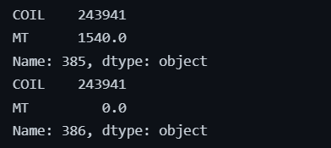
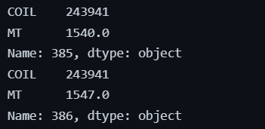
Data Preparation
Production Dataset – Inconsistencies Checkup
Before the inconsistency correction, value number 386 in the observation of COIL 243941’s ‘MT’ column restarted (incorrectly) after the value number 385
However, after using the previously explained solution, it is evident that this problem was solved as 386th value in the given COILS’ ‘MT’ column shows continuous value after 385th value in the same column

Slide 11
Data Preparation
Data Merging and Cleaning
‘COIL’ column includes COIL IDs identifies the item in both Production and Defect Dataset
In Production Dataset = ‘COIL’ column is the key together with the ‘MT’ column
In Defect Dataset = ‘COIL’ column is the key together with ‘MT_from’ and ‘MT_to’ columns
Using merge function, a Left merge is performed on the coil column of the both datasets
Merging the
Datasets
NaN Values of columns representing errors (6 columns from Defect Dataset) are filled with ‘0’
Rows not matching ‘MT’ column with ‘MT_from’ and ‘MT_to’ column were dropped to avoid mismatches
Columns not relevant to achieve mining goals such as ['DATE_x’, 'DATE_y’, 'TIME_START_PROCESS’, 'MT_FROM', 'MT_TO’, 'COIL', 'MT'] were dropped
All the remaining rows containing NaN values were dropped
Data
Cleaning

Slide 12
Modeling
A Decision Tree Classifier was adopted to model the problem at hand. Such a classifier enabled us to achieve good results and understand problem at hand better

Slide 13
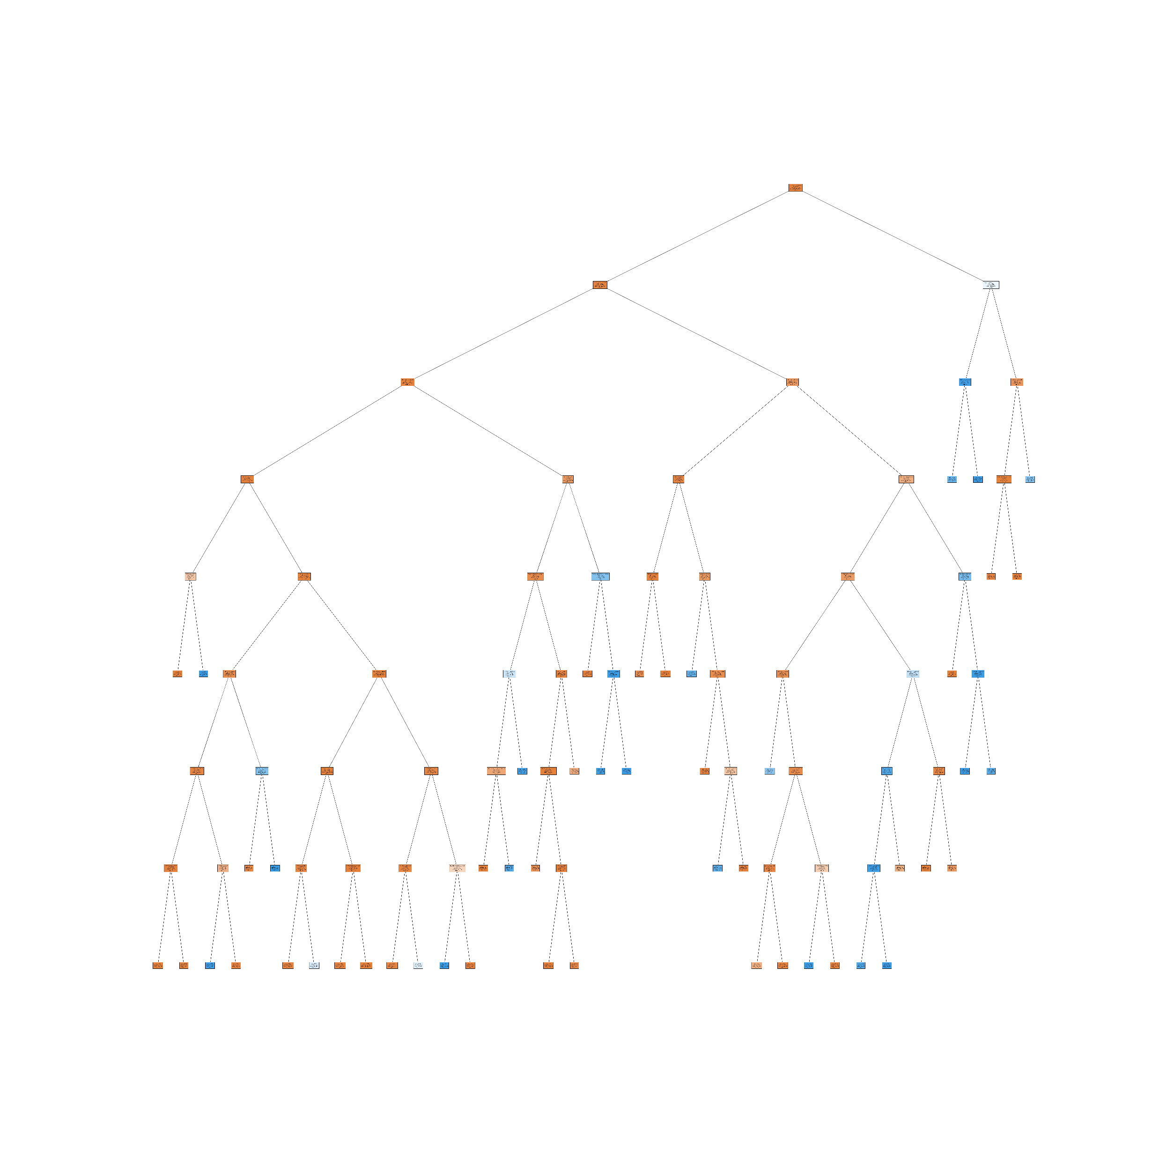

Modeling
Decision Tree Classifier
A Decision Tree Classifier will be utilized to model the problem at hand. There are 6 target variables.
It supports continuous variables and supervised learning
Allows visualization of trees
Enables investigation of root cause analysis
1
Decision Tree Classifier
Hyperparameter Optimization
A randomized search technique applied to optimize hyperparameters while respecting computational timings. The Parameters were applied individually to every single target variable.
2
Training and Predicting
Param | Defect 1 | Defect 2 | Defect 3 | Defect 4 | Defect 5 | Defect 6
Min sample leaf | 60 | 60 | 60 | 60 | 60 | 60
Min Sample Splits | 200 | 300 | 100 | 100 | 400 | 50
Maximum depth | 8 | 8 | 7 | 7 | 7 | 8
Criterion | Gini | Gini | Gini | Gini | Entropy | Entropy

Slide 14
Modeling
Splitting and Training
The dataset was split 70/30 amongst train/test. The split was stratified by the predictive variable
The Decision Tree Model was trained for every single target variable separately according to the defined hyperparameters
1
Decision Tree Classifier
2
Training and Predicting
Predicting
All the variables are predicted separately with tested against the test data to attain classification report.
This enables evaluation of the results attained separately and to understand what inputs can be associated with a given defect

Slide 15
Evaluation
We evaluated the results of every single defect individually to determine the root causes of occurrence of these defects

Slide 16
Evaluation
Evaluation Methodology
The purpose of this model is to understand variables resulting in the 6 distinct type of defects. For this purpose, every single predicted variable (defect) is evaluated separately.
The Decision Tree Figure of every defect is investigated separately
Top three paths on the Decision Tree that lead to maximization of false values and minimization of true values are noted
For each path, we start from the root node and follow the path
Path Investigation
For each path, we start from the root node and follow
Path splitting left denotes True, and path splitting to right denotes false
The path is evaluated according to a variable set by the DTC
These variables are then noted to understand reasons behind errors

Slide 17
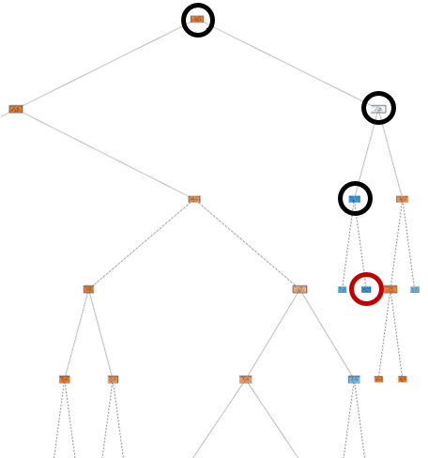

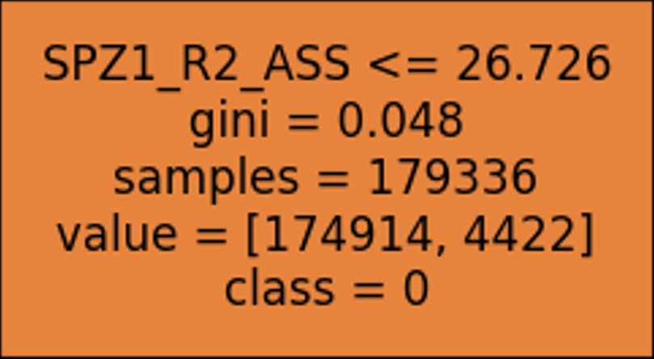
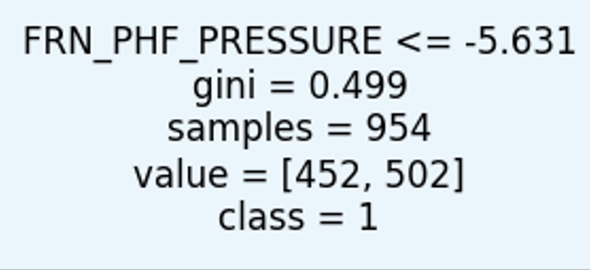
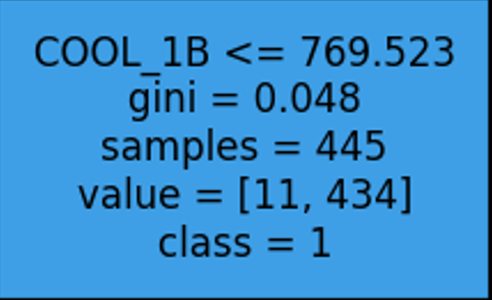

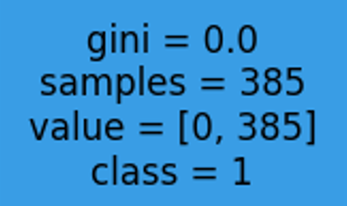
Evaluation
Path 1
Decision Tree Figure Path Investigation Example
Our focus is on blue nodes as they represent nodes where errors > non-errors

Slide 18
Evaluation
Defect 1
2
3
4
5
6
3rd Track
SPZ1_R2_ASS <= 26.726 TIRO_DECAP <= 5335.964 ELET_H2SO4 > 126.338
VENT_5 > 41.411 PYRO_3_LST_3_ZONE > 1122.604 GAS_Z3_1 > 289.429
[344 DEFECTS, no impurity]
Accuracy
0.99
2nd Track
SPZ1_R2_ASS > 26.726 FRN_PHF_PRESSURE <= -5.631 COOL_1B > 769.523
[385 DEFECTS, no impurity]
Precision
0.92
3
1st Track
SPZ1_R2_ASS <= 26.726 TIRO_DECAP > 5335.964
ELET_FE2 > 13.476
SPEED_PROCESS > 24.719
GAS_Z1_1 > 234.352
TEMP_Z1 <= 1272.197
[602 DEFECTS, no impurity]
2
Recall
0.76
1

Slide 19
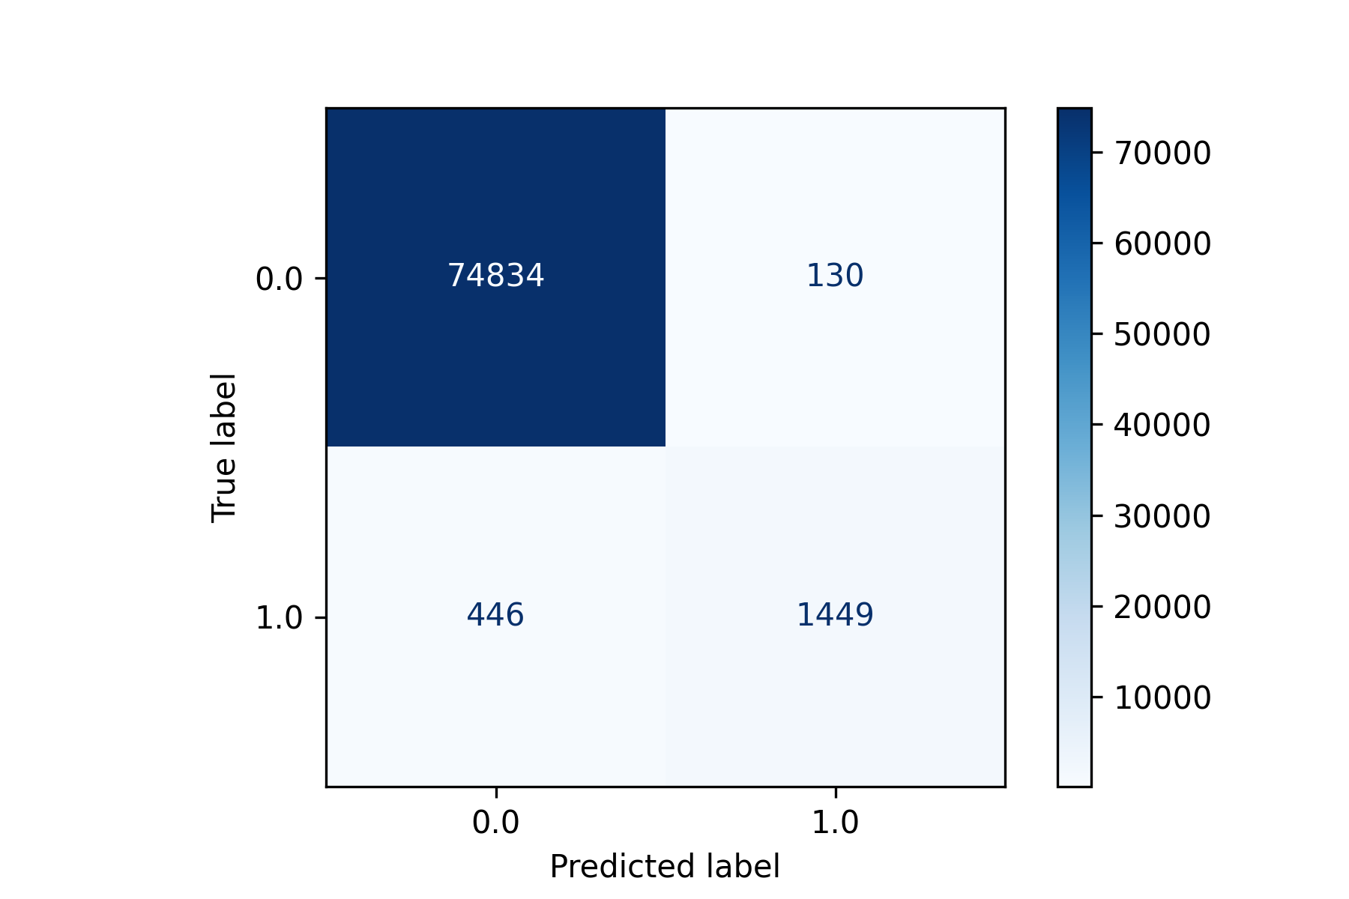
Evaluation
Defect 1
2
3
4
5
6
1st Track
SPZ1_R2_ASS <= 26.726 TIRO_DECAP > 5335.964
ELET_FE2 > 13.476
SPEED_PROCESS > 24.719
GAS_Z1_1 > 234.352
TEMP_Z1 <= 1272.197
[602 DEFECTS, no impurity]
Variable | Median value
SPZ1_R2_ASS | 19.125
TIRO_DECAP | 5033.35929
ELET_FE2 | 14.0625
SPEED_PROCESS | 25.821487
GAS_Z1_1 | 217.567432
TEMP_Z1 | 1270.09125
Looking at the median values of the 1st track variables associated with type 1 error.
The median of 4/6 variables is within the range of the track.

Slide 20
Evaluation
1
Defect 2
3
4
5
6
3rd Track
TEMP_Z6 > 1309.433
SPZ1_R1_ASS > 0.159
COOL_1B <= 680.417
SPEED_PROCESS <= 50.527
DEC_FE3 <= 37.003
ELET_FE2 <= 12.025
GAS_Z1_2 <= 215.88
LASER_FRN_2 <= 1265.279
[29, 475]
Accuracy
0.98
2nd Track
TEMP_Z6 > 1309.433
SPZ1_R1_ASS > 0.159
COOL_1B <= 680.417
SPEED_PROCESS > 50.527
FRN_PHF_PRESSURE > -4.244
LS_OVEN <= 1286.928
[475 DEFECTS, no impurity]
Precision
0.77
1st Track
TEMP_Z6 > 1309.433
SPZ1_R1_ASS > 0.159
COOL_1B > 680.417
LASER_RAFF_4 > 206.332
FILL_TIRO > 5150.193
SPZ1_R2_ASS > 21.288
ELET_H2SO4 <= 104.85
AIR_Z4_2 <= 2132.393
[480 DEFECTS, no impurity]
3
2
Recall
0.69
1

Slide 21

Evaluation
1
Defect 2
3
4
5
6
1st Track
TEMP_Z6 > 1309.433
SPZ1_R1_ASS > 0.159
COOL_1B > 680.417
LASER_RAFF_4 > 206.332
FILL_TIRO > 5150.193
SPZ1_R2_ASS > 21.288
ELET_H2SO4 <= 104.85
AIR_Z4_2 <= 2132.393
[480 DEFECTS, no impurity]
Variable | Median value
TEMP_Z6 | 1314.862969
SPZ1_R1_ASS | 18
COOL_1B | 724.112437
LASER_RAFF_4 | 269.87904
FILL_TIRO | 4241.372625
SPZ1_R2_ASS | 18
ELET_H2SO4 | 110.1375
AIR_Z4_2 | 1743.626652
Looking at the median values of the 1st track variables associated with type 1 error.
The median of 4/6 variables is within the range of the track.

Slide 22
Evaluation
1
2
Defect 3
4
5
6
3rd Track
GAS_Z4_2 > 131.213
TEMP_Z2 <= 1298.096
LASER_RAFF_5 > 272.611
VENT_1 > 31.856
COOL_3 <= 389.343
GAS_Z3_1 > 239.758
DEC_H2SO4 <= 125.438
[1795, 5585]
Accuracy
0.88
2nd Track
GAS_Z4_2 > 131.213
TEMP_Z2 <= 1298.096
LASER_RAFF_5 > 272.611
TEMP_Z1 > 1247.421
VENT_5 <= 27.422
LASER_FRN_3 <= 1267.832
DEC_H2SO4 >= 120.68
[1256, 6578]
Precision
0.81
3
1st Track
GAS_Z4_2 > 131.213
TEMP_Z2 <= 1298.096
LASER_RAFF_5 > 272.611
TEMP_Z1 > 1247.421
VENT_5 > 27.422
GAS_Z6_2 > 36.581
LS_OVEN <= 1304.014
[1386, 11536]
2
Recall
0.81
1

Slide 23
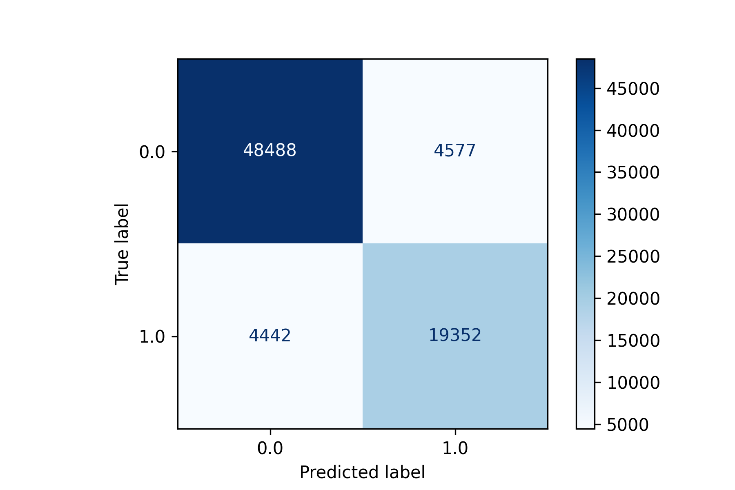
Evaluation
1
2
Defect 3
4
5
6
1st Track
GAS_Z4_2 > 131.213
TEMP_Z2 <= 1298.096
LASER_RAFF_5 > 272.611
TEMP_Z1 > 1247.421
VENT_5 > 27.422
GAS_Z6_2 > 36.581
LS_OVEN <= 1304.014
[1386, 11536]
Variable | Median value
GAS_Z4_2 | 144.85729
TEMP_Z2 | 1293.08233
LASER_RAFF_5 | 280.263375
TEMP_Z1 | 1269.50776
VENT_5 | 25.874545
GAS_Z6_2 | 85.266
LS_OVEN | 1266.70998
Looking at the median values of the 1st track variables associated with type 3 error.
The median of 6/7 variables is within the range of the track.

Slide 24
Evaluation
1
2
3
Defect 4
5
6
3rd Track
TEMP_Z3 > 1301.342
FILL_TIRO <= 5081.237
LASER_FRN_9 <=1046.747
TIRO_DECAP <= 2052.17
ELET_H2SO4 <= 111.153
PYRO_3_LST_3_ZONE > 1068.855
[29 , 2013]
Accuracy
0.90
2nd Track
TEMP_Z3 > 1301.342
FILL_TIRO <= 5081.237
LASER_FRN_9 >1046.747
DEC_H2SO4<=112.565
ELET_H2SO4 <= 107.417
PYRO_3_LST_3_ZONE <=1128.9
[23 , 1235]
Precision
0.81
3
2
1st Track
TEMP_Z3 > 1301.342
FILL_TIRO > 5081.237
LASER_RAFF_1 <= 240.108
ELET_CORRENTE > 2773.403
FILL FORZA <= 1841.417
[20 , 4216]
Recall
0.64
1

Slide 25
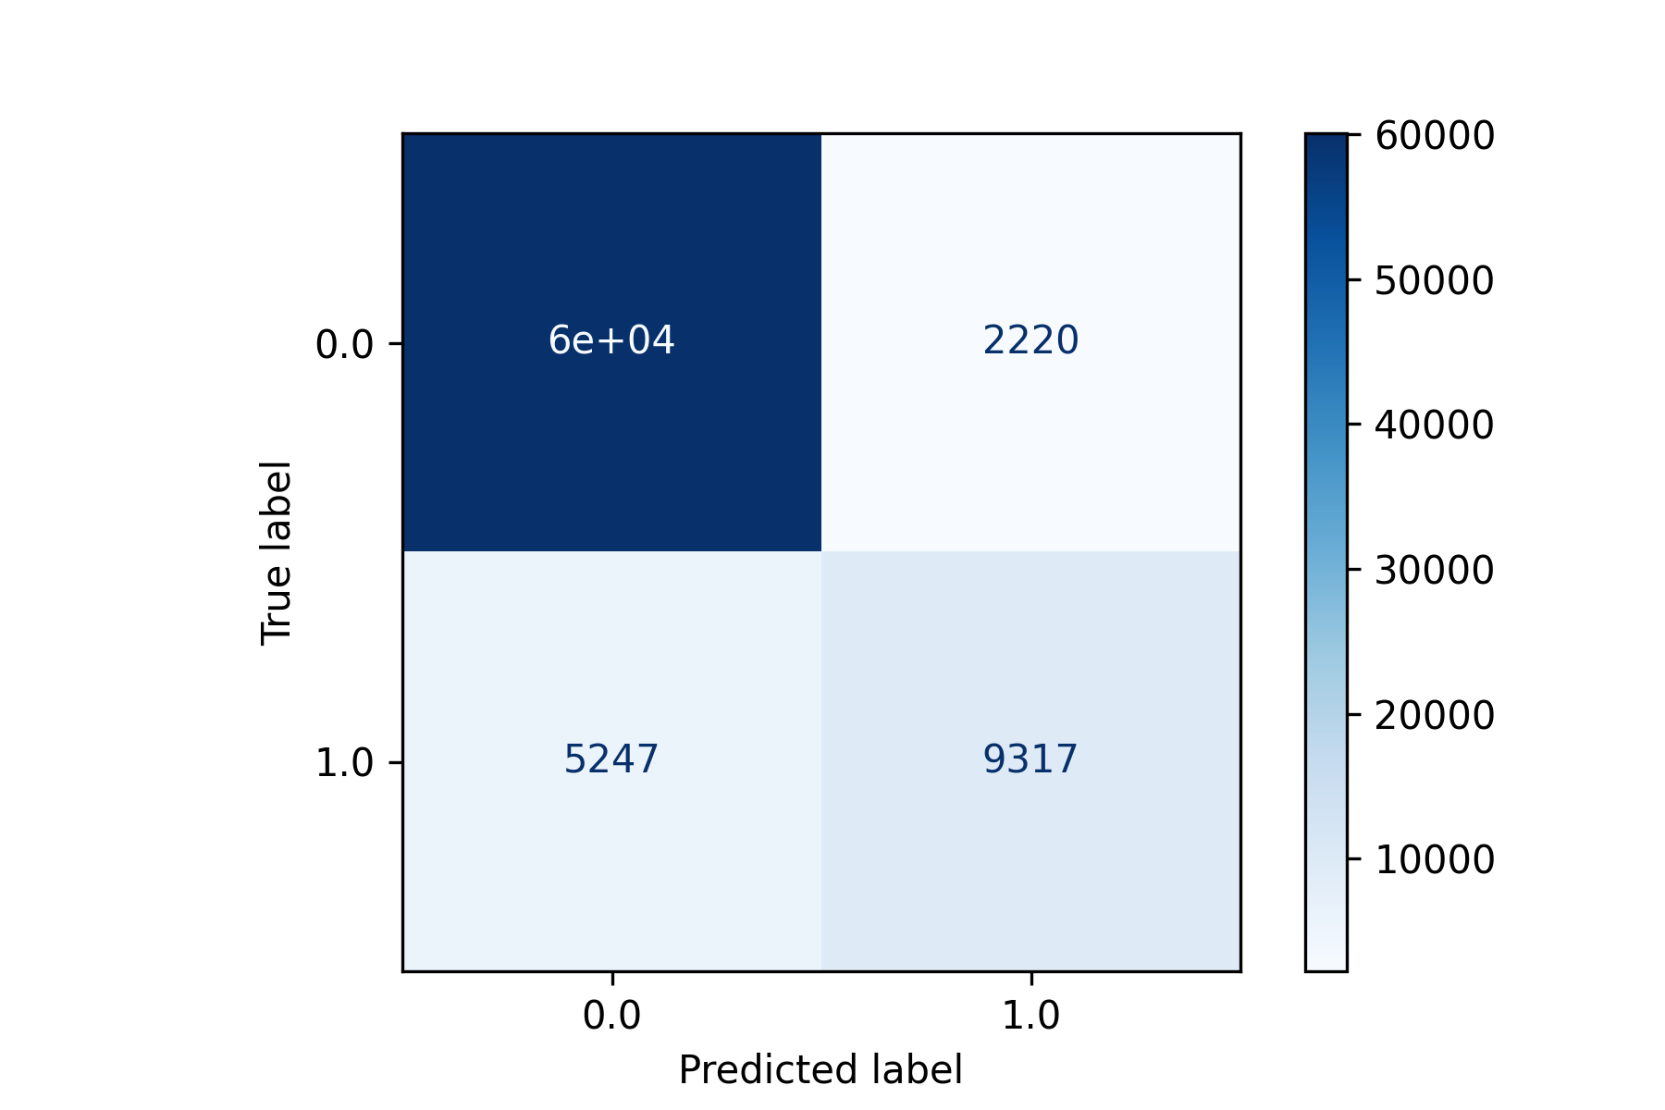
Evaluation
1
2
3
Defect 4
5
6
1st Track
TEMP_Z3 > 1301.342
FILL_TIRO > 5081.237
LASER_RAFF_1 <= 240.108
ELET_CORRENTE > 2773.403
FILL FORZA <= 1841.417
[20 , 4216
Variable | Median value
TEMP_Z3 | 1303.785
FILL_TIRO | 4190.73268
LASER_RAFF_1 | 116.606646
ELET_CORRENTE | 2997.66797
FILL_FORZA | 634.001625
Looking at the median values of the 1st track variables associated with type 4 error.
The median of 4/5 variables is within the range of the track.

Slide 26
Evaluation
1
2
3
4
Defect 5
6
3rd Track
COOL_3 > 342.374
AIR_Z4_2 > 898.744
LASER_FRN_1 <= 717.471
DEC_FETOT > 84.038
FILL_BENDING_NEG > 0.172
FILL_TIRO > 2786.422
[16 , 647]
Accuracy
0.99
2nd Track
COOL_3 > 342.374
AIR_Z4_2 > 898.744
LASER_FRN_1 > 717.471
DEC_FE2 > 34.983
TIRO_FORNO > 1379.157
TIRO_FORNO <= 1379.163
[43 , 334]
Precision
0.83
3
1st Track
COOL_3 > 342.374
AIR_Z4_2 <= 898.744
DEC_FE2 > 27.619
FILL_BENDING_NEG > 0.162
LASER_RAFF_1 <= 34.689
[5 , 468]
2
Recall
0.64
1

Slide 27

Evaluation
1
2
3
4
Defect 5
6
1st Track
COOL_3 > 342.374
AIR_Z4_2 <= 898.744
DEC_FE2 > 27.619
FILL_BENDING_NEG > 0.162
LASER_RAFF_1 <= 34.689
[5 , 468]
Variable | Median value
COOL_3 | 389.403563
AIR_Z4_2 | 1304.51143
DEC_FE2 | 28.4625
FILL_BENDING_NEG | 0.188997
LASER_RAFF_1 | 46.506431
Looking at the median values of the 1st track variables associated with type 5 error.
The median of 3/5 variables is within the range of the track.

Slide 28
Evaluation
1
2
3
4
5
Defect 6
3rd Track
ELET_FE2 > 14.735
LASER_FRN_2 <= 1088.233
TIRO_FORNO > 933.192
DEC_HF <= 40.837
DEC_FE3 > 46.961
DEC_HF > 19.964
DEC_H2SO4 > 139.23
[5 , 354]
Accuracy
0.99
2nd Track
ELET_FE2 > 14.735
LASER_FRN_2 <= 1088.233
TIRO_FORNO > 933.192
DEC_HF <= 40.837
DEC_FE3 > 46.961
DEC_HF <= 19.964
[377 DEFECTS, no impurity]
Precision
0.91
1st Track
ELET_FE2 > 14.735
LASER_FRN_2 <= 1088.233
TIRO_FORNO > 933.192
DEC_HF <= 40.837
DEC_FE3 <= 46.961
COOL_1A > 874.074
TEMP_Z3 <= 1336.536
LASER_RAFF_1 <= 222.223
[106 , 1849]
3
2
Recall
0.71
1

Slide 29

Evaluation
1
2
3
4
5
Defect 6
1st Track
ELET_FE2 > 14.735
LASER_FRN_2 <= 1088.233
TIRO_FORNO > 933.192
DEC_HF <= 40.837
DEC_FE3 <= 46.961
COOL_1A > 874.074
TEMP_Z3 <= 1336.536
LASER_RAFF_1 <= 222.223
[106 , 1849]
Variable | Median value
ELET_FE2 | 15.75
LASER_FRN_2 | 1031.75299
TIRO_FORNO | 1710.1785
DEC_HF | 39.15
DEC_FE3 | 46.4625
COOL_1A | 952.611429
TEMP_Z3 | 1288.67545
LASER_RAFF_1 | 109.012219
Looking at the median values of the 1st track variables associated with type 6 error.
The median of 8/8 variables is within the range of the track.

Slide 30

Evaluation
Exploration and Conclusion of Root Causes
As shown in the previous slides, all the models show a good level of precision, ranging between 77% and 92%
The recall is a bit lower, ranging from 64% to 81%. Higher recall is experienced when we run the model in a dataset with a greater number of errors of the same type
As expected, the combination of specific values for some variables leads to manufacturing defects of some type. The identification of the specific thresholds (shown in the previous slides), can help the domain experts to prevent these types of manufacturing errors
In conclusion, we can state that the model shows a good performance that allows us to isolate root causes correctly

