Slide 1
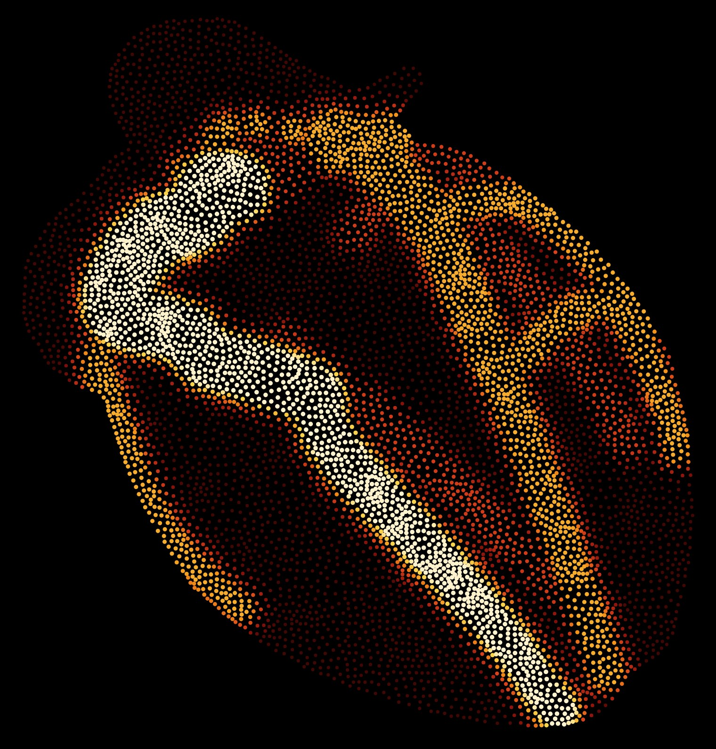
CoroSim
ACC Cardio Sim Creator Competition
A cardiovascular simulator where learners change the cause and watch the effect
corosim.com
A Voronoi stipple of CoroSim's own coronary tree.
Notes:
Open on the homepage heart: a weighted Voronoi stipple drawn from the simulator's own coronary tree, colored by nearness to a vessel. One-sentence pitch: CoroSim lets a learner block any coronary artery and watch the whole patient respond (ECG, rhythm, pressure, reflexes, infarct), then treat them while the muscle is dying.

Slide 2
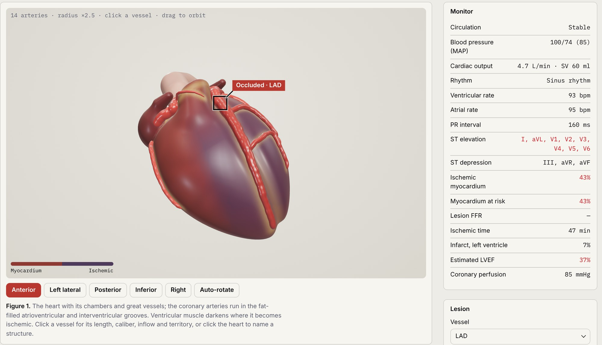
One simulated patient, six ways to learn from it
CoroSim at a glance
Six linked pages
Simulator, daily case, EKG, cath lab, structural and echo, all running the same patient model.
50+ EKG presets
Rhythms, blocks, ischemia and STEMI mimics, plus custom tracings on request.
Free in any browser
No install, account or license.
Figure 1. Proximal LAD occlusion 47 minutes in: anterior ST elevation, 43% of the myocardium ischemic, LVEF 37%.
Notes:
Every page runs on the same simulation core, so the heart, the 12-lead, the angiogram and the pressures agree with one another. The model is seeded and reproducible; constants are tagged literature-backed or assumed in the code.

Slide 3
What this submission answers
Contents
Problem solving and efficacy
What students and residents struggle with, and how CoroSim responds
4–12
Skillsets targeted
Six skills, and which pages practice each
13
Intended audience
Medical students and internal medicine residents
14
Assessment metrics and competency evaluation
Three levels, and a planned study in RSOM's Class of 2030
15
Significance and seamless integration
Why it matters, and how it drops into existing teaching
16–17

Slide 4
Learners want more ECG practice than they get
Problem solving and efficacy
96%
83%
of 401 medical students wanted more ECG training; they rated their teaching 2 of 5, and their confidence in emergencies 2 of 5.
of medical students said reading ECGs in a clinical setting makes them anxious.
Chaumont et al., BMC Med Educ 2024
El-Baba et al., Int J Emerg Med 2023
35%
No gain
of answers on core cardiovascular and respiratory concepts stayed wrong from second year to the final year (987 students).
in knowledge after a 14-week ECG lecture series for internal medicine residents, though their confidence rose (2.8 to 3.5 of 5).
Badenhorst et al., Adv Physiol Educ 2021
Esomonye et al., JACC Case Rep 2026
Notes:
The pattern across these studies: learners want more practice, feel anxious and unconfident with the ECG, carry cardiovascular misconceptions through medical school, and lectures alone raise confidence without raising accuracy. Supporting: Liang 2025 found fewer than 10% of 165 residents fully confident in their ECG reads, and none correctly identified LBBB. Full citations on the last slide.

Slide 5
Where learning breaks down, and what changes
Problem solving and efficacy
What gets in the way
What CoroSim does
ECGs are memorized as patterns, cut off from anatomy
Students say past teaching "focused on memorizing traces" (Cardoso Pinto 2024)
Every tracing comes from a lesion in a 3D coronary tree, and the leads are drawn as axes, so learners see why ST rises or falls
Physiology is taught as static curves
Misconceptions persist through training (Badenhorst 2021)
One closed loop: lesion, ischemia, ECG, pressure and reflexes, beat by beat
STEMI and shock decisions are rarely practiced
Learners treat while the muscle dies; every drug and device has its real cost, and warnings name the harm
Simulation time is scarce and tied to a lab
Free in any browser, at any hour; a link opens a specific case
Notes:
Efficacy argument: CoroSim targets mechanism, not memorization. Because the ECG is computed from the injury current of the ischemic bed, a learner who moves the lesion sees the lead pattern move with it: the cause-and-effect loop that lectures and flash cards cannot give.

Slide 6
Block an artery and watch the patient respond
Problem solving and efficacy: simulator
Place a lesion on any of 14 arteries, across nine anatomic variants
Ischemia, the 12-lead, rhythm, AV block and blood pressure all follow from the physics
The infarct grows in clinical minutes and lowers LVEF until reperfusion
Figure 2. The simulator during a proximal LAD occlusion.
Notes:
corosim.com/sim. The learner chooses a vessel, a position and a stenosis or occlusion, optionally exertion. Variants include left dominance, ramus intermedius, absent left main, wrap-around LAD, and the origin of the SA- and AV-nodal arteries.

Slide 7
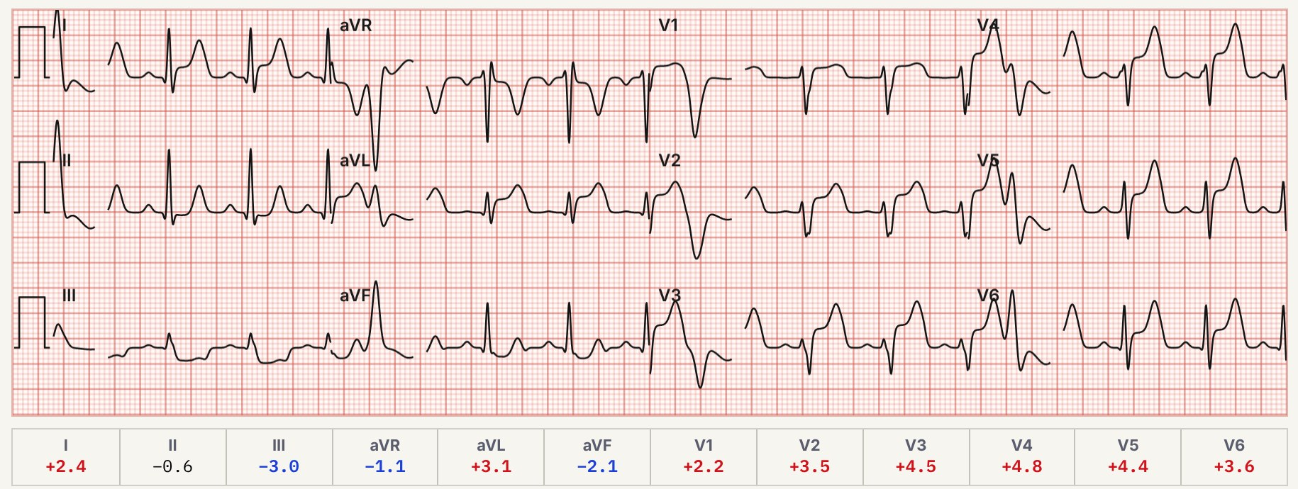
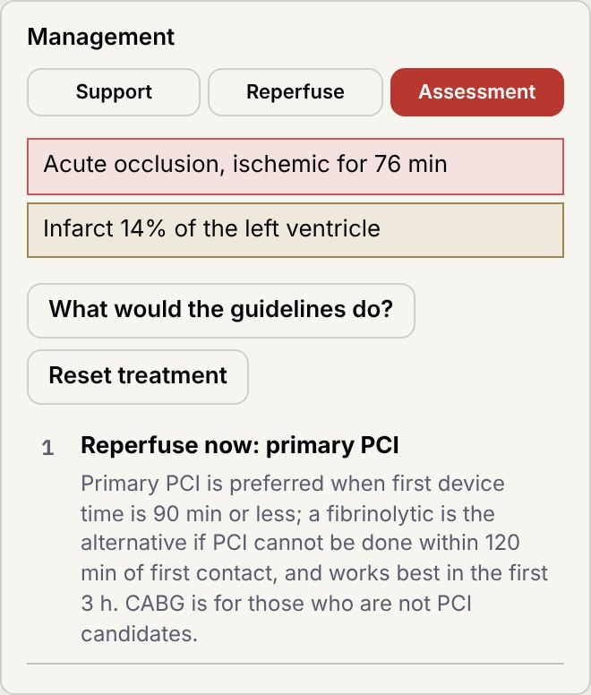
Read the 12-lead, then treat the patient
Problem solving and efficacy: simulator
Figure 3. The simulator's own 12-lead: ST up in I, aVL and V1–V6, down in III and aVF.
ST shifts point to the blocked artery
Each drug and device carries its real cost
PCI, lysis and CABG take their real time
Figure 4. Assessment tab.
Notes:
The Assessment tab lists live problems and, on request, the guideline order of steps, so a learner can decide first and check after. Warnings fire for harmful choices: nitrate in an RV infarct, a pressor in pump failure, dobutamine in ischemic muscle.

Slide 8
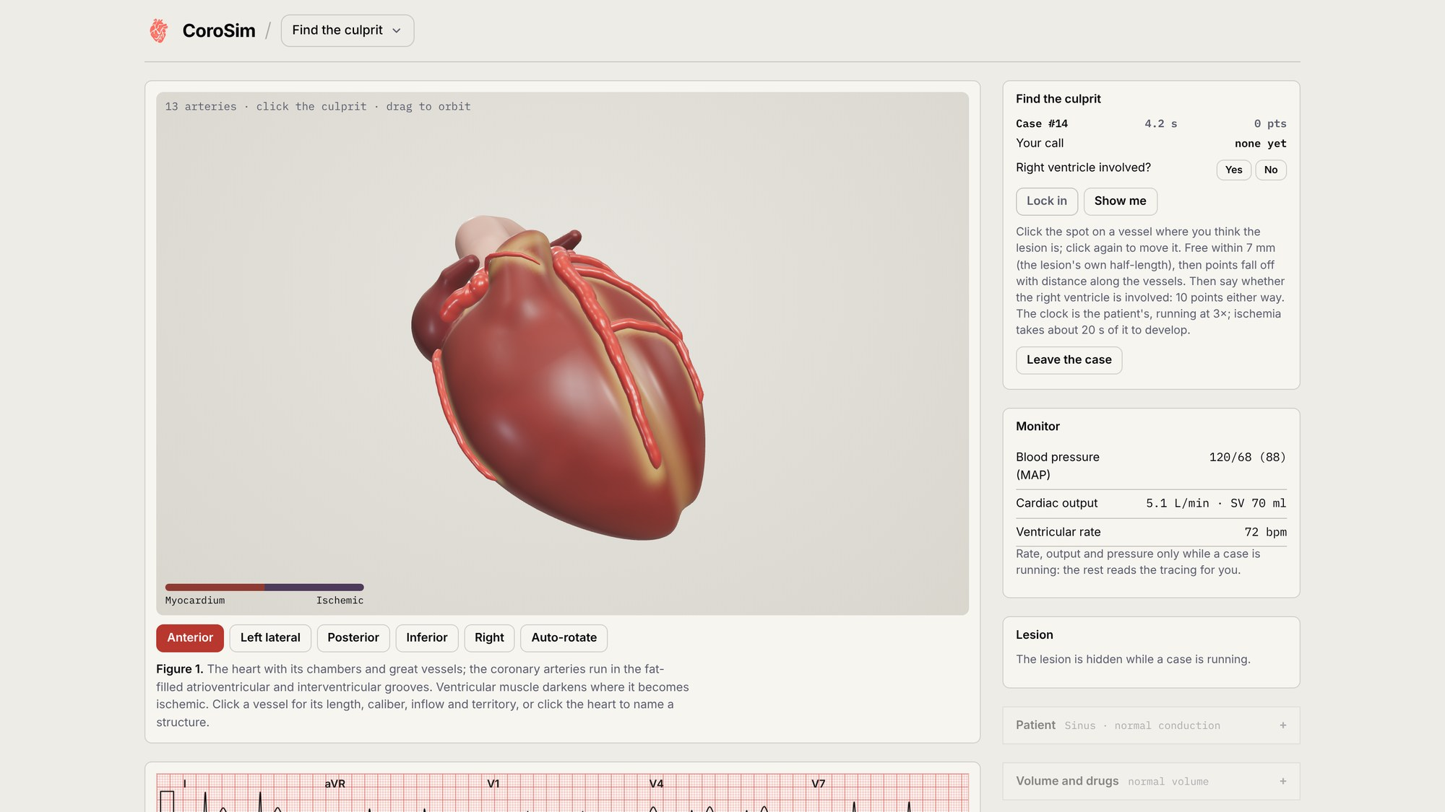
A daily hidden-lesion case, the same for everyone
Problem solving and efficacy: Find the culprit
The lesion is hidden: read the tracing and monitor, then click where it is
Points for accuracy along the vessel tree and for speed, then the RV call
Then manage the case: points for muscle saved and time out of shock, minus harm
Figure 5. Find the culprit, case 14, mid-case.
Notes:
corosim.com/game. Up to 170 points per case; every case is checked to be solvable. The debrief explains what the lesion did to the tracing and compares the infarct with immediate PCI and with no reperfusion.

Slide 9
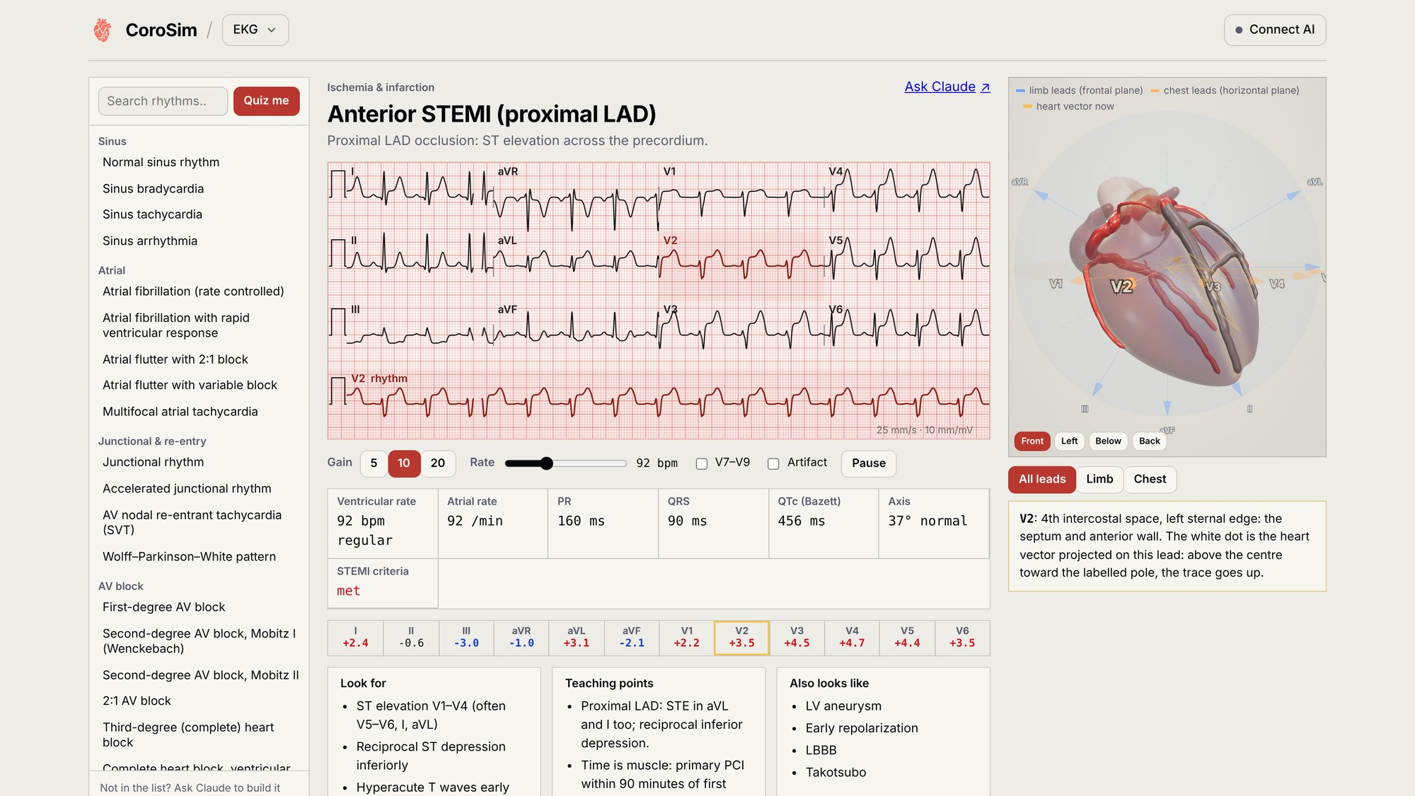
More than 50 tracings, each drawn through a 3D heart
Problem solving and efficacy: EKG
Rhythms, blocks, ischemia patterns and STEMI mimics, with teaching points
Each lead is an axis through the heart, so learners see why it goes up or down
Intervals, axis and ST are measured from the waveform; a quiz mode hides the name
Figure 6. The EKG page, anterior STEMI preset.
Notes:
corosim.com/ekg. Acute coronary presets take their ST vector from the coronary model with a real lesion.

Slide 10
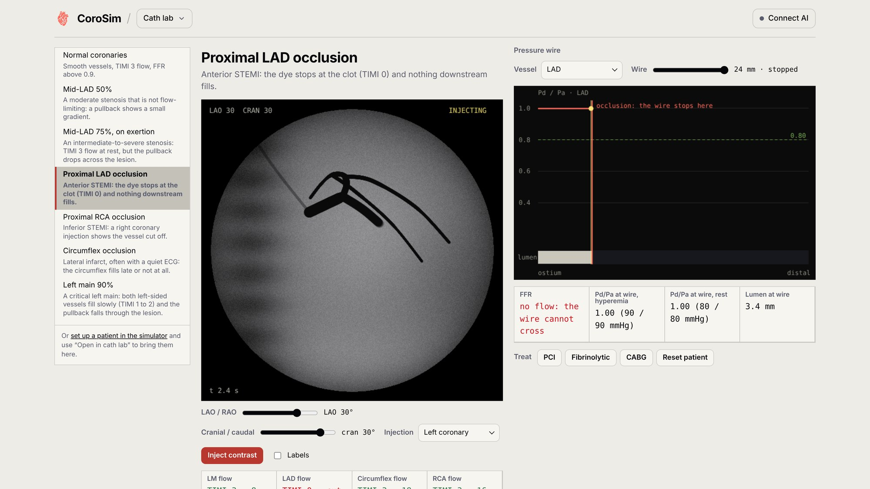
A virtual cath lab on the same patient
Problem solving and efficacy: cath lab
Angiography from any C-arm angle; dye moves at each vessel's solved flow
A pressure-wire pullback reads Pd/Pa and FFR
PCI, lysis and CABG show the vessel before and after
Figure 7. The cath lab, proximal LAD occlusion: TIMI 0 flow.
Notes:
corosim.com/cath. For students this is where coronary anatomy meets the angiogram; for residents, what the cath lab will report back.

Slide 11
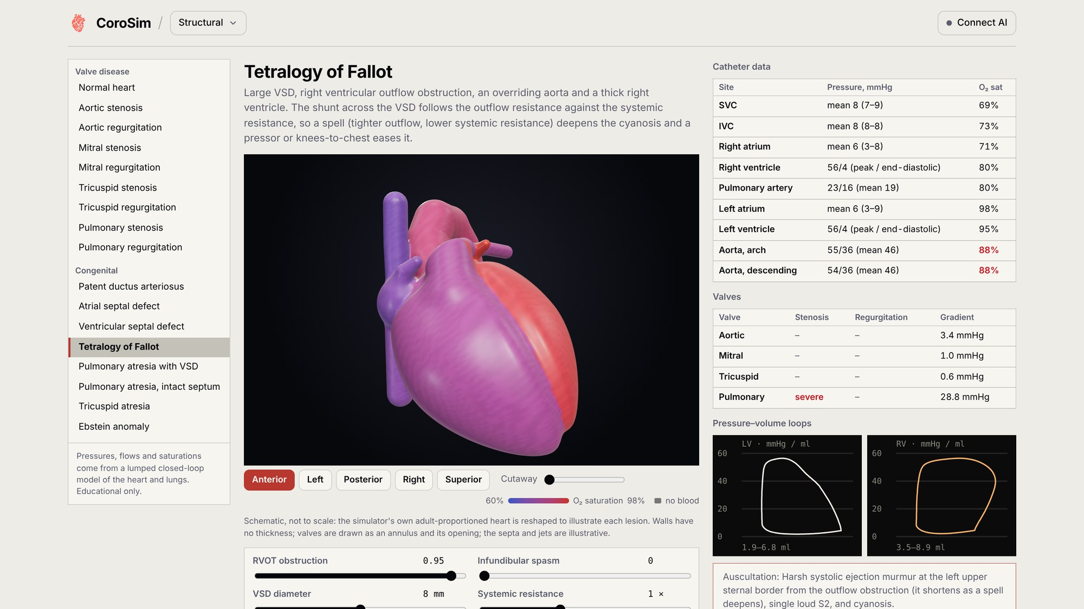
Valve and congenital lesions on a closed-loop heart
Problem solving and efficacy: structural
Eight valve lesions and eight congenital defects, each with severity sliders
Pressures, saturations, gradients, Qp:Qs and pressure–volume loops update live
Auscultation findings and oxygen saturation shown on the 3D heart
Figure 8. The structural page, tetralogy of Fallot.
Notes:
corosim.com/structural. Shown: aortic saturation 88%, a severe pulmonary gradient and equal LV and RV pressures.

Slide 12
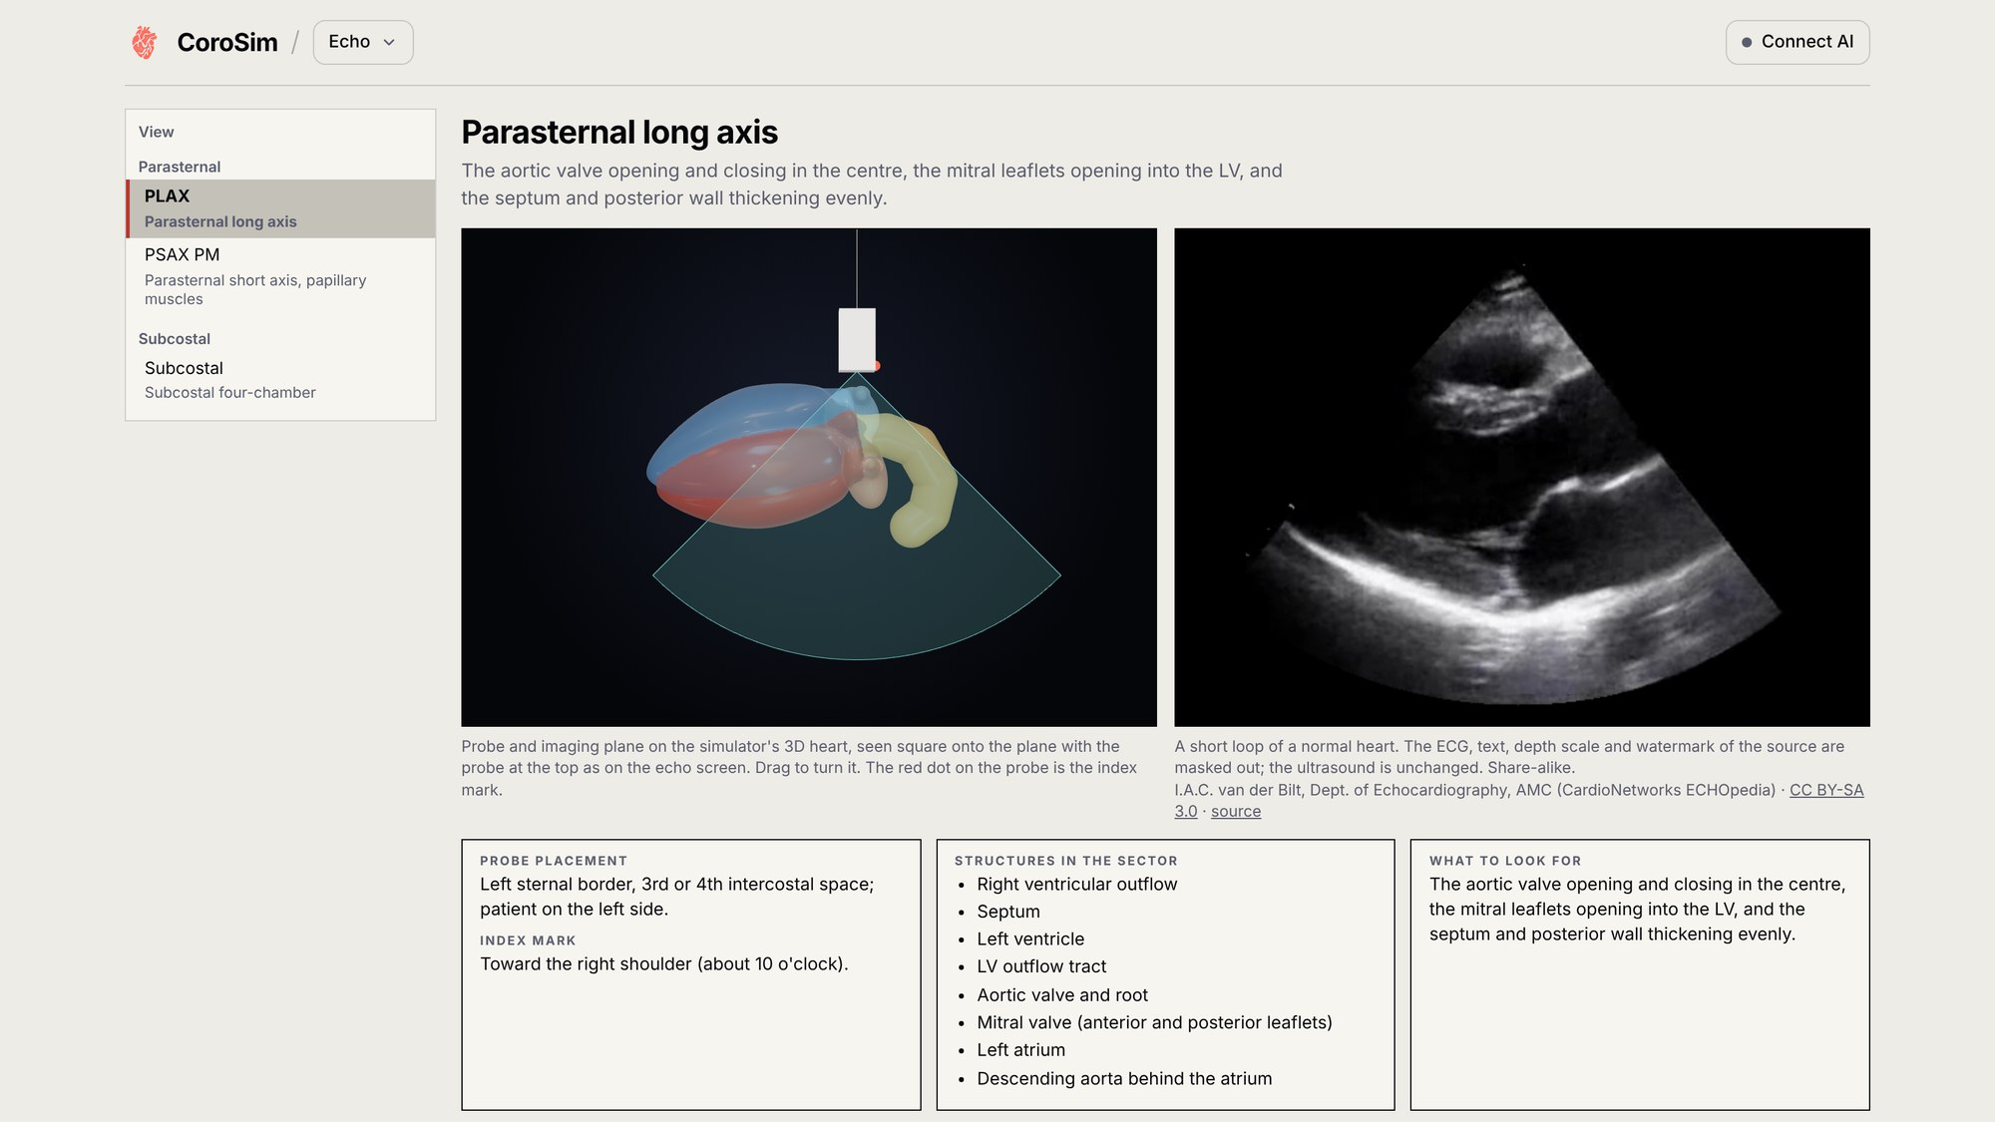
From probe position to the echo loop
Problem solving and efficacy: echo
Probe and imaging plane on the 3D heart beside a real TTE loop
Parasternal long axis, short axis and subcostal views
Probe placement, index mark and what to look for
Figure 9. The echo atlas, parasternal long axis.
Notes:
corosim.com/echo. The loops are real normal studies (ECHOpedia, CC BY-SA).

Slide 13
Six skills, and the pages that practice them
Skillsets targeted
Simulator
Find the culprit
EKG
Cath lab
Structural
Echo
Reading the ECG and localizing the culprit
Coronary anatomy and territories
Ischemia and hemodynamic physiology
STEMI and shock management
Reading angiograms, FFR and echo views
Valve and congenital hemodynamics
practiced directly
reinforced
Students start with rows 1–3; residents add the rest.
Notes:
Skills map to ACGME Medical Knowledge and Patient Care and to the cardiovascular objectives of a preclinical curriculum: reasoning from data (ECG, monitor, angiogram) to diagnosis, then to time-critical management with feedback on harm.

Slide 14
Built for medical students and IM residents
Intended audience
Medical students
Internal medicine residents
First-year physiology through the clerkships
Wards, CCU and the cardiology rotation
Cardiovascular physiology block and small groups
Coronary anatomy and territories
How a blocked artery becomes an ST change
Normal and abnormal rhythms
Noon conference, ECG conference and morning report
Culprit localization and STEMI mimics
Reperfusion timing, pressors, inotropes and support devices
Right-ventricular infarct pitfalls
Notes:
Primary audience: medical students (starting in the first-year cardiovascular physiology block) and internal medicine residents. The same model serves both: students work on mechanism and anatomy, residents on recognition and management under time pressure.

Slide 15
Three levels of evaluation, starting with one class
Assessment metrics and competency evaluation
1
Reaction
2
Learning
3
Behavior
Usability (System Usability Scale)
Perceived realism
Confidence reading ECGs, before and after
Pre/post test: culprit localization from 12-leads
Rhythm identification
Core cardiovascular concept questions
Performance across repeated daily cases
Location error, time to call, harm avoided
Course ECG and physiology exam items
Planned study
CoroSim is being planned for study among first-year students in RSOM's Class of 2030, measuring reaction, learning and behavior as above. In-app data already scores each case: location error, time to call, the RV call, muscle saved against immediate PCI, time in shock and harmful actions.
First-year medical students, RSOM Class of 2030
Notes:
Kirkpatrick levels 1 to 3. Level 1: SUS, realism, confidence pre/post. Level 2: pre/post knowledge test on culprit localization, rhythm ID and cardiovascular concepts. Level 3: performance trend across repeated daily cases and on course exam items. The planned study is in first-year students at RSOM (Class of 2030); design and timeline to be finalized.

Slide 16
Why CoroSim matters in the wider training picture
Significance and seamless integration
Cause and effect, made changeable
Cardiology is learned by seeing cause and effect; CoroSim makes the cause something a learner can change
One model from physiology to residency
The same heart runs from the first-year physiology block to the CCU, so learners build one mental model and keep it
Practice of rare, high-stakes events
Unlimited low-stakes repetitions of STEMI, shock and heart block, which rotations cannot guarantee
Complements existing simulation
Comes before mannequin and ACLS sessions, so lab time goes to hands-on skills and teamwork
Notes:
DRAFT SUBMISSION TEXT (Significance and Seamless Integration):
Cardiology is learned by connecting cause to effect: an occluded artery to an ischemic wall, that wall to the ST segments, the failing ventricle to the blood pressure, and each treatment to its cost. Most curricula teach these links separately, in lectures, ECG flash cards and occasional mannequin sessions, and learners report the result: low confidence reading ECGs, misconceptions that persist through medical school, and a wish for more practice. CoroSim joins the links. One closed-loop model of the coronary tree, the myocardium, the ECG and the circulation drives every page, so a learner who moves a lesion sees the whole patient change, and then has to treat that patient while the muscle is dying.
CoroSim is built to fit into what programs already do rather than replace it. It runs free in any browser with no installation, account or license, so it works on a student's phone, a lecture-hall projector or a resident's workstation. Faculty can open a specific patient, tracing or cath case from a link and use it in a first-year physiology small group, flipped-classroom pre-work, clerkship ECG teaching, or internal medicine noon conference and morning report, or embed the link in an LMS module or exam. The daily 'Find the culprit' case gives spaced practice with scored feedback, and an optional AI connection lets Claude or ChatGPT run Socratic rounds on the learner's own patient. CoroSim comes before mannequin and ACLS simulation, so that lab time can go to hands-on skills and teamwork while the reasoning is practiced everywhere else.

Slide 17
Fits into the teaching that already happens
Significance and seamless integration
Opens anywhere
Laptop, phone or the lecture-hall projector; no install, account or license.
Fits sessions already on the calendar
Physiology small groups, flipped pre-work, clerkship ECG teaching, noon conference and morning report.
Faculty assign exact cases
A link opens a set patient, tracing or cath case for a lecture, LMS module or exam.
An AI tutor on request
Connect AI lets Claude or ChatGPT run Socratic rounds on the learner's own patient.
A daily habit
One Find the culprit case a day. A daily ECG quiz for students held 81% participation over six weeks (Moulin 2025).
Open about its limits: every model constant is tagged literature-backed or assumed, more than 280 automated tests run on each change, and it is for education only. Validation against patient data is the next step.
Notes:
Links: corosim.com/sim/#s=… opens a set patient; corosim.com/ekg/#p=stemi-anterior opens a preset; corosim.com/cath/#case=ladocc opens a cath case. Connect AI uses the MCP connector at mcp.corosim.com.

Slide 18
Time is muscle.
Practice is free.
corosim.com
Educational simulation; not for clinical decisions.

Slide 19
Sources
References
Chaumont C, Morgat C, Ollitrault P, et al. How to improve medical students' ECG interpretation skills? Multicenter survey and results of a comparative study evaluating a new educational approach. BMC Med Educ. 2024;24:979. doi:10.1186/s12909-024-05929-7
El-Baba M, McLaren J, Argintaru N. The HEARTS ECG workshop: a novel approach to resident and student ECG education. Int J Emerg Med. 2023;16:81. doi:10.1186/s12245-023-00559-0
Badenhorst E, Mamede S, Abrahams A, et al. What happens to misunderstandings of biomedical concepts across a medical curriculum? Adv Physiol Educ. 2021;45(3):526-537. doi:10.1152/advan.00203.2020
Esomonye TC, Makawi A, Azees R, et al. A burst-learning electrocardiogram curriculum for internal medicine residents. JACC Case Rep. 2026;31:108886. doi:10.1016/j.jaccas.2026.108886
Cardoso Pinto AM, Soussi D, Qasim S, et al. The use of animations depicting cardiac electrical activity to improve confidence in understanding of cardiac pathology and ECG traces among final-year medical students. JMIR Med Educ. 2024;10:e46507. doi:10.2196/46507
Moulin T, Lellouche N, Gandjbakhch E, Laredo M. Daily quiz-based microlearning program to support ECG interpretation training for medical students: a feasibility study. CJC Open. 2025;8(1):43-50. doi:10.1016/j.cjco.2025.09.009
Liang S, Lai R, Xu T. Evaluating the competency and confidence in ECG interpretation among residents. Adv Med Educ Pract. 2025;16:2481-2489. doi:10.2147/AMEP.S550536
Image credits: echo loops, I.A.C. van der Bilt, AMC (CardioNetworks ECHOpedia), CC BY-SA 3.0; cath-lab heart mesh, Rodero C, et al. PLoS Comput Biol. 2021;17(4):e1008851, CC BY 4.0.

