Slide 1
Online Rental Contract Booking & Payment System
Database Systems Engineering & Distributed Backend Development (25CS1302E)
Team 32 | Y25 2026–2027

Slide 2


The Problem
No Unified Platform
The rental market lacks a single digital destination for property discovery, browsing, and booking — leaving tenants and owners to navigate disconnected tools.
Manual Friction & Delays
Contract generation and payment processing are largely manual, introducing costly delays and errors at every step of the rental lifecycle.
No Intelligent Matching
There is no mechanism to intelligently connect tenant preferences with the right available properties — resulting in poor search experiences and missed opportunities.

Slide 3

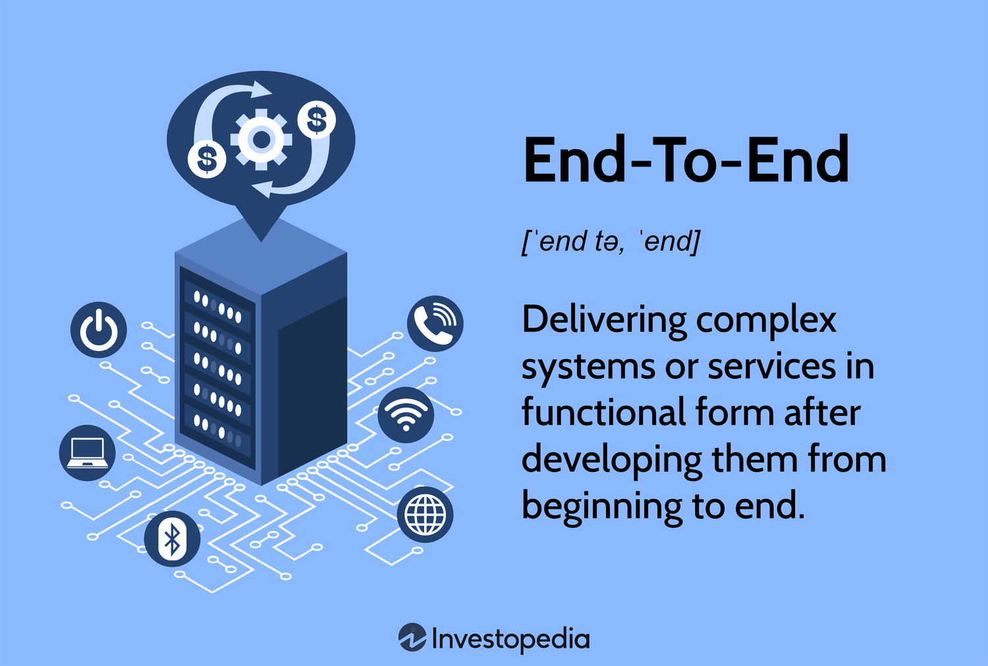



Our Solution
End-to-End Digital Platform
AI-Powered Assistant
Maps & Secure Payments
A web-based system that digitizes the complete rental lifecycle — from listing discovery to contract signing.
Natural-language property recommendations powered by an intelligent rental assistant for effortless search.
Google Maps visualization and navigation integrated alongside secure online payments and digital contract generation.

Slide 4





Key Features
Smart Search
AI Rental Assistant
Price Comparison
Maps Integration
Filter by location, budget, type, amenities, and availability for precision results.
Natural-language queries with semantic recommendations tailored to tenant needs.
Compare rental rates and amenities across surrounding areas at a glance.
Interactive property visualization and turn-by-turn directions via Google Maps.

Slide 5
User Roles & Capabilities
Tenants
Property Owners
Administrators
Search and browse listings
Book properties online
View and sign digital contracts
Make secure payments
Manage property listings
Handle bookings and contracts
Track payments and revenue
Control availability calendars
Monitor users and properties
Oversee all transactions
Audit system activities
Ensure platform integrity

Slide 6
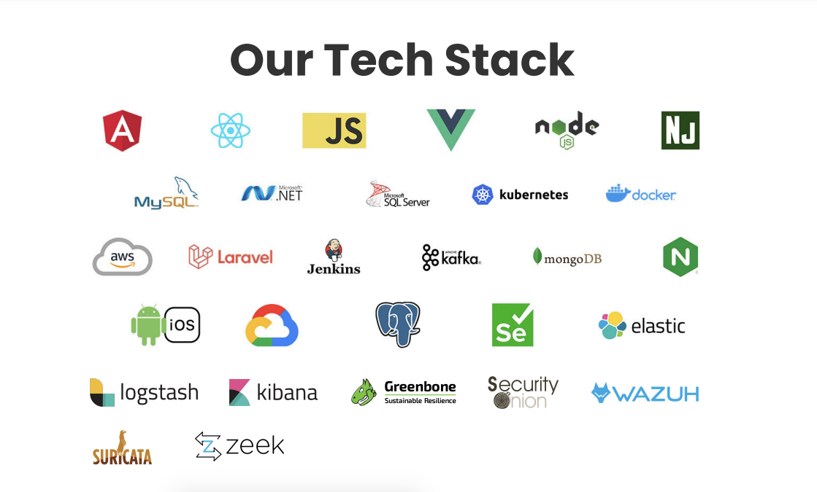
Technology Stack
Frontend
React.js, HTML5, CSS3, Bootstrap / Tailwind CSS
Backend
FastAPI (Python), Node.js / Express, Spring Boot
Databases
PostgreSQL, MongoDB, pgvector for semantic search
AI / ML
OpenAI API powering the intelligent rental assistant

Slide 7
Infrastructure & Security
Authentication
Payments
JWT, OAuth 2.0, and Role-Based Access Control ensuring only authorized access at every layer.
Razorpay and Stripe integration for reliable, encrypted, and compliant online transactions.
Deployment
DevOps
Docker and Docker Compose containerization, deployed on AWS, Azure, or Google Cloud infrastructure.
GitHub Actions CI/CD pipelines with Prometheus monitoring for continuous delivery and observability.

Slide 8

Architecture Highlights
Built for Scale
The system is architected using a microservices design pattern with REST-based communication between independent services — enabling teams to develop, deploy, and scale each component independently.
A vector database (pgvector / Pinecone) powers semantic search, allowing the AI assistant to return contextually relevant property results beyond simple keyword matching.
Containerized deployment and comprehensive Swagger/OpenAPI documentation ensure long-term reliability and developer-friendly extensibility.
Microservices
Vector Database
REST-based inter-service communication
pgvector / Pinecone for semantic search
Containerized Deployment
API Documentation
Docker for scalability and reliability
Swagger / OpenAPI comprehensive docs

Slide 9

Meet the Team
Team 32 — Database Systems Engineering & Distributed Backend Development
S. Harshith
Roll No: 2520030572
Chandra Prakash Verma
Roll No: 2500031353

