Slide 1
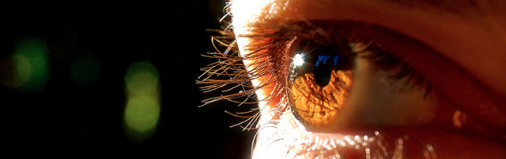
Visión por Computador
Domingo Mery
Departmento de Ciencia de la Computación
Escuela de Ingeniería
Universidad Católica de Chile
Calibration

Slide 2
[ Calibration ]

Slide 3
Calibration: Estimation of the parameters of the projection model
m
M
C
[3x1] [3x4][4x1]

Slide 4
[ Calibration ]
Calibration is the process that estimates the parameters of the camera given corresponding points 3D – 2D
INPUT: 3D points M₁, M₂, M₃, M₄, ... M_{n}
2D points m₁, m₂, m₃, m₄, ... m_{n} m_{i} is the projection of M_{i}.
OUTPUT:
Parameters of the Model
Notes:
\lambda \begin{bmatrix}
u\\
v\\
1
\end{bmatrix}
=
\begin{bmatrix}
\alpha_x & s & u_0\\
0 & \alpha_s & v_0 \\
0 & 0 & 1
\end{bmatrix}
\begin{bmatrix}
f & 0 & 0 & 0\\
0 & f & 0 & 0 \\
0 & 0 & 0 & 1
\end{bmatrix}
\begin{bmatrix}
{\bf R}' & {\bf t}'\\
{\bf 0} & 1
\end{bmatrix}
\begin{bmatrix}
X'\\
Y'\\
Z'\\
1
\end{bmatrix}

Slide 5
[ Calibration ]
Calibration is the process that estimates the parameters of the camera given corresponding points 3D – 2D
Measurements:
INPUT: 3D points M₁, M₂, M₃, M₄, ... M_{n}
2D points m₁, m₂, m₃, m₄, ... m_{n} m_{i} is the projection of M_{i}.
OUTPUT:
Parameters of the Model
parameter
model
Notes:
\lambda \begin{bmatrix}
u\\
v\\
1
\end{bmatrix}
=
\begin{bmatrix}
\alpha_x & s & u_0\\
0 & \alpha_s & v_0 \\
0 & 0 & 1
\end{bmatrix}
\begin{bmatrix}
f & 0 & 0 & 0\\
0 & f & 0 & 0 \\
0 & 0 & 0 & 1
\end{bmatrix}
\begin{bmatrix}
{\bf R}' & {\bf t}'\\
{\bf 0} & 1
\end{bmatrix}
\begin{bmatrix}
X'\\
Y'\\
Z'\\
1
\end{bmatrix}

Slide 6
[ Simple Calibration ]

Slide 7
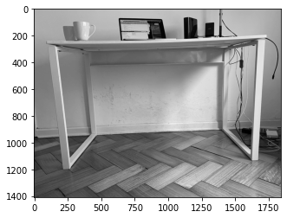

Slide 8
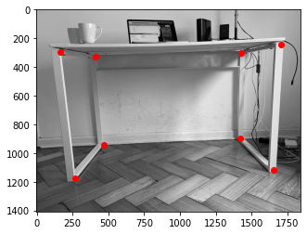
Selection
of Points

Slide 9

2D Points
(measurement)
5: (1704, 246)
1: (166,294)
2: (412,328)
6: (1426, 304)
3: (470,940)
7: (1420,900)
0: (268,1178)
4: (1654,1118)

Slide 10

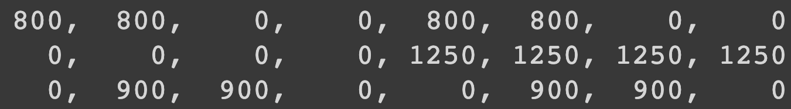
3D Points
(measurement)
5
1
2
6
3
7
0
4
0 1 2 3 4 5 6 7
3D POINTS

Slide 11
Selection
of Points
5: (1704, 246)
1: (166,294)
(measurement)
2: (412,328)
6: (1426, 304)
3: (470,940)
7: (1420,900)
0: (268,1178)
4: (1654,1118)
0 1 2 3 4 5 6 7
3D POINTS

Slide 12
For each point

Slide 16

LEAST SQUARES

Slide 17
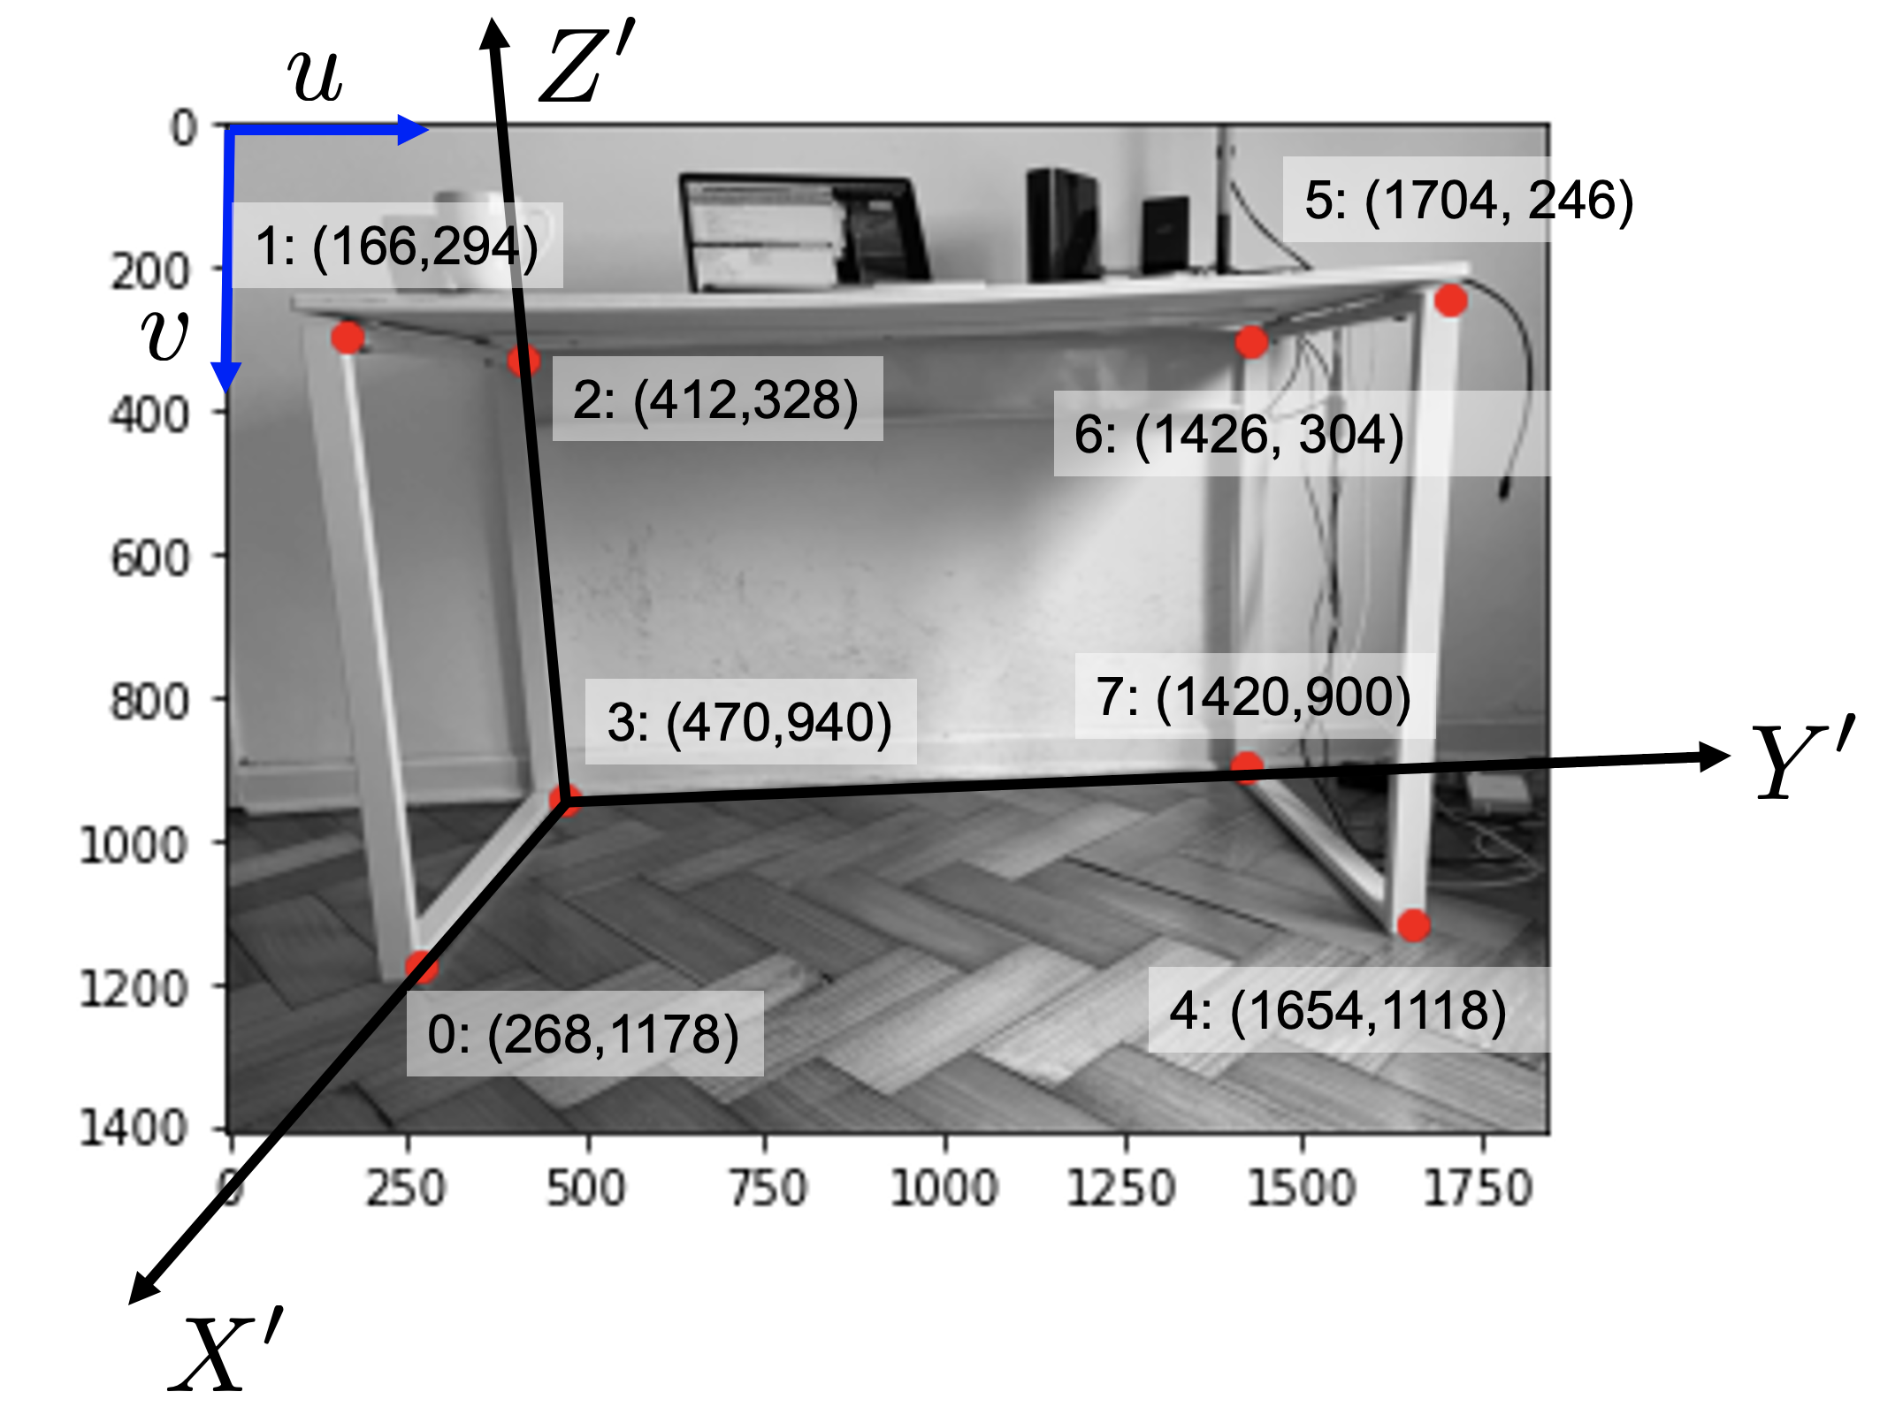
2D POINTS
Calibration
3D POINTS
u = 268 166 412 470 1654 1704 1426 1420
= 271 164 412 468 1656 1699 1429 1417
v = 1178 294 328 940 1118 246 304 900
= 1180 289 331 937 1119 246 302 899

Slide 18
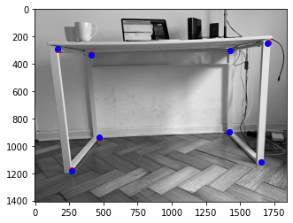



Slide 19
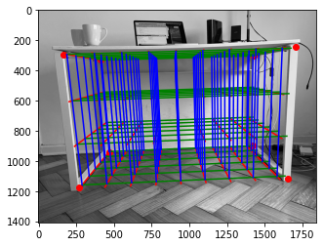

Slide 20
[ Non-Linear Calibration ]

Slide 21

[ Camera Model ] (see explanation in CV02_Transformation3D2D.pptx)
f
v
m
Y
Z'
M
Y'
(u,v)
y
(X',Y',Z')
Z
C
u
X'
x
X

Slide 22
[ Camera Model ]
Notes:
\lambda \begin{bmatrix}
u\\
v\\
1
\end{bmatrix}
=
\begin{bmatrix}
\alpha_x & s & u_0\\
0 & \alpha_s & v_0 \\
0 & 0 & 1
\end{bmatrix}
\begin{bmatrix}
f & 0 & 0 & 0\\
0 & f & 0 & 0 \\
0 & 0 & 0 & 1
\end{bmatrix}
\begin{bmatrix}
{\bf R}' & {\bf t}'\\
{\bf 0} & 1
\end{bmatrix}
\begin{bmatrix}
X'\\
Y'\\
Z'\\
1
\end{bmatrix}

Slide 23
[ Camera Model ]
Notes:
\lambda \begin{bmatrix}
u\\
v\\
1
\end{bmatrix}
=
\begin{bmatrix}
\alpha_x & s & u_0\\
0 & \alpha_s & v_0 \\
0 & 0 & 1
\end{bmatrix}
\begin{bmatrix}
f & 0 & 0 & 0\\
0 & f & 0 & 0 \\
0 & 0 & 0 & 1
\end{bmatrix}
\begin{bmatrix}
{\bf R}' & {\bf t}'\\
{\bf 0} & 1
\end{bmatrix}
\begin{bmatrix}
X'\\
Y'\\
Z'\\
1
\end{bmatrix}

Slide 24
[ Camera Model ]
11 DoF:
5 intrinsec parameters
6 extrinsec parameters
Notes:
\lambda \begin{bmatrix}
u\\
v\\
1
\end{bmatrix}
=
\begin{bmatrix}
\alpha_x & s & u_0\\
0 & \alpha_s & v_0 \\
0 & 0 & 1
\end{bmatrix}
\begin{bmatrix}
f & 0 & 0 & 0\\
0 & f & 0 & 0 \\
0 & 0 & 0 & 1
\end{bmatrix}
\begin{bmatrix}
{\bf R}' & {\bf t}'\\
{\bf 0} & 1
\end{bmatrix}
\begin{bmatrix}
X'\\
Y'\\
Z'\\
1
\end{bmatrix}

Slide 25
[ Calibration ]
Calibration is the process that estimates the parameters of the camera given corresponding points 3D – 2D
11 DoF:
5 intrinsec parameters
6 extrinsec parameters
Notes:
\lambda \begin{bmatrix}
u\\
v\\
1
\end{bmatrix}
=
\begin{bmatrix}
\alpha_x & s & u_0\\
0 & \alpha_s & v_0 \\
0 & 0 & 1
\end{bmatrix}
\begin{bmatrix}
f & 0 & 0 & 0\\
0 & f & 0 & 0 \\
0 & 0 & 0 & 1
\end{bmatrix}
\begin{bmatrix}
{\bf R}' & {\bf t}'\\
{\bf 0} & 1
\end{bmatrix}
\begin{bmatrix}
X'\\
Y'\\
Z'\\
1
\end{bmatrix}

Slide 26
[ Calibration ]
Calibration is the process that estimates the parameters of the camera given corresponding points 3D – 2D
INPUT: 3D points M₁, M₂, M₃, M₄, ... M_{n}
2D points m₁, m₂, m₃, m₄, ... m_{n} m_{i} is the projection of M_{i}.
OUTPUT:
Notes:
\lambda \begin{bmatrix}
u\\
v\\
1
\end{bmatrix}
=
\begin{bmatrix}
\alpha_x & s & u_0\\
0 & \alpha_s & v_0 \\
0 & 0 & 1
\end{bmatrix}
\begin{bmatrix}
f & 0 & 0 & 0\\
0 & f & 0 & 0 \\
0 & 0 & 0 & 1
\end{bmatrix}
\begin{bmatrix}
{\bf R}' & {\bf t}'\\
{\bf 0} & 1
\end{bmatrix}
\begin{bmatrix}
X'\\
Y'\\
Z'\\
1
\end{bmatrix}

Slide 27
[ Camera Model ] (see explanation in CV02_Transformation3D2D.pptx)
f
v
m₁
Y
Z'
M₁
Y'
m₂
y
M₂
Z
C
M_{n}
u
X'
m_{n}
x
X

Slide 28
[ Calibration ]
Calibration is the process that estimates the parameters of the camera given corresponding points 3D – 2D
Measurements:
INPUT: 3D points M₁, M₂, M₃, M₄, ... M_{n}
2D points m₁, m₂, m₃, m₄, ... m_{n} m_{i} is the projection of M_{i}.
OUTPUT:
parameter
model
Notes:
\lambda \begin{bmatrix}
u\\
v\\
1
\end{bmatrix}
=
\begin{bmatrix}
\alpha_x & s & u_0\\
0 & \alpha_s & v_0 \\
0 & 0 & 1
\end{bmatrix}
\begin{bmatrix}
f & 0 & 0 & 0\\
0 & f & 0 & 0 \\
0 & 0 & 0 & 1
\end{bmatrix}
\begin{bmatrix}
{\bf R}' & {\bf t}'\\
{\bf 0} & 1
\end{bmatrix}
\begin{bmatrix}
X'\\
Y'\\
Z'\\
1
\end{bmatrix}

Slide 29
[ Calibration ]
Calibration is the process that estimates the parameters of the camera given corresponding points 3D – 2D
For each corresponding pair of points m_{i} – M_{i}:
Error:
Objective Function to be minimized:
model
Notes:
\lambda \begin{bmatrix}
u\\
v\\
1
\end{bmatrix}
=
\begin{bmatrix}
\alpha_x & s & u_0\\
0 & \alpha_s & v_0 \\
0 & 0 & 1
\end{bmatrix}
\begin{bmatrix}
f & 0 & 0 & 0\\
0 & f & 0 & 0 \\
0 & 0 & 0 & 1
\end{bmatrix}
\begin{bmatrix}
{\bf R}' & {\bf t}'\\
{\bf 0} & 1
\end{bmatrix}
\begin{bmatrix}
X'\\
Y'\\
Z'\\
1
\end{bmatrix}

