Slide 1

Visión por Computador
Domingo Mery
Departmento de Ciencia de la Computación
Escuela de Ingeniería
Universidad Católica de Chile
Epipolar Geometry

Slide 2
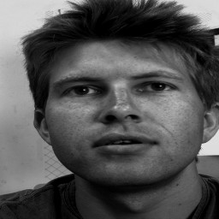
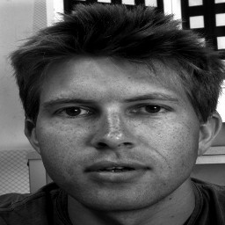
Correspondence in two images:
Two points are corresponding points if they are 2D projections of the same 3D point.

Slide 3
Epipolar Geometry:
m₁
m₂
Epipolar line
M
Image 1
Image 2
C₂
C₁
Epipolar Constraint:
If m₁ and m₂ are corresponding points
then m₂ lies on the epipolar line of m₁

Slide 4
Correspondence in two images:
Epipolar Constraint.
EPIPOLE

Slide 5
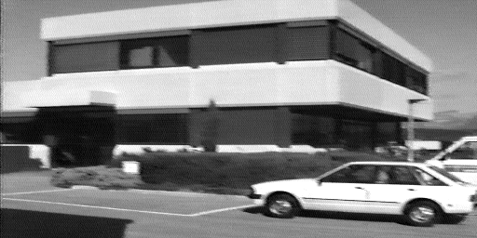
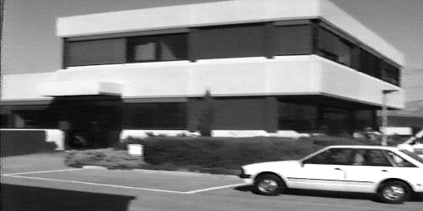
Image 1
Epipole
Image 2

Slide 6

[ STEP 1 ]
2 points on <C₁,m₁>
1) M_{p} = C₁ = null(A)
2) M_{q} = A^{T}[AA^{T}]⁻¹m₁ = A⁺m₁
Estimation of Fundamental Matrix:
m_{q}
m₁
m₂
[ STEP 2 ]
Projection onto image 2
λ_{p}m_{p} = BM_{p} , λ_{q}m_{q} = BM_{q}
Epipolar line
M_{q}
m_{p}
Image 1
C₂
C₁ = M_{p}
Image 2
[ STEP 3 ]
Epipolar Line
= m_{p} x m_{q}
= [BM_{p}] x [BM_{q}]
= [BC₁]_{x}BA⁺m₁ = Fm₁

Slide 7
Calibrated Views
(A and B are known)
FUNDAMENTAL
MATRIX
where:
EPIPOLAR CONSTRAINT:
cross product

Slide 8
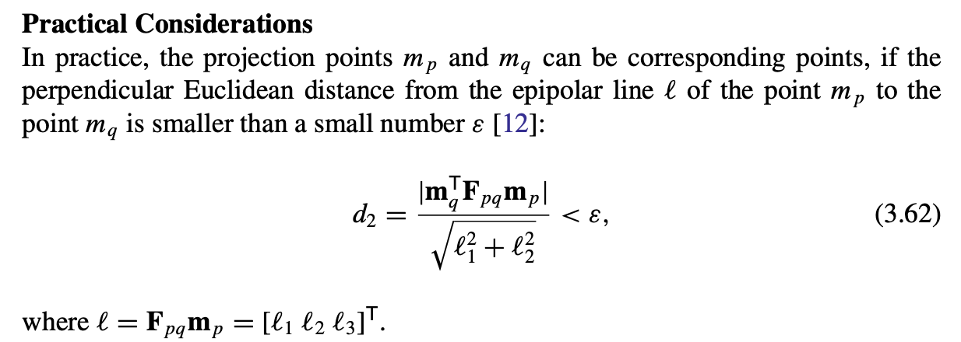

Slide 9
Uncalibrated Views
(A and B are unknown)

Slide 10


Uncalibrated Views
(A and B are unknown)
Corresponding
points
FUNDAMENTAL
MATRIX
Estimation of F
2
3
2
3
1
4
1
4
5
9
5
9
6
8
6
8
7
I₁
7
I₂

Slide 11

For each pair of points and
we have the epipolar constraint:

Slide 12
For each pair of points and
we have the epipolar constraint:

Slide 13
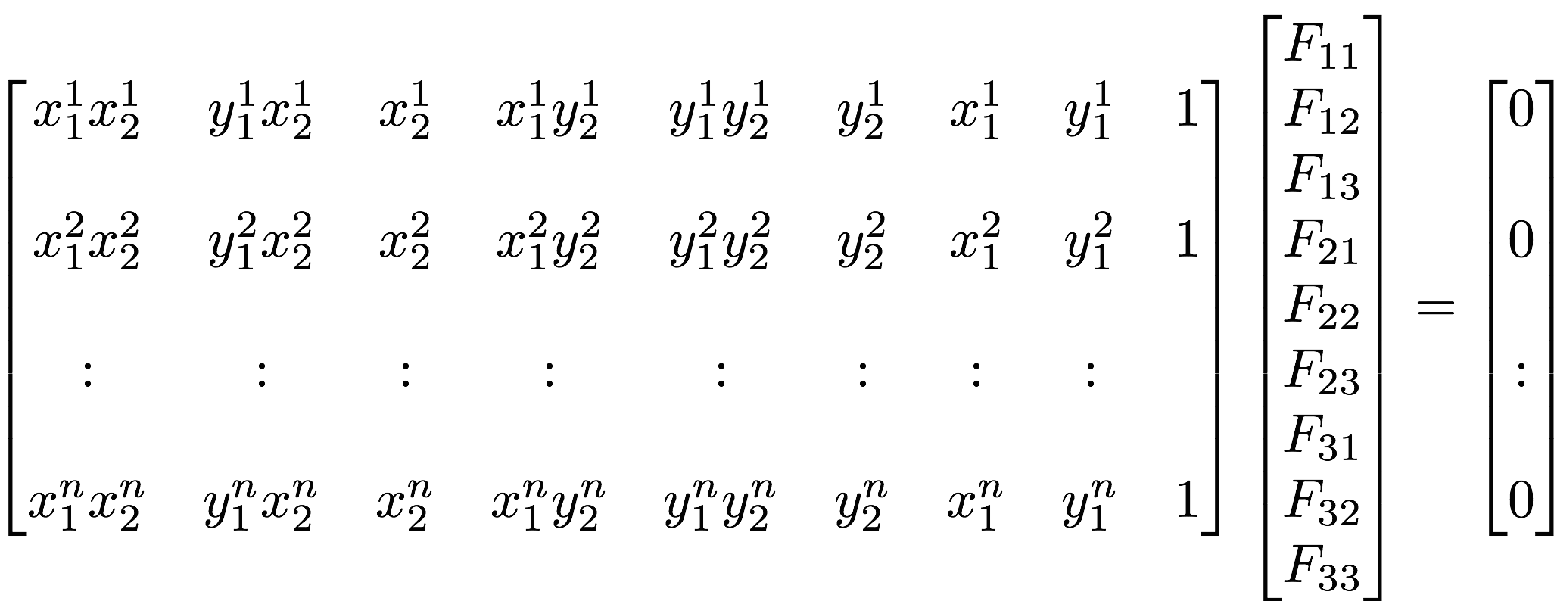
For n pair of points and (i=1 … n)
we have n epipolar constraints:
We can set F₃₃ = 1
(because F is homogeneous)

Slide 14
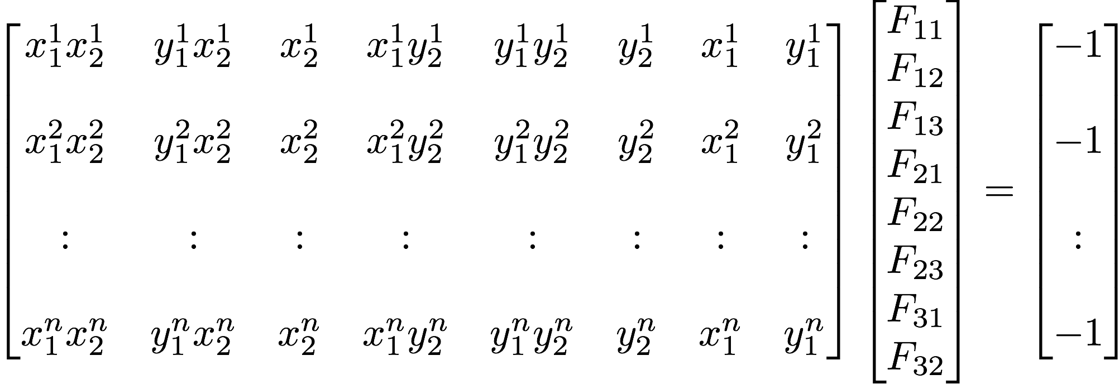
For n pair of points and (i=1 … n)
we have n epipolar constraints:
with F₃₃ = 1
QF’ = r
F’ = Q⁻¹r for n=8
F’ = [Q^{T}Q]⁻¹Q^{T}r for n>8

Slide 15
Corresponding points can be established using SIFT
(see demo using Bmv_fundamentalSIFT)

Slide 16
Epipolar Geometry:
m₁
m₂
Epipolar line
M
Image 1
Image 2
C₂
C₁
Epipolar Constraint:
If m₁ y m₂ are corresponding points
then m₂ lies on the epipolar line of m₁

Slide 17

Epipolar Geometry for 3 views:
m₂
m₁
m₃
Image 1
Image 2
Image 3
Problem:
Given m₁, m₂ (and projection matrices A, B and C)
find m₃

