Slide 1
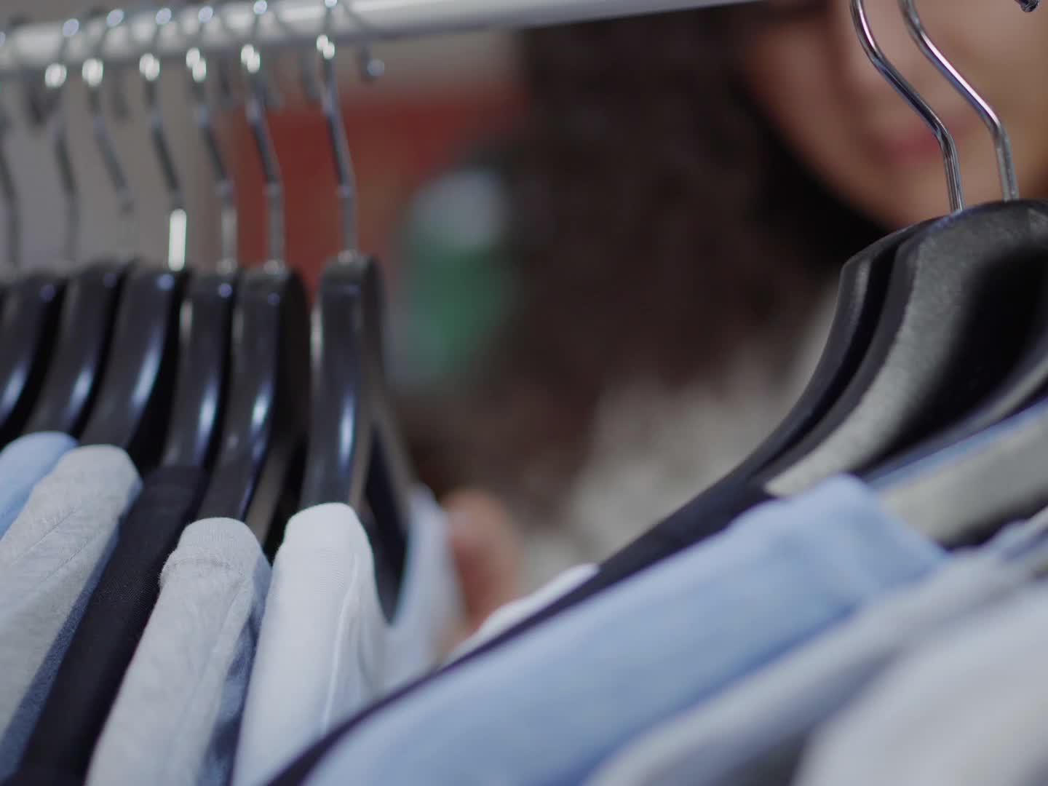

Understanding Customer Fashion Behavior at H&M
Sirra Danso

Slide 2
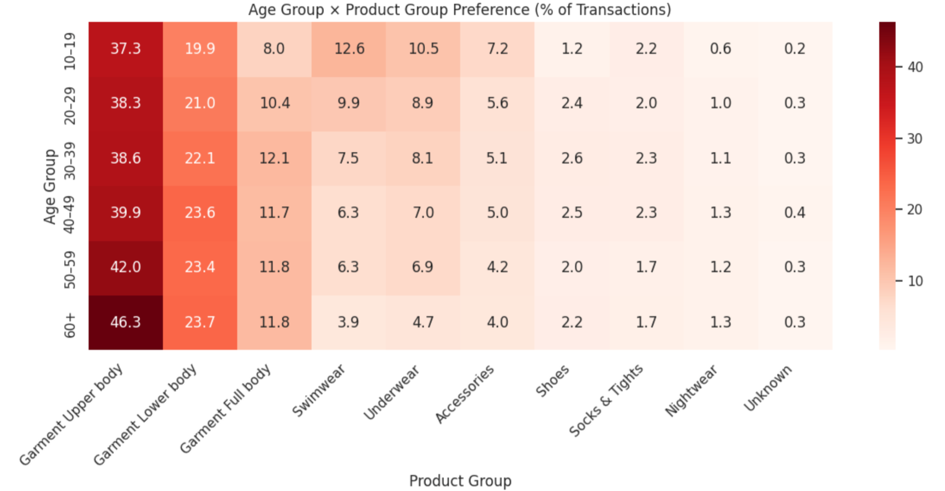
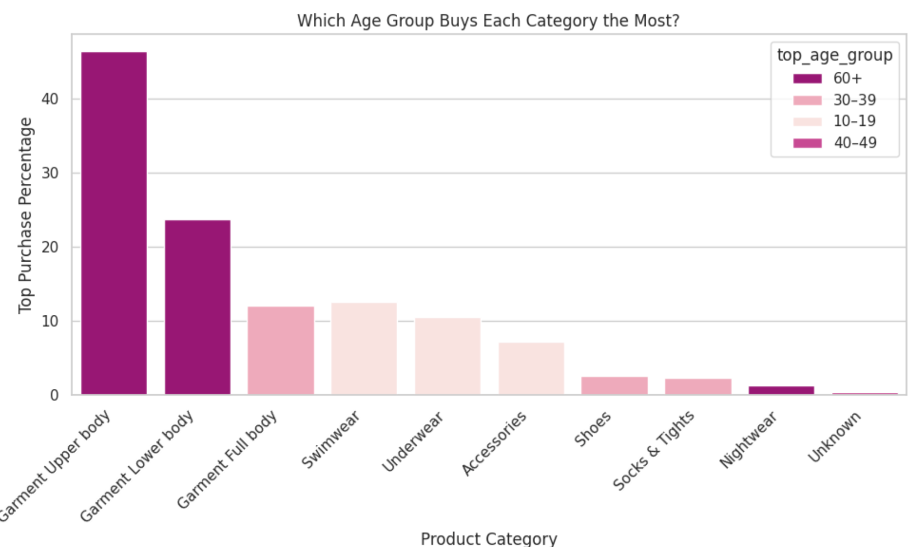
Do different age groups shop differently or is fashion taste more universal than we think?
What I Analyzed:
Age × Product Category Purchases
Across all ages, upper-body garments dominate the universal wardrobe staple.
Ages 60+ lead the highest share in classic categories like tops and bottoms
Younger groups (10–29) show more interest in trendier Swimwear & Accessories.
Category preferences are surprisingly stable across ages.

Slide 3
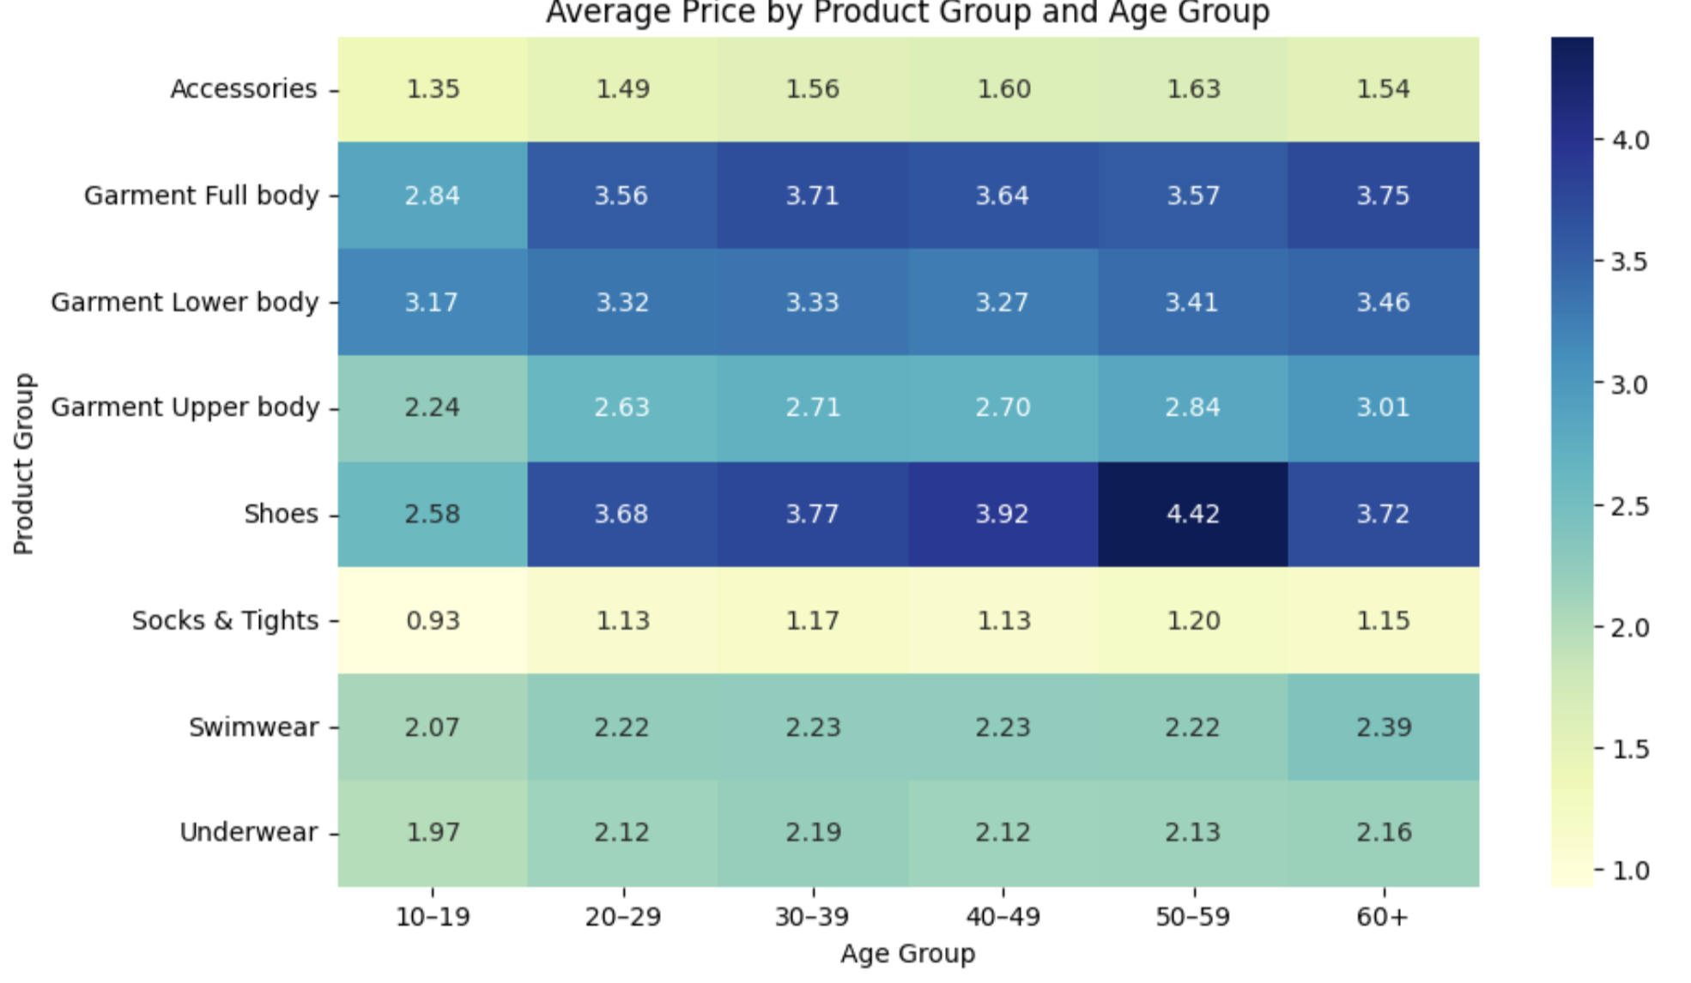
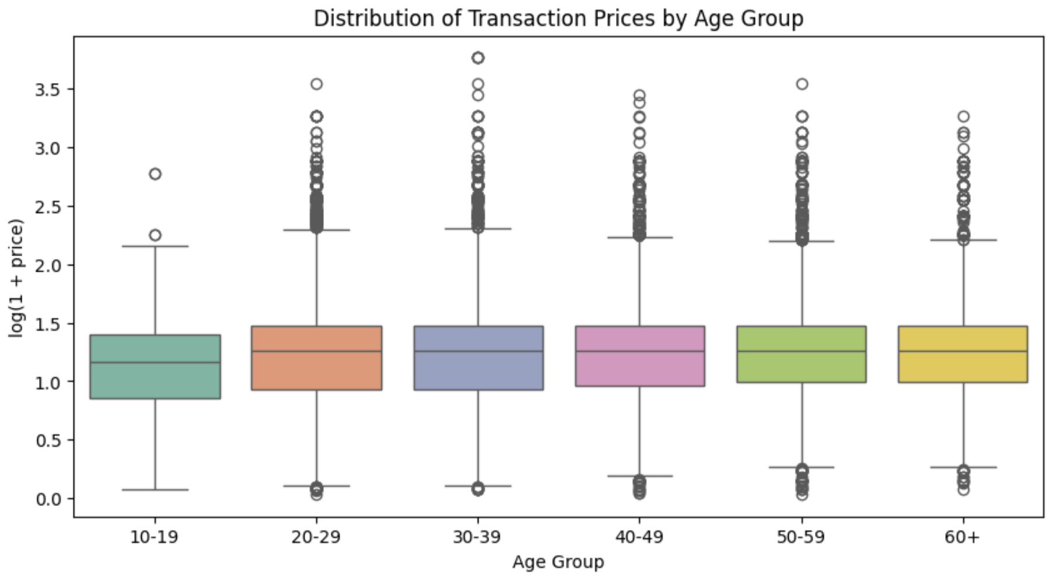
Does age change how much customers are willing to pay for fashion?
What I Analyzed:
Price distributions + category-level averages by age
All age groups spend within nearly the same price range spending is stable.
Ages 30–49 show slightly higher median prices, but not dramatically.
Category, not age, drives price differences. Shoes remain the most expensive.
Fashion pricing appears demographically inclusive across the customer base.

Slide 4
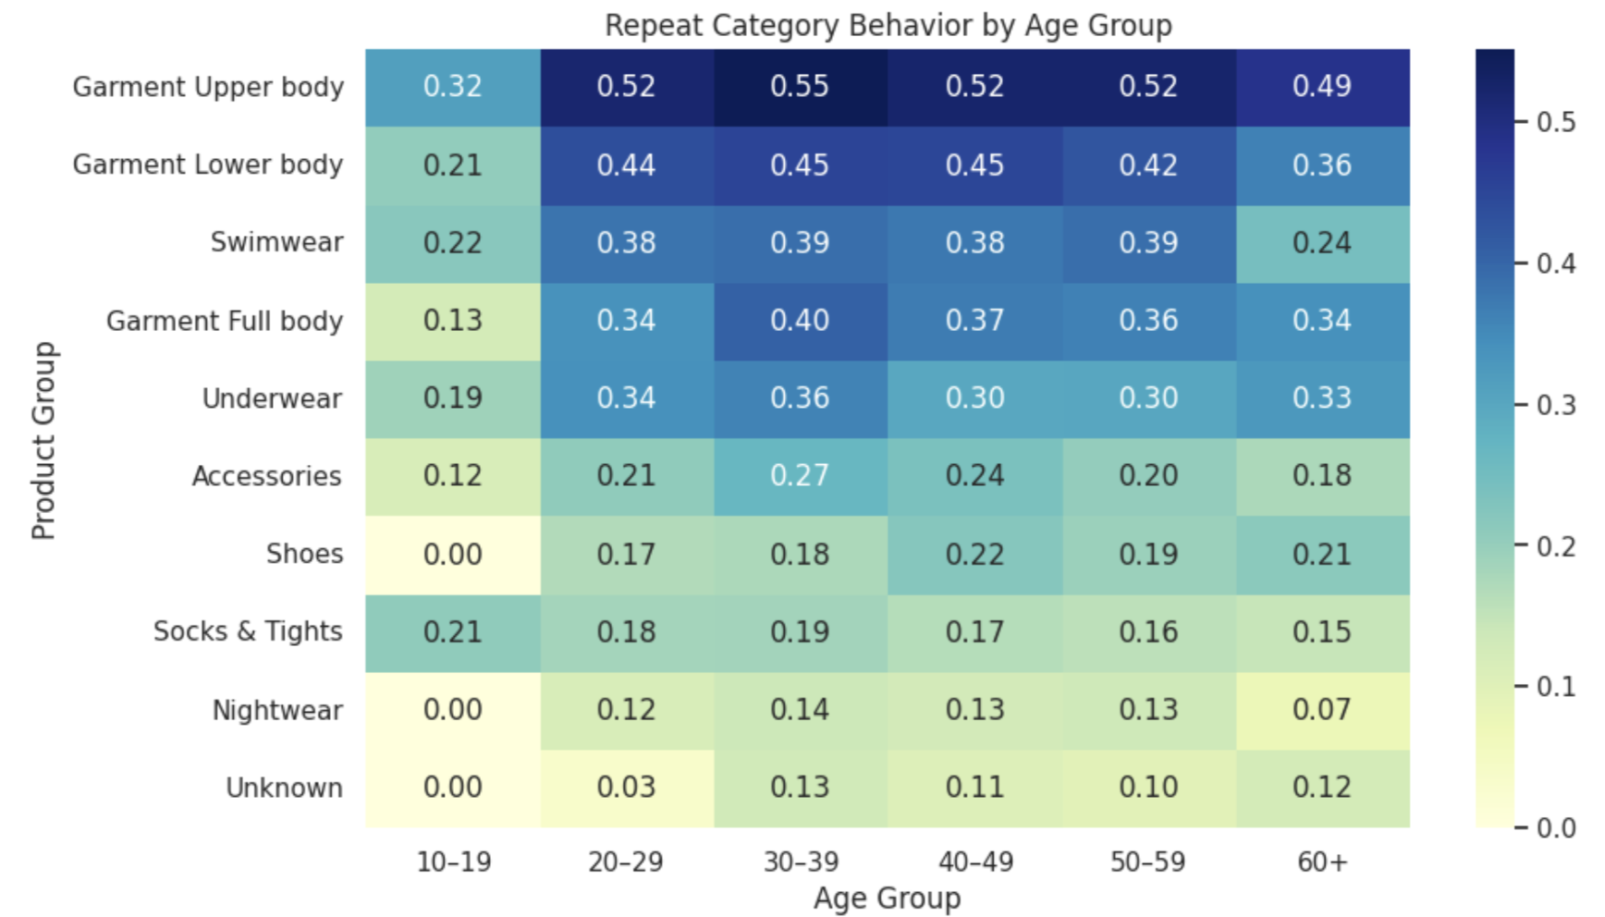
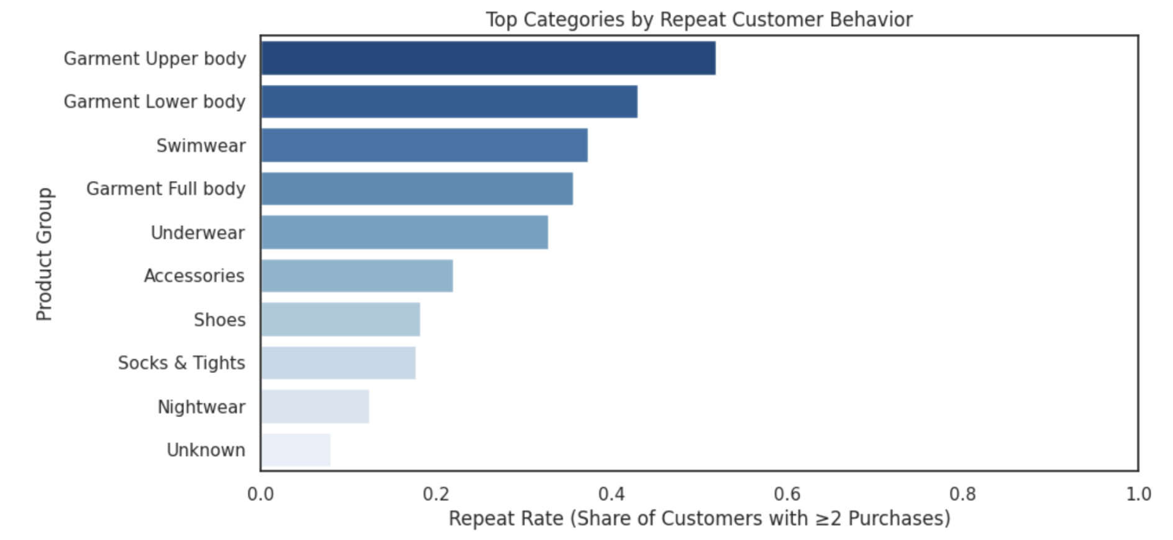
Which product categories keep customers coming back and why?
What I Analyzed:
Category repeat rate + repeat rate by age
Upper-body garments generate the highest repeat purchases.
Swimwear shows surprisingly high repeat behavior, indicating multiple seasonal purchases.
Shoes and Accessories show the lowest loyalty, suggest more one-off purchases.
Ages 20–39 show the highest overall repeat engagement across categories.

Slide 5
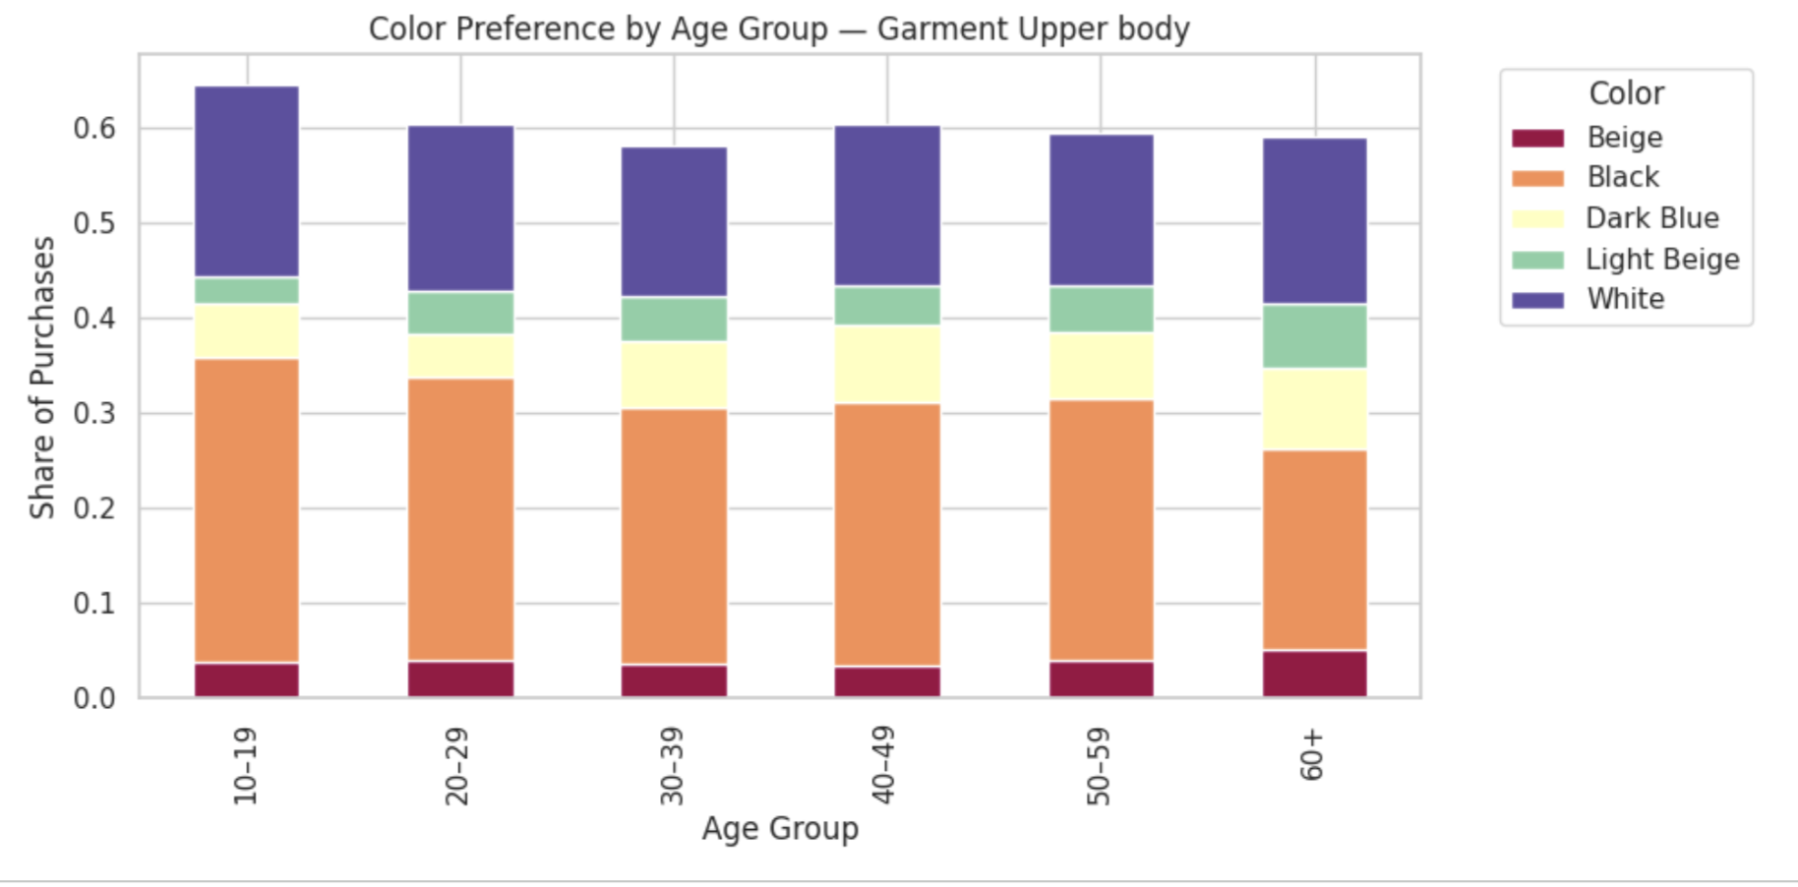
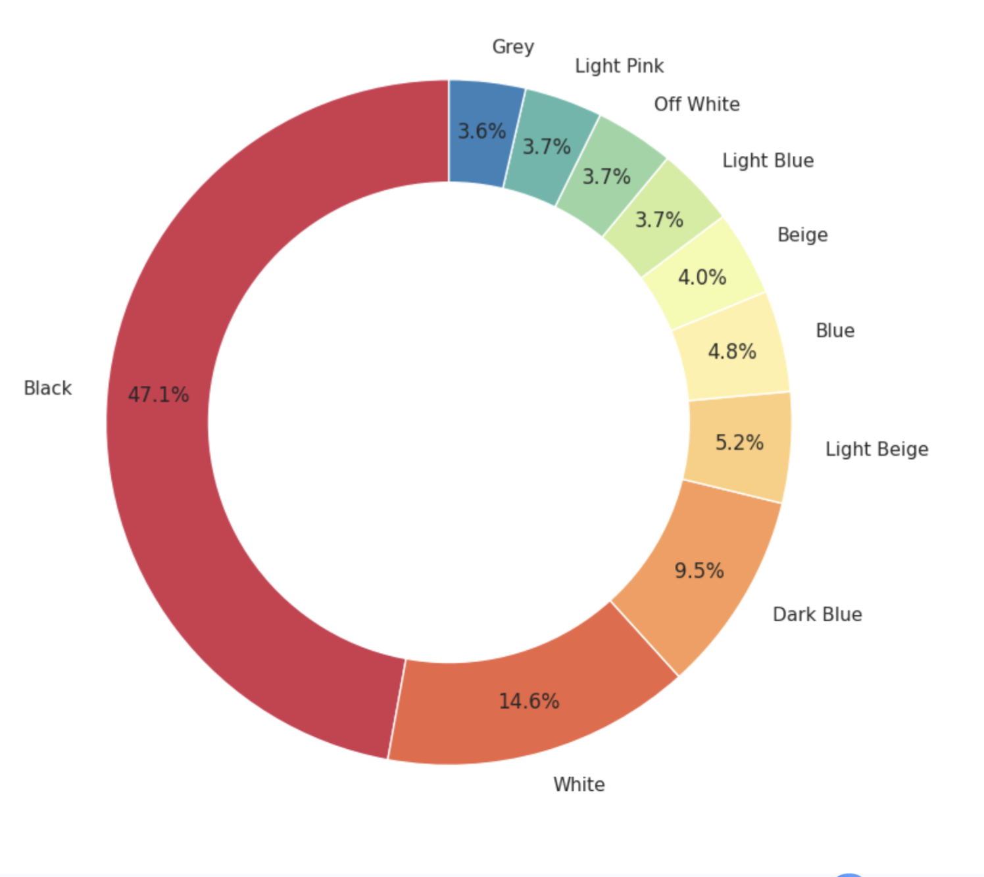
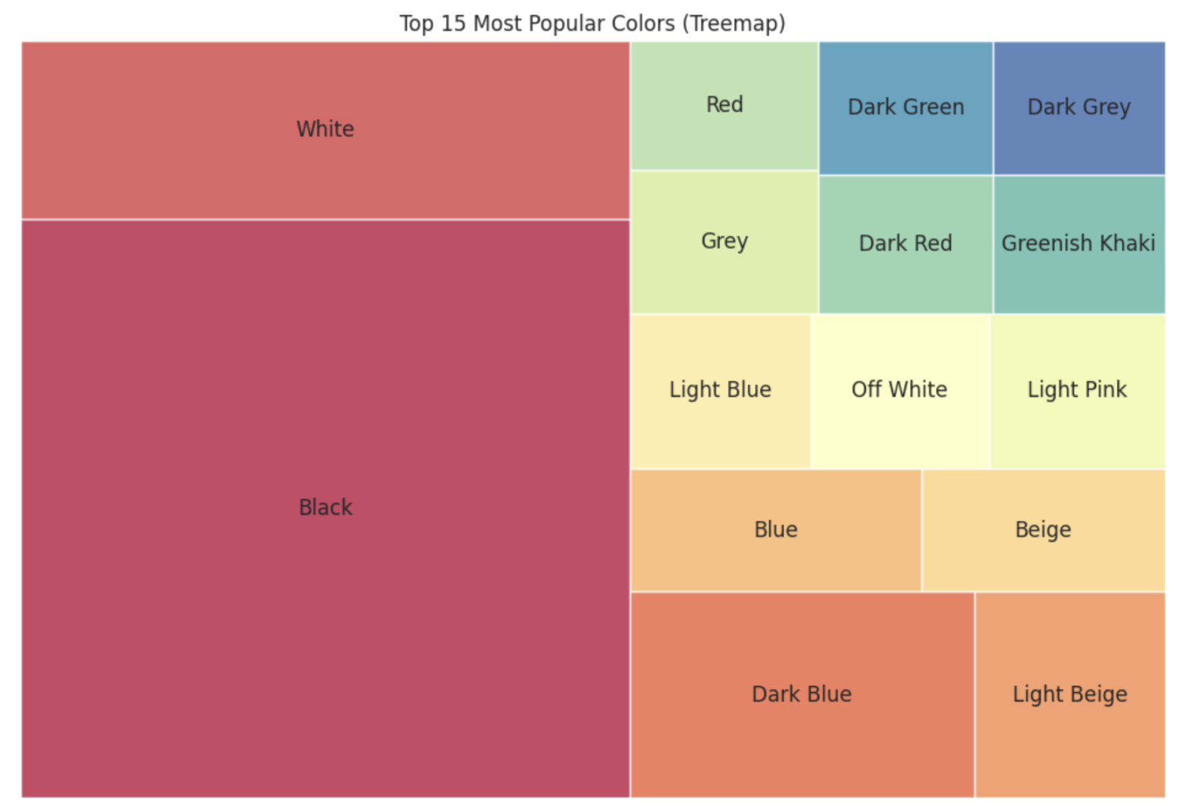
Do different age groups express style differently through color?
What I Analyzed:
Top colors overall + color preference by age
Black dominates nearly half of all purchases the core of modern fashion.
White and neutral tones make up the second major palette cluster.
Color preferences are consistent across all age groups, showing shared taste.
Younger shoppers display slightly more color variation, but neutrals still win.

Slide 6

What does all this tell us about fashion shoppers and where can we go from here?
Age shapes what customers buy, not how much they spend.
Core apparel categories drive reliable, repeat purchasing.
Color preference is nearly universal, dominated by neutrals.
H&M's assortment and pricing appear aligned with broad customer behavior.
Next Steps:
Explore seasonal patterns.
Build customer segments.
Analyze basket size.

