Slide 1
6.092: Introduction to Java 5: Packages, Containers, Using Objects

Slide 2
Objects
Combine data and operations on that data together (encapsulation)
Don’t need to understand the implementation, only the interface (abstraction)
Build a higher level interface from small parts

Slide 3
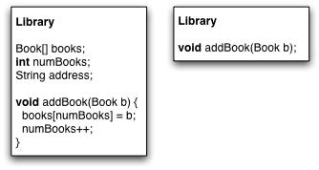

Slide 4
class
Templates for creating objects
Define the data (variables) and code (methods) that an object has
Create an instance of an object with new

Slide 5
General Guidelines
Using static is rare: normally want non-static methods and variables
Class names start with CapitalLetters
Method names start with lowerCase

Slide 7
Hiding Details
Java access control: hide unnecessary detailsfrom users
Example:
Do not change Book.borrowed variable
Call Book.borrowed(); Book.returned()

Slide 8
Access Control
public: Accessible by everyone
private: Accessible only by the same class
Best practice: mark everything private unless needed by something

Slide 9
public static void main(String[] args) {
}

Slide 10
Finding Names (scope)
General rule:
Start in the current block { }
Search the next enclosing block, then the next, etc …
What happens when we get to the last class block?

Slide 11
Packages
Each class belongs to a package.
Classes in the same package are automatically visible.
Classes in other packages need to be imported.
package package.name;

Slide 12
Importing
import package.name.ClassName;
import package.name.*;

Slide 13
Access Control Revisited
What if you don’t specify any access control?
Default access: accessible only from the same package

Slide 14
Special Packages
All classes “see” classes in the same package (no import needed)
All classes “see” classes in java.lang
Example: java.lang.String; java.lang.System

Slide 15
Java API
Java includes lots of classes already
Reuse these classes to avoid extra work
http://java.sun.com/javase/6/docs/api/

Slide 16
Putting objects in an array
Create the array bigger than you need
Track the next “available” slot
Book[] books = new Book[10];
int nextIndex = 0;
books[nextIndex] = b;
nextIndex += 1;

Slide 17
ArrayList
Provides a modifiable list
Internally implemented with arrays
Get/put items by index
Iterate over all items
Add items
Delete items

Slide 18
import java.util.ArrayList;
class ArrayListExample {
public static void main(String[] arguments) {
ArrayList<String> strings = new ArrayList<String>();
strings.add("Olivier");
strings.add("Evan");
strings.add("Phil");
System.out.println(strings.size());
System.out.println(strings.get(0));
System.out.println(strings.get(1));
strings.set(0, "Goodbye");
strings.remove(1);
for (String s : strings) {
System.out.println(s);
}
}
}

Slide 19
Sets
Like math: contains objects
Is an object in the set?
Add objects to the set
Remove objects from the set
TreeSet: Sorted (lowest to highest)
HashSet: Unordered (pseudo-random)

Slide 20
import java.util.TreeSet;
class SetExample {
public static void main(String[] arguments) {
TreeSet<String> strings = new TreeSet<String>();
strings.add("Olivier");
strings.add("Evan");
strings.add("Phil");
System.out.println(strings.size());
System.out.println(strings.first());
System.out.println(strings.last());
strings.remove("Evan");
for (String s : strings) {
System.out.println(s);
}
}
}

Slide 21
Maps
Stores a (key, value) pair of objects
Look up the key, get back the value
Very useful for simple “databases”
Example: Map from names to email addresses
TreeMap: Sorted (lowest to highest)
HashMap: Unordered (pseudo-random)

Slide 22
public static void main(String[] arguments) {
HashMap<String, String> strings = new HashMap<String, String>();
strings.put("Olivier", "koch@csail.mit.edu");
strings.put("Evan", "evanj@mit.edu");
strings.put("Phil", "pcm@csail.mit.edu");
System.out.println(strings.size());
strings.remove("Evan");
for (String s : strings.keySet()) {
System.out.println(s);
}
for (String s : strings.values()) {
System.out.println(s);
}
for (Map.Entry<String, String> pairs : strings.entrySet()) {
System.out.println(pairs);
}
}

Slide 23
Assignment: Drawing graphics
Draw some graphics using the Java API
Use an ArrayList to hold some animated objects

Slide 24
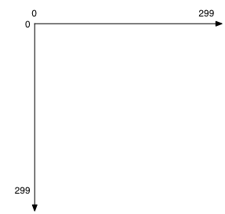
Brief Introduction to Graphics

