Slide 1
6.092
Lecture 7
Good programming skills
Collections
Exceptions
iapjava-staff@mit.edu

Slide 2
Assignment 6 Review
public abstract class BouncingDevice {
int x; // used to belong to BouncingBox
int y;
public BouncingDevice(int startX, int startY, Color startColor) { // constructor
}
public void animate () {
// move animation code here.
}
public void moveInDirection (int dx, int dy) {
}
}

Slide 3
Assignment 6 Review
public class BouncingBall extends BouncingDevice {
public BouncingBall (int x, int y, Color c) {
super (x, y, c);
}
public void draw (Graphics2D surface) {
// drawing code specific to a ball
}
}

Slide 4
Assignment 6 Review
Move as much as you can to BouncingDevice
Abstract method draw: excellent idea!
public abstract void draw ();
moveInDirection() at the wrong place again!
Please submit all your Java files
You cannot call super outside a constructor!

Slide 5
Assignment 6 Review
public class BouncingBall extends BouncingDevice {
public BouncingBall (int x, int y, Color c) {
super (x, y, c);
}
public void draw (Graphics2D surface) {
super.animate (); // NO!!
}
}

Slide 6
Assignment 6 Review
public class BouncingBall extends BouncingDevice {
public BouncingBall (int startX, int startY, Color startColor){
super (startX, startY, startColor);
}
public void draw (Graphics2D surface){
surface.setColor(color);
surface.fillOval(x - SIZE/2, y - SIZE/2, SIZE, SIZE);
surface.setColor(Color.BLACK);
surface.setStroke(new BasicStroke(3.0f));
surface.drawOval(x - SIZE/2, y - SIZE/2, SIZE, SIZE);
animate();
moveInDirection(xDirection, yDirection); // NO!
}
}

Slide 7
Refresher
Intro/Overview
– compilation, execution• Java Basics:
– Structure & Syntax, Variables, Types, & Operators
Control Flow
– Methods & Conditionals, Loops & Arrays
Object-oriented Programming (OOP):
– Objects & Classes
– Inheritance & Abstraction:
Classes, Abstract Classes & Interfaces
– Encapsulation
Brief Intro to Software Design

Slide 8
Outline
Good programming skills (II)
Collections
Exceptions

Slide 9
Good programming skills
Use meaningful variable and method names.
Indent your code.
What else?

Slide 10
Good programming skills
Use abstraction to avoid duplicating code.
//GOOD
public abstract class BouncingDevice {
public int x, y;
public abstract void draw ();
}
public abstract class BouncingBall {
public void draw () {
// ...
}
}

Slide 11
Good programming skills
Use abstraction to avoid duplicating code.
//BAD
public abstract class BouncingBall {
public int x, y;
public void draw () {
// does stuff
}
}
public abstract class BouncingBox {
public int x, y;
public void draw () {
// does the same stuff
}
}

Slide 12
Good programming skills
Comment your code, but not too much!
//GOOD
public abstract class BouncingDevice {
public int x, y; // device position
/* draw the device on the image */
public abstract void draw ();
}

Slide 13
Good programming skills
Comment your code, but not too much!
//BAD
public abstract class BouncingDevice {
public int x, y;
public abstract void draw ();
}
//BAD
public abstract class BouncingDevice {
/* We define a bouncing device class; it contains a position x,y and has a drawing method draw() that draws the object on the image; Do not forget the food for the cat on Wednesday; Oh by the way, this project is due next week, I need to send an email to the instructors telling them that I will be late... */
public int x, y;
public abstract void draw ();
}

Slide 14
Good programming skills
Have a main() method in each class for unit testing.
//GOOD
public abstract class BouncingDevice {
public int x, y; // device position
public static void main (String[] args) {
}
}

Slide 15
Good programming skills
Start small. Focus on the core capabilities first (skip the details). Do not over-anticipate.
// BAD
public class BouncingDevice {
public int switchingColor;
}

Slide 16
Good programming skills
Use meaningful variable and method names.
Indent your code.
Use abstraction.
Comment your code.
Use main() for unit testing.

Slide 17
Why should I write nice code?
Save yourself some time when you read the code 10 weeks/month/years later.
Help your friends understand your code in a team's project.
Help your instructor/TA give you a good grade.
Make debugging faster by not duplicating code.

Slide 18
Outline
Good programming skills (II)
Collections
Exceptions

Slide 19
Collections
The Problem with arrays:
Not resizable
Not useful for creating mappings between objects (requires at least three arrays)
Not useful for keeping track of duplicate objects
Not useful for constant-time operations

Slide 20
Collections
The Solution: Collections
Allow to create dynamic groupings (Set), orderings (List), and mappings (Map) between objects
Mirror mathematical constructs
Are automatically resized to fit new members
Live in java.util package

Slide 21
Collections
Example of a collection: ArrayList.
But there is much more!
ArrayList<BouncingBox> boxes = new ArrayList<BouncingBox>();
BouncingBox b = new BouncingBox (200, 50, Color.RED);
boxes.add(b);
BouncingBox d = boxes.get(0);

Slide 22
Collections
Collection
  generic container, most of the framework implements this
List
  stores multiple items in an explicit order (rep. elts allowed)
  ArrayList, LinkedList, etc.
Set
  stores unique items in no particular order
  HashSet, SortedSet, etc.
Map
  stores unordered key-value pairs (like a dictionary; keys are unique)
  HashMap, Hastable, TreeMap, etc.

Slide 23
Collections
Basic useful methods:
– add
– addAll
– remove
– clear
– isEmpty
– size (not length!)
– toArray
• See API for more + usage!

Slide 24
Collections Generics
Collections can hold objects of different runtime types, though we generally don’t and shouldn’t
Generics allow one to specify the type of the elements in a Collection
  Avoids messy casting
  Enables us to use more than just plain Object

Slide 25
Collections Generics
• Instantiation:
  Person[] p = new Person[10];
  ArrayList<Person> al = new ArrayList<Person>();
• Iteration:
  Set<Person> s = new HashSet<Person>();
Iterator<Person> i = s.iterator();
while (i.hasnext()) { p = i.next(); }
or
for (Person p : s) { p.doSomething(); }

Slide 26
Outline
Good programming skills (II)
Collections
Exceptions

Slide 27
Exceptions
A way to tell when something goes wrong in a method call
When an error happens, an Exception object is thrown
Useful for debugging & control flow

Slide 28
Exception Types
Common types of Exceptions
  RuntimeExceptions
    NullPointerException
    ClassCastException
    ArrayIndexOutOfBoundsException
    Etc.
  Other Exceptions

Slide 29
Throwing an Exception
To declare that you throw an exception:
public int pop(int size) throws EmptyStackException {
  if (size == 0) {
throw new EmptyStackException();
}
size--;
return size;
}

Slide 30
Catching an Exception
Using a method that throws an Exception
– try it
– If it doesn’t work, it will throw its Exception
– Then you must catch the exception
– You can catch multiple Exception types

Slide 31
Catching an Exception
try {
pop(0);
} catch (EmptyStackException e) {
System.err.println("Blah”);
throw new SampleException(e);
} catch (IOException e) {
System.err.println("Blah again!”);
}

Slide 32
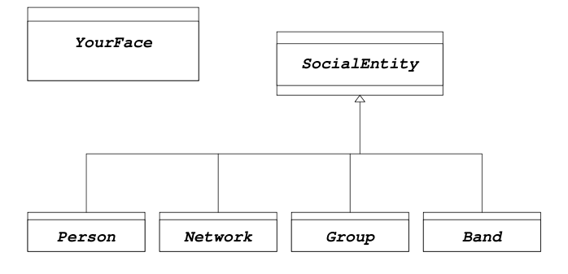
Assignment 7: YourFace
Build a (simple) social network in Java!

