Slide 1
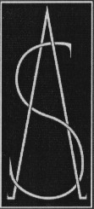
Safe Yellow IC
SINO-AMERICAN PIGMENTS
1620 Norvell Street
El Cerrito, CA 94530
Phone 510.848.8890 Fax: 510-848-8889
www.safepigment.com

Slide 2
What Is Safe Yellow IC
Modified Yellow Lithopone
BaSO4-ZnS
The Internal Core in Safe Yellow Pigments
Extender for Organic Pigments

Slide 3
Properties of Safe Yellow IC
Low Oil Absorption
Extends Red, Yellow and Orange Organic Pigments
Low Cost
Good Hiding Power
Disperses Easily
Non-Toxic, No Heavy Metals
High UV Durability
High Temperature Resistance (to 1080ºC)
Non-Abrasive, Moh’s Hardness of 3.5

Slide 4
Properties: Soft Particles
Hardness Comparison (Moh’s)
Silica 7.0
Titanium Dioxide 6.5
Safe Yellow IC 3.5

Slide 5
Safe Yellow IC is safe for:
Gravure Printing
Fibers
Polyester
Nylon
Polypropylene
Plastic Film - Polyethylene

Slide 6
Properties: Low Oil Absorption
Reduced Resin Demand Yields:
Lower Costs (resin can be replaced with fillers)
Better Flow and Improved Viscosity
Better Gloss (lower oil absorption yields more free resin)
Excellent For:
* High Solids Paints
* Powder Coatings

Slide 7
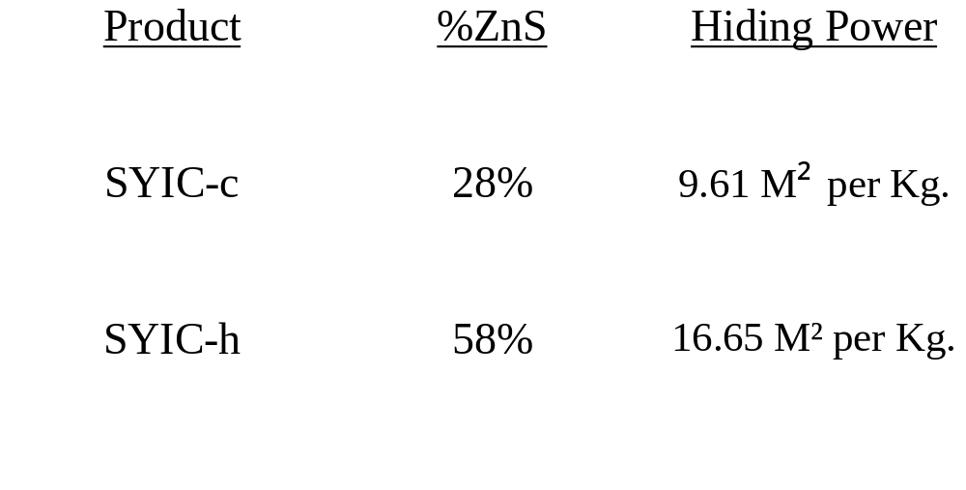
Properties: Hiding Power - ZnS

Slide 8
Applications
Extender for Organic Pigments
Water and Solvent Coatings
Powder Coatings
Thermoplastic Road Markings
Plastic Fiber
Plastic Film
Gravure Printing Inks
Water Flexo printing Inks
Textile Printing Inks

Slide 9
Result
Lower Pigment Cost
Virtually the Same Color
Improved Rheology:
  More Free Resin
  Improved Flow

Slide 10
Contact Information
Sino-American Pigment System, Inc.
1620 Norvell Street, El Cerrito, CA 94530 USA
Tel: 510-848-8890
Fax: 510-848-8889
Email: sales@safepigment.com
Website: www.safepigment.com

