Slide 1
SubZero Lineage APIs for Scientific Databases
eugene wu, samuel madden, michael stonebraker

Slide 2

SubZero Lineage APIs for Scientific Databases
eugene wu, samuel madden, michael stonebraker
http://bbsimg.ngfiles.com/1/21544000/ngbbs4c52149d38558.gif

Slide 3
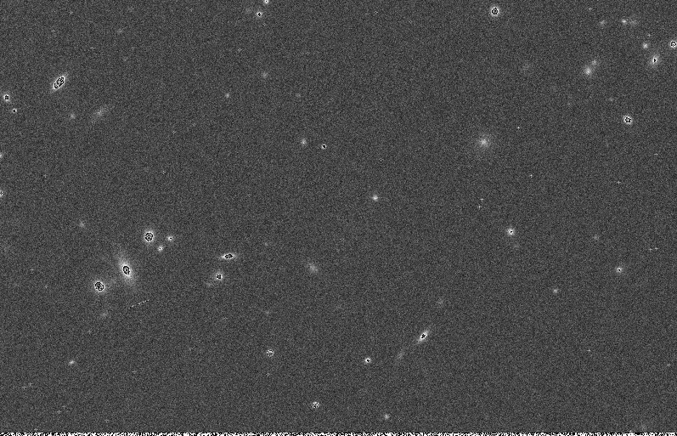
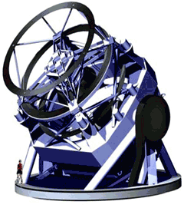
LSST Telescope

Slide 4
LSST Telescope

Slide 5

LSST Pipeline
Raw Image
Detect Stars
Stars
Notes:
Of course not so easy

Slide 6
LSST Pipeline
Raw Image
Detect Stars
Stars

Slide 7
LSST Pipeline
Convolve
Mean background
rm –rf background
Apply Mask
Interpolate
Remove Cosmic Rays
And more ....
Raw Image
Detect Stars
Stars

Slide 8
LSST Pipeline
C
D
A
B
Database Operator
User Defined Operator
Notes:
Don’’t worry about it, except that for

Slide 9
Considerations
User defined operators
Lots of data, limited storage
What kind of lineage to store?
How to store the lineage?

Slide 10
LSST Data Scale
>360,000
Images/night

Slide 11
LSST Data Scale
10M+
Images/month

Slide 12
LSST Data Scale
10M+
Images/month
Notes:
Several months down the line, they find a set of strange stars, and want to know information about the data sources and intermediate results

Slide 13
LSST Data Scale
?
10M+
Images/month

Slide 14
LSST Data Scale
10M+
Images/month

Slide 15
LSST Data Scale
?
10M+
Images/month

Slide 16
Need to support lineage queries

Slide 17
What kind of lineage queries?
Coarse
Fine
grained

Slide 18
What kind of lineage queries?
Coarse
Fine
grained
Backward
Which image
is this star from?

Slide 19
What kind of lineage queries?
Coarse
Fine
grained
Backward
Forward
Which image
is this star from?
What stars are
from this image?

Slide 20
What information to store?
Coarse
Fine
grained
input
output
1 pointer
Notes:
We are not interested in this explicitly

Slide 21
What kind of lineage queries?
Coarse
Fine
grained

Slide 22
What kind of lineage queries?
Coarse
Fine
grained
Backward
Which pixels
is this star from?

Slide 23
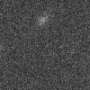
What kind of lineage queries?
Coarse
Fine
grained
Backward
Forward
Which pixels
is this star from?
What pixels in
step X affected?

Slide 24
What information to store?
Coarse
Fine
grained
input
output

Slide 25
What information to store?
Coarse
Fine
grained
input
output

Slide 26
What information to store?
Coarse
Fine
grained
input
output
O(N²) pointers
N = # array cells!
Notes:
This is the problem to solve!
Clearly, what we store depends on the types of queries we are executing

Slide 27
Considerations
User defined operators
Lots of data, limited storage
What kind of lineage to generate?
How to store the lineage?
Notes:
Tons of data, but LSST only wants to devote < 20% OR 2???? to provenance

Slide 28
Considerations
User defined operators
Lots of data, limited storage
What kind of lineage to generate?
How to store the lineage?
Query Workload
Notes:
Mention what we are not considering? – query languages, theory, definitions of provenance, etc

Slide 29
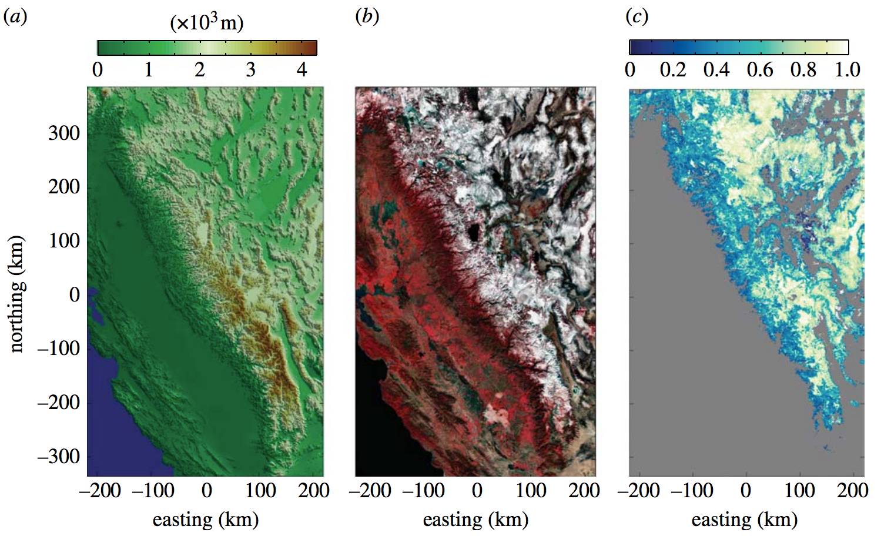
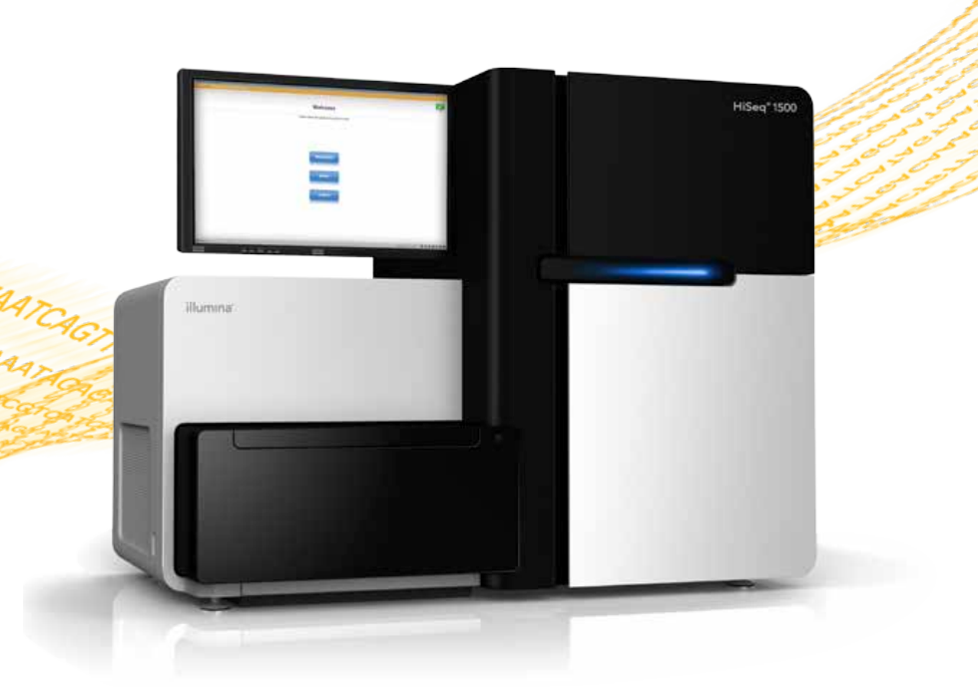
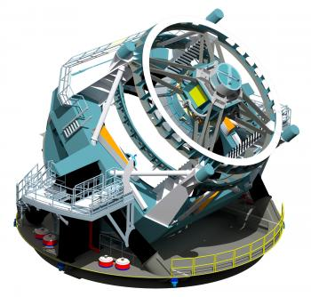
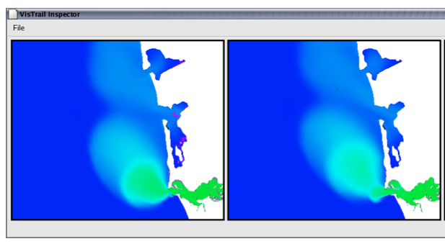
Environmental Science
Genomics
Astronomy
Surface Salinity Research
VisTrails: Enabling Interactive Multiple-View Visualizations .
Computational provenance in hydrologic science: a snow mapping example
https://news.slac.stanford.edu/features/nsf-large-synoptic-survey-telescope-approved-advance-final-design-stage.
http://www.illumina.com/systems/hiseq_2500_1500.ilmn
Notes:
Every other scientist has this these problems

Slide 30
Roadmap
Introduction
API
Storage System
Optimizer
Some results
Future thoughs
Small # ways to encode lineage
The ways inform a lineage API
System decides what lineage to store

Slide 31

SubZero
Goal
Insights
Efficiently store & query lineage
Small # ways to encode lineage
Lineage API for UDFs
Query-driven storage optimizer
http://images2.fanpop.com/image/photos/10600000/sub-zero-mortal-kombat-10603273-66-137.gif
Notes:
The goal is to introduce the main concepts from the paper, so presenting highly simplified version of the ideas. See papers for the gory details

Slide 32
Architecture
Array
Array
Workflow Executor
A
D
C
Runtime
Data Store

Slide 33
Architecture
Array
Array
Workflow Executor
A
A
D
C
Implements
lineage APIs
Runtime
Data Store

Slide 34
Architecture
Array
Array
Workflow Executor
A
A
D
C
Implements
lineage APIs
Runtime
Encoder
Decoder
Data Store

Slide 35
Architecture
Array
Array
Constraints
Workflow Executor
Optimizer
A
A
D
C
Implements
lineage APIs
Runtime
Encoder
Decoder
Data Store

Slide 36
Architecture
Array
Array
Constraints
Queries
Cells
Workflow Executor
Optimizer
Lineage
Query Executor
A
A
D
C
Implements
lineage APIs
Runtime
Encoder
Decoder
Re-executor
Data Store

Slide 37
Representing Lineage Encoding Region Lineage Black-boxes (UDFs) What lineage to store? Does this work? Misc…

Slide 38
Describing Lineage
Context
Assumptions
Fine-grained backward lineage
Coarse lineage always stored
Intermediate results persisted*
Scientific databases (arrays)

Slide 39
Naïve Lineage
1 | 2
3 | 4
1 | 2
3 | 4
Operator
input
output
Individual cell to cell
2 ← 1
2 ← 2
Notes:
Note the arrows.
Define relationship in terms of individual items (cells)

Slide 40
Naïve Lineage
O(N²)
1 | 2
3 | 4
1 | 2
3 | 4
Operator
input
output
Individual cell to cell
2 ← 1
2 ← 2
Notes:
Note the arrows.
Define relationship in terms of individual items (cells)

Slide 41
Region Lineage
1 | 2
3 | 4
1 | 2
3 | 4
Operator
input
output
Set of cells to Set of cells
{2} ← {1,2}
Notes:
Relationships between sets of cells (items)
In contrast to naïve, it’s not N squared

Slide 42
Describing Region Lineage
Full
Map
Payload
Composite
input
output
Store input and output cells
{ } ← { }

Slide 43
Describing Region Lineage
Full
Map
Payload
Composite
 |  | X
Map_{b}(•)
input
output
Map_{b}( ) →
X
Fully computed.
Nothing to store!

Slide 44
Describing Region Lineage
Full
Map
Payload
Composite
Map(•, 1)
input
output
Map(•, 0)
input
output
Notes:
Some local knowledge is all that is necessary to know what the input lineage is.

Slide 45
Describing Region Lineage
Full
Map
Payload
Composite
 |  | X
Map_{p}(•, payload)
input
output
Map_{p}( , payload) →
X
{ , payload }
X
Notes:
How to specify that map_p needs to be defined and [coords]+payload need to be stored?
Note that payload is general enough to include existing models of provenance storage.
e.g., trio stores predicates, which can be encapsulated in the payload

Slide 46
Describing Region Lineage
1 to 1
Full
Map
Payload
Composite
 |  | X
Payload
input
output
Payload + Map
{ , payload }
X
Notes:
How to specify that map_p needs to be defined and [coords]+payload need to be stored?

Slide 47
Representing Lineage Encoding Region Lineage Black-boxes (UDFs) What lineage to store? Does this work? Misc…

Slide 48
Encoding Region Lineage
Full
Payload

Slide 49
Encoding Region Lineage
Full
Payload
Many
One

Slide 50
Encoding Region Lineage
Full
Payload
Many
One
1 | 2
3 | 4
{ } ← { }
rtree

Slide 51
Encoding Region Lineage
Full
Payload
Many
One
1 | 2
3 | 4
{ } ← { }
#HASH
1
#HASH
2
#HASH
3
#HASH
4
#HASH

Slide 52
Encoding Region Lineage
Full
Payload
Many
One
1 | 2
3 | 4
{ , payload }
rtree
payload

Slide 53
Encoding Region Lineage
Full
Payload
Many
One
1 | 2
3 | 4
{ , payload }
payload
1
payload
2
payload
3
payload
4

Slide 54
Storage Strategy (per operator)
(Type, Encoding, Direction)
Type
Encoding
Direction
Full, Map, Payload, Composite, None
Many, One
Forward / Backward
Notes:
To recap. We’ve discussed the type, the encoding, and we assumed the direction is backward, but forward optimized storage is possible as well.

Slide 55
Storage Strategy (per operator)
(Type, Encoding, Direction)
Type
Encoding
Direction
Full, Map, Payload, Composite, None
Many, One
Forward / Backward
Notes:
To recap. We’ve discussed the type, the encoding, and we assumed the direction is backward, but forward optimized storage is possible as well.

Slide 56
Storage Strategy (per operator)
(Type, Encoding, Direction)
Type
Encoding
Direction
Full, Map, Payload, Composite, None
Many, One
Forward / Backward
Notes:
To recap. We’ve discussed the type, the encoding, and we assumed the direction is backward, but forward optimized storage is possible as well.

Slide 57
Storage Strategy (per operator)
(Type, Encoding, Direction)
Type
Encoding
Direction
Full, Map, Payload, Composite, None
Many, One
Forward / Backward
Notes:
To recap. We’ve discussed the type, the encoding, and we assumed the direction is backward, but forward optimized storage is possible as well.

Slide 58
Representing Lineage Encoding Region Lineage Black-boxes (UDFs) What lineage to store? Does this work? Misc…

Slide 59
UDFs
Input Array
UDF
[ ]
1
2
Override
mapping methods
Call lineage
API within UDF

Slide 60
UDFs
Input Array
UDF
[ ]
2
supported_modes()
map_{p}(cell, payload)
map_{b}(cell)
Call lineage
API within UDF

Slide 61
UDFs
Input Array
UDF
[ ]
2
supported_modes()
return [“payload”]
map_{p}(cell, payload)
map_{b}(cell)
Call lineage
API within UDF

Slide 62
UDFs
Input Array
UDF
[ ]
2
supported_modes()
return [“payload”]
map_{p}(cell, payload)
n = payload.n
neighbors(cell, n)
map_{b}(cell)
Call lineage
API within UDF

Slide 63
UDFs
Input Array
UDF
[ ]
2
supported_modes()
return [“map”]
map_{p}(cell, payload)
map_{b}(cell)
Call lineage
API within UDF

Slide 64
UDFs
Input Array
UDF
[ ]
2
supported_modes()
return [“map”]
map_{p}(cell, payload)
map_{b}(cell)
neighbors(cell, 3)
Call lineage
API within UDF

Slide 65
UDFs
Input Array
UDF
[ ]
supported_modes()
map_{p}(cell, payload)
map_{b}(cell)
cur_mode()
lwrite(outcells, incells)
lwrite(outcells, payload)

Slide 66
UDFs
Input Array
UDF
[ ]
supported_modes()
map_{p}(cell, payload)
map_{b}(cell)
if cur_mode() == “full”:
for star in stars:
cells = neighbors(star)
lwrite(star, cells)

Slide 67
UDFs
Input Array
UDF
[ ]
supported_modes()
map_{p}(cell, payload)
n = payload.n
neighbors(cell, n)
map_{b}(cell)
if cur_mode() == “payload”:
for star in stars:
lwrite(star, 2)

Slide 68
UDFs
Input Array
UDF
[ ]
supported_modes()
map_{p}(cell, payload)
map_{b}(cell)
if cur_mode() == “nothing”:
// don’t call lwrite()

Slide 69
API
cur_mode()
Default
Reproducible
Mechanism to control which & if lineage is generated
All output cells → all input cells
Can rerun operator to recreate lineage
Notes:
Assuming deterministic! Could instrument things like random(), curtime not a problem.

Slide 70
Representing Lineage Encoding Region Lineage Black-boxes (UDFs) What lineage to store? Does this work? Misc…

Slide 72
SubZero
Spectrum of hybrid strategies
Taverna
PASS
GenePattern
Trio
Coarse-grained
Fine-grained
Query log
Rerun at query time. Slow!
Store all region pairs
Takes too much space!

Slide 73
SubZero
Spectrum of hybrid strategies
Nothing
Composite
Map
Payload
Full
Coarse-grained
Fine-grained
Query log
Rerun at query time. Slow!
Store all region pairs
Takes too much space!

Slide 74
ILP Formulation
Minimize
s.t.
Ignoring
E[queries] + disk/runtime overhead
Disk overhead within bounds
Runtime overhead within bounds
Every operator has a strategy
Multi-operator strategy interactions

Slide 75
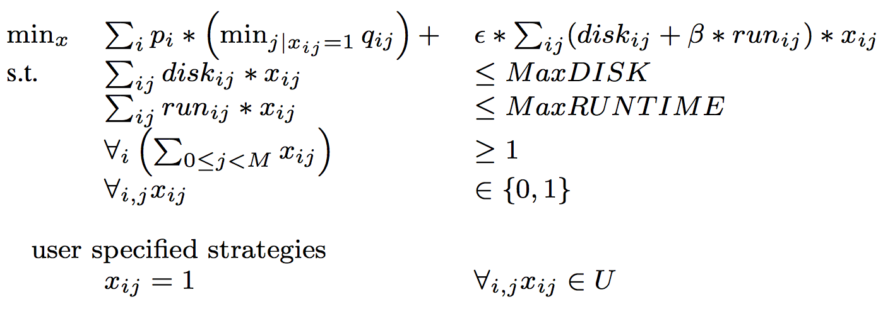
ILP Formulation

Slide 76
Representing Lineage Encoding Region Lineage Black-boxes (UDFs) What lineage to store? Does this work? Misc…

Slide 77
LSST Pipeline
C
D
A
B
Database Operator
(Full, Map)
User Defined Operator
(Full, Payload, Composite)
Notes:
Don’’t worry about it, except that for

Slide 78
Disk Overhead (MB)

Slide 79
Runtime Overhead (sec)

Slide 80
Query Costs (sec, log)
BQ back query
FQ forward query

Slide 81
Take Aways
Peel away true black-box operators
Region Pairs representation
Lineage API
System optimizes lineage to generate
Trade lineage storage overhead for query performance
A lot of developer work :(

Slide 82
Related work
Other lineage/provenance systems
Real lineage query languages
Other types of lineage requirements
Refresh (Ikeda et al.)
Undo (Chandra et al.)
Probabilistic (…)
Other angles of attack
Notes:
Obviously this work doesn’t live within a vacuum.

Slide 83
Related work
Previous support for black-box ops
Lipstick on PIG (Amsterdamer et al.)
RAMP (Ikeda et al.)
Nested data collections (Taverna/Keplar)
Notes:
Obviously this work doesn’t live within a vacuum.

Slide 84
Representing Lineage Encoding Region Lineage Black-boxes (UDFs) What lineage to store? Does this work? Misc…

Slide 85
Provenance is everywhere
And outside of databases!
Program Tracing/Analysis
Browser history
EndoScope
Notes:
And the scope exists everywhere!

Slide 86
Practical problem
Adding lineage to existing systems is really hard!
Adding lineage to new system can end up over engineering.
Notes:
For example, we started with workflows and intended queries by several different applications, then worked backwards to construct our prototype and API.
So clearly, it supports a larger range of queries than any individual application may need.
But we ask developers to implement all (as many as possible) different ways _just in case_g

Slide 87
The key is the locations in the program/workflow to instrument, and how to minimize them
Wikipedia
Google Docs
PASS
Browser history

Slide 88
Query driven provenance system
Science
Taint tracking
I want to track ownership during collaboration (e.g., etherpad)
What author first wrote this piece?
What authors contributed to this piece?
I want to know source of data
I care about this scope of provenance
I need to know what types of websites I go to
I only care about 2 levels deep of prov of sites I go to

