Slide 1
Old Slides

Slide 2
Roadmap
Introduction
API
Storage System
Optimizer
Some results
Future thoughs

Slide 4
Why is this hard?
Because of black boxes. Outside of magical dynamic program tracing (e.g., taint tracking), need black box to expose information

Slide 5
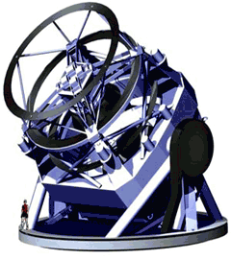

LSST Telescope
Raw Image
Detect Stars
Stars

Slide 6
LSST Telescope
Stars!

Slide 7
Noo! Cosmic Rays!

Slide 8
Noo! Cosmic Rays!

Slide 9
Noo! Cosmic Rays!
NO

Slide 10
Cleaning Cosmic Rays

Slide 11
Cleaning Cosmic Rays

Slide 12
Cleaning Cosmic Rays

Slide 13
Cleaning Cosmic Rays
YES!
9:00pm
9:15pm

Slide 14
Cosmic Ray Pipeline
C
D
A
B
Cleaning
Fix Cosmic Rays

Slide 15
Cosmic Ray Pipeline

Slide 16
Some queries: coarse grained
What files generated these stars?
What stars were found from these bad input files

Slide 17
Some queries: fine grained

Slide 18
Forward Query
Input T1
Operator
Output T1
Input T2
Output T2
Input T3
Output T3

Slide 19
SciDB Data Model
Arrays
Processing

Slide 20
API

Slide 21
Address dev complexity concerns

