Slide 1
Old Slides

Slide 2

LSST Data Scale
Strange stars
Notes:
The astronomers identify a collection of strange stars, and want to know information about the data sources and intermediate results, because verifying claims is important

Slide 3
LSST Data Scale
?
Which
raw images?
Notes:
Well they need to have encoded some relationship between those stars and the inputs.

Slide 4
LSST Data Scale
Defective
images
Notes:
Similarly, they may find that a part of their lens was not working properly, and want to discount a set of pictures and corresponding stars extracted from those images.

Slide 5
LSST Data Scale
?
Which stars?

Slide 6
LSST Data Scale
?
Lineage

Slide 7
What lineage to store?
Notes:
But of coures, the type of lineag you store depends on

Slide 8
What information to store?
Taverna
Lipstick
Auditing
etc
Coarse
Fine
grained
Notes:
At this point It’s worth pointing out that most lineage systems today focus primarily on Coarse grained lineage. This makes sense because, there’s only one pointer to store between files, tables or arrays.

Slide 9
What information to store?
Taverna
Lipstick
Auditing
etc
Coarse
Fine
grained
Trio
Notes:
In contrast, there are only a few systems like Trio that have worked on fine-grained lineage

Slide 10
1051 MB
15 MB
Coarse-grained
Fine-grained

Slide 11
1051 MB
15 MB
Coarse-grained
Fine-grained
Slower lineage queries
Must re-run operators
Faster lineage queries
Takes too much space!

Slide 12
Representing Lineage Encoding Region Lineage Black-boxes (UDFs) What lineage to store? Does this work? Misc…

Slide 13
Encoding Region Lineage
Full
Payload

Slide 14
Encoding Region Lineage
Full
Payload
Many
One

Slide 15
Encoding Region Lineage
Full
Payload
Many
One
1 | 2
3 | 4
{ } ← { }
rtree

Slide 16
Encoding Region Lineage
Full
Payload
Many
One
1 | 2
3 | 4
{ } ← { }
#HASH
1
#HASH
2
#HASH
3
#HASH
4
#HASH

Slide 17
Encoding Region Lineage
Full
Payload
Many
One
1 | 2
3 | 4
{ , payload }
rtree
payload

Slide 18
Encoding Region Lineage
Full
Payload
Many
One
1 | 2
3 | 4
{ , payload }
payload
1
payload
2
payload
3
payload
4

Slide 19
Disk Overhead (MB)
SIMPLIFY to BLACKBOX, FULL, SUBZERO

Slide 20
Runtime Overhead (sec)

Slide 21
Lineage Query Costs (sec, log)
Simplify to 1 back and 1 forward query
BQ = back query FQ = forward query

Slide 22
Describing Lineage
Context
Assumptions
Fine-grained backward lineage
Coarse lineage always stored
Intermediate results persisted*
Scientific databases (arrays)

Slide 23
UDFs
Input Array
Operator
[ ]
Just say developers implement mapping functions and write lineage to disk.
Just talk about cur_modes separately.
Single example.
1
2
Override
mapping methods
Call lineage
API within UDF

Slide 24
UDFs
Input Array
UDF
[ ]
2
map_{p}(cell, payload)
map_{b}(cell)
Call lineage
API within UDF

Slide 25
UDFs
Input Array
UDF
[ ]
2
supported_modes()
return [“payload”]
map_{p}(cell, payload)
map_{b}(cell)
Call lineage
API within UDF

Slide 26
UDFs
Input Array
UDF
[ ]
2
supported_modes()
return [“payload”]
map_{p}(cell, payload)
n = payload.n
neighbors(cell, n)
map_{b}(cell)
Call lineage
API within UDF

Slide 27
UDFs
Input Array
UDF
[ ]
2
supported_modes()
return [“map”]
map_{p}(cell, payload)
map_{b}(cell)
Call lineage
API within UDF

Slide 28
UDFs
Input Array
UDF
[ ]
2
supported_modes()
return [“map”]
map_{p}(cell, payload)
map_{b}(cell)
neighbors(cell, 3)
Call lineage
API within UDF

Slide 29
UDFs
Input Array
UDF
[ ]
supported_modes()
map_{p}(cell, payload)
map_{b}(cell)
cur_mode()
lwrite(outcells, incells)
lwrite(outcells, payload)

Slide 30
UDFs
Input Array
UDF
[ ]
supported_modes()
map_{p}(cell, payload)
map_{b}(cell)
if cur_mode() == “full”:
for star in stars:
cells = neighbors(star)
lwrite(star, cells)

Slide 31
UDFs
Input Array
UDF
[ ]
supported_modes()
map_{p}(cell, payload)
n = payload.n
neighbors(cell, n)
map_{b}(cell)
if cur_mode() == “payload”:
for star in stars:
lwrite(star, 2)

Slide 32
UDFs
Input Array
UDF
[ ]
supported_modes()
map_{p}(cell, payload)
map_{b}(cell)
if cur_mode() == “nothing”:
// don’t call lwrite()

Slide 33
SubZero
Spectrum of hybrid strategies
Taverna
PASS
GenePattern
Trio
Coarse-grained
Fine-grained
Query log
Rerun at query time. Slow!
Store all region pairs
Takes too much space!

Slide 34
Architecture
Array
Array
Workflow Executor
A
D
C
Runtime
Data Store

Slide 35
Architecture
Array
Array
Workflow Executor
A
A
D
C
Implements
lineage APIs
Runtime
Data Store

Slide 36
Architecture
Array
Array
Emphasize A via highlight instead.
Workflow Executor
A
Revisit this diagram through the sections
A
D
C
Implements
lineage APIs
Runtime
Encoder
Decoder
Data Store

Slide 37
Architecture
Array
Array
Constraints
Workflow Executor
Optimizer
A
A
D
C
Implements
lineage APIs
Runtime
Encoder
Decoder
Data Store

Slide 38
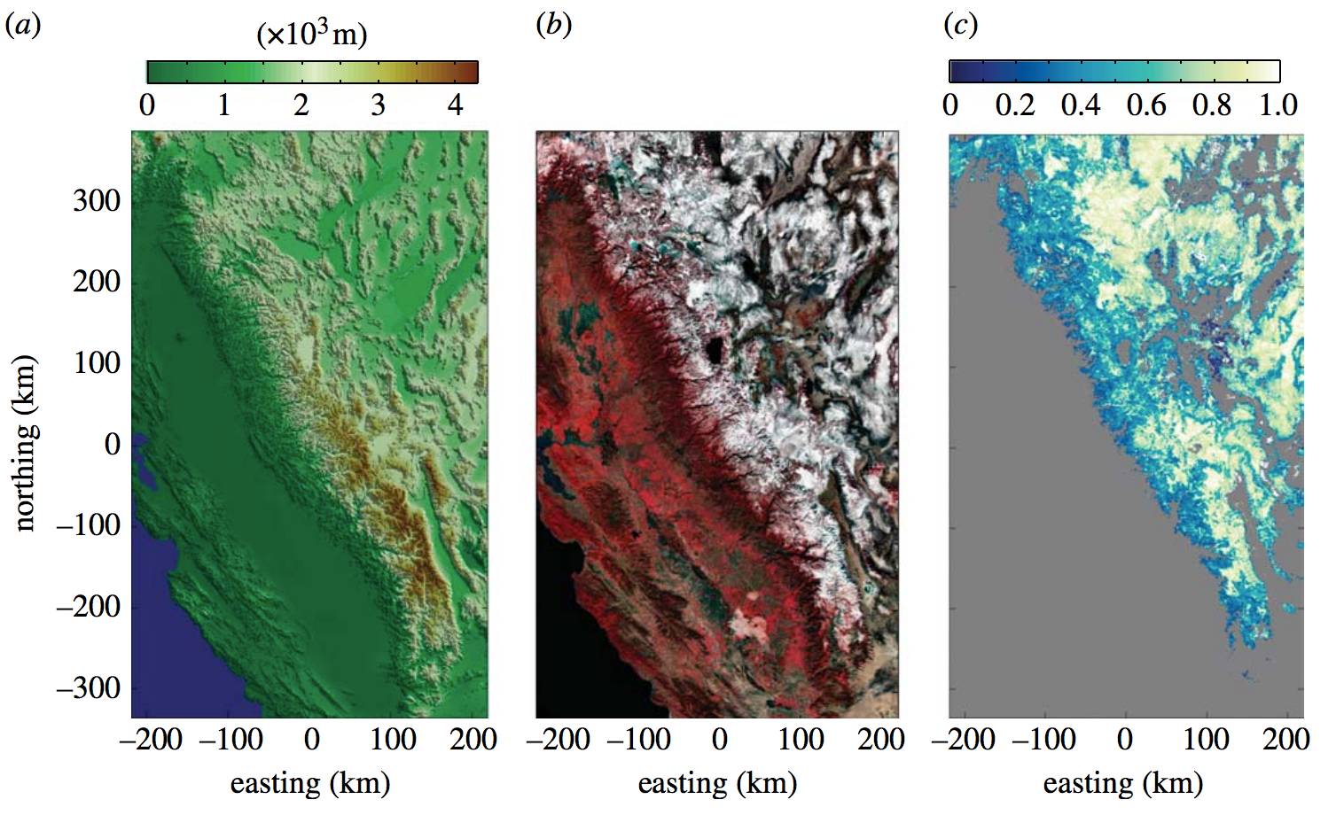
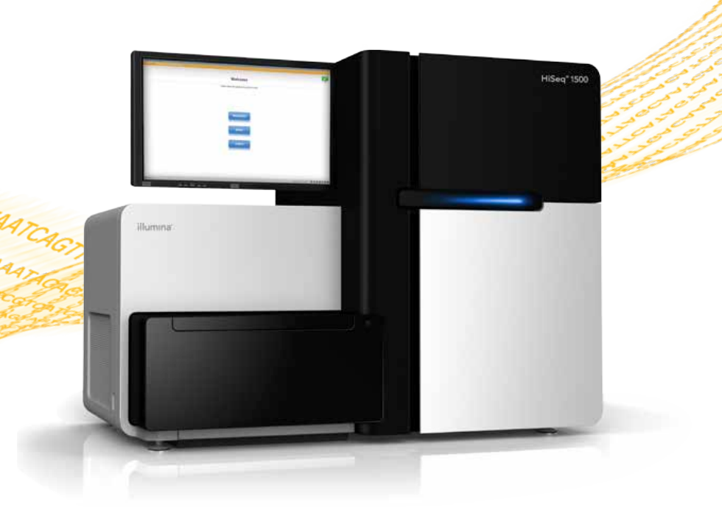
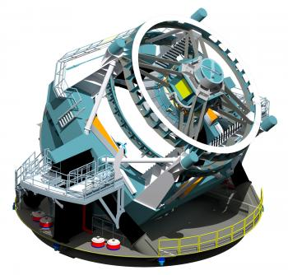
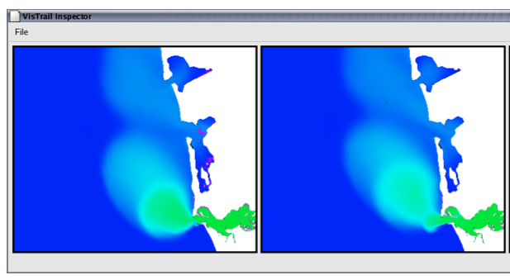
Environmental Science
Genomics
Astronomy
Surface Salinity Research
VisTrails: Enabling Interactive Multiple-View Visualizations .
Computational provenance in hydrologic science: a snow mapping example
https://news.slac.stanford.edu/features/nsf-large-synoptic-survey-telescope-approved-advance-final-design-stage.
http://www.illumina.com/systems/hiseq_2500_1500.ilmn
Notes:
Every other scientist has this these problems.
Santa barbara snow sciencies uses satellite images to infer snow conditions and ratio of dirt/forestry/snow

Slide 39
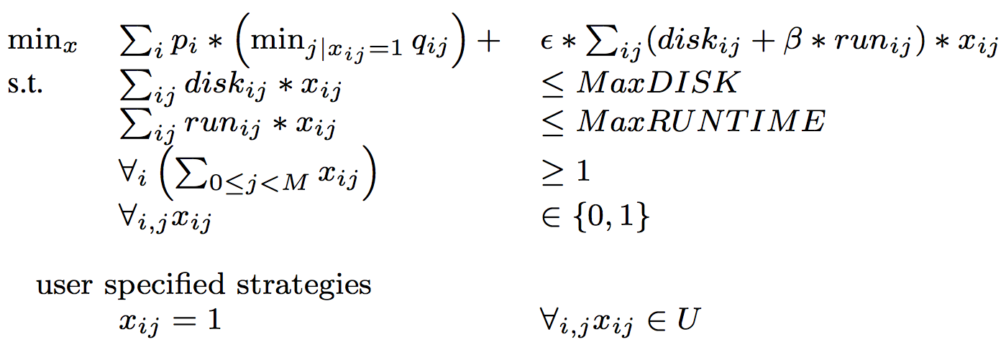
ILP Formulation

Slide 40
Disk (MB)
Storage Strategies

Slide 41
Coarse-grained
Fine-grained
Slower lineage queries
Must re-run operators
Faster lineage queries
Takes too much space!

Slide 42
Map/Coarse
Composite
Payload
Full
Coarse-grained
Fine-grained
Slower lineage queries
Must re-run operators
Faster lineage queries
Takes too much space!

Slide 43
SubZero
Spectrum of hybrid strategies
Map/Coarse
Composite
Payload
Full
Coarse-grained
Fine-grained
Slower lineage queries
Must re-run operators
Faster lineage queries
Takes too much space!

Slide 44
Roadmap
Introduction
API
Storage System
Optimizer
Some results
Future thoughs

Slide 46
Why is this hard?
Because of black boxes. Outside of magical dynamic program tracing (e.g., taint tracking), need black box to expose information

Slide 47
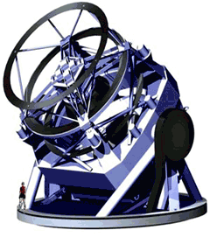
LSST Telescope
Raw Image
Detect Stars
Stars

Slide 48
LSST Telescope
Stars!

Slide 49
Noo! Cosmic Rays!

Slide 50
Noo! Cosmic Rays!

Slide 51
Noo! Cosmic Rays!
NO

Slide 52
Cleaning Cosmic Rays

Slide 53
Cleaning Cosmic Rays

Slide 54
Cleaning Cosmic Rays

Slide 55
Cleaning Cosmic Rays
YES!
9:00pm
9:15pm

Slide 56
Cosmic Ray Pipeline
C
D
A
B
Cleaning
Fix Cosmic Rays

Slide 57
Cosmic Ray Pipeline

Slide 58
Some queries: coarse grained
What files generated these stars?
What stars were found from these bad input files

Slide 59
Some queries: fine grained

Slide 60
Forward Query
Input T1
Operator
Output T1
Input T2
Output T2
Input T3
Output T3

Slide 61
SciDB Data Model
Arrays
Processing

Slide 62
API

Slide 63
Address dev complexity concerns

