Slide 1
HOW THE WEB
WORKS

Slide 2
How does the web work?
The backbone of the web is the network of webservers across the world. These are really just computers that have a particular type of software running on them - software that knows how to speak the HTTP protocol and knows which information stored on the computer should be made accessible through the web.
It's possible to turn almost any computer into a webserver by downloading and installing server software (the most popular is Apache, see http://www.apache.org/), though it's not recommended unless you know what you're doing!
Web servers and web browsers communicate via HTTP
HTTP ensures that all parts of the web page are delivered
Web browser decides how these items are displayed

Slide 3
How HTTP works: retrieving a web page
The HyperText Transfer Protocol (HTTP) is actually quite simple. The web browser (or client) makes a request of a webpage to the server, and the webserver passes the page back to the browser (see Figure 2.1, “How HTTP works: retrieving a web page”. More cleverly, it also passes back any images, sounds or other media items back to the browser too.
The web browser is also particularly clever in the way it displays what it retrieves. Web pages are written in HTML, and the browser knows how to display these correctly, whether you have a huge flat screen or a tiny screen on a handheld device or phone. The HTML language gives the browser hints on how to display things, and the browser decides the final layout itself.

Slide 4
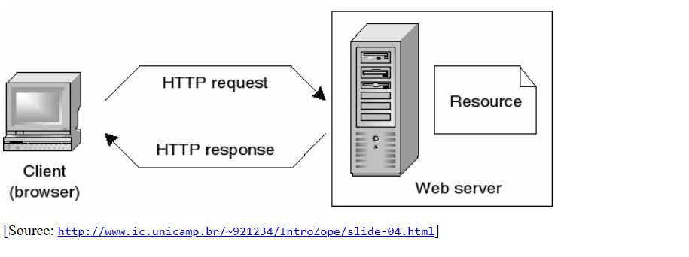
How HTTP works: retrieving a web page

Slide 5
How websites work?
Let's start with the most obvious way of using the internet: You visit a website like
gomycode.com
The moment you enter this address in your browser and you hit ENTER, a lot of different things happen:
The URL gets resolved
A Request is sent to the server of the website
The response of the server is parsed
The page is rendered and displayed

Slide 6
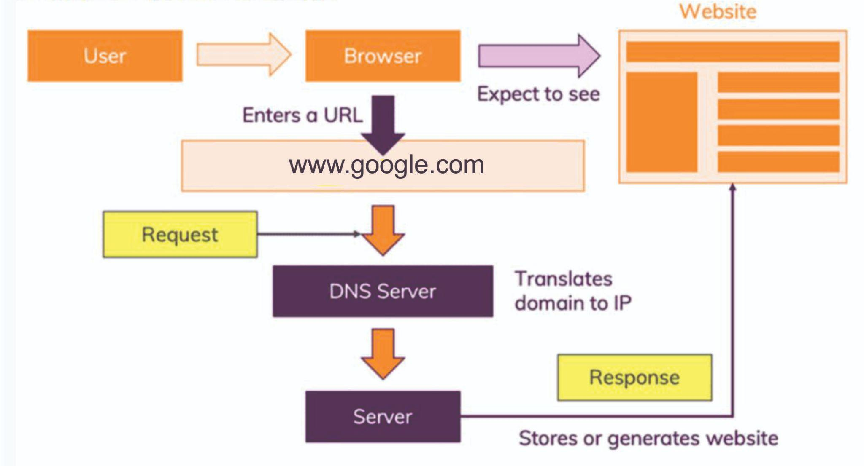
How websites work?

Slide 7
WHAT DO YOU NEED
TO BE A
WEB DEVELOPER

Slide 8
What does a web developer do?
Also known as web programmers or web coders, web developers essentially make a website work by building the functionality, interactivity and visible structure of the site, normally based on the vision of designers and other key roles.
Web developers are also responsible for ensuring a site functions correctly on all browsers - both desktop and mobile - through testing. Once a site is live, a developer carries out updates and other maintenance tasks as necessary.

Slide 9
Qualifications needed to be a web developer?
While there are no formal or specific qualifications required to become a web developer, a numerate degree in a subject such as maths or science will be useful.
You should also ideally have an aptitude for - or experience of - elements such as:
User experience (UX)
User interface (UI)
Visual design
Coding languages including HTML and CSS
Frontend web programing languages and skills such as JavaScript, Ajax and web animation techniques

Slide 10
Backend web programing languages such as C# or Java, PHP and Ruby
Design software like Photoshop and Illustrator and Sketch
An understanding of SEO
Web servers and how they function
A portfolio of your work is an ideal way to demonstrate your skills as a developer. Aim to include:
Examples of websites you've worked on - this allows you to share the work you have completed and helps to show prospective clients what you can do
Testimonials from clients you have previously worked with - this will reassure prospective clients that you have completed work for other clients and they were happy with what you delivered. Always ask any clients you work for to provide a testimonial once you complete a project.

Slide 11
What skills do you need to become a web developer?
Key skills to be successful in web development include:
Computer literacy
Strong numeracy skills
Strong creative ability
Attention to detail
Strong communication skills
Excellent problem-solving skills
The ability to explain technical matters clearly
A keen interest in technology
Ongoing self-learning is key to developing in a web development role, in order to stay up to date with ever more frequent technological advancements and updates.

Slide 12
WHY I CHOOSE TO
LEARN WEB
DEVELOPMENT

Slide 13
Why i choose to be a web developer
I have always been interested in computers and technology from a young age. I learned graphics years ago and Worked on several design projects for my personal use and also for businesses.
I would say I choose to learn web development because I love it! I've been taking free youtube classes on HTML/CSS and it opened my eyes to the enormous possibilities that being a full-stack web developer presents for my career.
I believe it's never too late to learn and decided I can learn this course and make a positive impact on the tech environment in Nigeria.
As a web designer, I will be involved in designing new websites and keeping current websites up to date, including the layout, and function according to the client's requirements.
I also particularly love the fact that web development gives me the flexibility to work from home and also do other things while also making a living doing what I love to do best.

