Slide 1
AURAHEALTH AI
Agentic AI Health Companion
"Your Personalized AI Health Companion"
DEVELOPMENT DECK
Presented by: Shivansh Mishra
Evaluator: Lenovo Leap | BharatCares
Department: Computer Science & Engineering
Institution: Lenovo Leap | Bharat Cares

Slide 2
ABOUT THE PROJECT
An agentic health suite providing natural-language wellness guidance and interactive logs.
What is AuraHealth AI?
Core Objectives & Purpose
AuraHealth AI is a premium, open-source health and wellness portal designed to assist users with daily metrics tracking (sleep hygiene, hydration status) and interactive clinical screening.
It features a fully secure backend proxy connecting directly to the Groq API, allowing private evaluations. User-facing habit profiles, hydration score points, and BMI records are stored locally for privacy, while real-time advice streams word-by-word like a real chat assistant.
• Democratize Wellness Coaching: Give users immediate answers to nutrition, exercise, and sleep hygiene questions.
• Unified Tracking: Replace fragmented apps with a single, elegant dashboard summarizing metrics into a unified Health Score.
• Secure Symptom Screening: Perform preliminary assessment of physical symptoms and guide users toward seek-care thresholds.
• Protect Privacy: Save sensitive wellness records locally in the browser's storage, eliminating cloud database dependencies.

Slide 3
SDG GOAL 3: GOOD HEALTH & WELL-BEING
How AuraHealth AI contributes to the United Nations Sustainable Development Goals.
Target 3.4: Reduce Non-Communicable Diseases (NCDs)
Promotes healthy lifestyles by prompting hydration, monitoring sleep hygiene, and calculating body mass indexes to support physiological balances and mitigate chronic NCD risks.
3
Target 3.8: Universal Health Coverage Access
Provides secure, immediate health and wellness screening free of charge to any user with internet connection, bridging the clinical consultation gap in remote environments.
GOOD HEALTH
AND WELL-BEING
Target 3.d: Risk Reduction & Early Warning
Ensure healthy lives and promote well-being for all at all ages.
Analyzes primary discomforts to alert users on urgent clinical symptoms, emphasizing professional consultations and diagnostic seek-care parameters.

Slide 4
THE CURRENT HEALTHCARE CHALLENGE
Identified clinical bottlenecks and tools gaps that slow down wellness management.
⚠️
📊
🔍
Delayed Primary Guidance
Fragmented Tracking Tools
Unguided Online Searches
Clinician shortages and consulting backlogs mean users wait days or weeks for basic feedback on minor discomforts or routine lifestyle inquiries, delaying early adjustments.
Hydration tracking, sleep logs, and BMI assessments are scattered across separate, isolated apps. Users cannot easily see correlations between sleep debt, weight, and general hydration score.
Searching symptoms on typical engines often results in extreme health anxiety due to alarmist layouts. Alternatively, it leads to false security, lacking proper seek-care thresholds.

Slide 5
THE AURAHEALTH SOLUTION
Bridging tracking, diagnostics, and conversational AI under one low-latency, local-first platform.
01
02
03
04
05
User Logs Habits
AI Health Chat
Symptom Analysis
Tailored AI Tips
Dashboard Score
User inputs sleep quality and hydration progress.
Streams context-packed queries securely via SSE.
Checker extracts discomforts to build diagnostic reports.
AI references current logged metrics to generate tips.
Synthesizes inputs into a dynamic circular Health Index.

Slide 6
CORE PLATFORM FEATURES
AI Health Chat
Symptom Checker
BMI Calculator
Daily Health Score
Full-height conversation thread parsing markdown and streaming answers under one second.
Select specific body areas to generate structured urgency summaries.
Interactive form tracking Height and Weight with animated spectrum ranges.
动态 (Dynamic) 0-100 rating aggregating BMI, water progress, and sleep duration.
Hydration Tracker
Sleep Logger
Daily AI Tips
Modern Design Theme
Quick-add hydration cups with confetti milestones when targets are met.
Log duration and rate quality (Restless, Average, Deep) using custom range controls.
Fetches personalized lifestyle tips referencing active profile metrics.
Clean dark Slate accents, glassmorphism, responsive templates, and light/dark modes.

Slide 7
SYSTEM ARCHITECTURE
Secure client-proxy architecture with Server-Sent Events (SSE) data pipeline.
Data Pipeline Diagram
Architectural Advantages
React SPA Client (Browser)
Zero Client Key Leak Risk
User submits message or symptom list
No API keys are stored in the client-side JavaScript or localStorage, avoiding security and billing vulnerabilities.
Express Proxy Backend (Port 5000)
Cleans payloads, restricts context to last 5 logs, protects API key
Server-Sent Events (SSE)
We utilize HTTP streaming (SSE) to send token characters from the server as they arrive, avoiding standard body buffering delays.
Groq AI completions endpoint
Streams tokens asynchronously via llama-3.1-8b-instant
Context Slicing Optimizer
The Express API slices discussion transcripts, forwarding only the last 5 messages, ensuring tiny prompt sizes and sub-second token startup.
SSE Stream Parser client
Decodes binary chunks into UI state and scrolls instantly

Slide 8
THE TECHNOLOGY STACK
Modern, high-performance web frameworks and AI pipelines.
FRONTEND FRAMEWORK
STYLING SYSTEM
BACKEND SERVER
React (v18) & Vite
Tailwind CSS
Node.js & Express
Provides SPA rendering, fast component modularity, and lightning-fast Hot Module Replacement (HMR) development compiles.
Ensures utility-first styling with responsive, curated glassmorphic tokens, consistent dark/light grids, and fluid mobile sizing.
Handles server operations asynchronously. Provides custom route endpoints for SSE streaming chat and symptom analysis.
AI ENGINE & SDK
COMPLETION MODEL
ANIMATION ENGINE
Groq SDK & API
Llama 3.1 8B Instant
Framer Motion
Connects to Groq Llama models. Delivers fast response inference using custom hardware accelerators.
Fast production model with 8-billion parameter weights. Configured with temperature 0.3 and 250 max tokens.
Controls micro-interactions, responsive panel slide transitions, fade-in card delays, and typing state indicators.

Slide 9
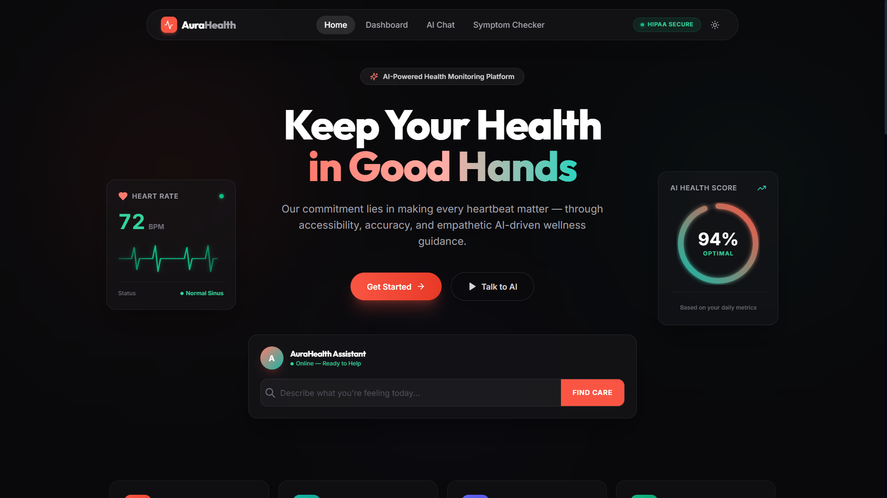
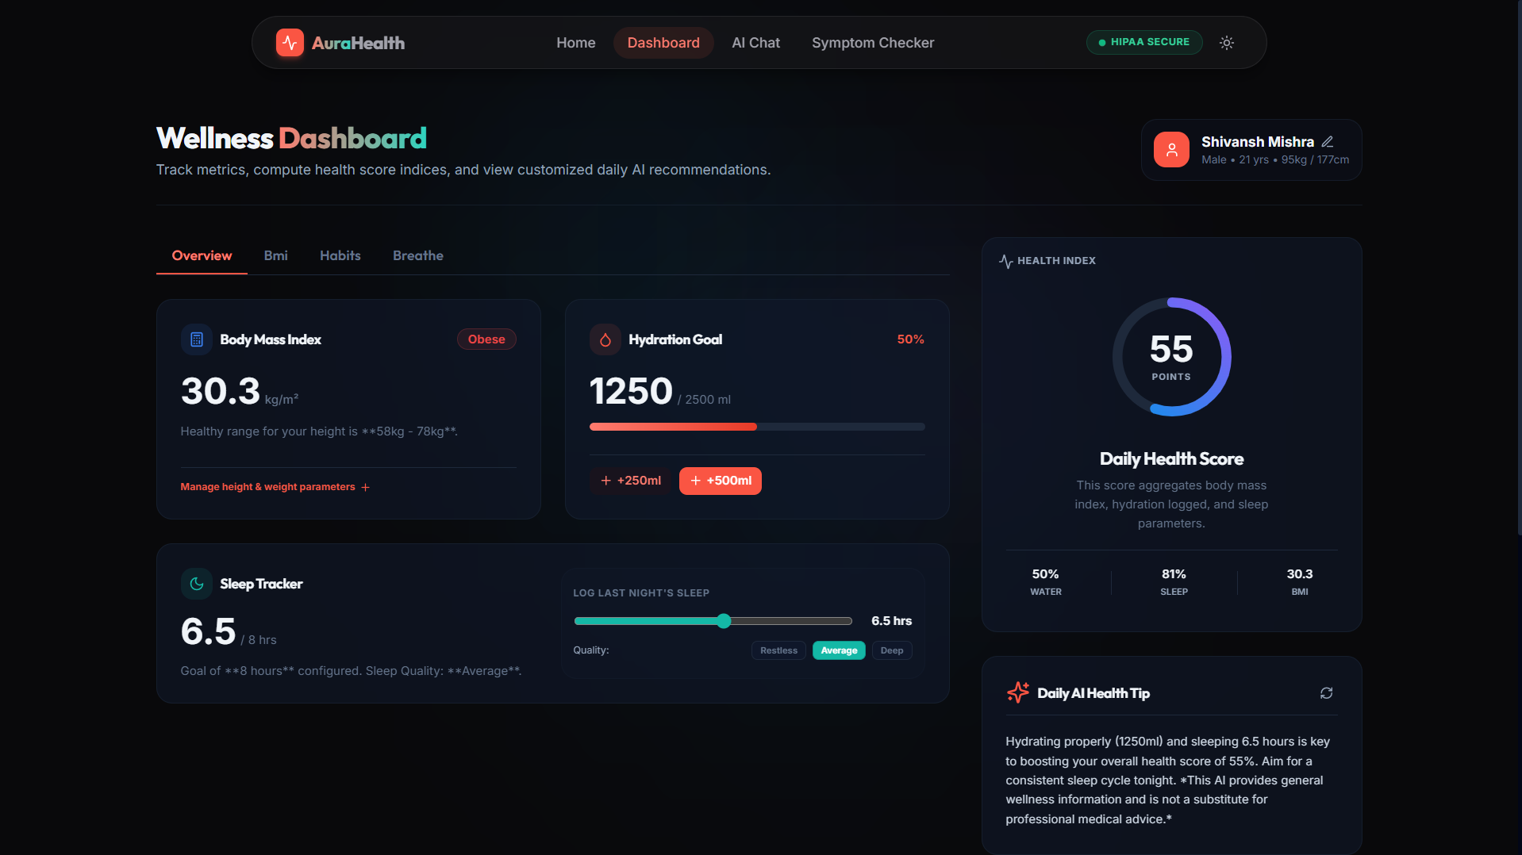
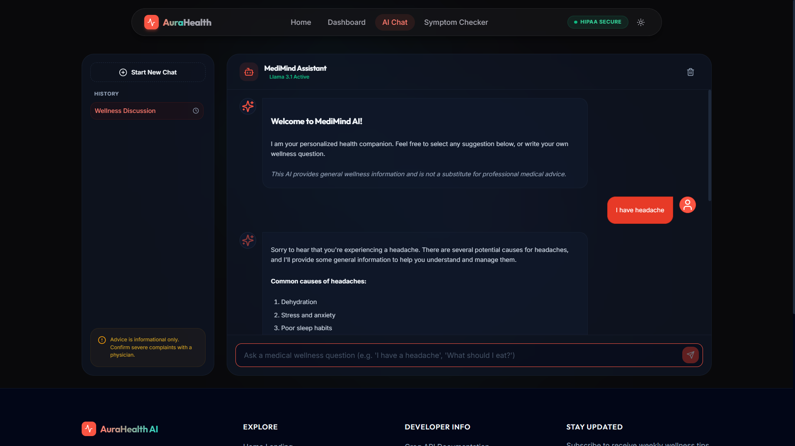
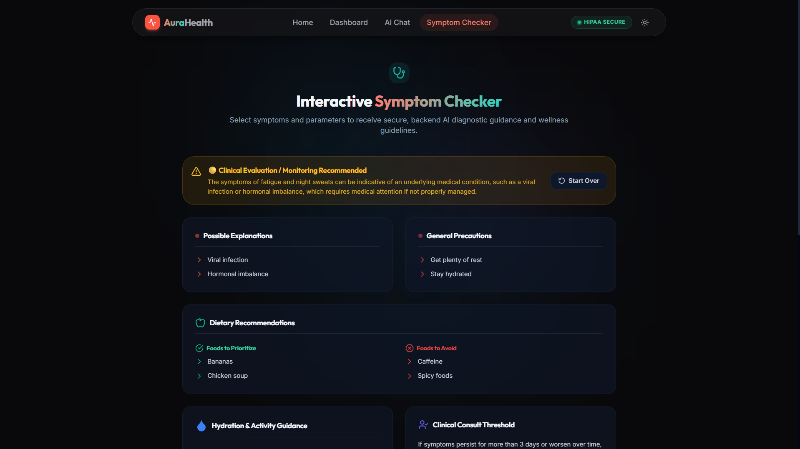
WEBSITE DEMONSTRATION
Live screenshots showcasing modern glassmorphic theme, chat streaming, checker cards, and dashboard scores.
Premium Landing Page Hero
Dynamic Habits Tracker & Score
Interactive AI Chat Stream Page
Structured Symptom Checker Panel

Slide 10
CONVERSATIONAL AGENT FLOW
Step-by-step processing of a user health inquiry with sub-second streaming feedback.
1
1. Message Submission
User inputs text and submits form. Client locks the submission using a synchronous `isLoadingRef`, clears the textbox, immediately appends user message to state, and mounts a blank AI message.
2
2. Backend Packaging
Node backend intercepts the query. It slices the history list to the last 5 messages, appends the compressed safety system prompt, and calls the Groq completions endpoint.
3
3. Server-Sent Events stream
Express opens an HTTP Server-Sent Events (SSE) stream. It asks the Groq SDK client for a `llama-3.1-8b-instant` model with temperature 0.3 and streams choice delta contents.
4
4. Client-Side Chunk Decoding
React's client utilizes a `ReadableStreamReader` to decode binary stream pieces immediately. If a rate limit or API key error object is parsed, it throws an exception immediately.
5
5. Real-Time UI Renders
The frontend updates the placeholder message state text on the fly, rendering letters as they emerge. Auto-scrolling runs instantly on chunks, returning input focus to the cursor.

Slide 11
STARTUP LEAN CANVAS
PROBLEM
SOLUTION
UNIQUE VALUE PROP
UNFAIR ADVANTAGE
CUSTOMER SEGMENTS
• Delayed basic health info access
• Fragmented health calculators & trackers
• Alarmist self-diagnosis search results
• Unified glassmorphic dashboard
• Secure agentic chatbot
• Rapid symptom check reports
• Secure proxy health chat
• Dynamic habits scoring
• Fast Groq SSE stream
• 100% Client-side local data storage privacy
• Proprietary local-first logic
• Zero cloud database cost
• Multi-symptom JSON scheme mapping
• Busy professionals tracking habits
• Rural patients seeking basic screening
• Health-conscious tracking enthusiasts
KEY METRICS
CHANNELS
• Active habit log frequency
• Chat response latency (<1s)
• Symptom analysis completions
• Corporate wellness programs
• College wellness centers
• Open-source community
COST STRUCTURE
REVENUE STREAMS
• Server API computing fees (Groq/Express)
• Domain keeping & SSL security
• Open-source codebase enhancements & maintenance
• Premium custom wellness logs (B2C)
• Anonymous, structured symptom analytics (B2B)
• Corporate employee health dashboard licenses

Slide 12
COMPETITIVE ADVANTAGE MATRIX
Comparing AuraHealth AI with major industry health and diagnostic applications.
Core Feature | Google Fit | Ada Health | AuraHealth AI
Daily Habits Log | Yes (Fitness/Steps) | No (Symptoms focus) | Yes (Sleep, Water, BMI, Breathe)
Interactive Chatbot | No | No (Linear questionnaire) | Yes (Conversational Agent)
Sub-Second Streaming | N/A | No (Full-page loads) | Yes (SSE Stream Output)
Data Privacy Model | Cloud sync (Google DB) | Cloud sync (Ada DB) | Local-first (localStorage)
Unified Health Index | No (Raw statistics) | No | Yes (Aggregated Score)

Slide 13
KEY BUSINESS ADVANTAGES
Highlighting why our architecture provides a better developer and user experience.
24/7 Virtual Care Support
Ultra-Low API Latency
Strict Local-First Privacy
Zero Client Key Vulnerabilities
Cohesive Wellness Indexing
Delivers wellness advice instantly at any time of day, completely bypassing clinical wait times or consult reservation bookings for routine lifestyle inquiries.
By optimizing models to llama-3.1-8b-instant, temperature to 0.3, and max tokens to 250, we establish connections and begin stream renders in under a second.
Locks user records (sleep, BMI progress, water targets) inside the browser's localStorage. Zero compliance liabilities with GDPR or HIPAA cloud databases.
All connection keys are locked inside the backend environment variables, restricting exposure to browser code or client-side storage inspectors.
Fuses isolated metrics into a single dynamic Health Score. This visual index encourages users to improve sleep and water levels to see scores climb.

Slide 14
ROADMAP & FUTURE SCOPE
Expanding the platform into wearable integrations, mobile formats, and clinical scheduling.
Voice Agent Integration
Smartwatch Wearable Sync
Direct Clinician Booking
Integrate Web Speech API for hands-free health logs and voice-synthesized wellness coaching.
Import sleep duration, step counts, and active calories from Apple Watch and Android Fit telemetry APIs.
Provide scheduling connections with certified doctors when symptoms exceed medium urgency thresholds.
Secure EHR Prescriptions
Native Mobile Platform
AI Predictive Analytics
Create secure PDF parsing tools to decode clinical prescription records locally.
Package pages into a native Android/iOS wrapper using React Native for mobile push reminders.
Examine habits histories to forecast potential wellness drops and prompt proactive rest periods.

Slide 15
PROJECT CONCLUSION
Empowering early personal wellness tracking through Agentic AI interfaces.
Project Summary
Platform Impact Metrics
AuraHealth AI successfully demonstrates that daily health logs can be aggregated, analyzed, and reinforced by conversational AI without compromising user privacy or speed.
By leveraging low-latency models and HTTP streaming pipelines, the platform bypasses the wait times of traditional websites, giving users sub-second answers to wellness questions, while the structured symptom reporter highlights warning flags for serious complaints.
Sub-Second Latency (<1s)
First tokens render immediately, keeping the interface snappy and preventing loading freezes.
100% Local Compliance
Data remains on the client device, resolving database liabilities and compliance costs.
Active SDG 3 Contribution
Provides early health warnings and free guidance to remote users.

Slide 16
THANK YOU
Empowering Wellness through Intelligent Agentic Guidance
Questions & Answers Section
Developer Contact Info:
Email: shivnsh01@gmail.com | AuraHealth.ai
GitHub: github.com/sirshivansh/AuraHealth-ai

