Slide 1


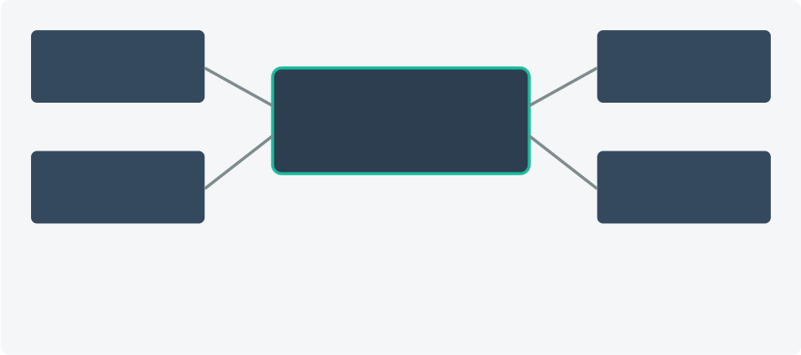




10/16/26, 8:01 AM gemini-svg.svg
SMART CLASSROOM & AI TIMETABLE GENERATOR Intelligent IoT-Driven Infrastructure & Automated Scheduling System AI Constraint Engine • ESP32 Smart Mesh • Real-Time Campus Synchronization
PROJECT TEAM MEMBERS • Manikanta • Vignesh • Ram Charan
Project Objectives & Problem Statement
 | Manual Scheduling Bottlenecks Replaces weeks of spreadsheet planning with an automated solver, eradicating human calculation errors and staff timetable conflicts.
 | Room Overlaps & Overcrowding Enforces hard constraints based on room capacity, departmental zones, and specialized lab equipment availability across departments.
 | Ambient Hallway & Corridor Noise Monitors sound decibel levels outside active lectures to maintain an undisrupted learning environment using automated threshold alerts.
 | Target Outcome 100% Conflict-free dynamic campus execution & automated control.
6 IOT HARDWARE PROTOTYPE
ESP32 Edge Microcontroller Mesh
1 SYSTEM OVERVIEW
2 SYSTEM ARCHITECTURE & DATA FLOW
Phase 1: Ingestion • Faculty Workloads • Room Capacities • Lab Equipment • Student Strengths
Phase 2: AI Solver • CSP Combinatorics • Clash Verification • Workload Balancing • Transit Minima
Phase 3: Edge Sync • Student Mobile App • Faculty Web UI • Door OLED Status • ESP32 Door Relays
ou d B
RFID
P M
Wi-Fi + BLE Master
D D
Door
⊗
唰
Optimization Formulation: min ∑ (Transit Cost + Fatigue Penalty) subject to Hard Constraints = 0
3 AI CONSTRAINT SATISFACTION MATRIX
Monitors hallway chatter > 65dB • Enforces punctuality via automated lock
ARAM | N U DO AIN | HARD ON RAI | E R E N
Faculty | Teaching hours/limits | Zero simultaneous overlaps | Zero Double-Booking
Classroom | Capacity & Projector | Batch size ≤ Room limit | No Room Overflow
Workload | Max classes/day | Mandatory rest periods | Fatigue Prevention
Location | Department block zones | Block transit < 10 mins | Localized Timetables
Live Synchronized Status: Updated instantly across MQTT when schedule or noise alerts change.
7 SMART DOORWAY DISPLAY MODES
4 FEATURE IMPLEMENTATION STACK
Prioritized System Modules
CS301: Algorithms Lecturer: Dr. Sharma Door Locked • Quiet Zone
Room Available Next: Discrete Math (11:00) Door Open • Eco-Mode Active
B
FREE
RI | M DU M M
RANK 1 | AI Schedule Engine Eliminates clashes & double-booked Constraint satisfaction solvperofessors in seconds.
RANK 2 | Restricts walk-ins during sessions & monitors noise breaches.
RANK 3 | Live Campus Sync Instant timeline updates and door Mobile & Web Dashboard isplay status changes.
Smart Energy Saver Turns off lighting and fans in RANK 4 Automated Power Controlvlearcant halls automatically.
IoT Hardware Relays
ESP32 & Sound Sensors
 | Upload Campus Specs Admins upload teacher rules, room specs, and curricula into cloud DB. Execute Constraint Solver AI tests combinations, generating master schedules in seconds. Deploy Campus Broadcast Transmits schedules to mobile apps, web portals, and door OLEDs. Hardware-Driven Control Locks doors during lectures, detects noise breaches, and dims idle rooms.
5 OPERATIONAL DEMONSTRATION WORKFLOW
8 PRACTICAL APPLICATIONS & RESULTS
Efficiency Conflict-Free Eco Savings
98% Faster 0 Clashes -25% Power
i _{s}^{l} ^{e} _{ffort.} a d _{i} _{g} ºi ^{e} _{i} _{l} i _{lls.}
f
d
d
l
d
b
b
k
d
h
f
f
im
S
c
e
es
ge
n
e
ra
t
E
i
t
A
to
at
to
u
d
f
l
na
es
o
u
e
-
o
fa
u
m
s
u
o
n
3
0
se
on
ty
d
h
t
i
k
f
c
s
v
s
cu
a
n
o
ve
r
a
p
p
n
g
n
s
an
g
n
g
n
2
e
e
o
m
a
n
l
l
b
k
d
tu
h
ua
e
c
as
s
ro
o
m
o
o
n
s
u
n
oc
cu
p
e
c
r
e
a
PROJECT PRESENTATION COMPLETED | DEPARTMENT OF COMPUTER SCIENCE & ENGINEERING | THANK YOU!
file:///C:/Users/vigne/Downloads/gemini-svg.svg 1/ 1

