Slide 1
CEPH
Help me, Stack Overflow! You’re my only hope.

Slide 2
Chapters
Architecture
CRUSH
Troubleshoot
Listing resources

Slide 3
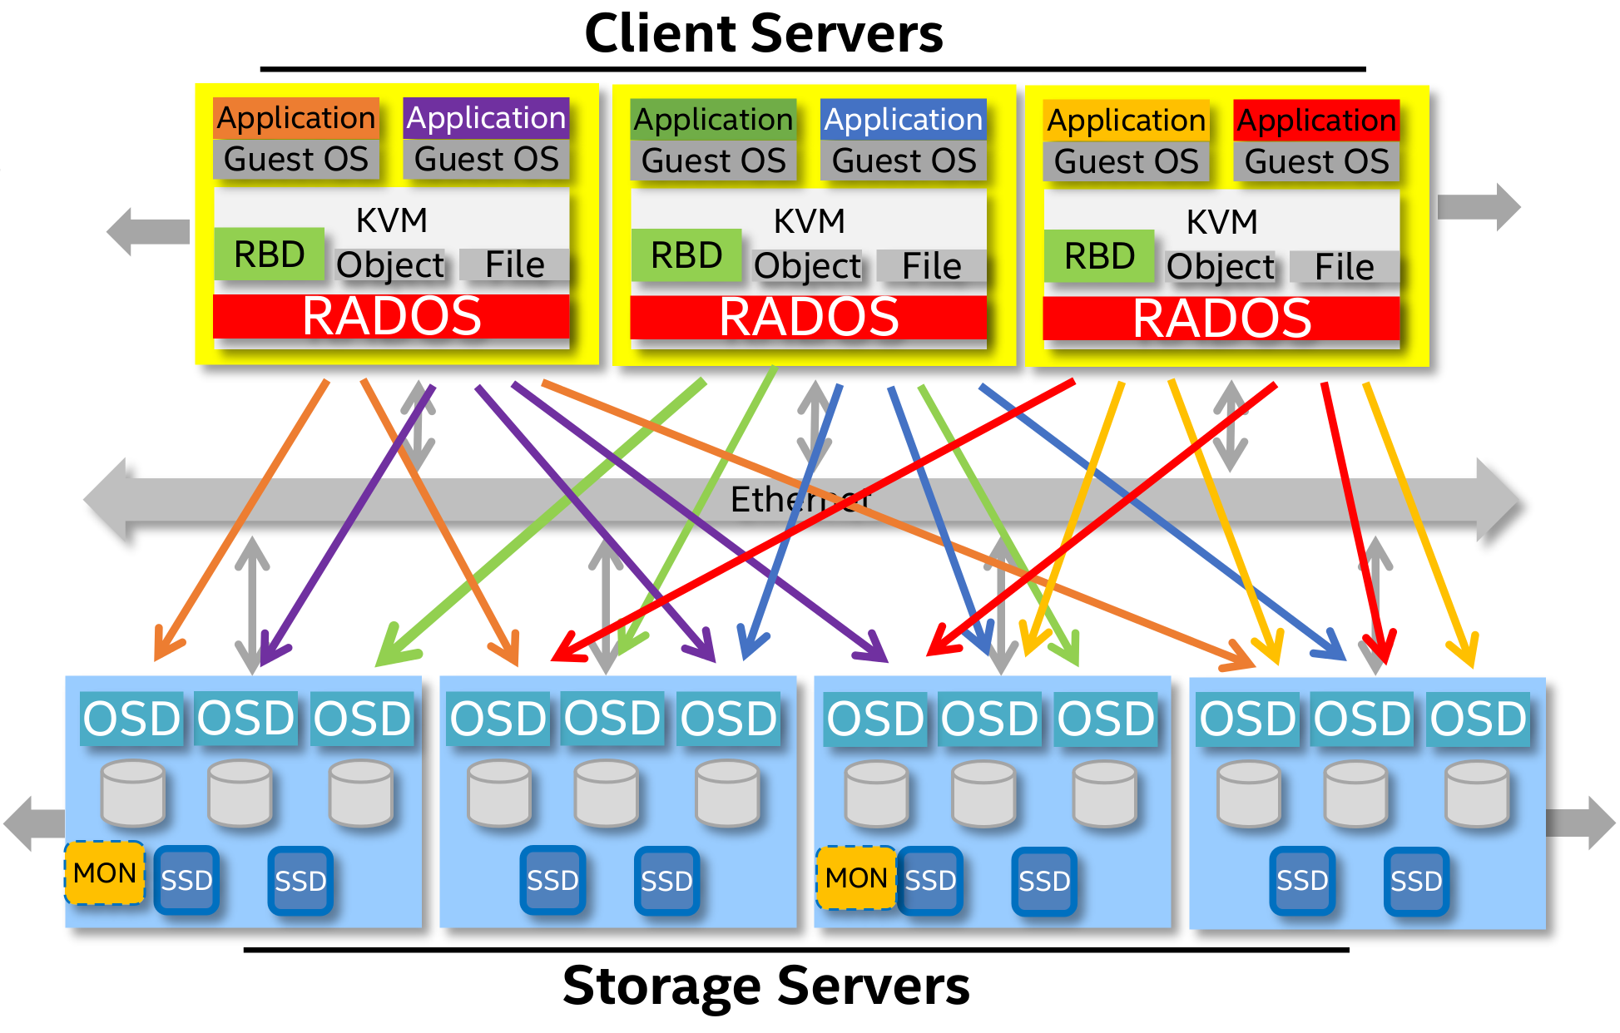
Architecture
Ceph is self-explanatory and simple to understand.
See it for yourself:

Slide 4
Architecture
Just kidding…

Slide 5
Architecture
What does Ceph consist of?
MON or Monitor
Holds maps of the cluster state, e.g. CRUSH map or OSD map and monitors the cluster state
Manages authentication between daemons and clients
Must be at least 3 to work properly
OSD or Object Storage Device
Basically the hard drive itself, can be of any kind, doesn’t matter if HDD or SSD or NVMe
At least 3 OSDs should be configured
MGR or Manager
Holds metrics, can expose them to external monitoring tools
Must be at least 2
MDS or Metadata Server
Stores metadata to do some basic stuff like ‘ls’ without stressing the cluster
Should be >=2 but can work with a single one
To be continued…

Slide 6
Architecture
What does Ceph consist of?
RADOS or Reliable Autonomic Distributed Object Store
Assigns each object a unique object ID
Stores data across multiple OSDs
Provides features such as replication, scrubbing, self healing, data migration and placement
Uses CRUSH algorithm
RADOSgw or Reliable Autonomic Distributed Object Store Gateway
Object Storage
Provides interface to access data stored in RADOS
Serves as ‘frontend’ for RESTful APIs using HTTP or S3-compatible calls
Does some access control magic
RBD or RADOS Block Device
Block Storage
Up to 16 EiB(!)
Thin Provisioning
Snapshots with QEMU/KVM
CephFS or Ceph File System
File STorage
POSIX and FUSE compliant
Separates Data and Metadata
Drop-in replacement for Hadoop
To be continued…

Slide 7
Architecture
CRUSH or Controlled Replication Under Scalable Hashing
Is the algorithm to determine where to store data and where to retrieve it from
Metadata only changes when OSDs are added or removed
Creates a CRUSH map which is a hierarchical representation of the storage devices
Stored on the MON servers
Distributes the data in a way that maximizes performance and reliability
Uses the CRUSH map to determine which OSDs have the data and where to retrieve it from
PG or Placement Group
Is the logical grouping of objects within the Ceph cluster
Is assigned to a specific OSD or set of OSDs depending on the configuration
Manages placement and replication of objects inside the OSD(s)
Should be ~100-200 PGs per OSD
Pool or Pool ;)
Is the logical grouping of PGs within the Ceph cluster
Configures number of copies to be made and the PG size
Uses the CRUSH config for replication settings
Data is first written into the pool and then to their specific PG
To be continued…

Slide 8
Architecture
Summary (from inner core to outer shell):
RADOS (Reliable Autonomic Distributed Object Store) - the core storage system that stores and manages objects across the storage cluster.
CRUSH (Controlled Replication Under Scalable Hashing) - the algorithm that determines how data is distributed and replicated across the storage cluster, based on the defined CRUSH map.
Placement groups (PGs) - the logical grouping of objects in the Ceph cluster, assigned to a specific OSD or set of OSDs in the cluster, and responsible for managing the placement and replication of objects within that group.
Pools - the logical grouping of placement groups in the Ceph cluster, with a specific configuration that determines how data is stored and managed within the pool, such as the number of copies to make, the placement group size, and the data protection scheme.
RADOSgw, RBD or CephFS - the component of Ceph that provides object storage or RESTful interfaces for accessing data stored in the RADOS cluster.

Slide 9
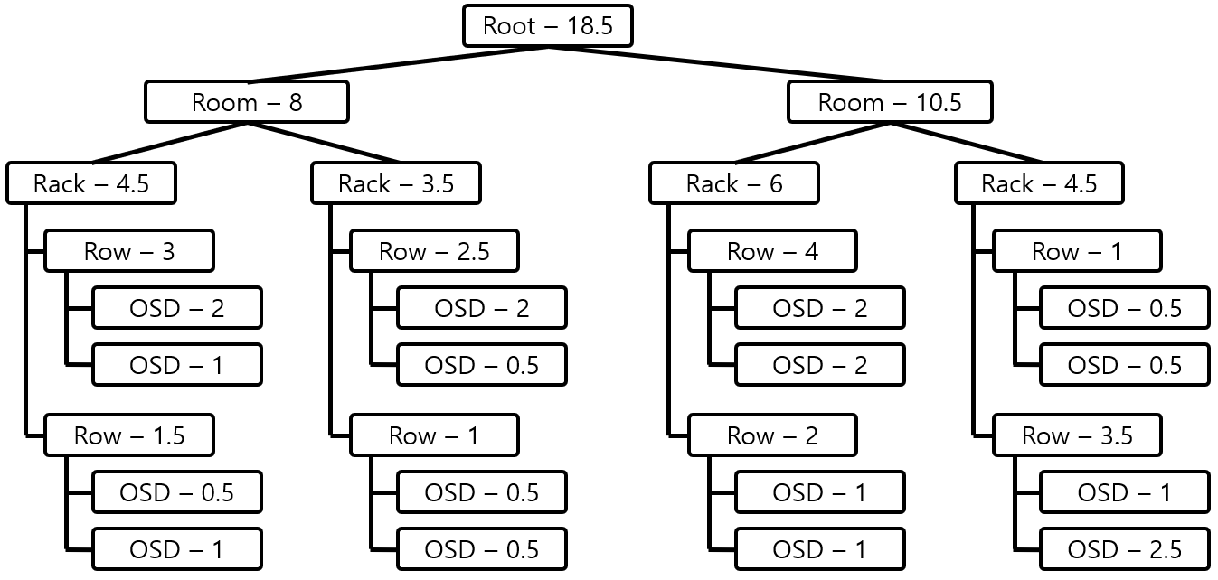
CRUSH
Is a hash-based algorithm used for storing and retrieving data
The storage cluster is represented by a nested tree of buckets
Each bucket represents a subset of the storage devices in the cluster
Each bucket has a weight which determines the relative number of replicas stored in this bucket
When data is written into the cluster it is divided into PGs
The CRUSH algorithm works by determining which bucket the PG belongs to by
Mapping the PG ID to a pseudo-random number
Using this number to select a bucket in the CRUSH hierarchy starting at the root
Adheres to the rules in the CRUSH map by considering the weight of the bucket at each step
Reminder: Number of OSDs, usage of OSDs, IOPS and so on…
Can be highly configured to ones needs
Automagic rebalancing can be temporarily turned off and on with the ‘ceph osd (un)set noout’ option
When a client requests data the CRUSH algorithm determines which PG is used to read data from and then hands over this ID to the client which itself then accesses one of the OSDs directly
Can automagically rebalance the cluster when OSDs are changed
Should at least have double the bandwidth of the “external” user-facing connection

Slide 10
Troubleshoot
To troubleshoot a full cluster please make use of the following commands:
ceph osd set-nearfull-ratio 0.0-1.0 (choose a float here)
ceph osd set-full-ratio 0.0-1.0 (choose a float here)
ceph osd set-backfillfull-ratio 0.0-1.0 (choose a float here)
ceph osd reweight-by-utilization
ceph osd crush tunables optimal
Please check https://docs.ceph.com/en/quincy/rados/troubleshooting/troubleshooting-osd for further details and instructions.

Slide 11
Listing resources
To check for available resources you can use
ceph status
Provides a short and concise high level overview of the cluster
ceph osd df
Gets the current disk utilization of all OSDs in the cluster
It only takes one outlier OSD filling up to fail writes to its pool
ceph df
Gets the current disk utilization of the whole cluster
ceph mds stat
Displays the status of the MDS
ceph pg dump
Provides detailed(!) information about the PGs
ceph pg stat
Provides a short information about the PGs including performance data such as op/s or read/write in MiB/s
ceph health
Simply returns either HEALTH OK or an error
ceph osd tree
Displays the hierarchical CRUSH map including weights
ceph osd perf
Provides the latency for each osd
ceph osd pool ls
Lists all pools in the cluster
ceph osd pool stats
Gets performance data for each pool

