Slide 1
Logical Circuit
Project
20003197 Gu hyukmo

Slide 2
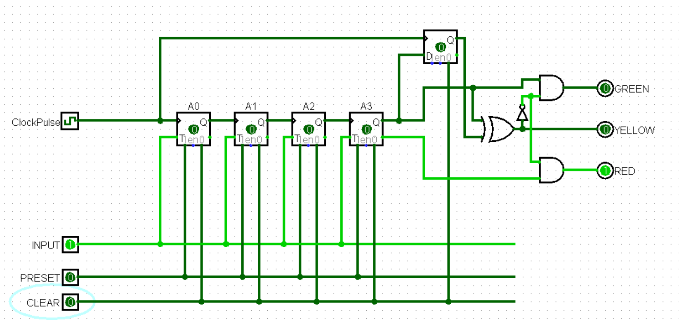
Project Description
Traffic Signal System using flip-flop and basic circuits.

Slide 3
STATE TABLE
Each Flip-Flop changes falling(negative) trigger
A3 | A2 | A1 | A0 | Color
0 | 0 | 0 | 0 | Yellow
0 | 0 | 0 | 1 | RED
0 | 0 | 1 | 0 | RED
0 | 0 | 1 | 1 | RED
0 | 1 | 0 | 0 | RED
0 | 1 | 0 | 1 | RED
0 | 1 | 1 | 1 | RED
A3 | A2 | A1 | A0 | Color
1 | 0 | 0 | 0 | Yellow
1 | 0 | 0 | 1 | GREEN
1 | 0 | 1 | 0 | GREEN
1 | 0 | 1 | 1 | GREEN
1 | 1 | 0 | 0 | GREEN
1 | 1 | 0 | 1 | GREEN
1 | 1 | 1 | 1 | GREEN

