Slide 1

Welcome to
Vocabular
The easiest way to expand your vocabulary

Slide 2
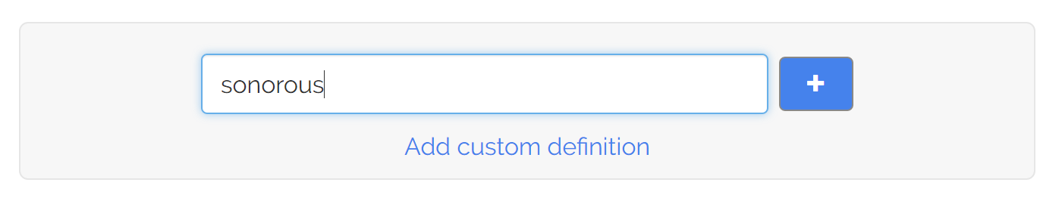
Let Vocabular know which words you’d like to learn
1
Using the “add a word” box on your new tab page…
Or just by defining the word on Google

Slide 3
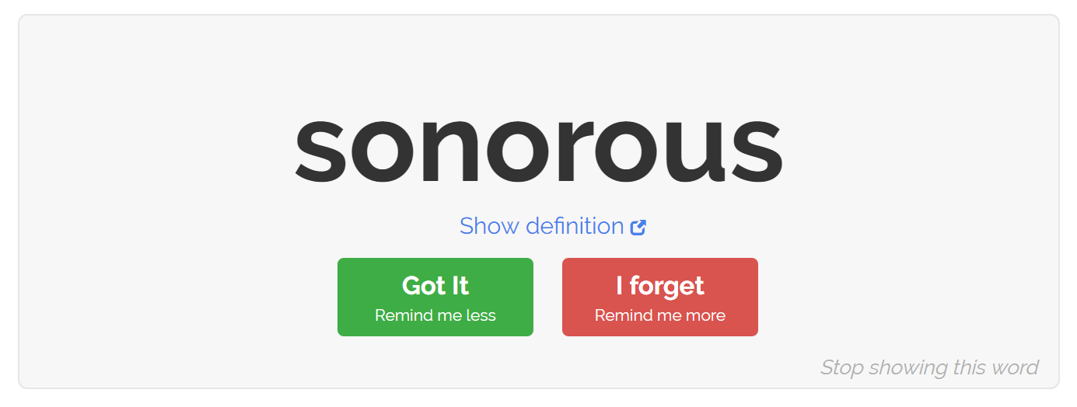
Vocabular periodically reminds you of those words as you browse the web
2
Reminders appear on your new tab page, which you already see dozens of times a day!
Uses spaced repetition algorithms for optimum word retention
Customizable reminder intervals – take control of your vocabulary

